Slide 1
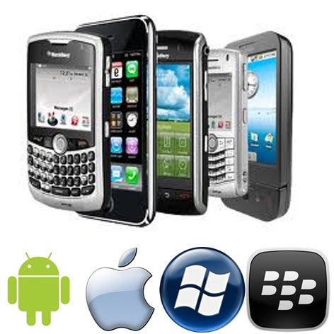
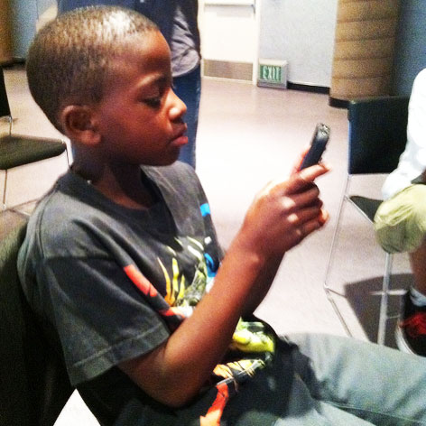
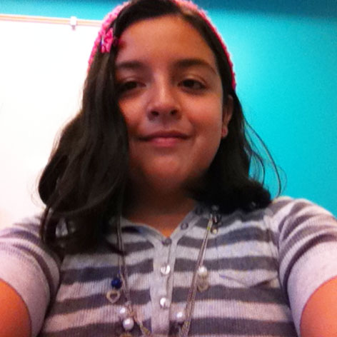
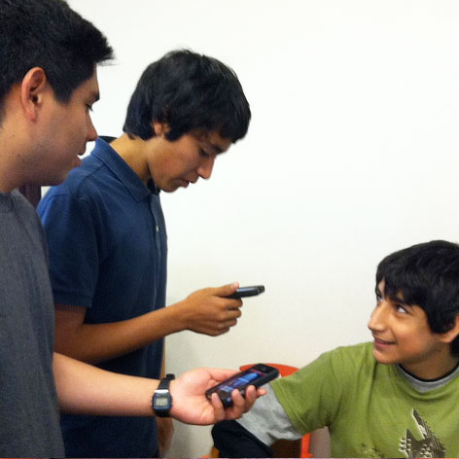
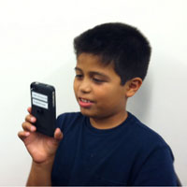
Using Smart Phones as a Marketing & Programming Tool
The Future is Mobile
Notes:
* Leave slide up through initial welcome and housekeeping by Infopeople
* At close of opening, jump to Promo Video (pre-install before webinar)
Greeting/ Introductions
Housekeeping: Send your questions as we go along
* Interactive: Promo Video 4 minutes

Slide 2
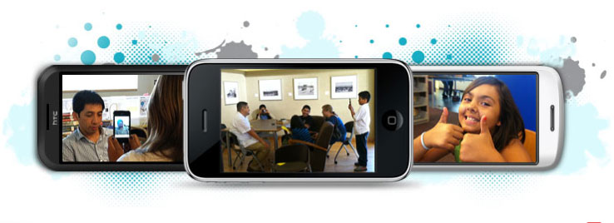
Using Smart Phones as a Marketing & Programming Tool
WHAT MAKES A PHONE SMART?
Notes:
* After promo video – open this page and pass Patric control
What makes a phone smart?
Twenty years ago, phones became smart with the introduction of the now forgotten IBM Simon. It was a dramatic shift from a bulky phone that you use to call home from while you where on the road.
Smart phones combine the functions of a personal digital assistant (PDA) with a mobile phone and today's models also serve as portable media players, web browsers, camera phones and game players with high-resolution touchscreens.
Though we hear a lot about iPhone and Blackberry devices, you might be surprised to learn that Android is the most common smartphone platform.
Of course, no one can beat Apple for the sheer number of applications.
Before we get into the presentation, let me ask a few questions to see who we have participating with us today and how you might already be using smart phones.

Slide 3
Using Smart Phones as a Marketing & Programming Tool
HOW MANY OF YOU ARE USING SMART PHONES IN YOUR LIBRARY ALREADY?
THOSE OF YOU WHO SAID YES, ARE YOU USING THEM FOR
____ BEHIND THE DESK
____ MARKETING
____ PROGRAMS
____ NETWORKING
Notes:
* Hand’s Up: How many participants are using smart phones already?
Survey: How are you using them at the library?
Across the globe libraries are taking note of this new sweeping revolution of mobile net access. One that looks to trump the advent of the Internet itself. In Europe, the Bavarian State Library Deputy Director Dr. Klaus Ceynowa reported this Summer that “We can’t afford any longer not to offer services for the mobile Internet. All relevant trend forecasts say that no later than 2012, the primary access to the Internet will no longer be through stationary PCs or laptops but mainly through smartphones or tablet PCs. And the proportion of those who use the Internet exclusively in mobile form is increasing more and more. In Egypt, it’s already 70 per cent of Internet users.”
The speed of technology shows no signs of slowing.
Dr. Ceynowa also predicted the near future by saying ““We’re moving step for step into a new situation. In three to five years you’ll be able to say: What isn’t in the mobile Web, doesn’t exist in principle for many younger users.”
Results of the first ?
Now ask 2nd question

Slide 4
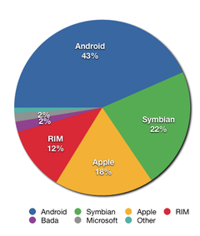
Using Smart Phones as a Marketing & Programming Tool
WHAT OPERATING SYSTEM ARE YOU USING?
____ IPHONE (APPLE)
____ SYMBIAN (NOKIA)
____ BLACKBERRY (RIM)
____ BADA (SAMSUNG)
____ ANDROID (GOOGLE)
____ MOBLE OS (MICROSOFT)
____ OTHER
Share of worldwide 2011 Q2 smartphone sales to end users by operating system, according to Gartner (wikipedia.com)
Notes:
* Survey: What phones/OS are you using?
Next question.
What operating system are you using? This may be different that they type of phone you have but to simplify things, if you are unsure click on the OS or phone name that you see that you recognize.
OS and phone brands are not always the same because some companies license their operating system to other companies For example, Google and Microsoft are licensed to many manufacturers while Apple, Nokia & Rim keep their operating systems in house – only for their phones. There is no one universal platform, which sometimes complicates things for us end-users because apps and features aren’t always available for our phones.
The two important things that I want you to be aware of is that there is a difference between phones and OS as well as what the public is embracing. Take a look at the graphic to see the latest trends. The Android wins.
And results of our poll show…

Slide 5
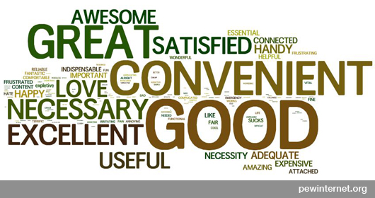
Using Smart Phones as a Marketing & Programming Tool
Highest User Group
58%
25-34 year olds
35% Adults
Own a Smart
Phone
44% Adults
African Americans & Latinos
68%
Use their Smart Phone to go Online
EVERYDAY
87%
Use their Smart Phone to access their E-mail
Notes:
Who has them?
Let me bring some stats back home to a personal level.
[Read the above bubbles]
Industry reports from Olswang and Berg Insight indicate that the rate of smartphone adoption is accelerating – in the one year period of 2009 to 2010 smartphone shipments increased 74%
According to the Pew Internet and American Life Project report that came out in July, Smartphone adoption is highest among the affluent and well-educated, the (relatively) young, and non-whites. When asked what device they normally use to access the internet, 25% of smartphone owners say that they mostly go online using their phone, rather than with a computer.
After reading the report, ALA Tech Source noted: The numbers cited in the Pew Report confirm the trends we are seeing, but the trend that the report revealed that is most important for libraries is that for some of the population, their phone IS their Internet access.
This is important to understand to make sure your library web sites are compatible with mobile devices. Menus, searching, and browsing on your site should be easy to do on a smartphone. We already know that many people only see us through our online presence and now we know fair portion of them are coming to us on their phones.

Slide 6
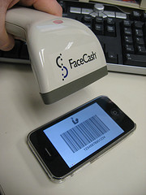
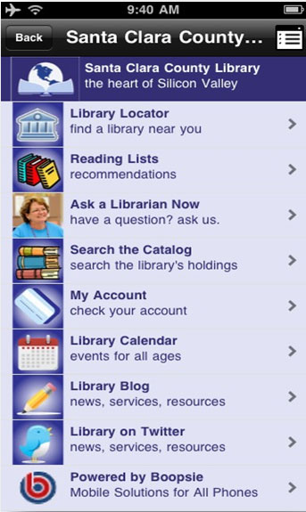
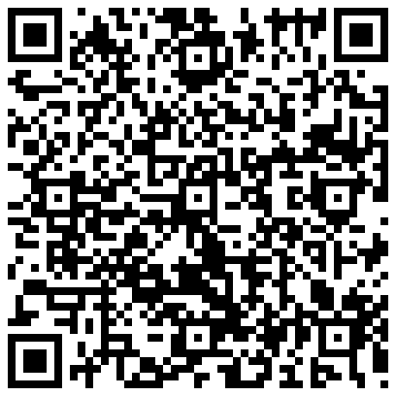
Using Smart Phones as a Marketing & Programming Tool
EMBRACING MOBILE TECHNOLOGIES
eBook & Audio Collections
Instruction via podcasts
Virtual tours of your library
Inventory & administrative Tasks
Mapping of historic collections
Community building blogs
Networking for librarians
Location-based ‘check ins’
Social sharing of what you’re reading
Scanning Library Cards
Mobilize Your Library
QR Codes
Notes:
For those of us who worked in the industry before fax machines and personal computers, it may seem that every year we have to learn some new gadget which can be frustrating but with the global society embracing interconnectedness the age of the personal computer in your pocket is here. Libraries are already finding new ways to incorporate smart phones behind the desk, in programming, and throughout the virtual world of the Internet.
Look at this list of how libraries are embracing smart phones already! WOW there is a lot we can do with them already. I wish I had an entire week to share with you the diverse and fascinating development of how we book lovers are embracing mobile technologies. But with only an hour, I’m going to scratch the surface by briefly focusing on how you can use the smart phone as a marketing tool, how to incorporate the technology into your programming and even explore a program as a case study that did both.

Slide 7
Using Smart Phones as a Marketing & Programming Tool
SMART MARKETING
PROGRAMMING
Social Networking
Quick Response Codes
Website Compatibility
M-Libraries
M-Library Creation Tools
Other online helper sites
A CASE STUDY
WordPress Set up
Social Network Interactivity
Working a Smart Phone App
Program Activities
Equipment Security
RETURN TO BASICS
WRAP UP
Keep It Simple
Defining Our Goals
Resources
Q&A
Notes:
I’m going to share a lot of information with you over the course of this webinar. I don’t expect you to understand or retain all of it so sit back and simply go along for the ride with me.
We interact with all of this new technology in a very personal and unique manner so I can assume that we have people here today that see all of this as a brand new concept and we also have others who are here looking for concrete ways to enhance their work. I’ll try to make this session valuable to everyone at the table, but be forewarned that for someone you, at times, I’ll be talking technobabble but I’ll also do my best to give real world examples to help give context so you are not too overwhelmed. The most complex information in this webinar is up front so hang in there and it will get more practical as we get into the second half of the webinar when we see some of the concepts and apps in action.
My goal is that all of you leave this webinar with an understanding that there are vast opportunities for you to use technology as a tool to connect with others and offer you some advice & resources to take the next steps, no matter what level of comfort and technological use you are currently at.
Go ahead and send me your comments as we move along the webinar. I’ll answer as many of your questions as time allows when we get to the end of the session.

Slide 8
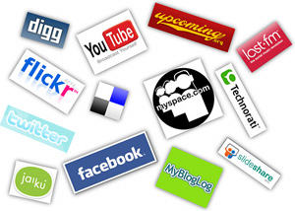
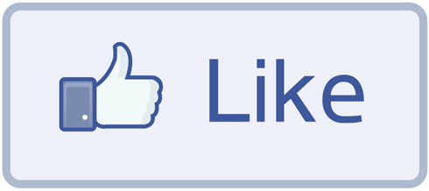
Using Smart Phones as a Marketing & Programming Tool
MAKING YOUR MARKETING SMART
Using Social Networks and apps to build community
Notes:
Making your marketing smart – I “LIKE” that!
Social networks & apps are a great way to build community.
Social media is becoming more and more a must for libraries and many libraries are finding that when used properly it can be a great tool to save money and promote library services and collections.
There are numerous mobile apps you probably are already familiar with like Facebook, Twitter, and YouTube but with each passing day, more and more apps are becoming available including those designed for library websites and by library database vendors.
I’m including a great website resource from Accredited Online Colleges that offers 40 examples of cool ways college libraries are leveraging social media. I’ll give you five examples right now.
1 - Trivia Tuesday – McCain Library at Agnes Scott College has contests on the library’s blog and Facebook each week, offering prizes to the first correct answer.
2 - Giving the Scoop – Announce breaking news and information before its otherwise available – like a fresh new stack of romance novels that just came in, announced first on Facebook.
3 - Text a Librarian – Middleton Library offers a feature that allows students to text questions to librarians and get an answer any time of day.
4 - Uploading visiting authors and lectures – college libraries have uploaded special talks to Facebook, YouTube and Flickr with quotes, videos and photos respectively.
And one of my favorites,
5 - The Library Minute – Arizona State University uses short videos on YouTube to share information about what’s going on at the library
We will see more of this in a bit when we explore today’s case study
Its my favorite because I’ve been training libraries on video use for the internet, especially digital storytelling, for the past five years

Slide 9
Using Smart Phones as a Marketing & Programming Tool
MAKING YOUR MARKETING SMART
Using QR Codes
Notes:
Using QR (Quick Response) codes
Have you seen these and wondered what they are? QR codes are considered the next step in marketing. It’s a two dimensional barcode, much like the barcodes that you see in grocery stories. The QR code you see here was specifically created for my series of InfoPeople webinars and directs you to a URL for more information. QR codes let you jump from printed content to online content .. like a video, a website or helpful information.
You can create QR codes free online or download an app. I use the app Qrafter (with a Q) on my iPhone, for example. Use QR codes to try to increase customer engagement and encourage users to take that “next step” in marketing and promotions on their own. These next steps sometimes include signing up for newsletters, routing users to book reviews on the web and rating the library’s customer service. You can only fit a certain amount of info on a flyer or postcard so the QR code offers an interested user access to MORE information and when used correctly, can also move the user to action. Some libraries offer incentives with their QR Codes like Coupons, Discount on products or Giveaway items. These incentives are called “calls to action.” Calls to action allow users to complete a certain action that produces a certain result. Your library might use giveaways or offer access to additional information.

Slide 10
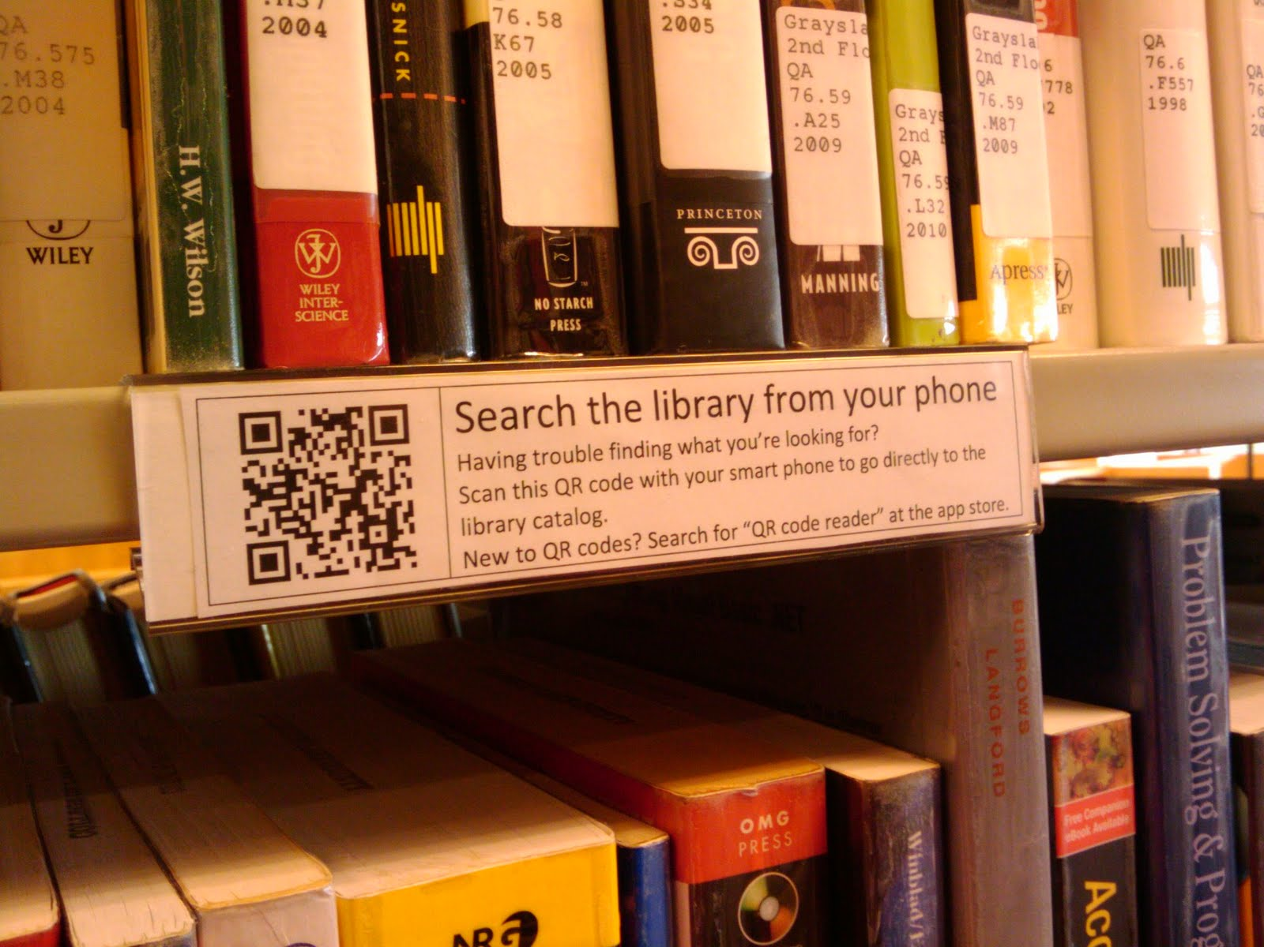
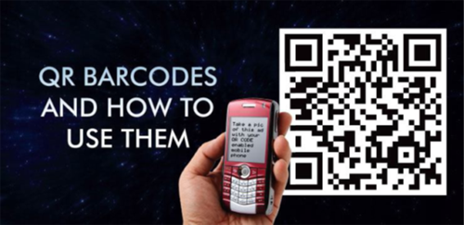
Using Smart Phones as a Marketing & Programming Tool
MAKING YOUR MARKETING SMART
Notes:
How do you use a QR code? If you have a smart phone, you would go to your phone’s marketplace and download what is called a “QR code reader”.
Once installed, when you come across a QR code, you simply open the QR code reader and look for the scan option. Then you hold your phone over the QR code to scan it, like taking a picture with your phone, and your phone will then automatically give you the additional information you were seeking. What makes QR Codes really nice is that you don’t need Internet access, all the information is included in the code itself.
Libraries can even provide incentives for scanning their barcodes, like businesses use Foursquare to check-in at their location.

Slide 11
Using Smart Phones as a Marketing & Programming Tool
TRIVIA TIME
Notes:
IT’S TRIVIA TIME:
Who was the first US library to create an application for the iPhone? It was the District of Columbia public library. Their attractive application simply called DCPL offers users a catalog search, library hours information, and the ability to place items on hold. They have made their code open source so that other libraries like you can build you own iPhone app! How cool it that?

Slide 12
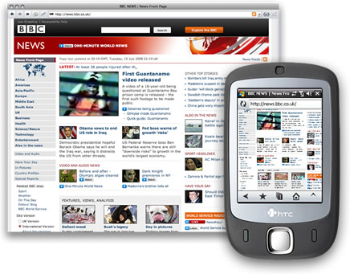
Using Smart Phones as a Marketing & Programming Tool
MAKING YOUR MARKETING SMART
No FLASH
Validate your code @ W3C
http://validator.w3.org
Use vSlow and PageSpeed tools
To increase speed
Compress images using Smush.it
www.smushit.com
Website Compatibility
Notes:
Website compatibility
Sure, launching a mobile-marketing strategy is a fairly complex process; and you want to get started off on the right foot. Okay, I know. . . even if you're "old school" when thinking about making your website mobile ready; you'll be surprised to find out that in 2010, there were 1.5 billion local searches made from mobile devices. Yes BILLION! Whew! Mobile media is coming whether we like it or not. Heck it's here already!
Let me offer a few common sense ways to make your website mobile-ready.
The goal is mobile COMPATIBLITY not Mobile FRIENDLY. Compatible means that when somebody visits your website on a smart phone they basically see the same thing as when on their computer. Friendly means creating a separate design that only appears for mobile users. Friendly means twice the work when updating and let’s face it, it costs more time and money in addition to creating redundancies that can create more headaches as you try to keep everything up to date.
Here are a few simple tips for making your website mobile compatible
Don’t use Flash! In addition to being heavy for loading times, many smartphone devices do not support Flash which means your visitors see nothing! For animation and interactivity, use a JavaScript library like jQuery combined with HTML5 to achieve virtually the same effects as Flash.
Validate your code by visiting the W3C website (validator.w3.org)
Use tools like ySlow and PageSpeed to see how you can speed up your load times (this will help for desktop browsing too)
Compress your images using the website smush.it (smushit.com) Images slow down any site, but are especially heavy for smartphone users. Smush.it can cut your loading time in half in some cases, and usually by at least 30%.
if the technical language means nothing to you then pass this to someone at the library you know is a techie!

Slide 13
Using Smart Phones as a Marketing & Programming Tool
MAKING YOUR MARKETING SMART
M-Libraries -
Virtual Access to your library
www.libsuccess.org/index.php?title=M-Libraries
NO SHELF REQUIRED:
E-BOOKS IN LIBRARIES
by Sue Polanka
Notes:
Create virtual access to your library
This might be out of your hands but virtual access to libraries is growing in popularity. Its known as M Libraries – M for Mobile.
The University of Cambridge surveyed students and found that 55% were in favor of being able to access the library catalog from a mobile phone
If you are ready to dip your toes into the m-library movement, I highly suggest the m-library wiki at
www.libsuccess.org/index.php?title=M-Libraries
which truly showcases an endless number of active m-libraries alphabetically from Aalborg to Yale, vendors like Boopsie , publishers including Encyclopedia Britannica and Project Gutenberg as well as suggested reading
Though it doesn’t appear on that list, I highly recommend reading the recent book NO SHELF REQUIRED: E-BOOKS IN LIBRARIES by Sue Polanka, which was released earlier this year. This read gives librarians a complete and comprehensive understanding of the e-book and how to more successfully integrate it into your library.

Slide 14
Using Smart Phones as a Marketing & Programming Tool
MAKING YOUR MARKETING SMART
MobilePress plugin
Notes:
If you are ready to create a mobile library website but are light on technical knowledge I suggest that you consider these online tools.
For example, WINKSITE (winksite.com) is great tool to create up to 5 mobile sites for free that can help you create a community around your library’s site and it includes built in chat, forums, surveys, events guest books and QR codes
To learn about the rest of my suggestions check out the documents attached to this webinar.

Slide 15
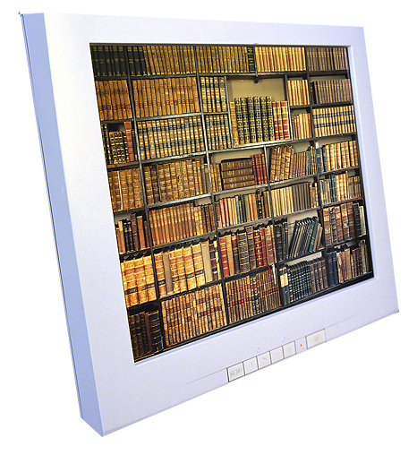
Using Smart Phones as a Marketing & Programming Tool
MAKING YOUR MARKETING SMART
Notes:
Other useful trends in libraries and social media use that also apply to smart phoneS include the following.
Google Applications- whether it’s collaborating with google docs, using google voice for text messaging or any of the other google applications. Google has a lot to offer libraries and more libraries will start using these.
Twitter- While more libraries may be using facebook, in many ways Twitter can offer more to libraries when it comes to reference and instant answers to questions
Virtual reference- While this is already offered at many libraries, new trends and offerings in the social media world make offering this service more practical than before. Whether it’s installing an instant chat application on a facebook fan page, using a live video site such as ustream.tv or one of the many other free applications available through social media, virtual reference is more doable and approachable than it has been in many years.
Increased collaboration between librarians at more than one institution as well as between faculty and librarians will occur thanks to social media tools that make this possible. Examples include twitter, twiddla, and many other white board and online sharing applications.
The new era of technology is overwhelming for sure. My most practical advice is to target one of the many ideas that I’m sharing with you today and simply incorporate it into your daily workflow. Once you feel confident then add another. If you haven’t embraced Facebook or twitter start there and then in a week or two, start to add QR codes to your marketing.

Slide 16
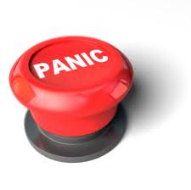
PATRIC’s ‘NOT SO FAST’ BUTTON
PUSH NOW
Notes:
Just in this webinar alone, you can see that the wonderful world of technology is surprisingly already very vast. For some of us its terribly exciting and for others, well, just terrible!
Let’s just stop for a moment shall we while I hit my NOT-So-FAST button. Sit up straight in your chair. Close your eyes. Take a deep breath. Visualize a nice cool breeze as you watch the sunset from your beach chair. Inhale….Exhale. And now return to me and your computer.
You’re doing great, by the way!

Slide 17
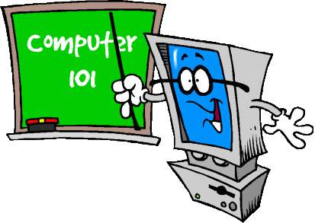
Using Smart Phones as a Marketing & Programming Tool
MAKING YOUR PROGRAMMING SMART
BASICS
Notes:
If you feel unsure about all this modern stuff, you are not alone. That’s the GOOD NEWS! It tells us that the best place to embrace technology is to start with the basics. Start slow and easy. Offer basic technology programs at the library … it will be the support that both your patrons and colleagues will appreciate.
As you develop your programs, make sure to keep in mind who your audience is … teen programming can move at a much quicker pace than say a program for your community elders.
Younger generations rarely notice the technology their using. Its not so much as new as simply is a part of their lives. To put that in perspective, I’m a baby boomer, that means I grew up in the 60’s…we only were aware of the programming when we watched our favorite tv shows – never gave any thought to the technology or infrastructure that brought those shows into our homes.
Today’s youth perceive technology differently than those of us who grew up in a time before VCRs and Fax machines… and as such they are using it differently than us. Something to keep in mind as you strategize on how you teach the basics.
Lengthy e-mails, advertising flyers and clunky websites are out…texting and social networking is in.

Slide 18
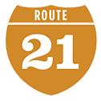
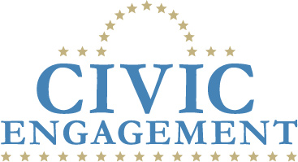
Using Smart Phones as a Marketing & Programming Tool
MAKING YOUR PROGRAMMING SMART
Notes:
Focus on civic engagement, work readiness education and 21st Century Skills or youth programs.
Technology is a simply tool. It comes with lots of bells and whistles but effective programming has a reason for being. It may be about the end result or it might be about the process of getting there. You decide which is most important.
Civic engagement – This means working to make a difference in the civic life of our communities and developing the combination of knowledge, skills, values and motivation to make that difference or like I like to think of it, as creating Healthy Neighborhoods. Programs that connect people to healthier lifestyles through the use of today’s media and technology.
Work Readiness education can help to bridge the gap between high school graduation and the work force, and provide tips for success in the early years of their working lives. This is true for many adults in our communities as well.
Youth Programs that build 21st century skills is the kind of fundamental programming that is needed in afterschool library programming. Look at YouMedia in Chicago for an example of how they have established informal, structured and mentored learning in the core of their programs and even their physical set up of their youth space.
I’ll also plug the growing need for STEM education. STEM – science, technology, engineering and mathematics. The future requires the knowledge of these areas and we see our country’s youth falling farther and farther behind the rest of the world. Fundamental STEM skills are sorely needed in the job market.

Slide 19
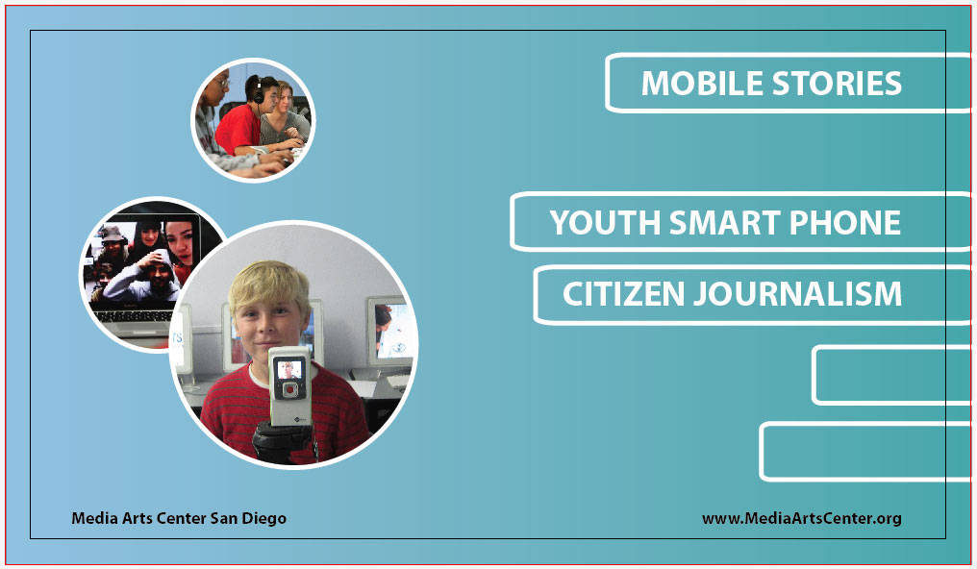
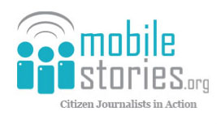
Case Study: MOBILE STORIES
Notes:
Now let’s take all of this information we just learned and see how it can be practically put into action!
Mobile Stories – citizen journalists in action as a case study of incorporating smart phones into youth programming
Launched earlier this year, Mobile Stories is an afterschool program that uses the popularity of mobile phone technology to connect local youth (ages 9-14 years old) with the extensive resources available at their local library in a format that is both current and easily accessible. The library, in this case San Diego Public Library, recognizes the ubiquity of cell phone technology; the need for under-represented teens to express their voices regarding news and events in their neighborhoods; and MobileStories potential to connect youth and their interests and needs with the information and resources of the library.
The main goal - Afterschool Workshops Seek to Increase Community and Library Literacy Using Mobile Technology
First let’s watch one of the cell phone videos that the kids put together
** VIDEO ** Watch and then return to PowerPoint

Slide 20
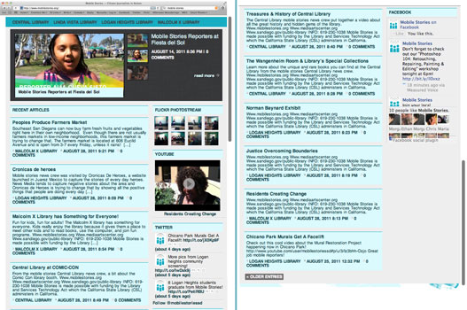
Case Study: MOBILE STORIES
WORDPRESS WEBSITE
Notes:
“The stories we tell in our local communities are part of the larger stories happening around the world. Youth at the library are not only highlighting the importance of these stories, but showing the importance of libraries as active parts in the creation and interpretation of these shared histories for the public.”, said Ethan van Thillo, Executive Director, MEDIA ARTS Center San Diego.
In affect the project of Library based teen citizen journalism project is bringing mobile marketing and programming together in a way that fits the smart phone technology.
First we will explore the marketing side of social networks and improving the content delivery for the mobile interface.

Slide 21
Case Study: MOBILE STORIES
FLICKR
YOUTUBE
FACEBOOK
WORDPRESS
BLOG
FB SOCIAL
PLUG IN
TWITTER
Notes:
Let’s look at how the program was visually and programmatically designed in terms of something that you could recreate.
Mobile Internet services cannot simply be reduced forms of traditional services. “It’s not a question of being able to see everything you can find at our website on a small smartphone screen. Rather, the services must be completely rebuilt so that they fit perfectly the conditions for use of smartphones and tablets.” (Bavarian State Library Deputy Director Dr. Klaus Ceynowa)
In this case, the library decided to chose to use WordPress for this project, which replaces traditional website development with plug in applications.
In addition the library set up user accounts in social networks: Facebook, Twitter, Flickr, and YouTube.
By simply filling in their account information into the WordPress app they are able to show off all current activity of all their diverse social networks

Slide 22
Case Study: MOBILE STORIES
Photos sent to Flickr account via smart phone
automatically appear on WordPress webpage as
Seen below
Notes:
Here you can see the relationship between a social network site and how it appears on the wordpress webpage & smart phone
We are looking at Flickr, a popular online photo management and sharing application
On the left you see the Flickr Home page and on the right you see how this information is feeding into wordpress
Let me skip back one slide so you can see the main page once again

Slide 23
Case Study: MOBILE STORIES
Notes:
Same thing occurs with Facebook and other online social network apps. A simple way to keep your core website up to date.
In the past, you could make a change to your social network app but then you had to also make the same changes to your website. Not any more!
It’s a breeze to keep things current and actively engage your “friends” in real-time.

Slide 24
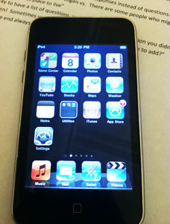
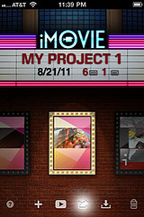
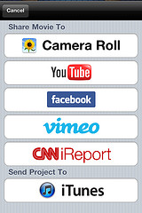
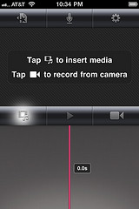
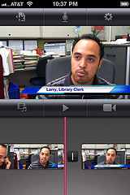
Case Study: MOBILE STORIES
Notes:
Now that we have prepped a wordpress webpage, its time to get into a little programming by having teens in this program use the social networks in an interesting way
Here is an example of a smart phone app and its ease of use. In this case, we are looking at iMovie, a video app.
Here the pictures tell the story – follow along…
The app is opened by touching the related icon on the smart phone screen.
Another tap opens up the video interface.
A third tap allows the user to capture a new video or add a pre-existing video saved on the phone.
Once the interview is captured it may be instantly sent to a number of social networks with a simple tap.
Literally you can open an app, record a video and instantly share it in a handful of taps. As you may have seen on TV, a new generation of Smart Phones are also coming with a glowing Facebook button on the phone itself so that anytime you create something to share, you can have instant access to sharing it immediately.
We really are living in the present with today’s technology

Slide 25
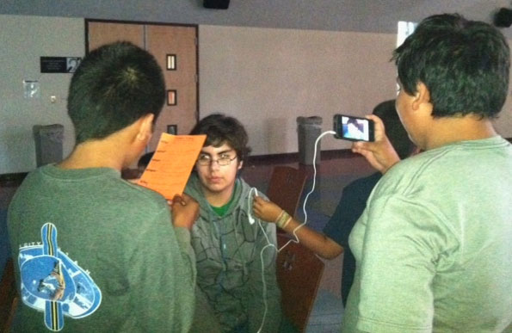
Case Study: MOBILE STORIES
Teens In Action creating a newsworthy video with a smart phone
Interviewer
Interviewee
Audio Person
Videographer
Notes:
So, now that you know what the technology looks like, you may be wondering what does this look like in use at the library during the youth program.
Here we see a team working on an interview together. One boy has a list of interview questions that the students developed earlier, another boy is the interview subject while two boys handled the audio and video capturing.
Mobile Stories starts the students by getting them familiar with the tools of the technology though brief tutorials and informal learning that included a scavenger hunt that had the students seeking to photograph items in the library, record a video of a librarian or another teen at the library, team up with another group via messaging app among other tasks. Eventually, the students were groomed to report on activities taking place at the library and sharing them with family & friends via the use of the smart phone applications. The real fun is when they started to communicate with students at the other libraries who were also involved in the project. The program took place at 4 libraries on different days of the week but during the same timeframe and utilizing the same curriculum.

Slide 26
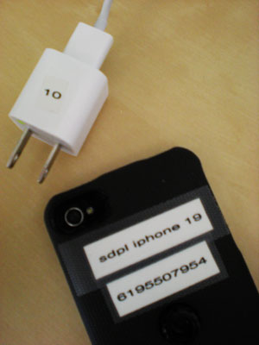
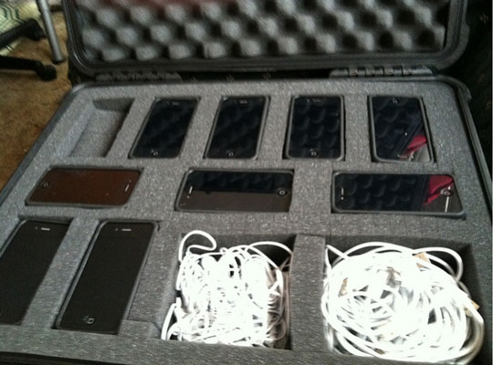
Case Study: MOBILE STORIES
Notes:
Security & Storage
Keeping tabs on your equipment is essential.
In this program, the phones and accessories were used only during mentored classtime and were checked out to students.
A custom case was purchased to hold 10 phones along with all the necessary cords.
Each phone was labeled and signed out for onsite use only. And a security tracking software app was installed & activated.

Slide 27
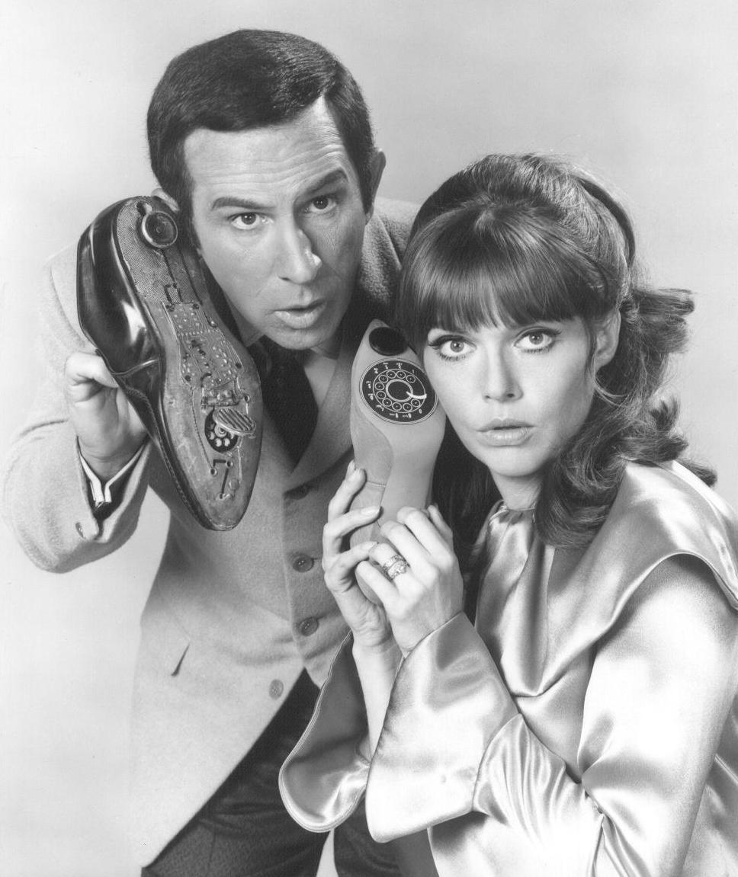
Using Smart Phones as a Marketing & Programming Tool
Get Smart
Notes:
So now its time to GET SMART and pull out those phones and use them wisely.
Located online at InfoPeople and at Media Arts Center San Diego, you’ll find the attachments for this webinar, including the PowerPoint you just watched. Please download the documents for your use. I’ve put together some resources that I believe will be of use to use whether you are seeking to add to your own knowledge, use as footnotes for grant narratives or to share with your colleagues.
These documents include:
Pew Internet Smart Phone Adoption & Usage
Library Technology Conference Mobile Info & Resource list
M-Libraries Best Practices Wiki
BOOK REVIEW - No Shelf Required: E-Books in Libraries
40 Cool Ways to Leverage Social Media
Top 30 Library iPhone Apps
7 Tools to Create a Mobile Library Website

Slide 28
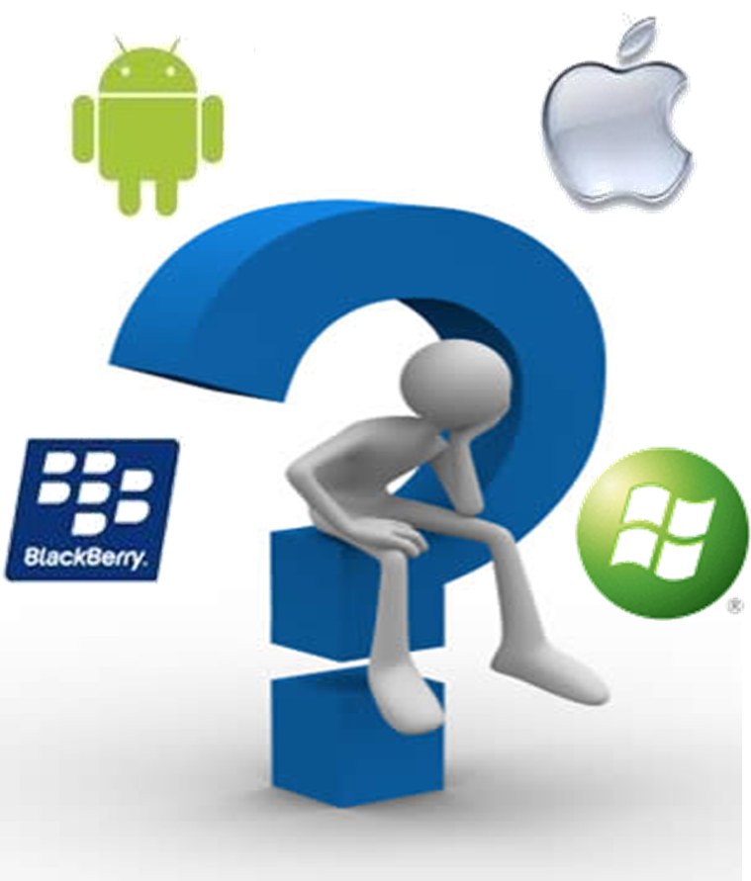
Using Smart Phones as a Marketing & Programming Tool
QUESTIONS & ANSWERS
Notes:
Open forum – Q&A

Slide 29
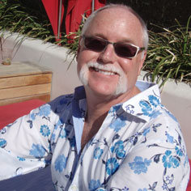
Using Smart Phones as a Marketing & Programming Tool
PATRIC STILLMAN
THANK YOU FOR ATTENDING
INNOVATIONS AND PROGRAMMING OFFICER
MEDIA ARTS CENTER SAN DIEGO
patric@mediaartscenter.org
The Future is Mobile
Notes:
Thank you for participating.
This is the first of four webinars being lead by Media Arts Center San Diego. Please join us …

