Slide 1
Communicating Through Infographics
An Webinar
Wednesday, November 14, 2011
12:00 Noon – 1:00 p.m. PST
Presenter: Dawne Tortorella
drt@bellcow.com
Infopeople webinars are supported by the U.S. Institute of Museum and Library Services under the provisions of the Library Services and Technology Act, administered in California by the State Librarian.
Notes:
Communicating Through Infographics
Hello, I’m Dawne Tortorella and I’ve loved data for as long as I’ve know how to count – which is a very large non-prime number ☺ We are inundated and fascinated with Infographics daily and I thought it would be interesting to take a closer look at their origin, how access to data is informing their creation, and how we can start to use this visual medium to tell our own library stories.
I am a library consultant who works with libraries of all types in technology planning, staffing, professional development, web technologies, and social media. My recent research includes study of social network analysis in organizational development and the impact of social media tools in professional development.

Slide 2
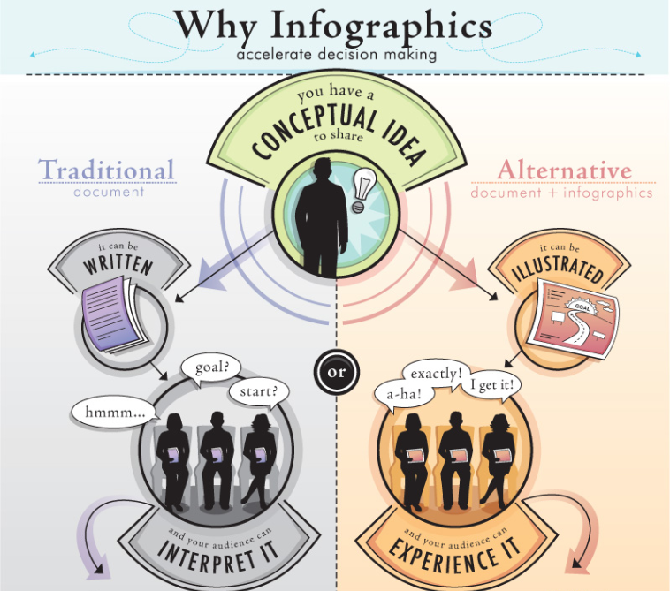
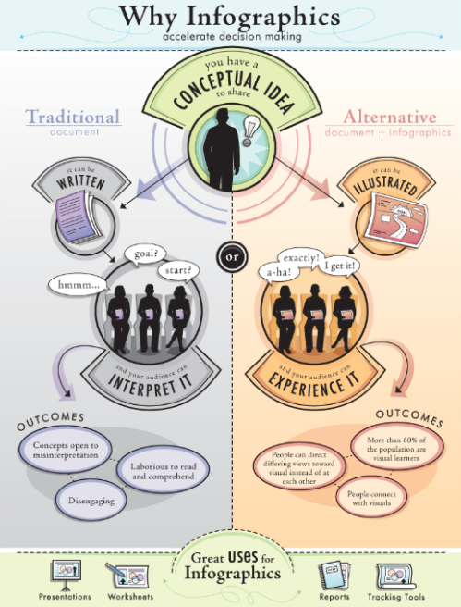
Interpret or experience
More than 60% of people are visual learners
Notes:
Source:
http://www.infographicsshowcase.com/wp-content/uploads/2010/03/Use-Infographics.jpg
What does that mean? 60% of people are visual learners?
“…visual signals are fed into at least three separate processing systems. One system appears to process information mainly about shape; a second, mainly about color; and a third, movement, location, and spatial organization. “ Source: Brain Facts, April, 2012 http://www.brainfacts.org/sensing-thinking-behaving/senses-and-perception/articles/2012/vision-processing-information/

Slide 3
Agenda
Infographics, Origins and Species
Big Data, Local Meaning
Visualization Tools
Creating an Infographic
Notes:
Our agenda for the next hour –
------
Before we get started, let’s cover some housekeeping details. Please enter any questions or comments you have during the webinar in chat. I’ll try to keep an eye on those and incorporate them into our discussion. At the end of the webinar, while you fill out the evaluation on your screen, I’ll answer any remaining questions submitted via chat.

Slide 4
Notes:
Spend 10 seconds reviewing this infographic.
Poll: On a scale of 1-5 how likely would you be to share this infographic?
Source: hiptype.com/#infographic

Slide 5
Definition
“Infographics provide a format that utilizes engaging visuals that not only appeal to an audience hungry for information, but also aid in the comprehension and retention of that material.”
Infographics: The power of visual storytelling Lankow, Ritchie, & Crooks
Notes:
Jason Lankow and associates from Column Five, columnfivemedia.com/ produce many of the iconic infographics found on the web. Their design firm specializes in visual storytelling, which is the art behind the science of infographics.
A successful infographic needs to engage the audience by presenting data and information that the viewer can easily understand and remember.
Wiley Publishing provides the first chapter of the book in PDF - http://media.johnwiley.com.au/product_data/excerpt/42/11183140/1118314042-44.pdf

Slide 6
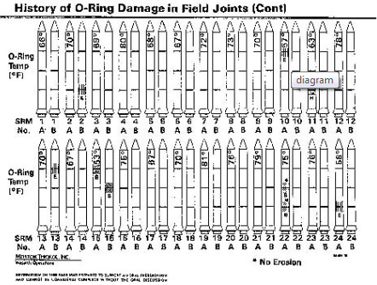
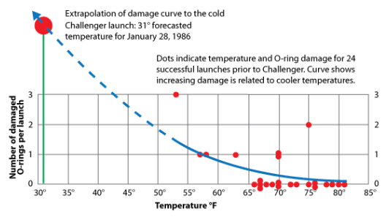
Clash of the Titans: Tufte vs. Holmes
Tufte
Pioneer of data visualization, information design
Academic (Yale) – statistician
Believes you should omit graphic elements of the design that do not communicate specific information
Avoid “chartjunk” and Powerpoint
Notes:
Edward Tufte and Nigel Holmes represent the opposing views on presenting data in visual form.
While we tend to associate Tufte with data-heavy charts, his work spans many visual dimensions. Above all, he believes data should be presented in an unbiased form, allowing the data to stand on its own.

Slide 7
Clash of the Titans: Tufte vs. Holmes
Holmes
Created “explanation graphics”
Publishing – Time
Believes stories can be more memorable and impactful
Importance of appeal through visual metaphor
Recent studies have shown his explanation graphics aid in retention
Notes:
Edware Tufte and Nigel Holmes represent the opposing views on presenting data in visual form.
Holmes on the other hand, approaches explanation graphics as an extension of editorial commentary. Using icons, design, and visual metaphors are critical in telling the story.
Both would despise these slides, so let’s move on!

Slide 8
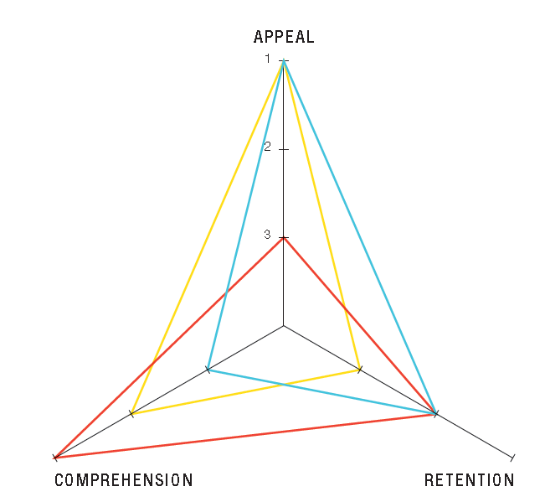
Are both right?
Objectives drive design
Vary based on agenda
Figure 1.6 Infographic priorities by application. p. 38 Infographics: The power of visual storytelling
Notes:
The designers from Column Five provide a helpful model in placing weight on the three critical components of an infographic: appeal, comprehension, and retention.
Your target audience can greatly affect the visual presentation of data you convey. For example, you may choose to share similar data in a Board Report and a patron bookmark. In a report to the board, you want them to understand how interlibrary loan transactions are increasing so that they can help evaluate the staffing and collection development implications. For patrons, you may want to highlight the increase in interlibrary loan as an expansion of material they can check-out. Same data, potentially different stories, targeted at specific audiences.

Slide 9
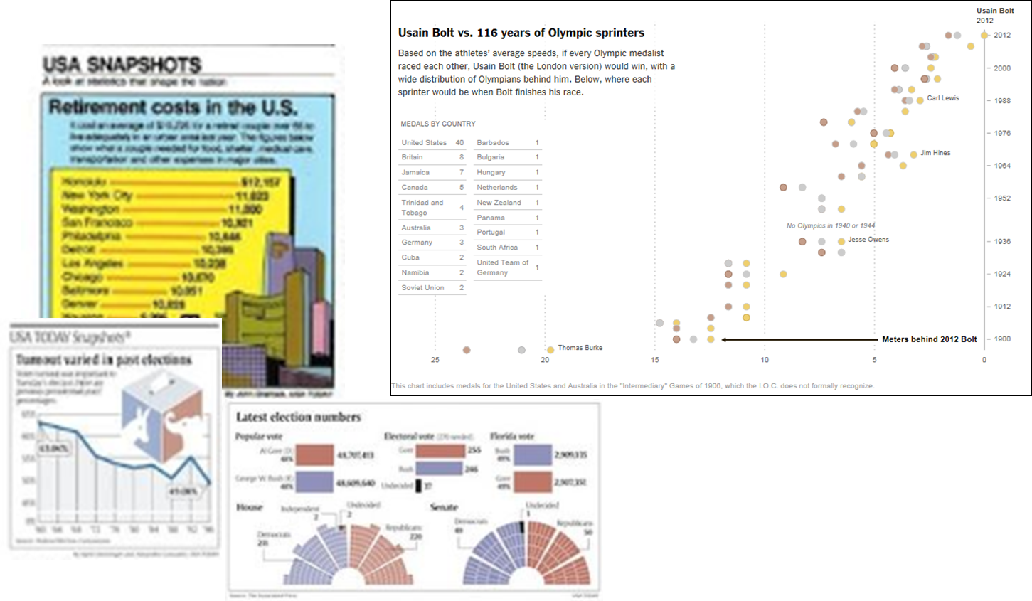
USA Today, NY Times
Sept.15, 1982
NY Times Olympic 100 meters, 2012
Nov Election, 2000
Notes:
The first edition of USA Today introduced a new way of featuring editorial content on the front page. Their easy to understand and colorful explanation graphics ushered their early success.
The New York Times Research & Development Labs - nytlabs.com/ continue to build tools for visualizing data, in both static and dynamic form. Jer Thorp, data artist in residence for the NY Times, shares some of his visualization research on his blog - blog.blprnt.com.
You can also watch a video on how the New York Times staff come up with a daily infographic - doobybrain.com/2012/04/04/making-the-infographics-for-the-new-york-times/
And to illustrate how data and visualization software is being used to tell a more complete story, look at some of the NY Times interactive features:
All the Medalists: Men’s 100-Meter Sprint - http://www.nytimes.com/interactive/2012/08/05/sports/olympics/the-100-meter-dash-one-race-every-medalist-ever.html
What’s Cooking on Thanksgiving - http://www.nytimes.com/interactive/2009/11/26/us/20091126-search-graphic.html
Is it Better to Buy or Rent? - http://www.nytimes.com/interactive/business/buy-rent-calculator.html
Credits:
Historic Front pages of USA Today - http://www.bizjournals.com/washington/news/2012/02/03/historic-front-pages-of-usa-today.html
All the Medalists: Men’s 100-Meter Sprint - http://www.nytimes.com/interactive/2012/08/05/sports/olympics/the-100-meter-dash-one-race-every-medalist-ever.html

Slide 10
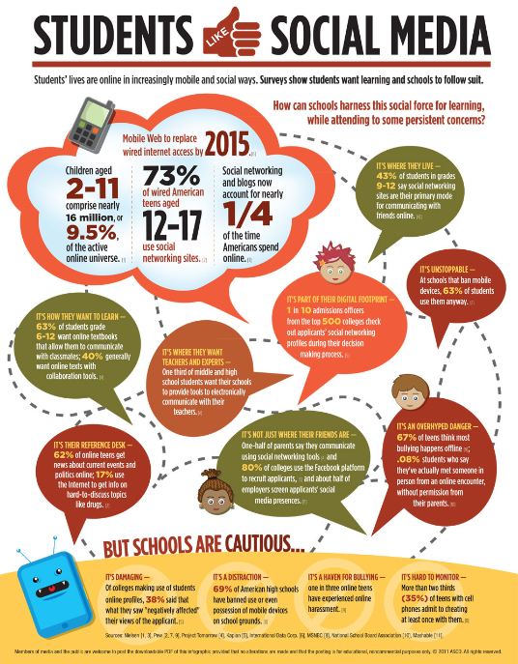
Typical Infographic Signature
Vertical presentation
Tells a story
Uses metaphor
Summarizes data
Cites data source(s)
Notes:
Vertical presentation format of infographics rose from their use in web blogs.
May include data, displayed in icon or symbolic form.
May include text-based highlights.
Colorful, designed to draw attention.
Use a metaphor to tell a story.
Flows from top to bottom.
Data source is identified, and ideally methodology related to data collection can be found.
Credits:
ASCD (formerly the Association for Supervision and Curriculum Development) http://www.ascd.org/publications/newsletters/policy-priorities/vol17/num04/Students-Like-Social-Media.aspx

Slide 11
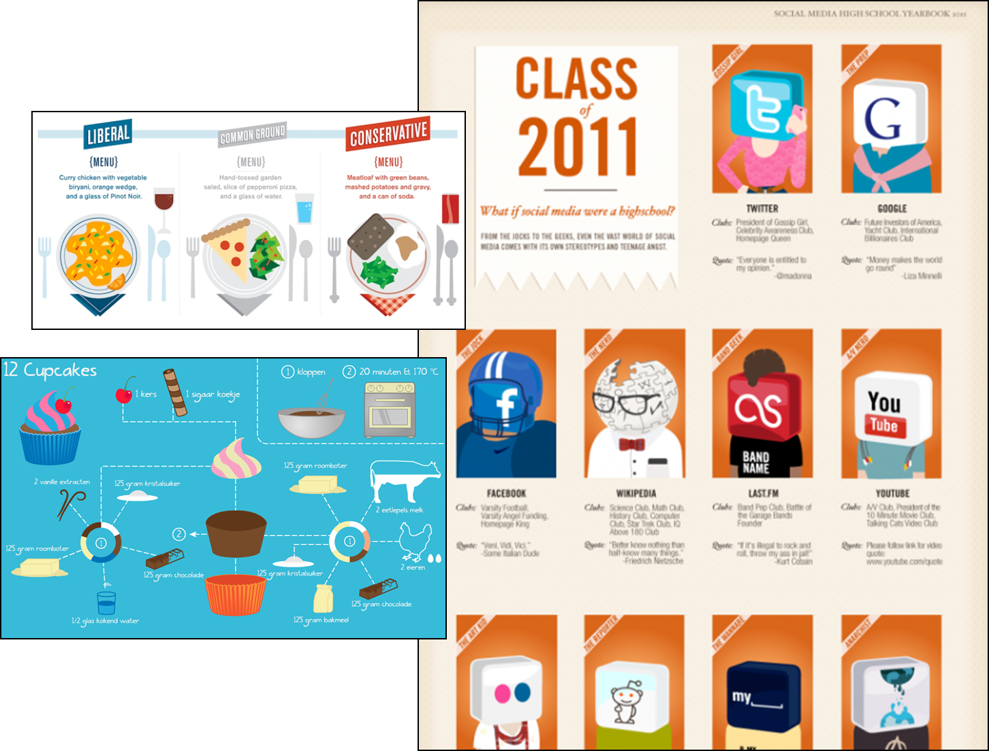
Poster Art
Notes:
Almost anything that follows the physical footprint of the typical infographic is called an “infographic.” But, we should distinguish between infographics and poster art. There is nothing wrong with poster art – it exists for the sole purpose of being visually pleasing and entertaining. However, it does not include data which can be verified and needs to be treated as a source of entertainment.
Credits:
Cupcake “Infographic” Graphic from Coconut Coding - http://coconutcoding.be/index.php?page=projectDetail&projectId=10
Class of 2011 from FlowData - http://www.flowtown.com/blog/class-of-2011-if-social-media-were-a-high-school
Food Profiles of Self-Proclaimed Liberals vs. Conservatives - http://blog.hunch.com/?p=48884

Slide 12
Does this graphic?
Tell a story
Provide a metaphor
Reflect data accurately
Reinforce the intended message
http://worldpneumoniaday.org/infographic/
Notes:
The Global Coalition Against Child Pneumonia, http://worldpneumoniaday.org/infographic/ created an infographic to bring awareness of childhood pneumonia for World Pneumonia Day. They provide this infographic to help support their Call to Action activities for the day. Research related to the statistics and additional resources can be found at http://worldpneumoniaday.org/act2012/
This portion of the infographic illustrates both the strengths and pitfalls of displaying data in this format.
Does it tell a story? Yes, children are affected by pneumonia
Provide a metaphor? The visual incorporates the silhouettes of children representing children around the world.
Reflect data accurately? The math is not correctly represented in this image. They state 1 in 5 child deaths in 2008 were due to pneumonia, yet 4/18 or 2/9s (not 2/10s) are displayed as pneumonia victims. This visual is not accurate and skews the data.
Reinforce the intended message? Yes, it does emphasize the impact of pneumonia in children, but could it be done more effectively?
Does this graphic minimize the impact for 8.8 million child deaths, and 1.76 million of those deaths attributed to pneumonia? Do you equate all of those children as death statistics, or just the “orange” ones? In other words, is this infographic misleading? Does it make us remember the wrong statistics? Perhaps 1 in 5 children die due to pneumonia rather than 1 in 5 deaths is attributed to pneumonia.
These are nuances we might not pick up on with a casual glance.

Slide 13
Big Data, Local Meaning
Public datasets
APIs and access to big data
Tracking local data
Notes:
The impact of your message depends on how the data is tied to your intended audience. The more you can localize the data used for reporting and compare it against your own demographic, the more powerful the message – and more memorable.
Relating data to national trends can also be effective in layering the story and highlighting similarities and differences of your target audience with a larger population.

Slide 14
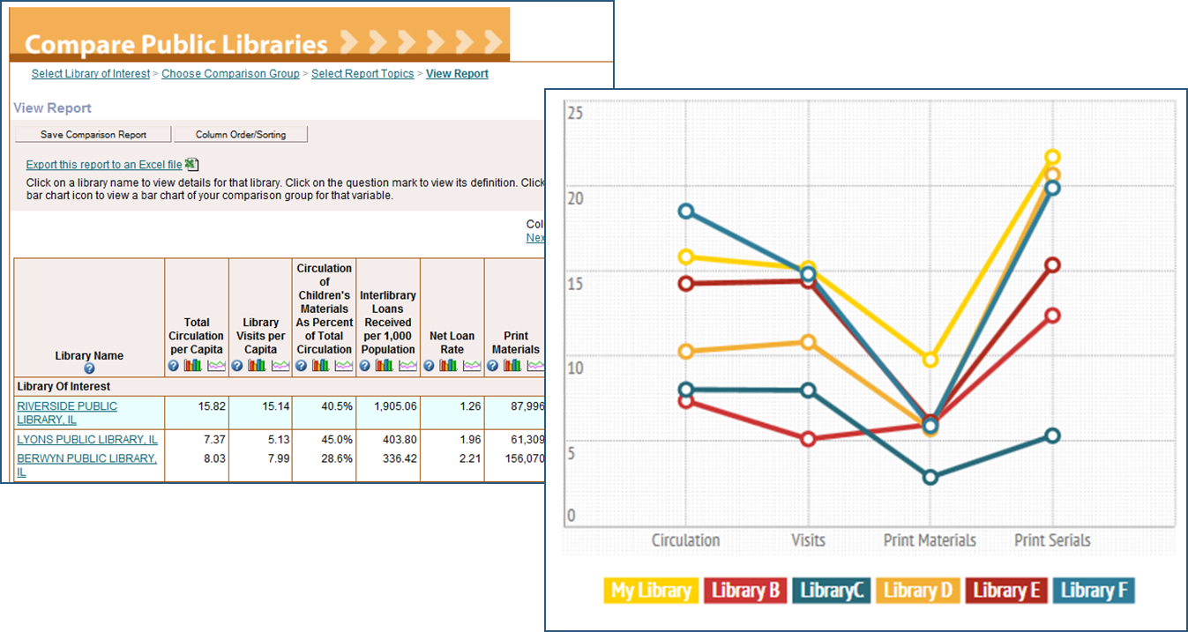
IMLS Public Library Comparison
http://www.imls.gov/research/public_libraries_in_the_united_states_survey.aspx
Notes:
IMLS provides access to public library datasets from 1992-2010. This is an excellent source for comparison analysis, especially geared toward stakeholders in regard to services, collections, staffing, and budget.
Source:
IMLS Research Datasets: Public libraries in the United States survey (1992-2010 data) - http://www.imls.gov/research/public_libraries_in_the_united_states_survey.aspx This site provides raw data, search, and comparison tools.
Graph created using infogr.am

Slide 15
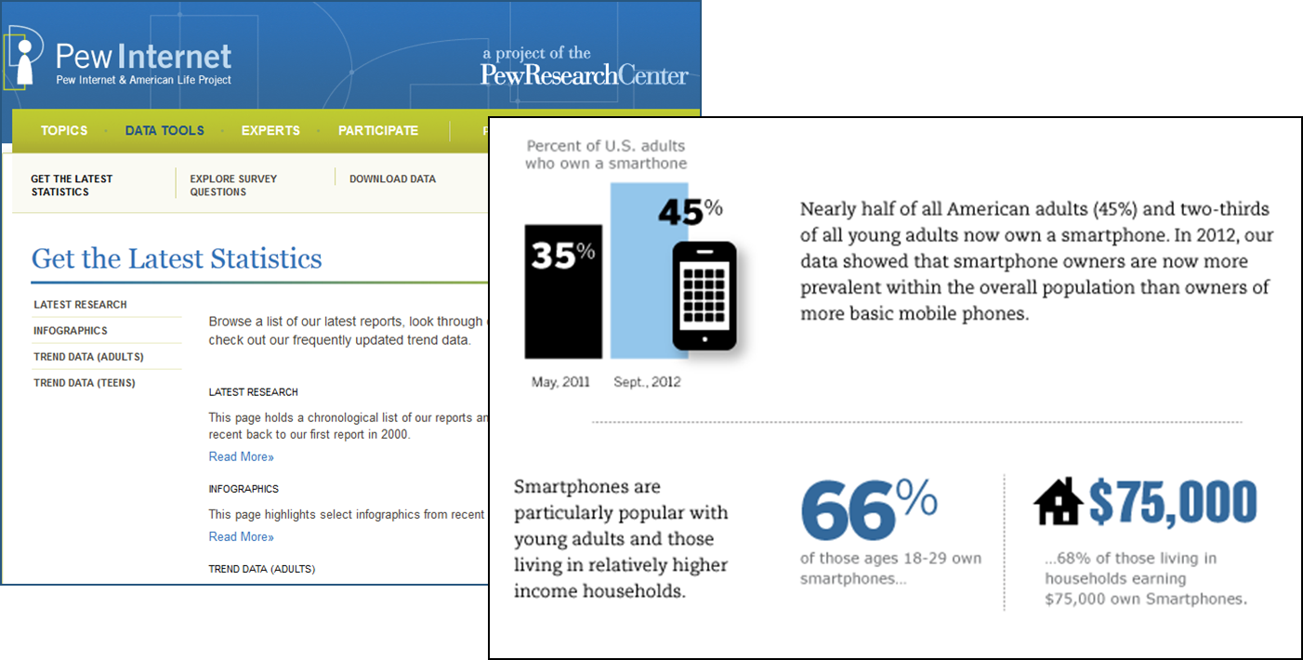
Pew Internet Data Sets
http://pewinternet.org/Data-Tools/Get-The-Latest-Statistics.aspx
Notes:
Additional research based studies represent strong data sources for illustrating the impact of libraries on society. The Pew Internet & American Life Project publishes data that can help tell the library story.
Source:
Pew Internet: Pew Internet & American Life Project http://www.imls.gov/research/public_libraries_in_the_united_states_survey.aspx Consider using data collected in these reports to supplement your own infographics.
http://pewinternet.org/Infographics/2012/Our-Smartphone-Habits.aspx

Slide 16
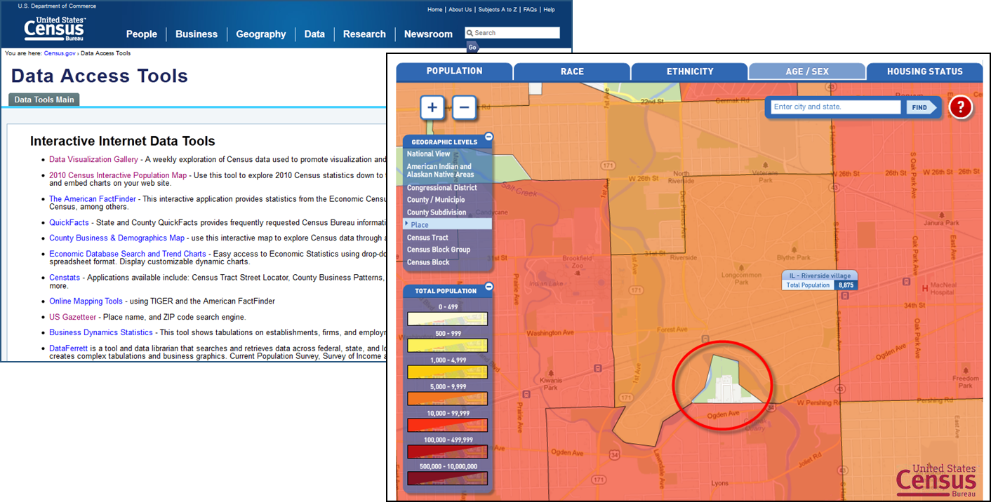
Census Data – Local Scoping
http://2010.census.gov/2010census/popmap/
Notes:
Consider the key data you refer to when submitting required local, state, and federal reporting. All libraries generally submit annual reports which pull baseline demographic data related to your service area. Investigate interesting trends and note any specific data elements of interest for inclusion in reporting and visualizing data.
Source:
U.S. Census: Data Access Tools. http://www.census.gov/main/www/access.html
Township level data shows area with no library service, using Census 2010 Population mapping - http://2010.census.gov/2010census/popmap/

Slide 17
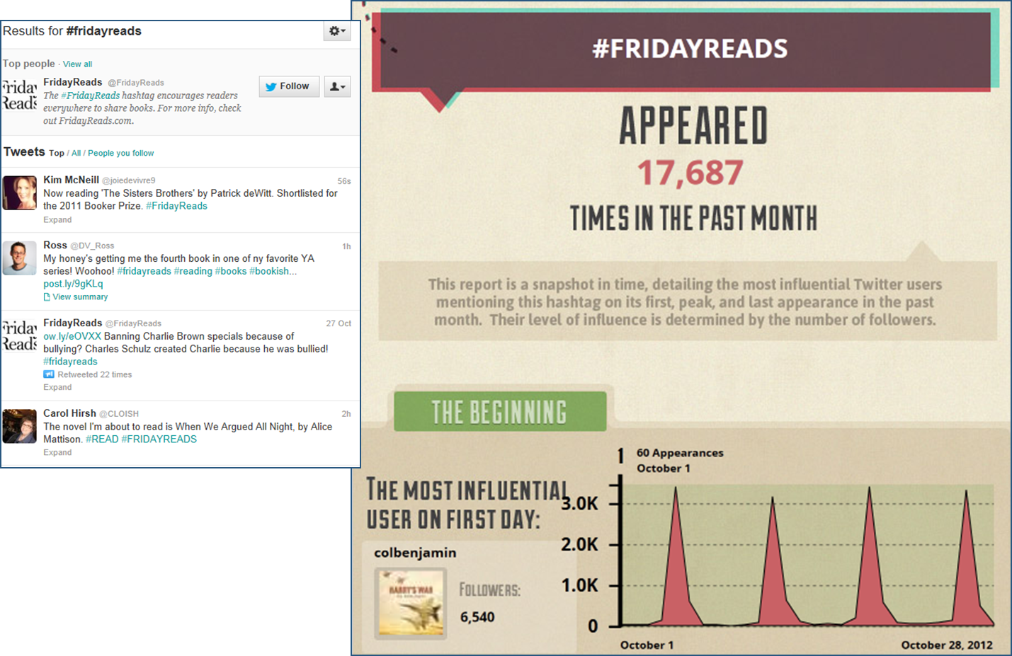
Big Data & APIs
Notes:
Social media is one of the most popular sources for generating big data. Projects are using the data generated from these sources in many creative ways. Using twitter traffic you can visualize how messages spread in a viral network. Using location-based signatures, human traffic patterns can be evaluated.
As libraries, we may not have a need to analyze these large data sources, but we certainly can get helpful information analyzing our content in these datasets.

Slide 18
Does it leave you feeling informed or delighted?
Inspired?
Notes:
Kate Hart has analyzed YA book covers and presents the information visually. Do these information graphics leave you feeling informed or delighted?
What industry data resonates with you and the services/resources your library provides? In Kate’s case, it is YA literature. Her passion drives her creative visualization of information related to the genre. She collects this data, painstakingly, manually, and diligently analyzing the information as she collects it, experimenting with how to present it to others.
Source:
Hart, K. (2011). Uncovering YA Covers: 2011. http://www.katehart.net/2012/05/uncovering-ya-covers-2011.html

Slide 19
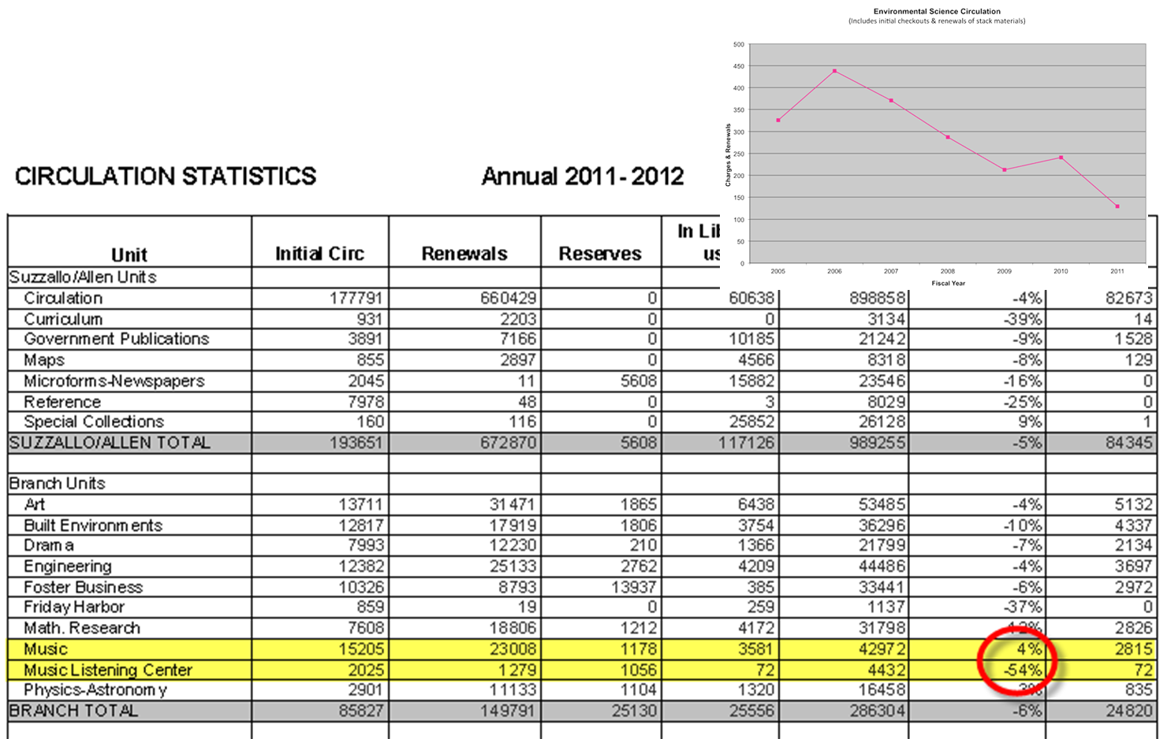
Circulation Data
Notes:
Look familiar? We have all pondered these rows and columns of numbers.
Source:
University Libraries, University of Washington, ResearchWorks Archive, Circulation Statistics 2011-2012 https://digital.lib.washington.edu/dspace/handle/1773/19998
Harold B. Lee Library, BYU, Library Statistics, http://lib.byu.edu/libstats/circ.php

Slide 20
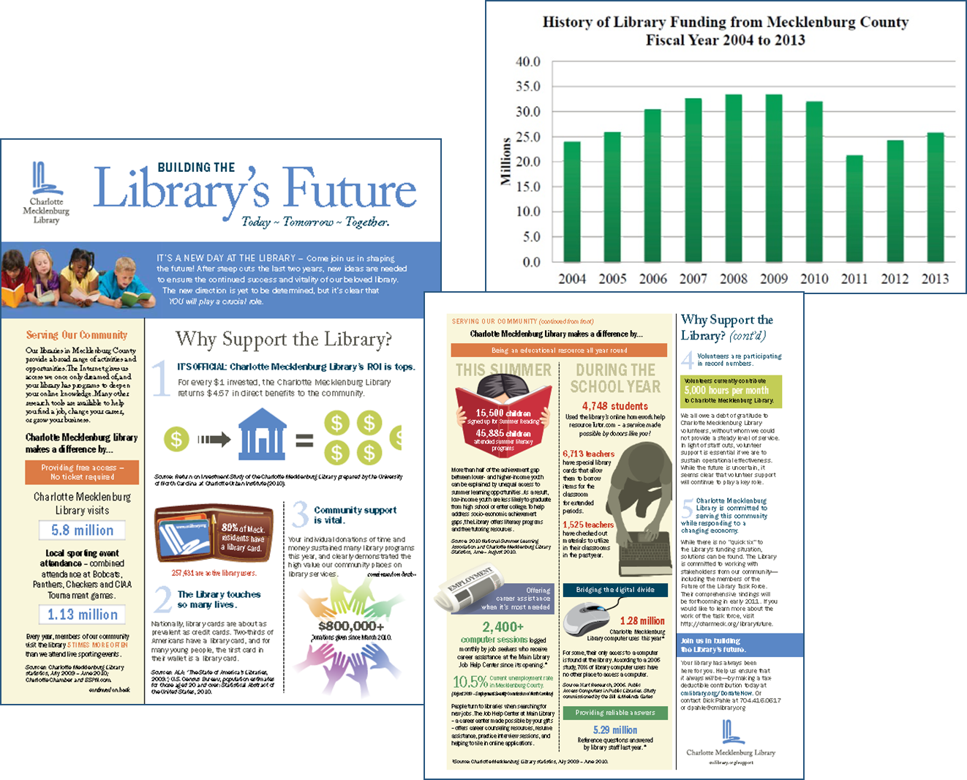
Budget & Funding
Notes:
Money talks – be prepared to have it say what you’d like to hear. Budget and funding data is a rich source of information for building a compelling story about your library.
What other local data do you maintain? Ask questions related to the data – find correlations and reasons for changes that can be visualized.
The Public Library of Charlotte-Mecklenburg County was forced to shut over ½ of their branch libraries and lay off over 100 employees in 2011. Which presentation tells the story best?
Source:
The Public Library of Charlotte-Mecklenburg County, Library Budget Information, http://www.cmlibrary.org/about_us/info.asp?id=13

Slide 21
Visualization Tools
Free tools for analyzing data
Free design tools
Visualization services
Daily tools – Excel, Photoshop, Illustrator
Notes:
Our minds are naturally wired to process data efficiently in visual format. That does not, however, mean we are fluent – or even comfortable – creating visual representations. Perhaps art and statistics should be required courses throughout our formal learning and professional development. There are some tools available that will help us experiment and gain visual literacy skills.

Slide 22
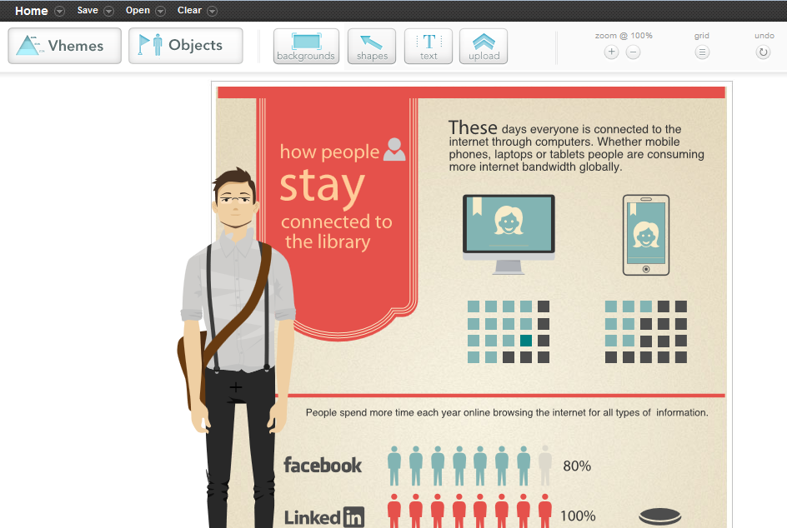
Easel.ly
Notes:
easel.ly (http://www.easel.ly/) is another web-based design tool. The free version has more themes and an especially useful object library, which includes people icons. These are helpful in relating personal activity to statistics.

Slide 23
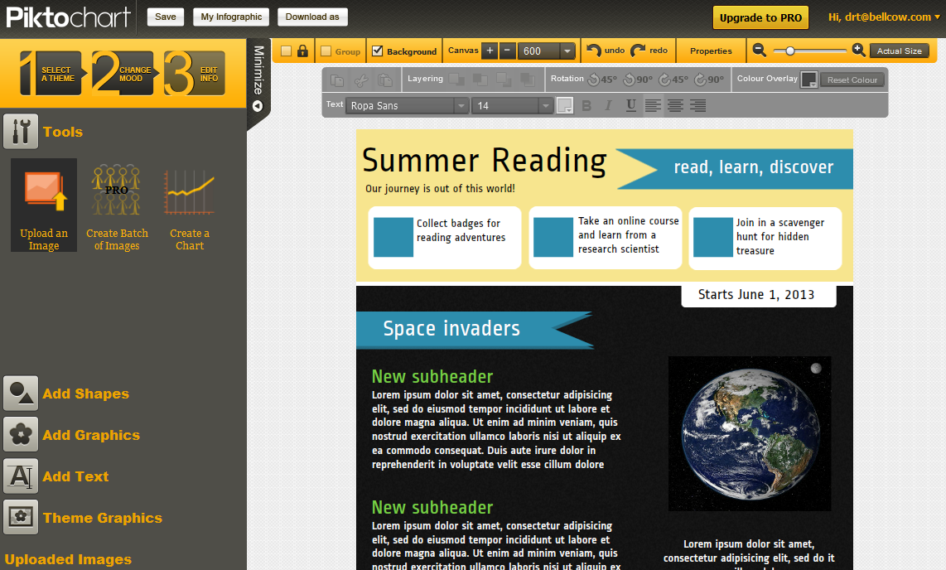
Piktochart
Notes:
Piktochart (http://www.piktochart.com) is a fun tool for creating visual infographics. Even if you do not use the finished infographic, you can copy visual elements and get a feel for layout and placement in a visual format.

Slide 24
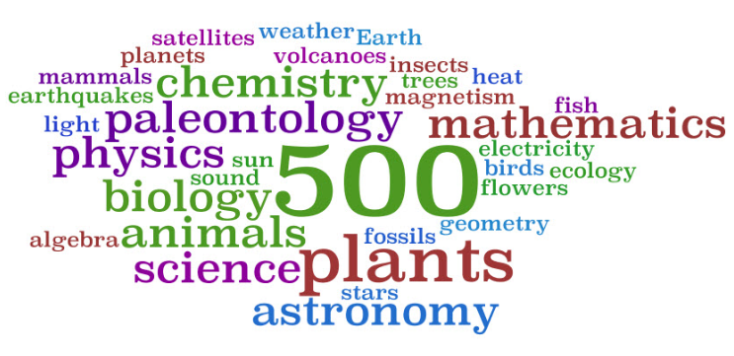
Text can be visual
http://www.wordle.net
Notes:
Using a strategically placed Wordle within your infographic can be extremely effective. For example, consider building a Wordle based on most common genres circulated to augment circulation statistics.
Source:
Love That: Tips and tricks in library technology, http://lovethat.edublogs.org/2009/09/24/wordle-for-dewey-and-genres/
Wordle. http://www.wordle.net/

Slide 25
Common Traps: Accuracy/Critique
Properly cite your data
Include methodology for data collection and reporting
Use supplemental data that relate to the service area
CHECK YOUR MATH
Notes:
If we want our data to be both information and delightful, if must be credible.

Slide 26
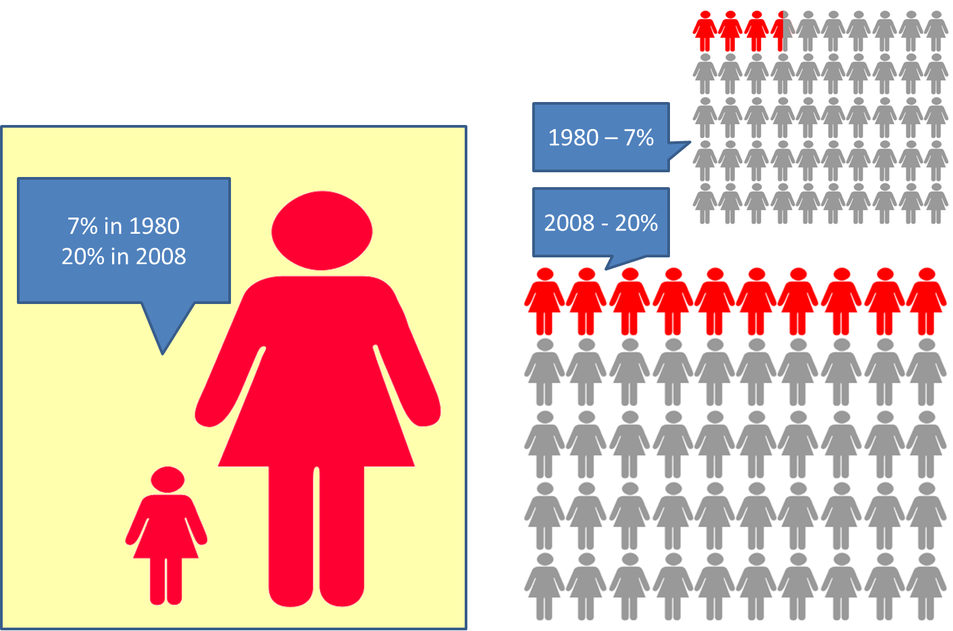
Best choice?
Childhood obesity rates have nearly tripled since 1980
Notes:
There are various approaches to showing numeric shifts.
Which representation would you choose to convey this dramatic increase in childhood obesity? (left or right)
Source:
Centers for Disease Control and Prevention - http://www.cdc.gov/obesity/data/childhood.html

Slide 27
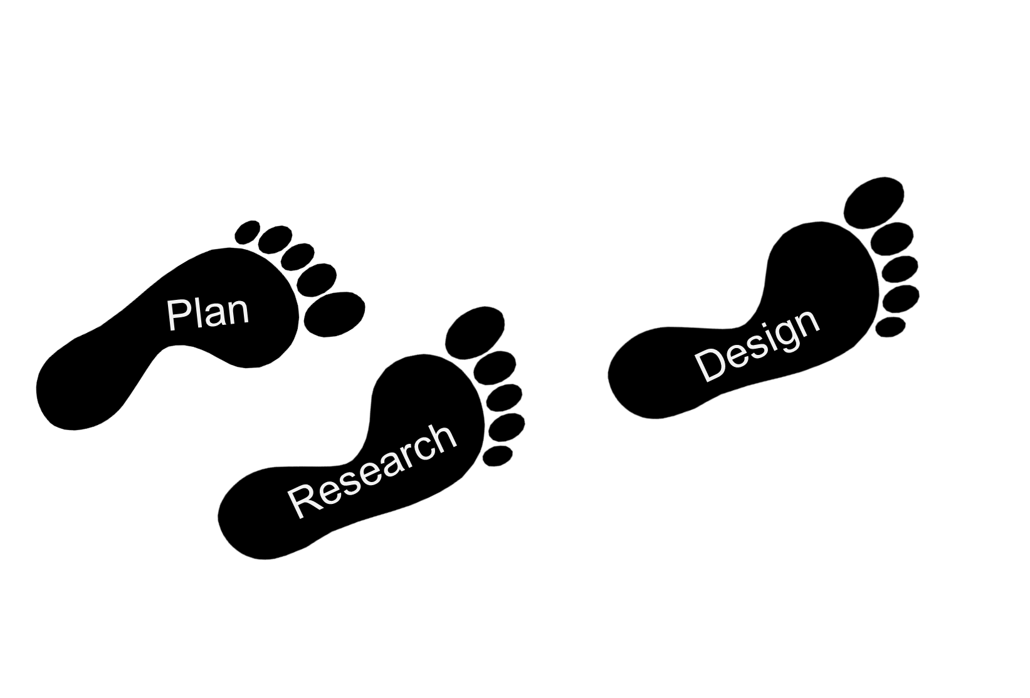
Creating an Infographic – Step-by-step
Tell a story
Notes:
The most critical part of creating an infographic is the work required in gathering information and graphic assets.
Plan the project: Why do you think an infographic is needed? Who is the target audience? Will you convey the information in different ways for different audiences?
Research: Gather your data and possible assets (icons, imagery). The more local and personalized your data is, the more effective it will be in telling your story.
Tell a Story: Develop a plot that serves as a platform for the presentation. Is there a metaphor that can reinforce the message?
Design: Consider color, images, typography, and layout as you design the infographic.
Color guides:
The Psychology of Color Infographic - http://nowsourcing.com/blog/wp-content/uploads/2012/01/louisville-painter.html
Color Psychology in Logo Design - http://hellotarte.com/blog/2012/04/26/color-psychology-in-logo-design-infographic/
Color Science - http://visual.ly/node/15845

Slide 28
Case Study – ALA “Weather the Storm”
Based on 2 years of research
Executive summary, detailed data findings, methodology cited & online
Notes:
The infographic is one of several documents/reports generated from Libraries Connect Communities: Public Library Funding & Technology Access Study 2011-2012 .
Included with the distribution of the infographic were links to the full study, executive summary, supplement report, detailed findings, and research questionnaires.
Source:
ALA. Infographic: Weather the Storm. http://www.ala.org/research/plftas/2011_2012/weatheringthestorm

Slide 29
Does it tell a story?
Incorporates metaphor
Leads the viewer on a journey
Targets message
Notes:
The infographic complements the findings presented in the Executive Summary.
“Strategic vision and careful management have helped U.S. public libraries weather the storm of the Great Recession, supporting their role as a lifeline to the technology resources and digital skills essential to full participation in civic life and in the nation’s economy. Libraries continue to transform lives by providing critical services and innovative solutions to technology access, in spite of years’ worth of consecutive and cumulative budget cuts.”
OK – so show me.

Slide 30
This?
“Strategic vision and careful management have helped U.S. public libraries weather the storm of the Great Recession, supporting their role as a lifeline to the technology resources and digital skills essential to full participation in civic life and in the nation’s economy. Libraries continue to transform lives by providing critical services and innovative solutions to technology access, in spite of years’ worth of consecutive and cumulative budget cuts.”
Notes:
Yes, indeed this is a summary of the extensive report (or at least the first paragraph in a 4 page Executive Summary).

Slide 31
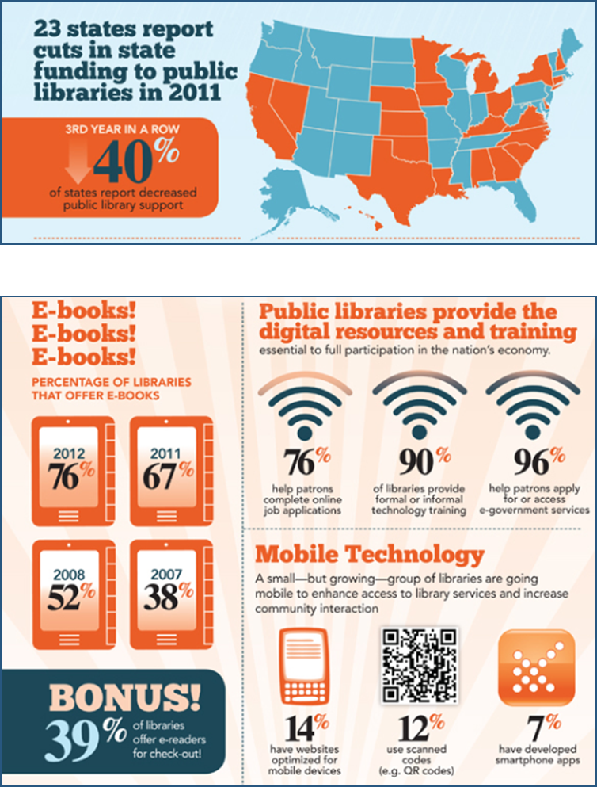
Or this?
Consider design, stormy to sunny
Transition from bad to good
Call to action at the end
Notes:
Let’s look at some of the design considerations that make this a powerful infographic.
Any suggestions for making this data more impactful?

Slide 32
Fine Print:
SOURCE: data compiled from e-readers by Hiptype
Notes:
Let’s try another poll related to the first infographic we reviewed, but only after considering the following:
According to US Census Data 2000, 79% of population lives in urban areas.
Do we know the baseline data of how many of the books in the study featured a male protagonist vs. female? Would it impact our understanding of the visual data representation?
How valuable is average page length in describing content?
Hiptype is a platform for data-driven book publishing
Poll: On a scale of 1-5 how informative is this infographic?

Slide 33
Thank You!
Contact Info for Dawne
Email: drt@bellcow.com
Twitter: dawne
LinkedIn: www.linkedin.com/in/dawnetortorella
Pinterest Infographics Board - pinterest.com/dtortore/infographics/
Scoop.it Infographics Creation Curation Thread - scoop.it/t/creating-infographics
Notes:
I welcome learning more and hearing your ideas. I’d especially love to see samples of Infographics your organization has created and the process used.
Dawne Tortorella
Email: drt@bellcow.com
Twitter: dawne
LinkedIn: www.linkedin.com/in/dawnetortorella
Pinterest Infographics Board - pinterest.com/dtortore/infographics/
Scoop.it Infographics Creation Curation Thread - scoop.it/t/creating-infographics

Slide 34
Survey and Certificate of Attendance
Please take a minute and fill out our webinar survey. You will find in at:
https://survey.qualtrics.com/SE/?SID=SV_56cweQvElL0B8DX
Thank you!

