Slide 1
Comics, Graphic Novels, and Teens
An Infopeople Webinar with
Francisca Goldsmith
Wednesday, April 9, 2014
Noon – 1 pm
Infopeople webinars are supported in part by the U.S. Institute of Museum and Library Services under the provisions of the Library Services and Technology Act, administered in California by the State Librarian. This material is licensed under a Creative Commons 3.0 Share & Share-Alike license. Use of this material should credit the author and funding source.

Slide 2
Agenda
Formats
Teen interests and developmental concerns
Growing the teen collection to grow teen assets
Resources on- and offline
Diversifying options for teen needs
Q & A
Notes:
type in the chat one graphic novel title you think is highly suited to teen readership in particular

Slide 3
Format: The Big Picture
Comics as medium
Narrative mechanics
Analog and digital possibilities

Slide 4
Supporting Teens with Comics
As readers
As students
As seekers of identity formulation support:
  Self discovery
  Possibility discovery
  Social and political awareness
  Aesthetic taste and creativity
Notes:
type in the chat a topic of high teen interest in their own social or emotional lives (not a reading taste)
Genre interest in fantasy, contemporary realism, politics and history, religion, and affinity group identification
Format capacity to relate complex ideas and feelings
Teen interest in art and in self-expression

Slide 5
Poll
Notes:
Poll: How are you building your teen graphic novel collection now? (a) published library literature reviews; (b) local staff expertise and/or special interest in the area; (c) responding to teen reader requests for specific materials; (d) donations; (e) gathering input from non-library sources, including community members, industry and fan blogs, non-library-oriented professional publications, etc.

Slide 6
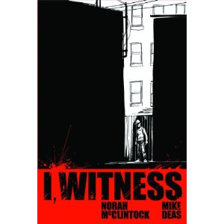

Slide 7


Slide 8
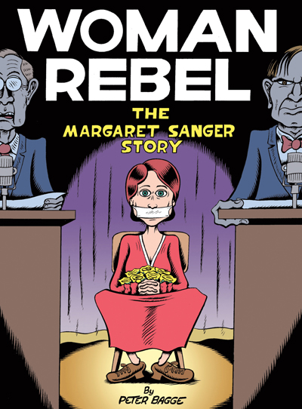

Slide 9
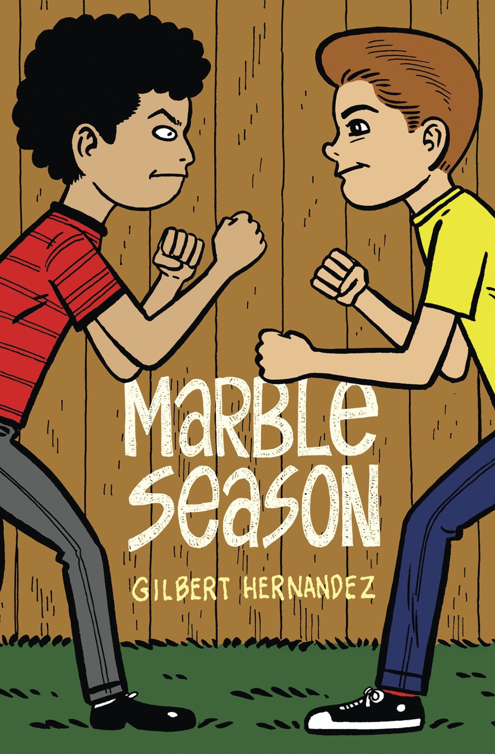

Slide 10
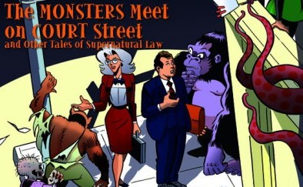

Slide 11
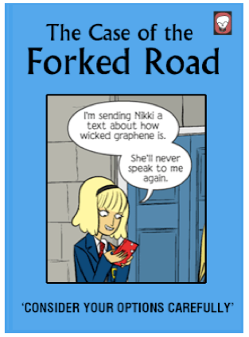
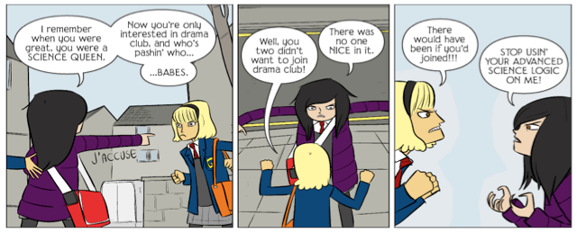
Web Comics: John Allison’s
Bad Machinery – a series of detective stories www.scarygoround.com/ar.php

Slide 12


Slide 13
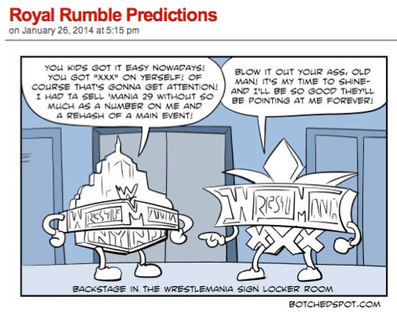
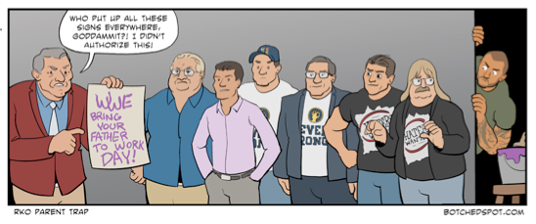
Web Comics: James Hornsby’s
Botched Spot

Slide 14
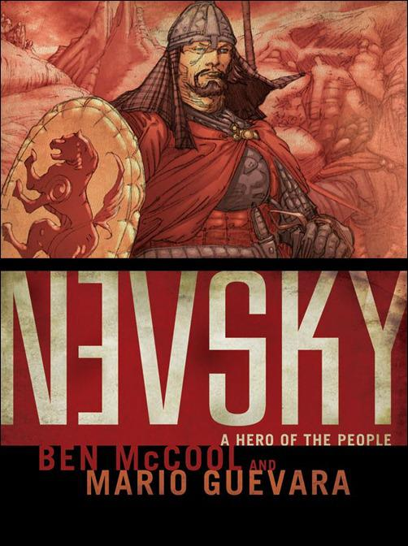

Slide 15


Slide 16
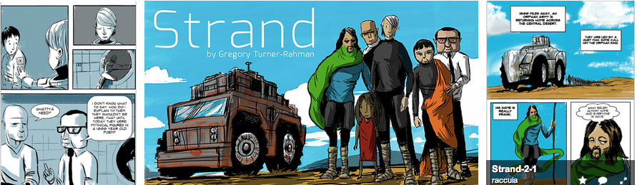
Apps for Comics Creation
Strip Designer – iPad app costs $2.99
Sample – Strand, by Greg Turner-Rahman
Tutorial - www.mexircus.com/Strip_Designer/manual.html

Slide 17
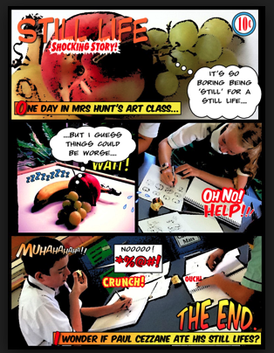
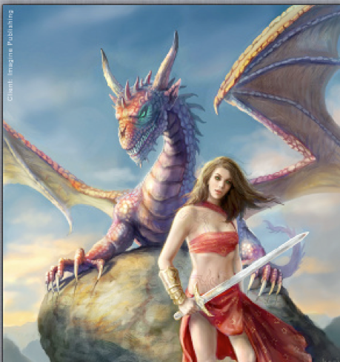
ComicBook! – iPad $2.99
Sample – iPad ArtRoom
Tutorial - www.youtube.com/watch?v=7IYa8QWeE8M
ArtStudio – iPad $4.99
Sample – LuckyClan
Tutorial - www.youtube.com/watch?v=_gZxD6FtzTY
Notes:
type in the chat a resource available you use to keep aware of forthcoming graphic novels of local high teen appeal

Slide 18
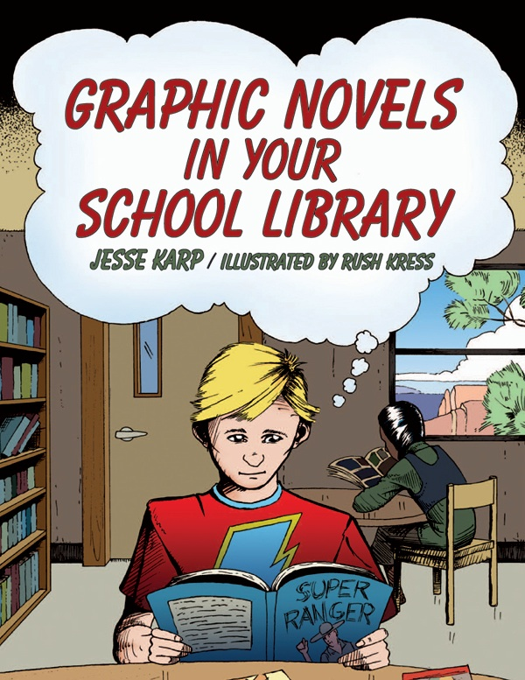
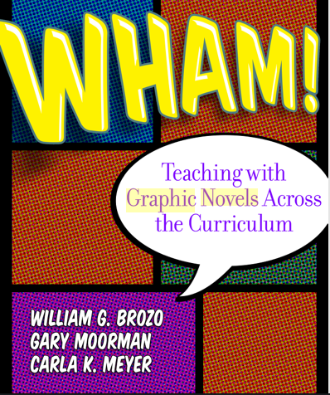
Resources for Collection Building
Multicultural Graphic Novels for Teens – Pinterest pinterest.com/adangelolib/multicultural-fantasy-graphic-novels-for-teens/
Great Graphic Novels for Teens – Young Adult Library Services Association ala.org/yalsa/great-graphic-novels-2014

Slide 19
Diversify!
Connect interests across formats and media
Some topics assigned for research make more sense visually than in traditional narrative text
Encourage transmedia literacy
Respect the reader

Slide 20
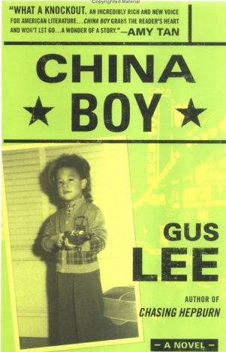
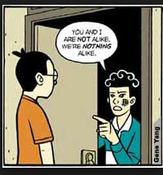
From Library of Congress American Memory Project:Chinese and Westward Expasiion
memory.loc.gov/ammem/award99/cubhtml/theme1.html
Gene Luen Yang’s American Born Chinese

Slide 21
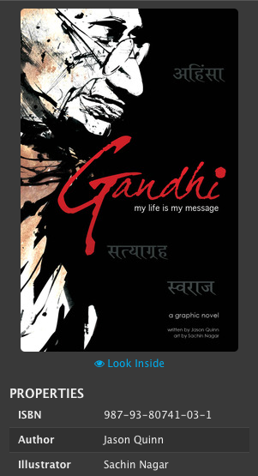
From Wikipedia, the free encyclopedia Gandhi
Directed by Richard Attenborough
Produced by Richard Attenborough
Screenplay by John Briley
Starring Ben Kingsley
Music by Ravi ShankarGeorge Fenton
Cinematography Billy Williams Ronnie Taylor
Editing by John Bloom
Studio Goldcrest Films
Distributed by Columbia Pictures
Release dates 30 November 1982 (India)2 December 1982 (UK)
Running time 183 minutes
Country IndiaUnited Kingdom
Language English
Budget £13 million[1]
Notes:
Reading promotion through programming

Slide 22
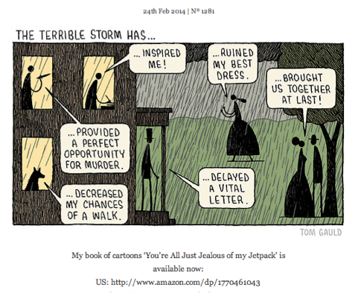
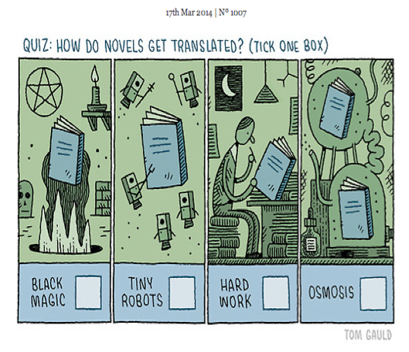
Web Comics: Tom Gauld on Tumblr myjetpack.tumblr.com/
Notes:
type in the chat a graphic novel and material of another format you have used as, or think would make, a good advisory pairing

Slide 23
For further discussion: Q & A
Francisca Goldsmith
francisca@infopeople.org

Slide 24
Infopeople webinars are supported in part by the U.S. Institute of Museum and Library Services under the provisions of the Library Services and Technology Act, administered in California by the State Librarian. This material is licensed under a Creative Commons 3.0 Share & Share-Alike license. Use of this material should credit the author and funding source.

