Slide 1
Today’s webinar is brought to you by Infopeople
Discover more learning opportunities at Infopeople.org
Follow us on Twitter @infotweets

Slide 2
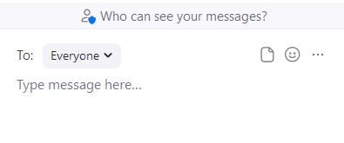
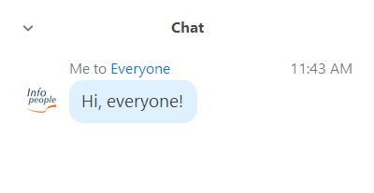
Want to interact with other attendees?
Use the chat!
Have a question for the panel?
Use Q&A!
Click the “Chat” icon
Press “Enter” to send!
Press “Enter” to send!
Choose who can see your messages

Slide 3
Live captioning is available.
Here’s how to access it!
Click the “Live Transcript” icon
Choose how you see the transcript
Select “Show Subtitle” to see captions

Slide 4
Infopeople On-Demand
Infopeople courses at a discounted price.
Repackaged and designed so that learners have unlimited access to materials and can participate at their own pace.
Explore on-demand courses at https://infopeople.teachable.com
Notes:
https://infopeople.teachable.com/

Slide 5
Other Upcoming Trainings
Little Makers: Program Planning and Implementation (Webinar)
Normalizing Discussions of Race with Children (Course)
Practicing Inclusion: Welcoming Transgender Customers and Colleagues (Webinar)
Technology in Libraries (Course)

Slide 6
Welcome

Slide 7
Libraries Hustle Hard

Slide 8
Covid, Monkeypox, and the Next Pandemic: How Libraries Can Prepare

Slide 9
Today’s Presenters
Dr. Catherine Troisi
Associate Professor in the Divisions of Management, Policy, and Community Health and Epidemiology at the UTHealth Houston School of Public Health.
Nicholas Brown
Acting Co-CEO and Chief Operating Officer for Communication and Outreach at the Prince George’s County Memorial Library System.

Slide 10
MONKEYPOX: What Librarians Need to Know
Catherine Troisi, PhD
UTHealth School of Public Health, Houston
Texas Epidemic Public Health Institute
Catherine.l.troisi@uth.tmc.edu
20 September 2022

Slide 11
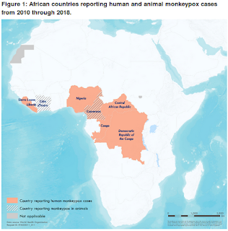
HISTORY
1958 - isolated from macaques but rodents are likely natural reservoir
Large outbreak in Nigeria since 2017
Until 2003, confined to West Africa and Congo Basin
2003 USA – associated with imported Ghanaian rats
Introduced into prairie dogs (pets)
47 cases (72 with suspected)
No human to human transmission; No fatalities
Various small outbreaks during intervening years
2022 – outbreak worldwide
Notes:
Decreasing herd immunity since end of smallpox immunization

Slide 12
TRANSMISSION
Contact with infected lesions or fluids, including old scabs
Contaminated bedding or clothing
Respiratory droplets – seems to require prolonged face to face contact
Human to human; Animal to human; Human to animal
CLINICAL SYMPTOMS
Incubation 5-15 days, up to 21
Initial flu-like; myalgia/malaise, fever, fatigue
Sore throat, cough
Rash Macules appears 1-3 d after fever
Evolve over 3-4 weeks
Infectious throughout

Slide 13
2022: LATEST EPIDEMIOLOGY
As of Sept 14: 61,282 confirmed cases in 104 (97 non-endemic) countries; 20 deaths
Near simultaneous appearance in multiple countries suggests undetected spread
23,499 in US (one death); appear to be declining
High assoc with MSM activity (95% of cases)
38% PLWH
Racial disparities in US (38% of cases in AA)
Atypical presentations
Difficult contact tracing
Personal nature of exposures
Unrecognized cases
Time lag
Notes:
All have rash - but
Often beginning mucosal areas
Scattered or localized
Different stages of progression
Papulovesicular and pustular at same time
Small lesions
Maybe not face or extremities
Not always a prodrome
Not always lymphadenopathy
Coinfections seen with several STIs: chlamydia, HSV, syphilis; others
Careful examination ALL OVER is essential
Have low threshold to test even if other STIs positive

Slide 14
PREVENTION
Smallpox vaccine protective
vaccination halted in US in 1972/1980 globally
Monkeypox vaccine now available (JYNNEOS)
Recommendations for sexual activity
Be aware of signs and symptoms
Discuss with partners
Limit number of partners
Avoid skin to skin contact
Notes:
Live non-replicating based on Modified Vaccine Ankara- Bavarian Nordic
Imvamune, Imvanex, MVA
FDA licensed 2019
For prevention of smallpox and monkeypox for adults at high risk
PrEP and PEP
Available through CDC via health department
Subcutaneous, 2 doses 1 month apart
Licensed as 2 doses regardless of prior vaccination
(but data supports good results after 1 if previously vaccinated against smallpox)
Less side effects

Slide 15
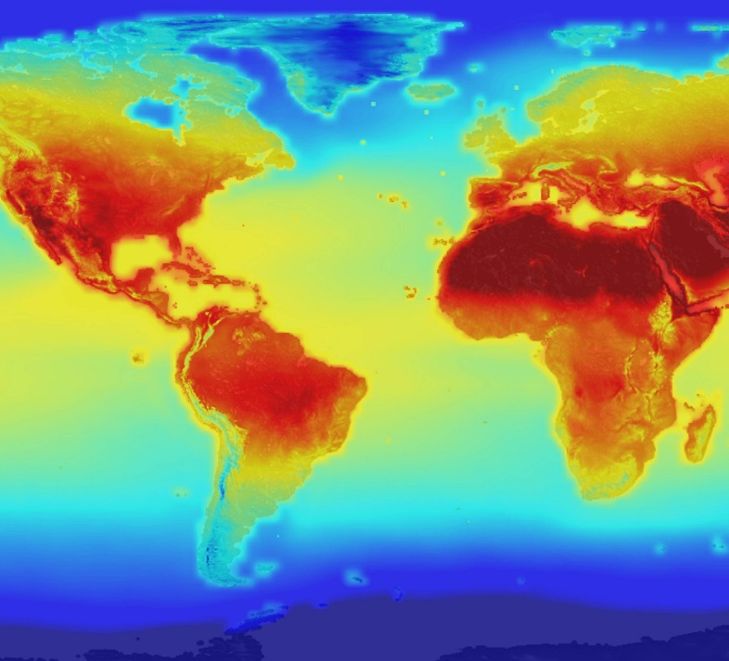
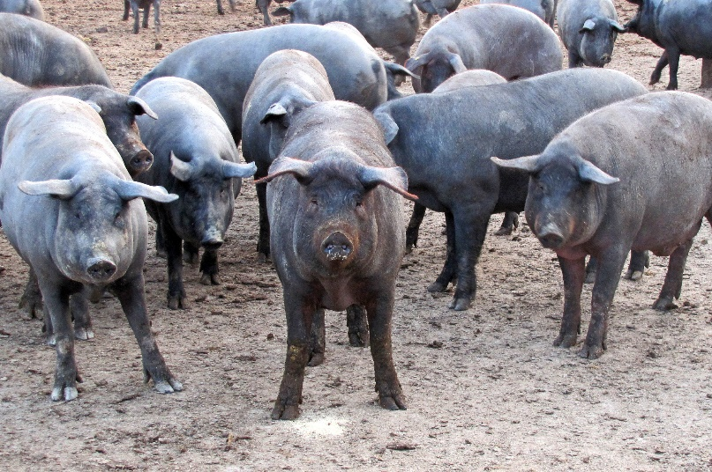
What’s ahead?
>2/3 new and emerging infections in humans come from animals
Increasing contact with animals
deforestation
large urban areas
climate change
Rapid and increased global travel
This Photo by Unknown Author is licensed under CC BY
This Photo by Unknown Author is licensed under CC BY-NC
This Photo by Unknown Author is licensed under CC BY-SA

Slide 16
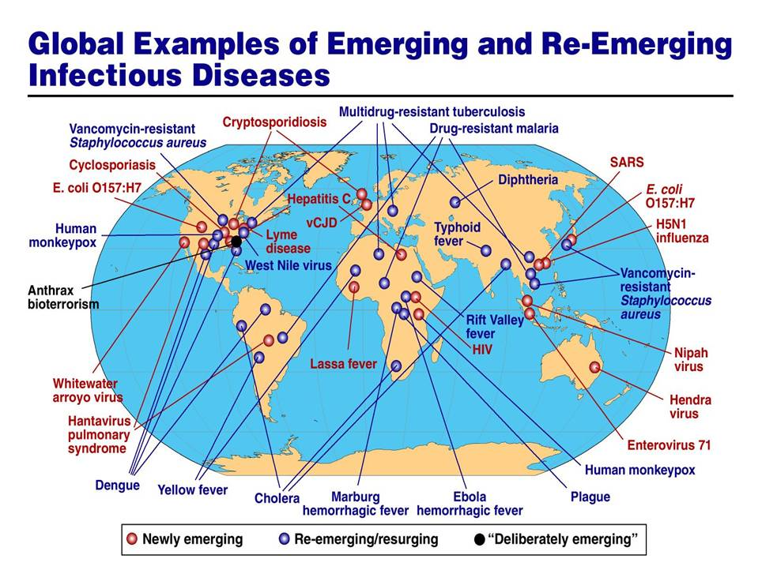
Source: Dr. Anthony Fauci, 2005

Slide 17
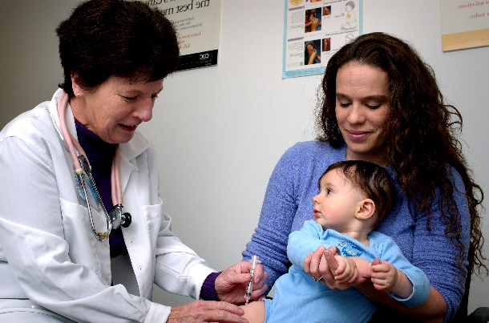
Why are we concerned about Emerging/Reemerging Infectious Diseases?
These diseases:
Pose a threat to all persons regardless of age, sex, lifestyle, ethnic background, or socioeconomic status
Cause suffering and death
Impose a financial burden on society
Notes:
New infections will continue to appear and organisms that have caused us illness will continue to evolve into different forms.
Our close association with animals, both domestic and wild, has led to species transfer and several new diseases appearing in humans. This has been the commonest cause of new communicable diseases and is likely to be their main source in the future.
More stringent methods need to be used to prevent this animal–human contact, including the modification of feeding and husbandry practices of domestic animals that might have an effect on human health.
Sadly, several serious infections have resulted from the excessive use – and often misuse – of antimicrobials, while terrorists have used disease organisms to attack people.
Basic methods of cleanliness, antisepsis and careful control of organisms and treatments will go a long way to reducing these threats, but new methods are required.

Slide 18
Everyone is not treated equally, especially in a pandemic.
Yale Medicine, 8 Lessons We Can Learn From the COVID-19 Pandemic
Notes:
https://www.yalemedicine.org/news/8-lessons-covid-19-pandemic
https://www.yalemedicine.org/news/8-lessons-covid-19-pandemic
Telehealth booths in delaware article
https://www.wdel.com/news/delaware-expanding-library-telehealth-kiosk-program/article_29202916-11bd-11ed-8b8e-d398281af20a.html
Delaware telehealth shoutout
QR code
https://www.wdel.com/news/delaware-expanding-library-telehealth-kiosk-program/article_29202916-11bd-11ed-8b8e-d398281af20a.html

Slide 19
“Stigma and discrimination can be as dangerous as any virus, and can fuel the outbreak.”
Dr Tedros Adhanom Ghebreyesus, World Health Organization Director-General
Notes:
Dr Tedros, WHO Director-General Dr Tedros Adhanom Ghebreyesus
https://www.who.int/publications/m/item/monkeypox--covid-19---other-global-health-issues-virtual-press-conference-transcript---27-july-2022
https://www.yalemedicine.org/news/8-lessons-covid-19-pandemic
Telehealth booths in delaware article
https://www.wdel.com/news/delaware-expanding-library-telehealth-kiosk-program/article_29202916-11bd-11ed-8b8e-d398281af20a.html
Delaware telehealth shoutout
QR code
https://www.wdel.com/news/delaware-expanding-library-telehealth-kiosk-program/article_29202916-11bd-11ed-8b8e-d398281af20a.html

Slide 20
We need to take mental health seriously.
Yale Medicine, 8 Lessons We Can Learn From the COVID-19 Pandemic
Notes:
https://www.yalemedicine.org/news/8-lessons-covid-19-pandemic
https://www.yalemedicine.org/news/8-lessons-covid-19-pandemic
Telehealth booths in delaware article
https://www.wdel.com/news/delaware-expanding-library-telehealth-kiosk-program/article_29202916-11bd-11ed-8b8e-d398281af20a.html
Delaware telehealth shoutout
QR code
https://www.wdel.com/news/delaware-expanding-library-telehealth-kiosk-program/article_29202916-11bd-11ed-8b8e-d398281af20a.html

Slide 21
Prevention is better than cure - we must learn to listen to science.
Forbes, Four Lessons We Should Learn From The Pandemic
Notes:
2) Prevention is better than cure - we must learn to listen to science
https://www.forbes.com/sites/georgkell/2020/04/11/four-lessons-we-should-learn-from-the-pandemic/?sh=6deb97a96370
https://www.yalemedicine.org/news/8-lessons-covid-19-pandemic
Telehealth booths in delaware article
https://www.wdel.com/news/delaware-expanding-library-telehealth-kiosk-program/article_29202916-11bd-11ed-8b8e-d398281af20a.html
Delaware telehealth shoutout
QR code
https://www.wdel.com/news/delaware-expanding-library-telehealth-kiosk-program/article_29202916-11bd-11ed-8b8e-d398281af20a.html

Slide 23
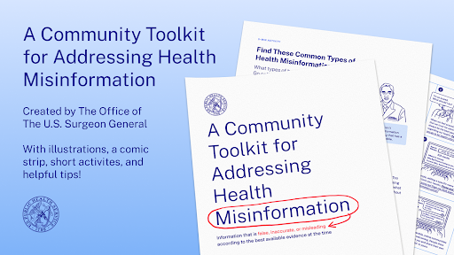
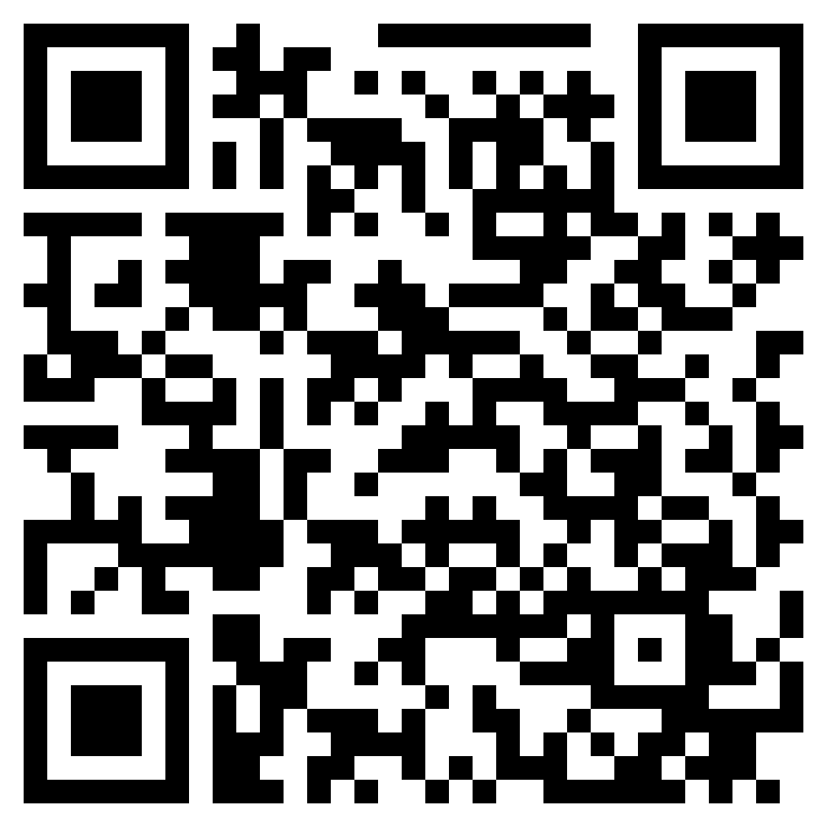
From the Office of the U.S. Surgeon General
Notes:
URL for health information kit:
https://oes.gsa.gov/collaborations/misinformation-toolkit/

Slide 24
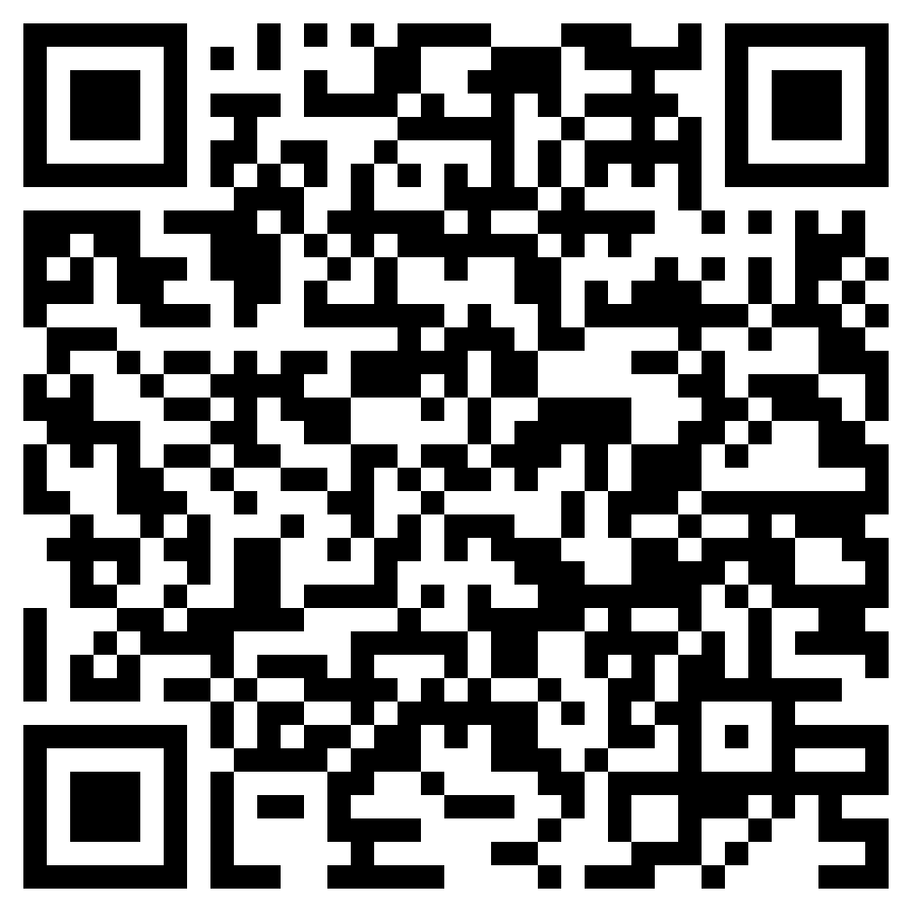
Resources Mentioned Today

Slide 25
Questions?

Slide 26
Thank you
Notes:
Thanks to all of you for all you do! We appreciate it! And we want more of your feedback!

Slide 27
Contact
Veronda Pitchford
Assistant Director, Califa Group
veronda@califa.org

