Slide 1

LITTLE MAKERS: PROGRAM PLANNING AND IMPLEMENTATION
Sept. 21, 2022
Gail Zachariah, Keene Public Library
Amy Kraemer, Keene Public Library
Lisa Regalla, Regallium Consulting
This project was made possible in part by the Institute of Museum and Library Services (#LG-95-18-0191-18).

Slide 2
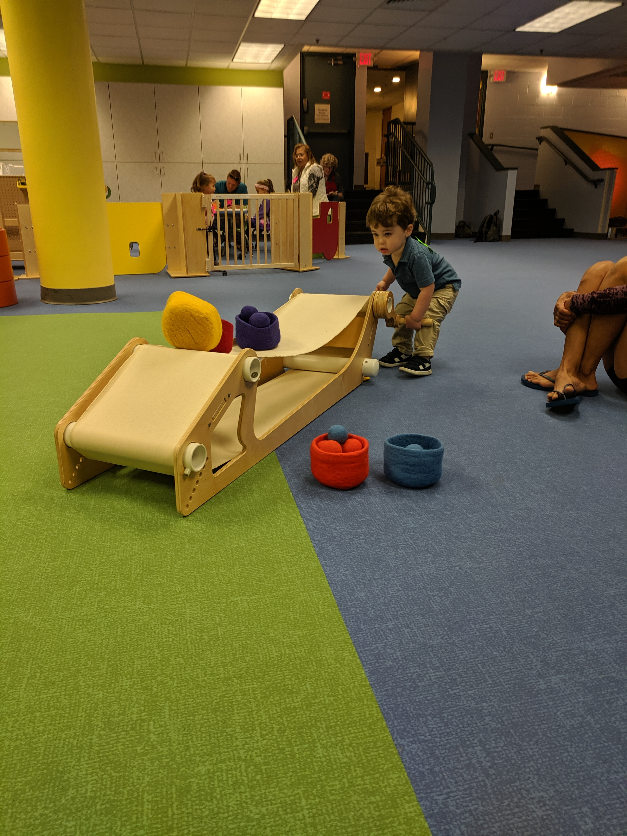
LITTLE MAKERS
Playful Process
Co-learning
Demystifying STEM
Parents and caregivers as key participants

Slide 3
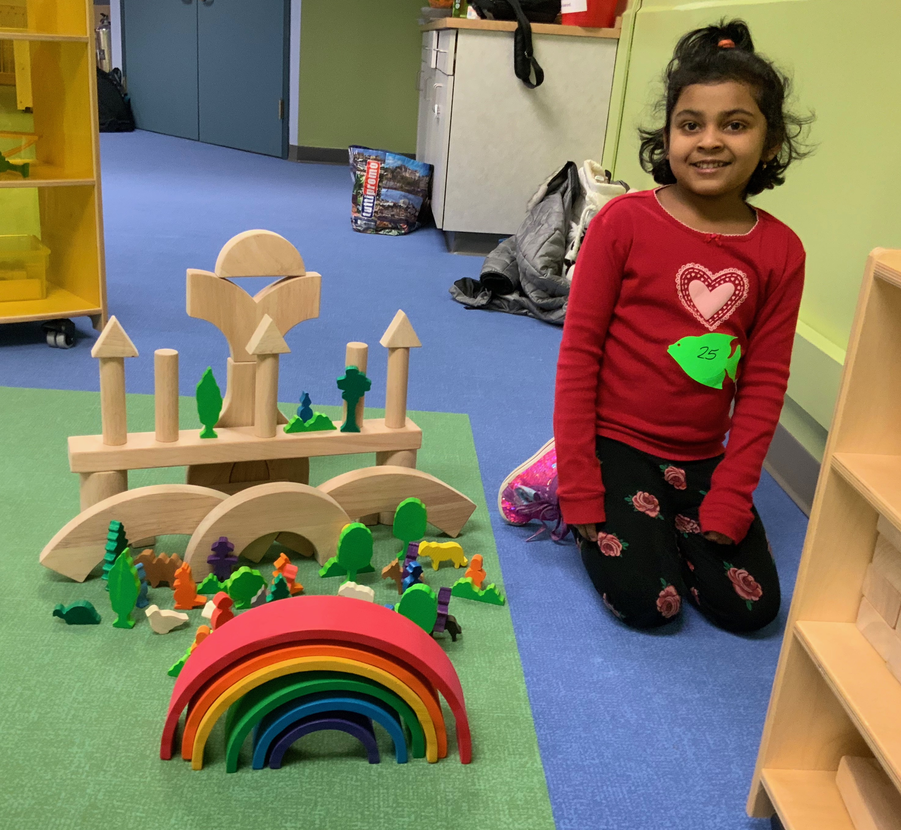
DEMOGRAPHICS
Keene, NH (Population 23,281)
Mixed community with a state college and university, yet there is a lot of poverty
Median Income, $57,393
13% of the community living in poverty
History of precision manufacturing;
now declining

Slide 4
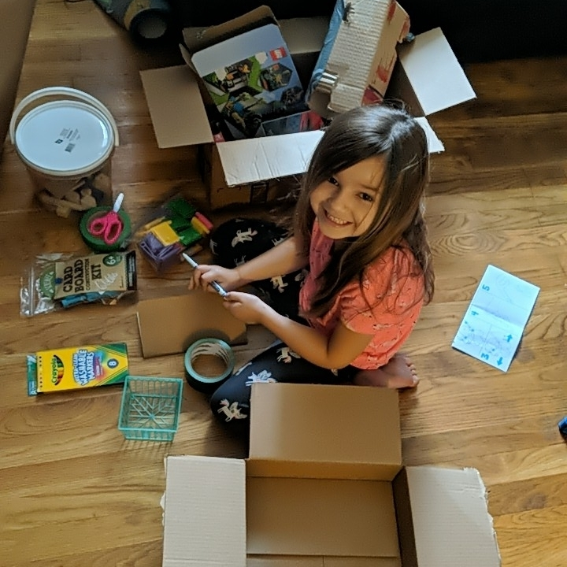
PROJECT GOALS
To engage early learners ages 2 to 6 in STEM, tinkering, and making activities through library programming in and inviting environment
To increase parent/caregiver understanding of the importance of STEM, tinkering, and making activities and efficacy in engaging their children with STEM

Slide 5

AGENDA
Why programming focused on making and tinkering is important for young children and what role libraries can play
In-person programming considerations
  Space, selecting materials and equipment, program length and frequency, prompts and signage
Virtual (at-home) programming
  Program structure, materials and kits, considerations, feedback
Overview of our new free Toolkit!

Slide 6
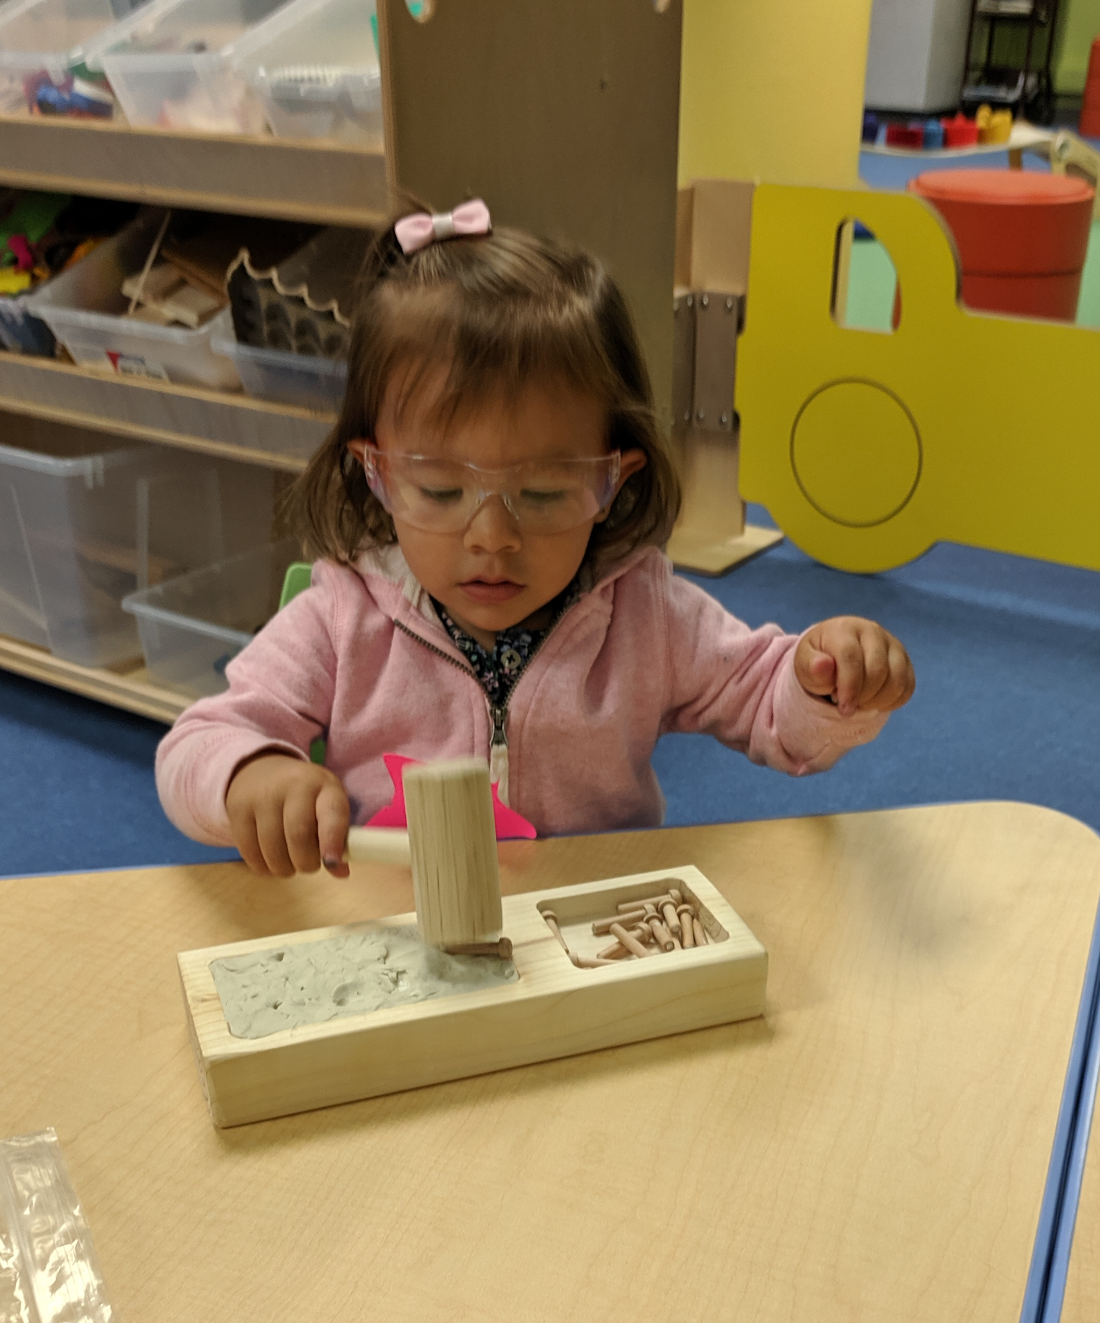
STARTING YOUNG
Early experiences build brain architecture and lay the foundation for lifelong thinking skills
Babies enter the world as scientists!
Early exposure to STEM can foster curiosity and build critical thinking skills
However, many adults aren’t comfortable incorporating STEM into everyday learning experiences

Slide 7
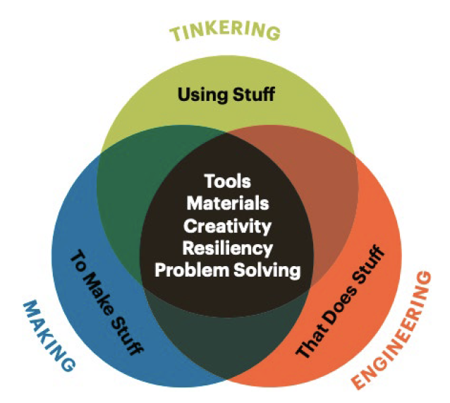
TINKER, MAKE, ENGINEER
Early childhood is the prime time to explore making and tinkering!
Making and tinkering encourage and amplify children’s creative ambitions and self-directed learning. This can help build executive function skills.
Many making experiences also involve collaboration, building critical social emotional skills.
National Association for the Education of Young Children (NAEYC)

Slide 8
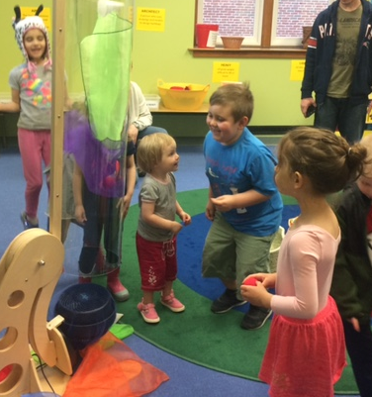
PLAYFUL PROCESS
Play is how children learn
Through a playful lens, the focus is on the process, rather than the end result
The interaction with novel materials and ideas is critical
One of the most authentic ways children can engage in exploration of the world around them is through tinkering!

Slide 9
POLL
Are your programs for children ages 2-6 and their caregivers done…
In-person
Virtually
Combo of both!

Slide 10
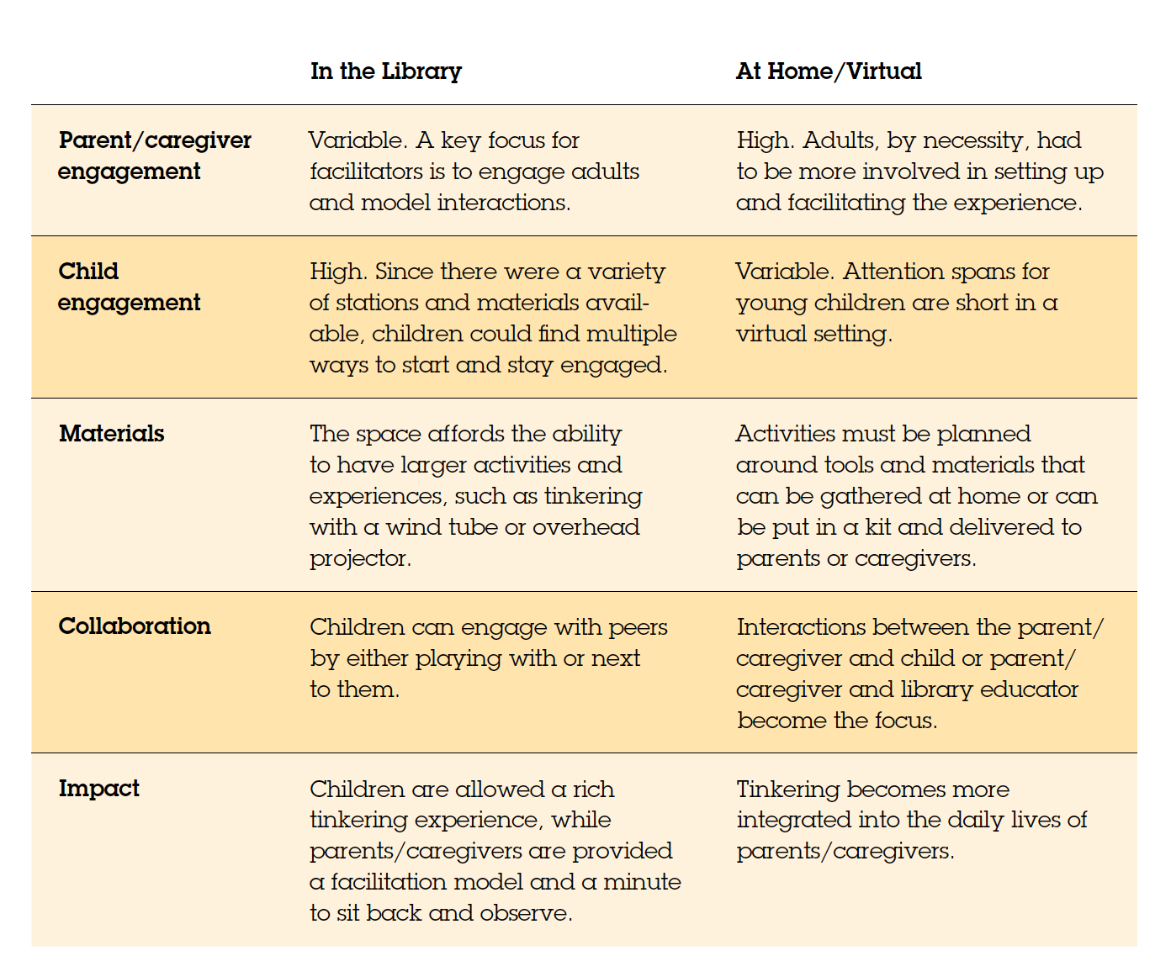
A TALE OF TWO PROGRAMS

Slide 11
A TALE OF TWO PROGRAMS

Slide 12
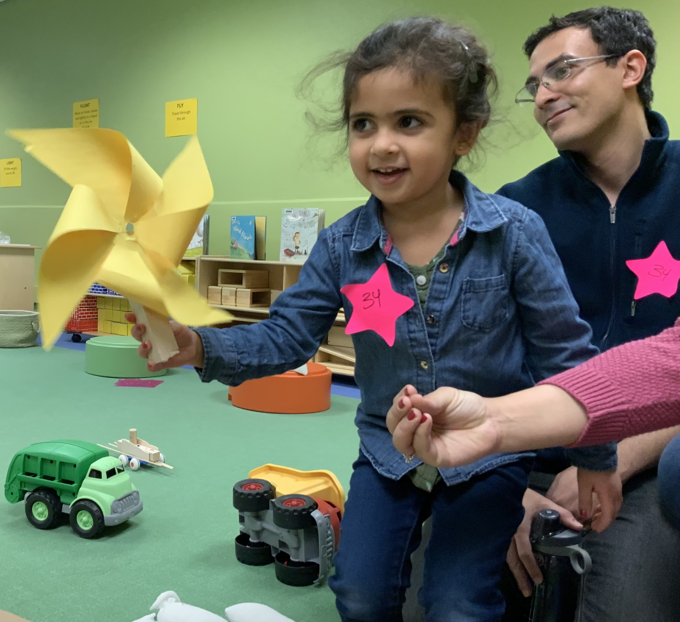
IN-PERSON PROGRAMMING
We started with pop-up events in the Youth Department.
Then we offered 2-hour family events on Saturdays with four activities for children ages 2-6 in a dedicated programming space.
In the summer of 2021, we offered outside programs. Outside we offered fewer activities.
Now we are incorporating Little Makers methods into all of our programs.

Slide 13
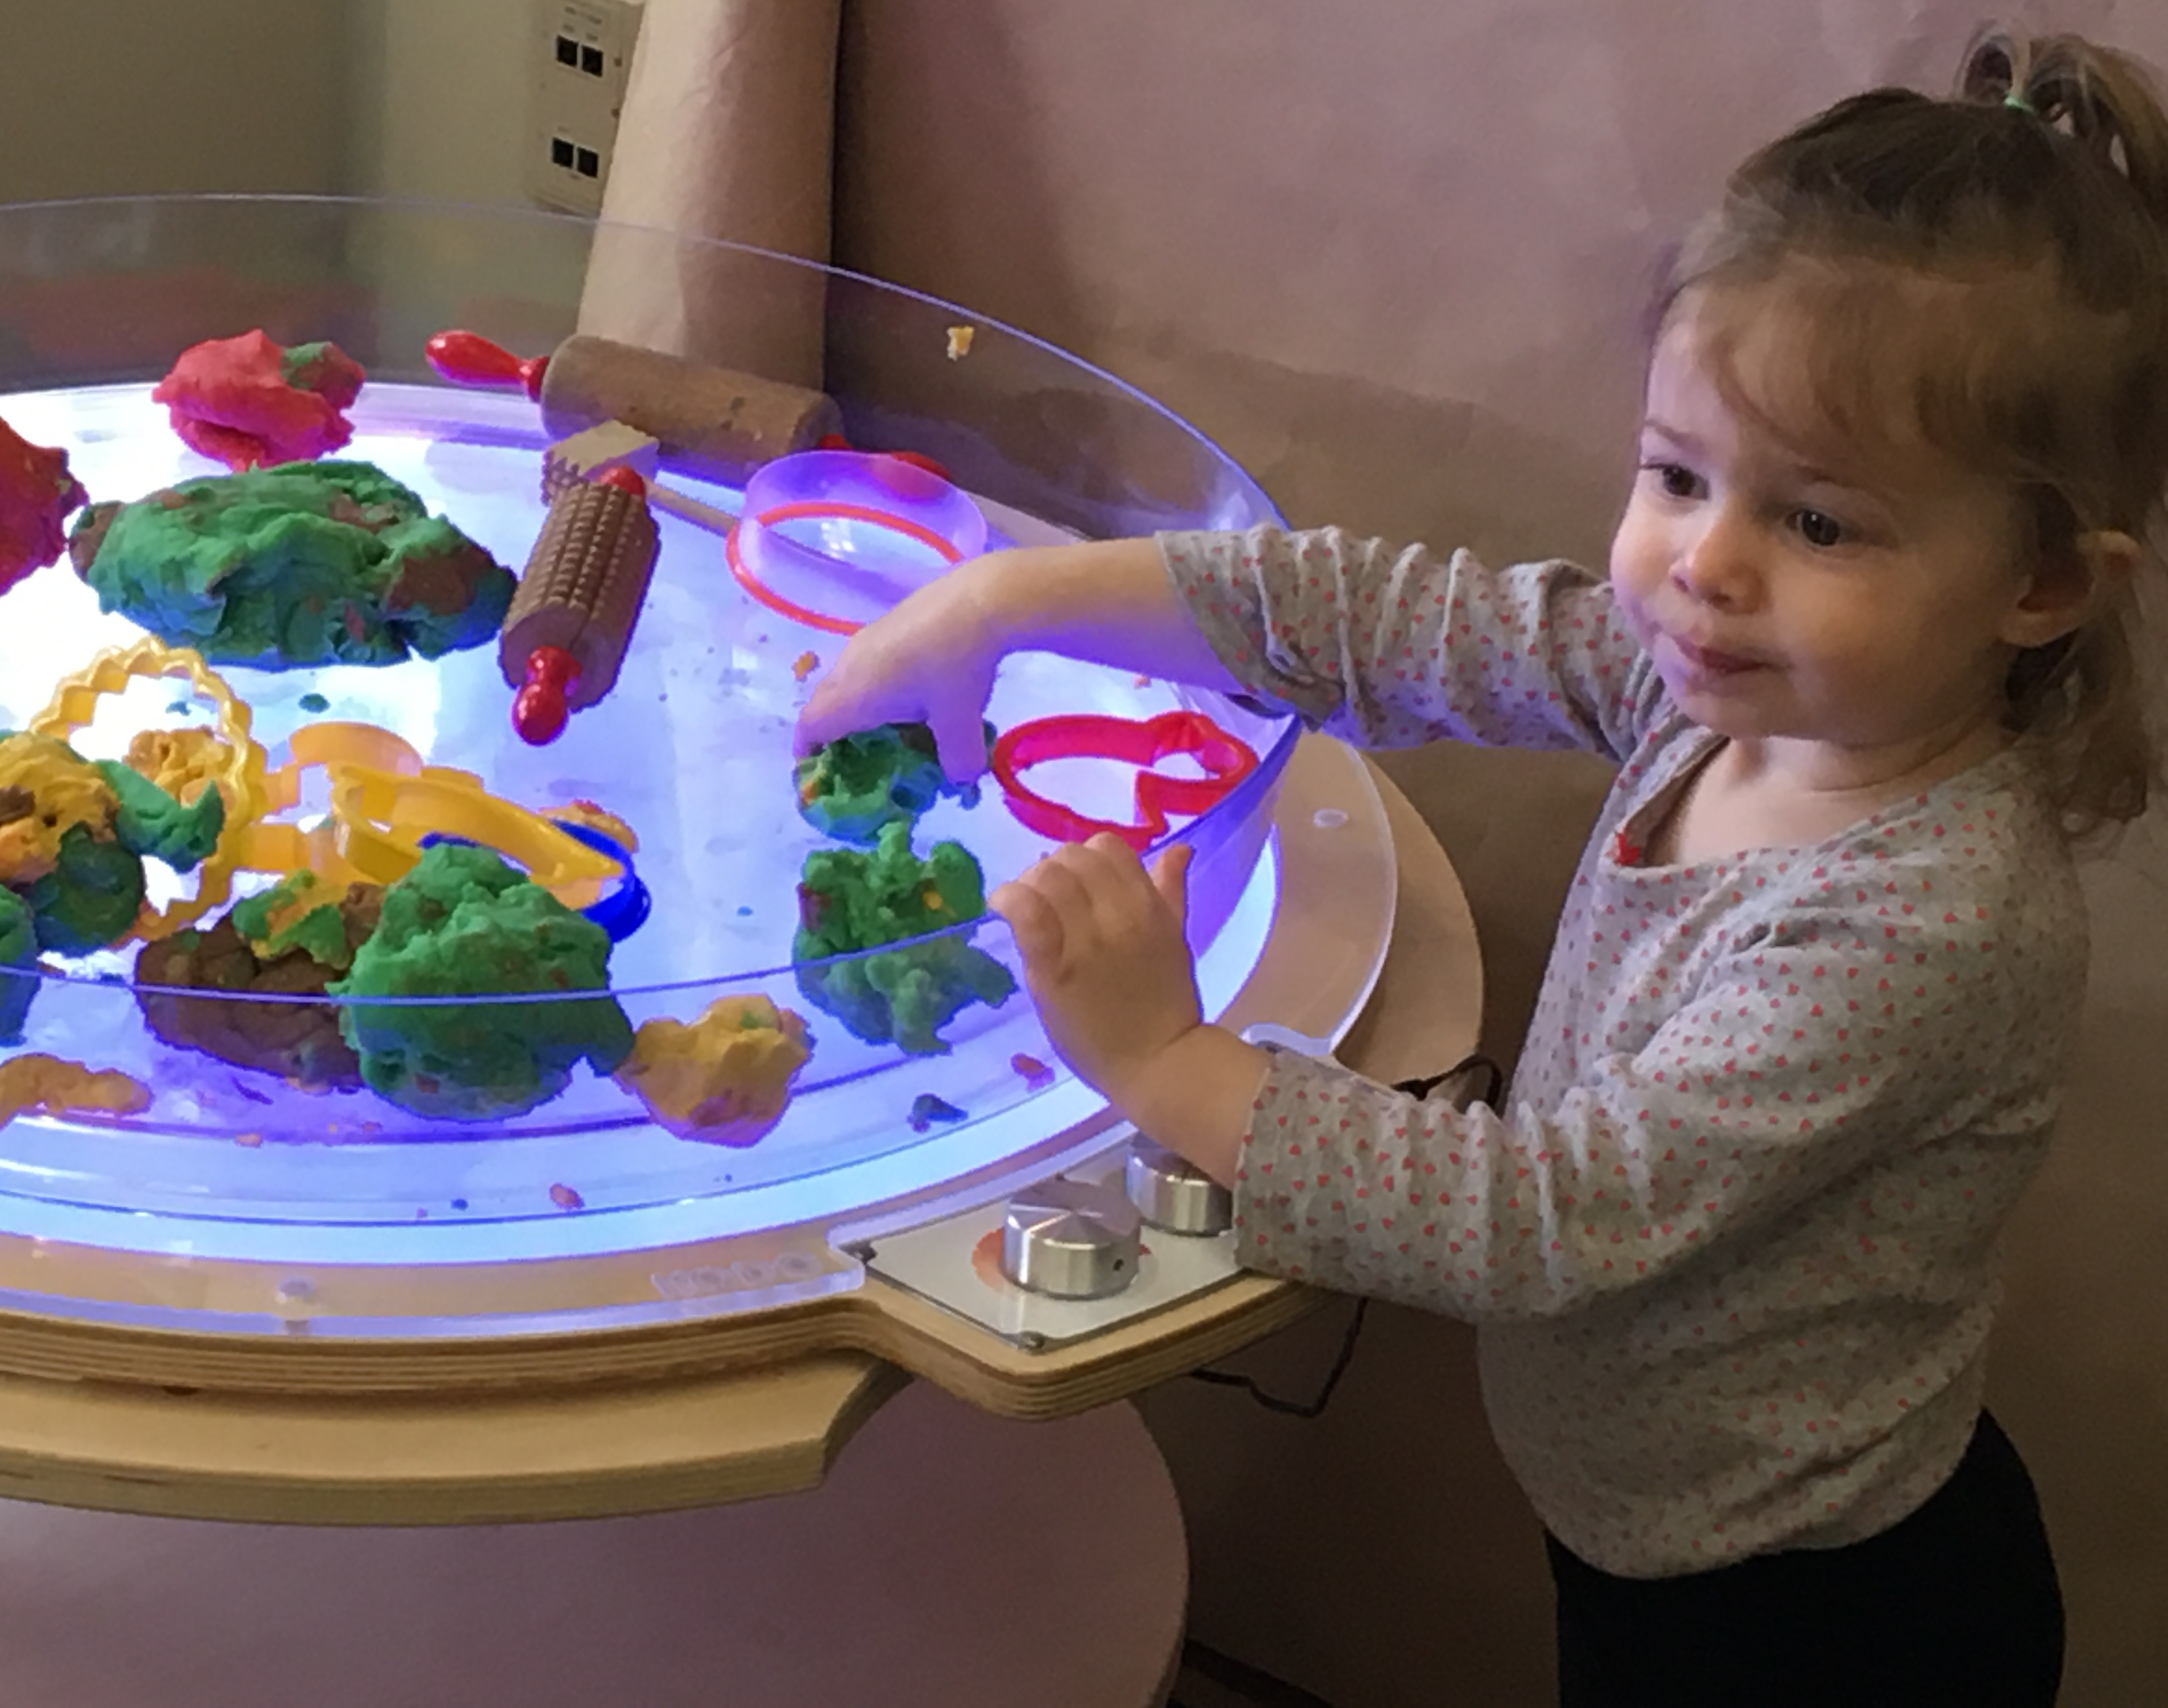
IN-PERSON PROGRAMMING
In-person challenges
  Staffing
  Cleanup and breakdown time
  Adjusting for varying family sizes; 1 adult arrives with more than 3 children
  Setting the expectation for parents to actively participate as their child’s learning partner

Slide 14
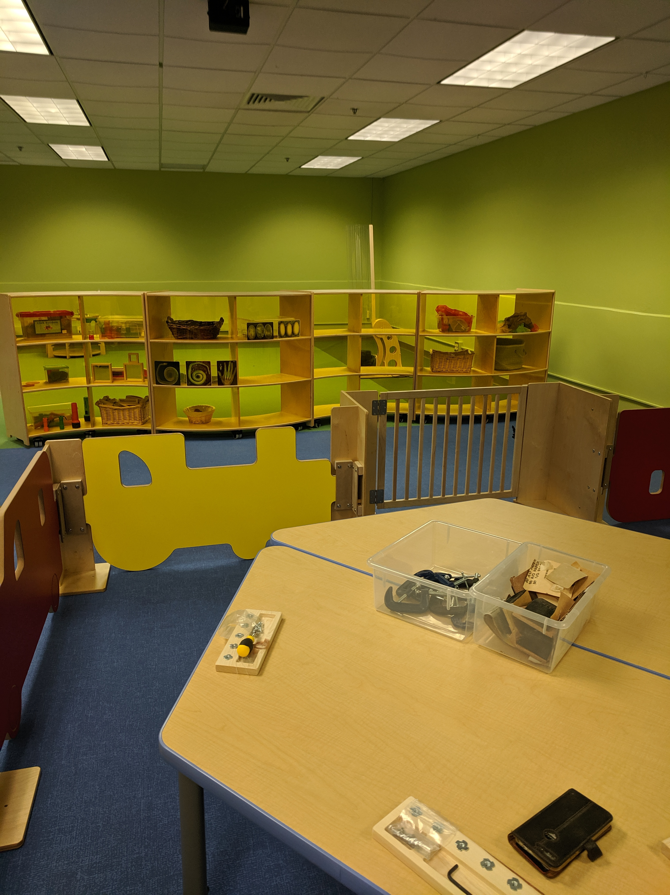
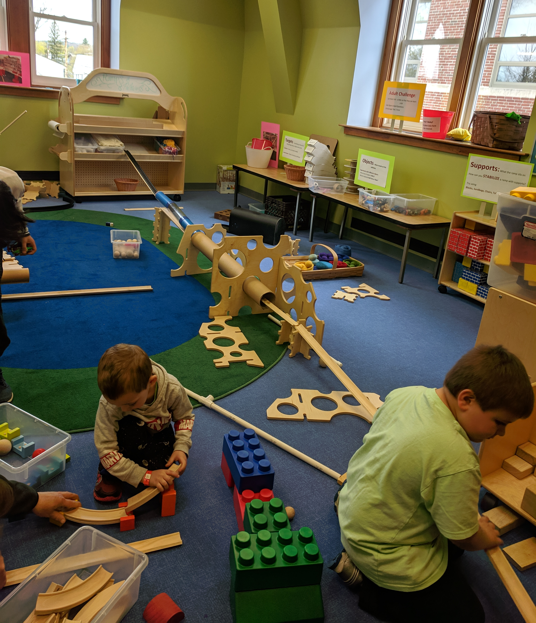
SPACE AFFORDANCES
Larger spaces allow for intentionally created areas for activities with different needs.

Slide 15
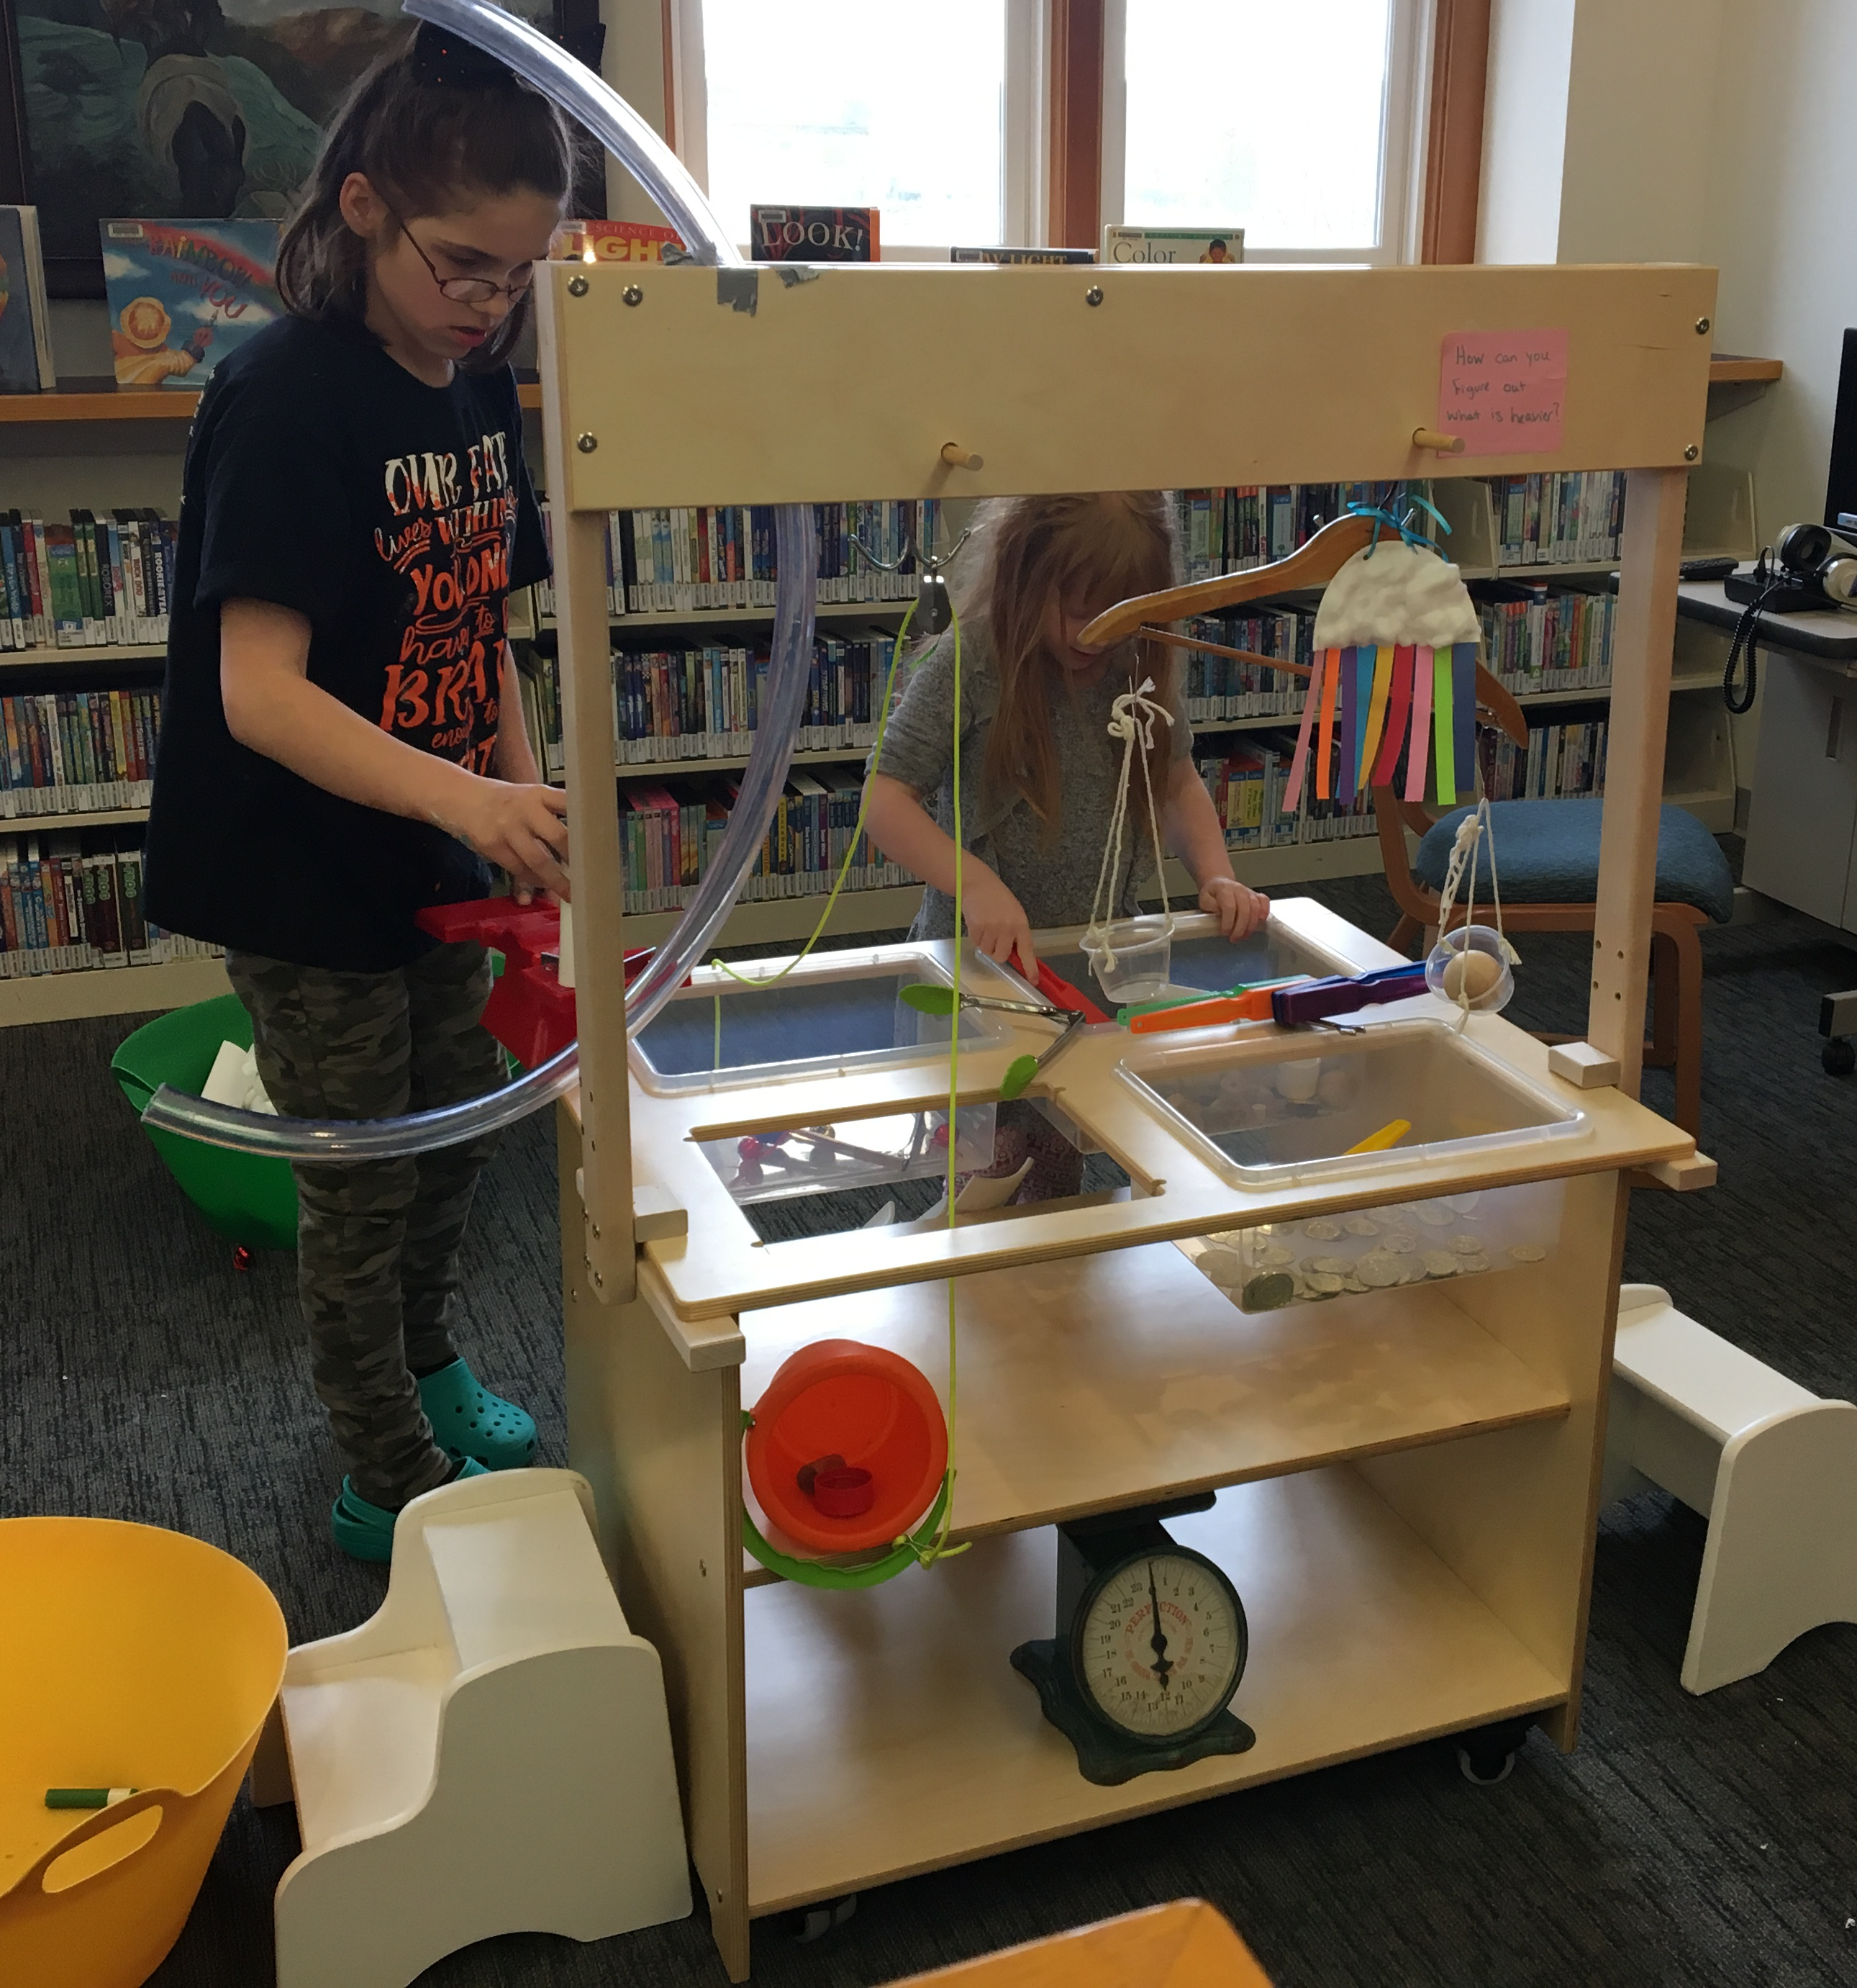
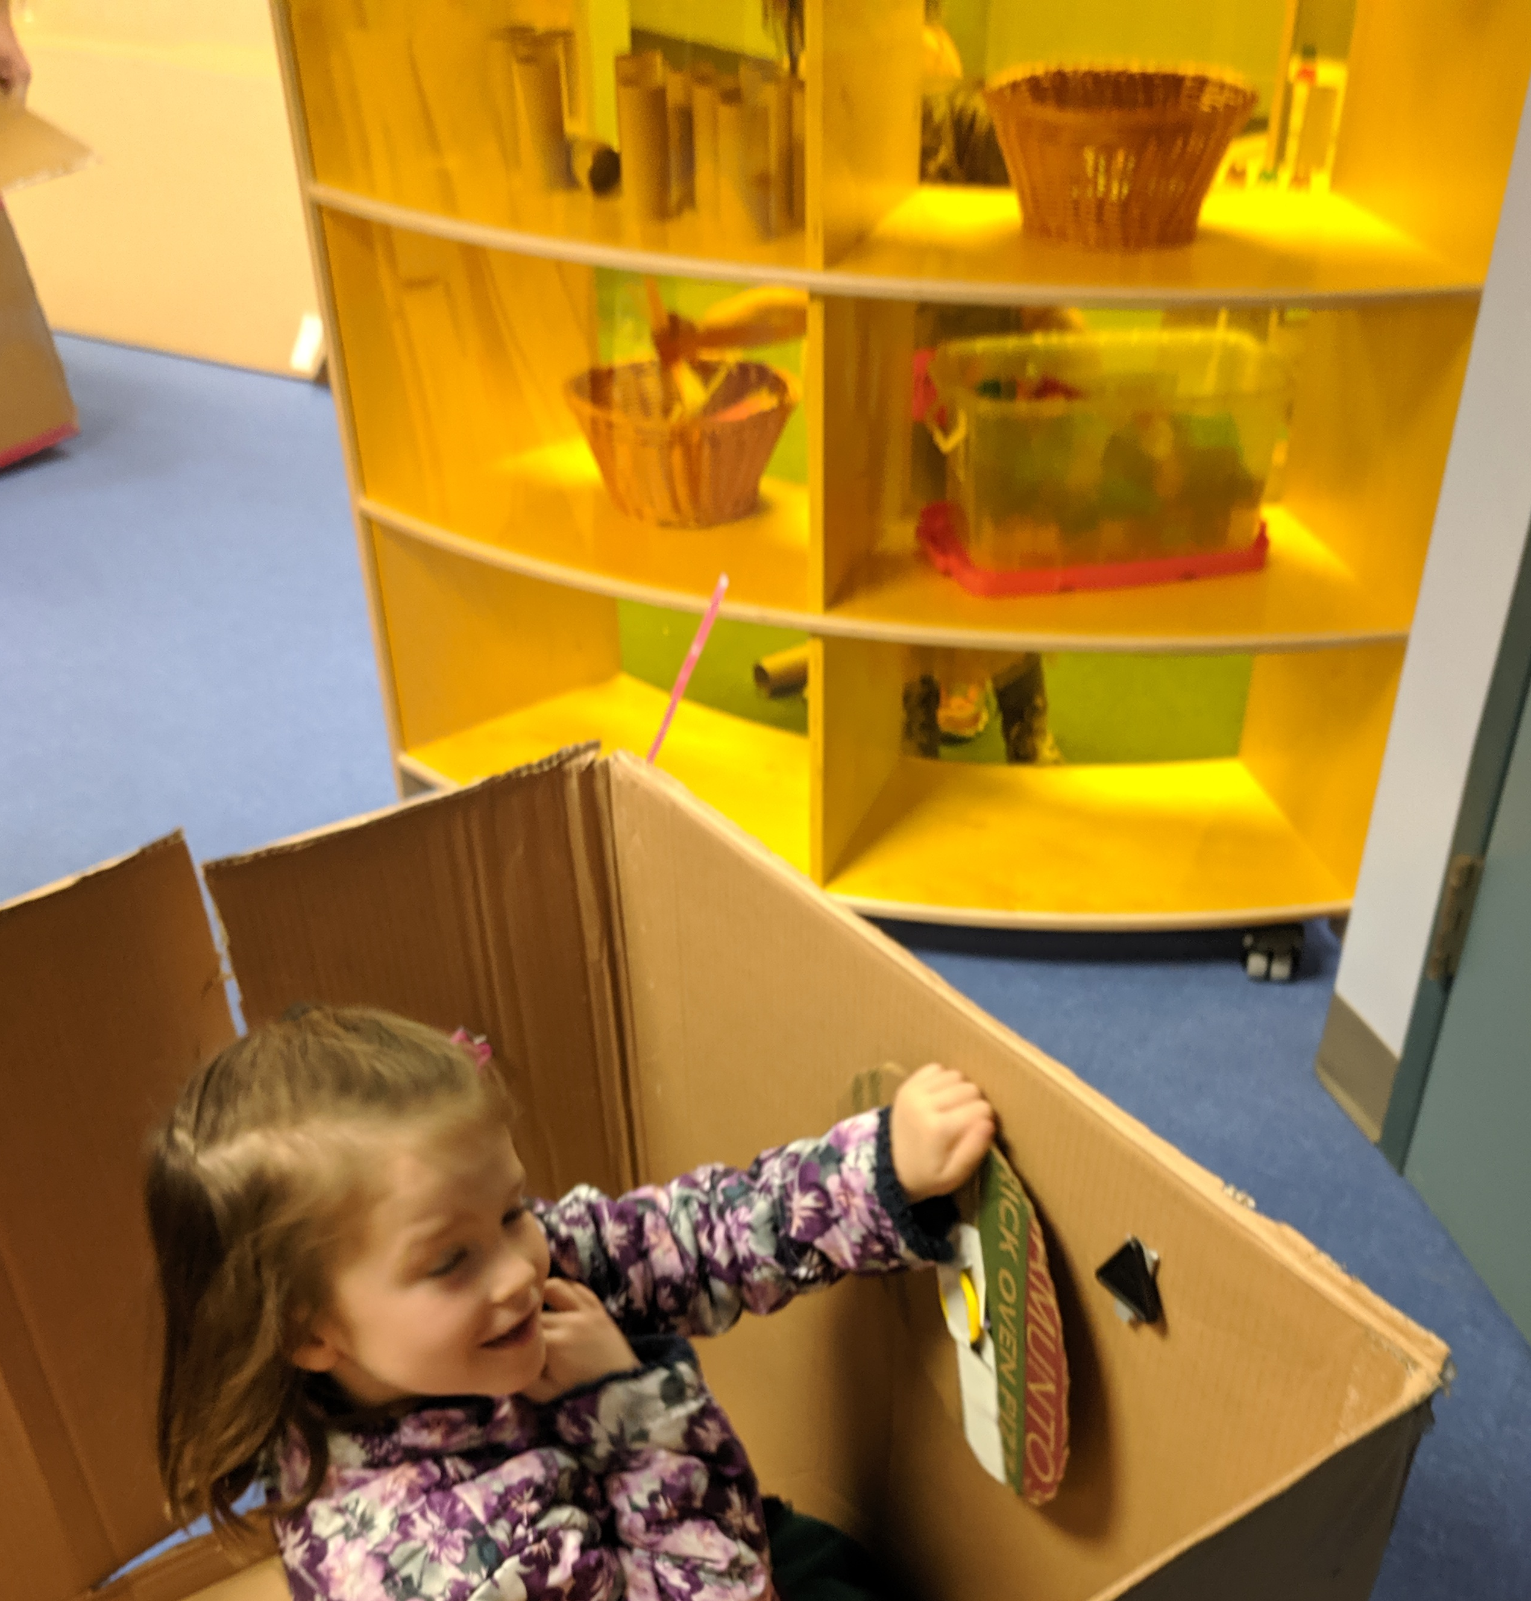
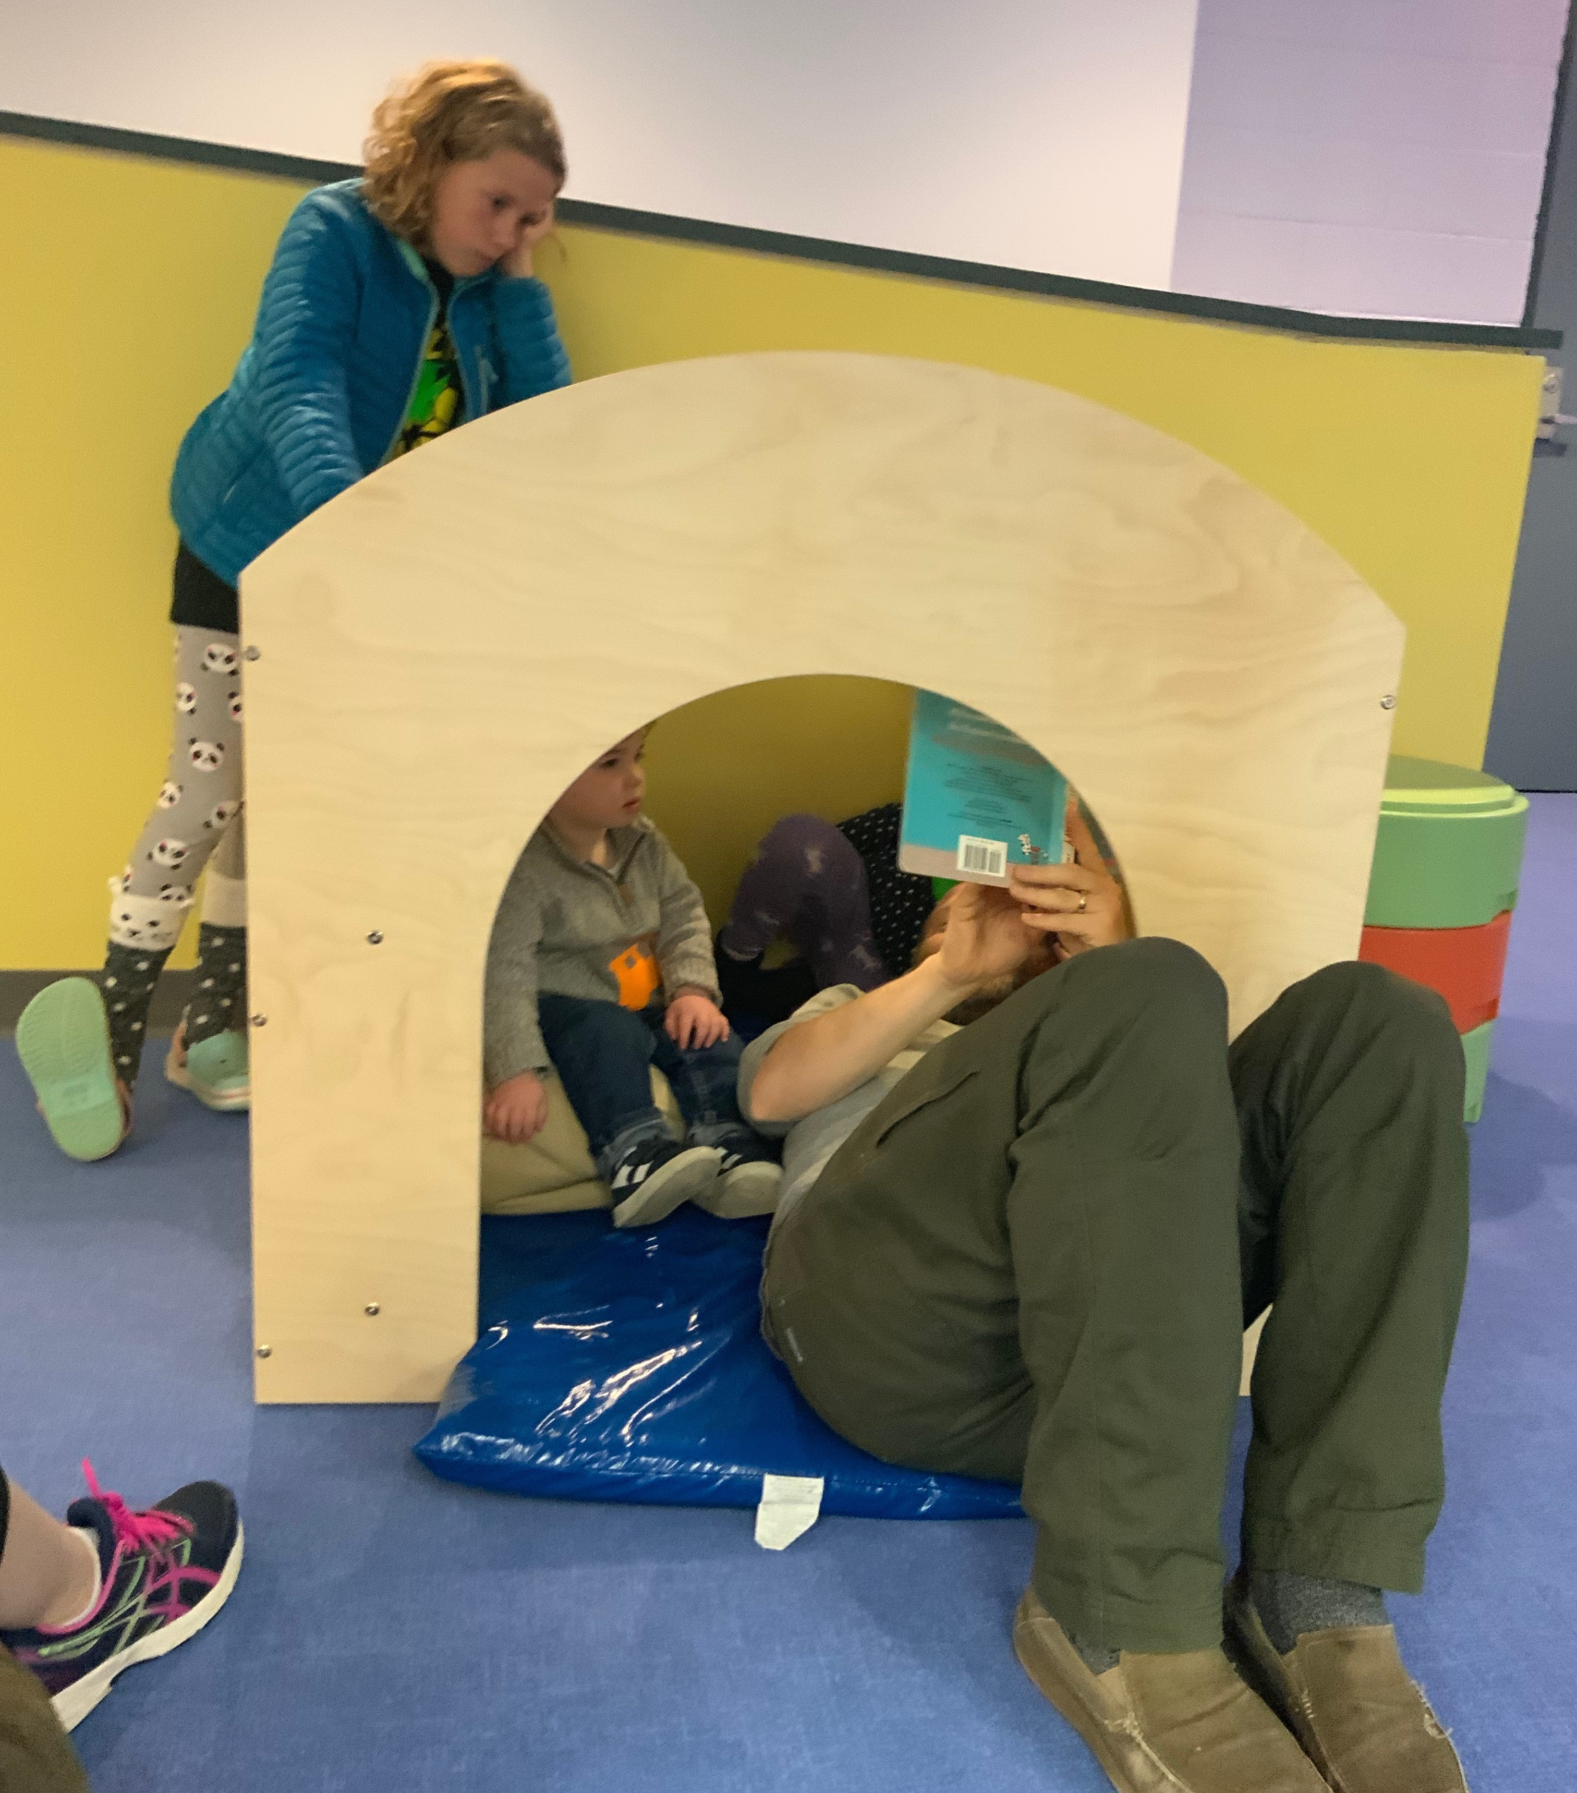
SPACE AFFORDANCES
  Small spaces can encourage collaboration.

Slide 16
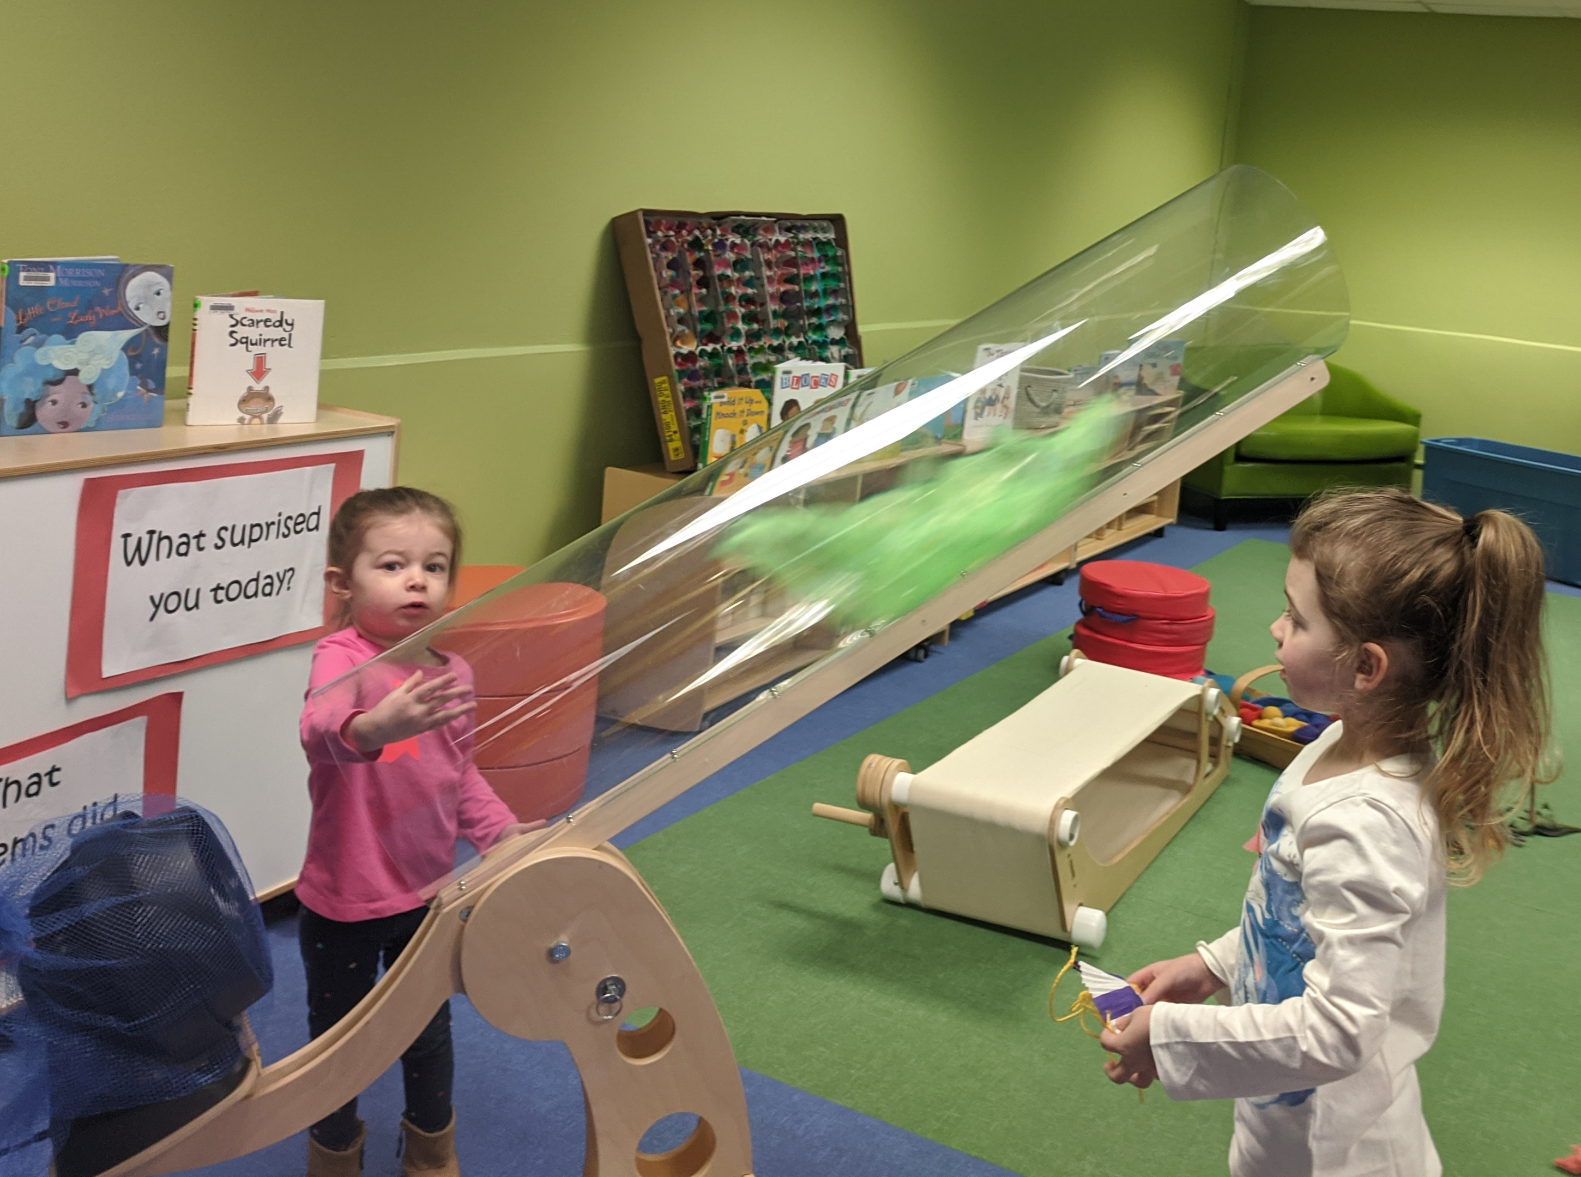
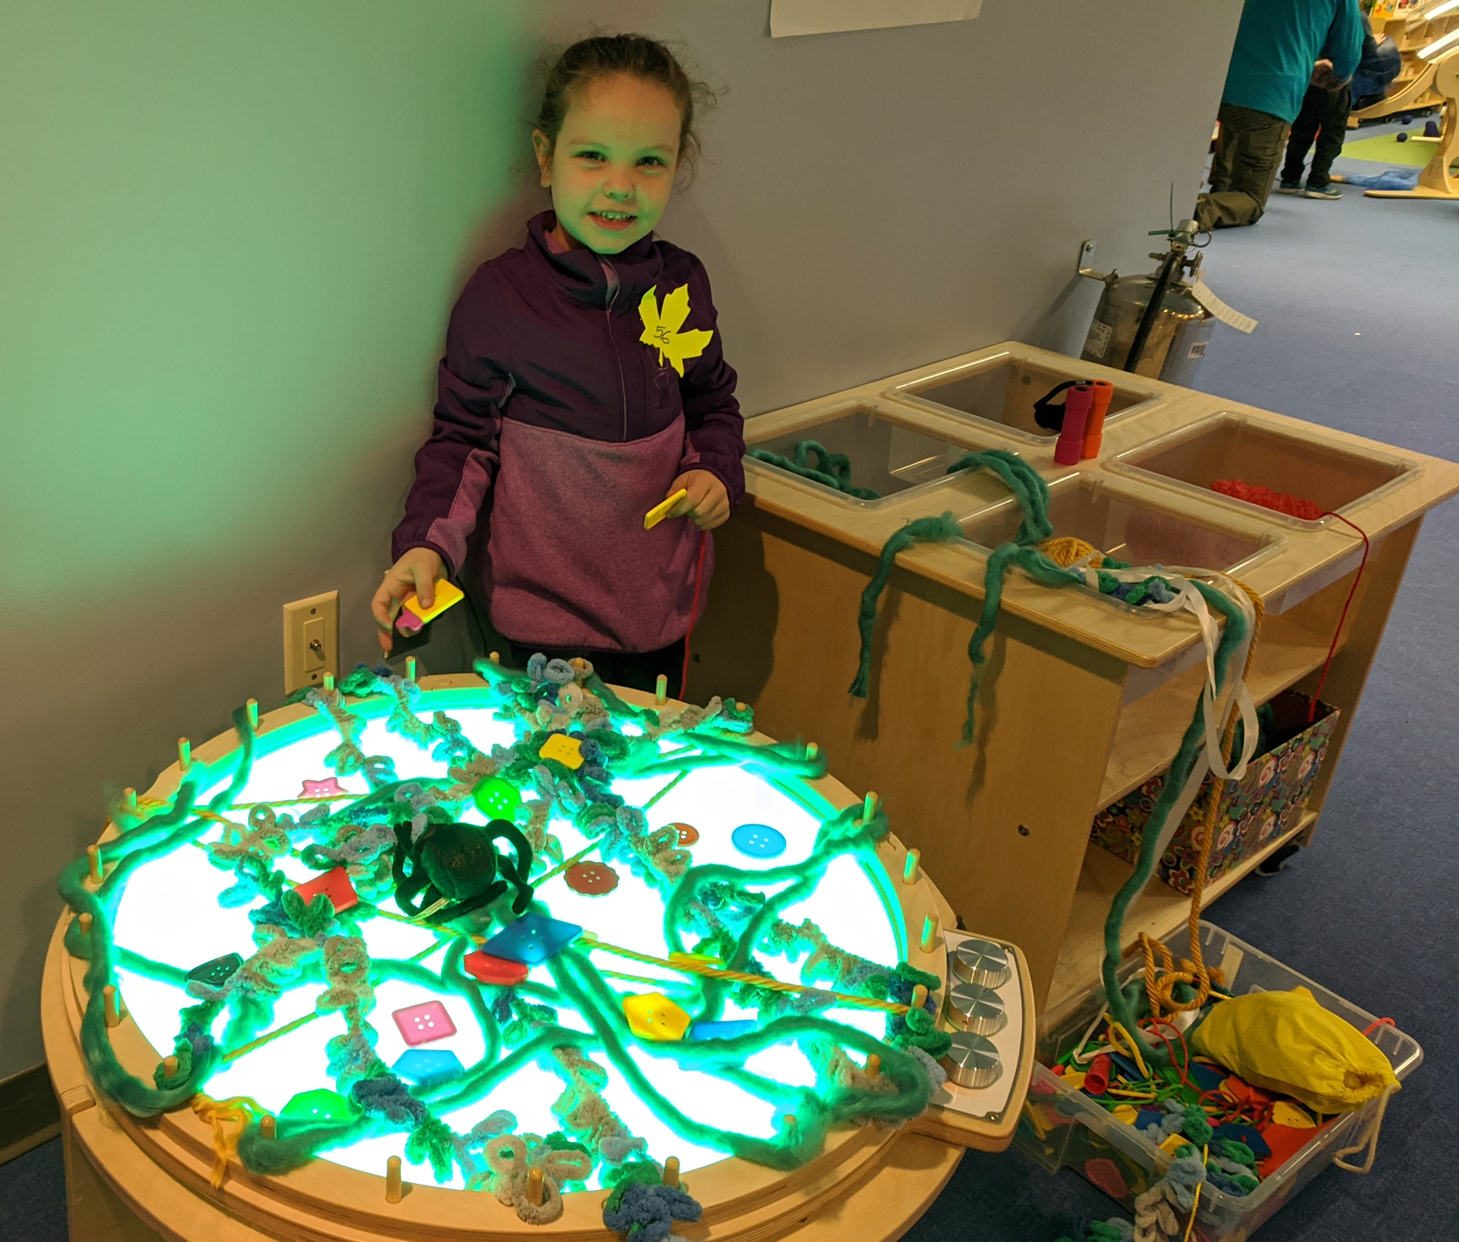
OUR FAVORITE THINGS
Wind tunnel
Color-changing light table

Slide 17
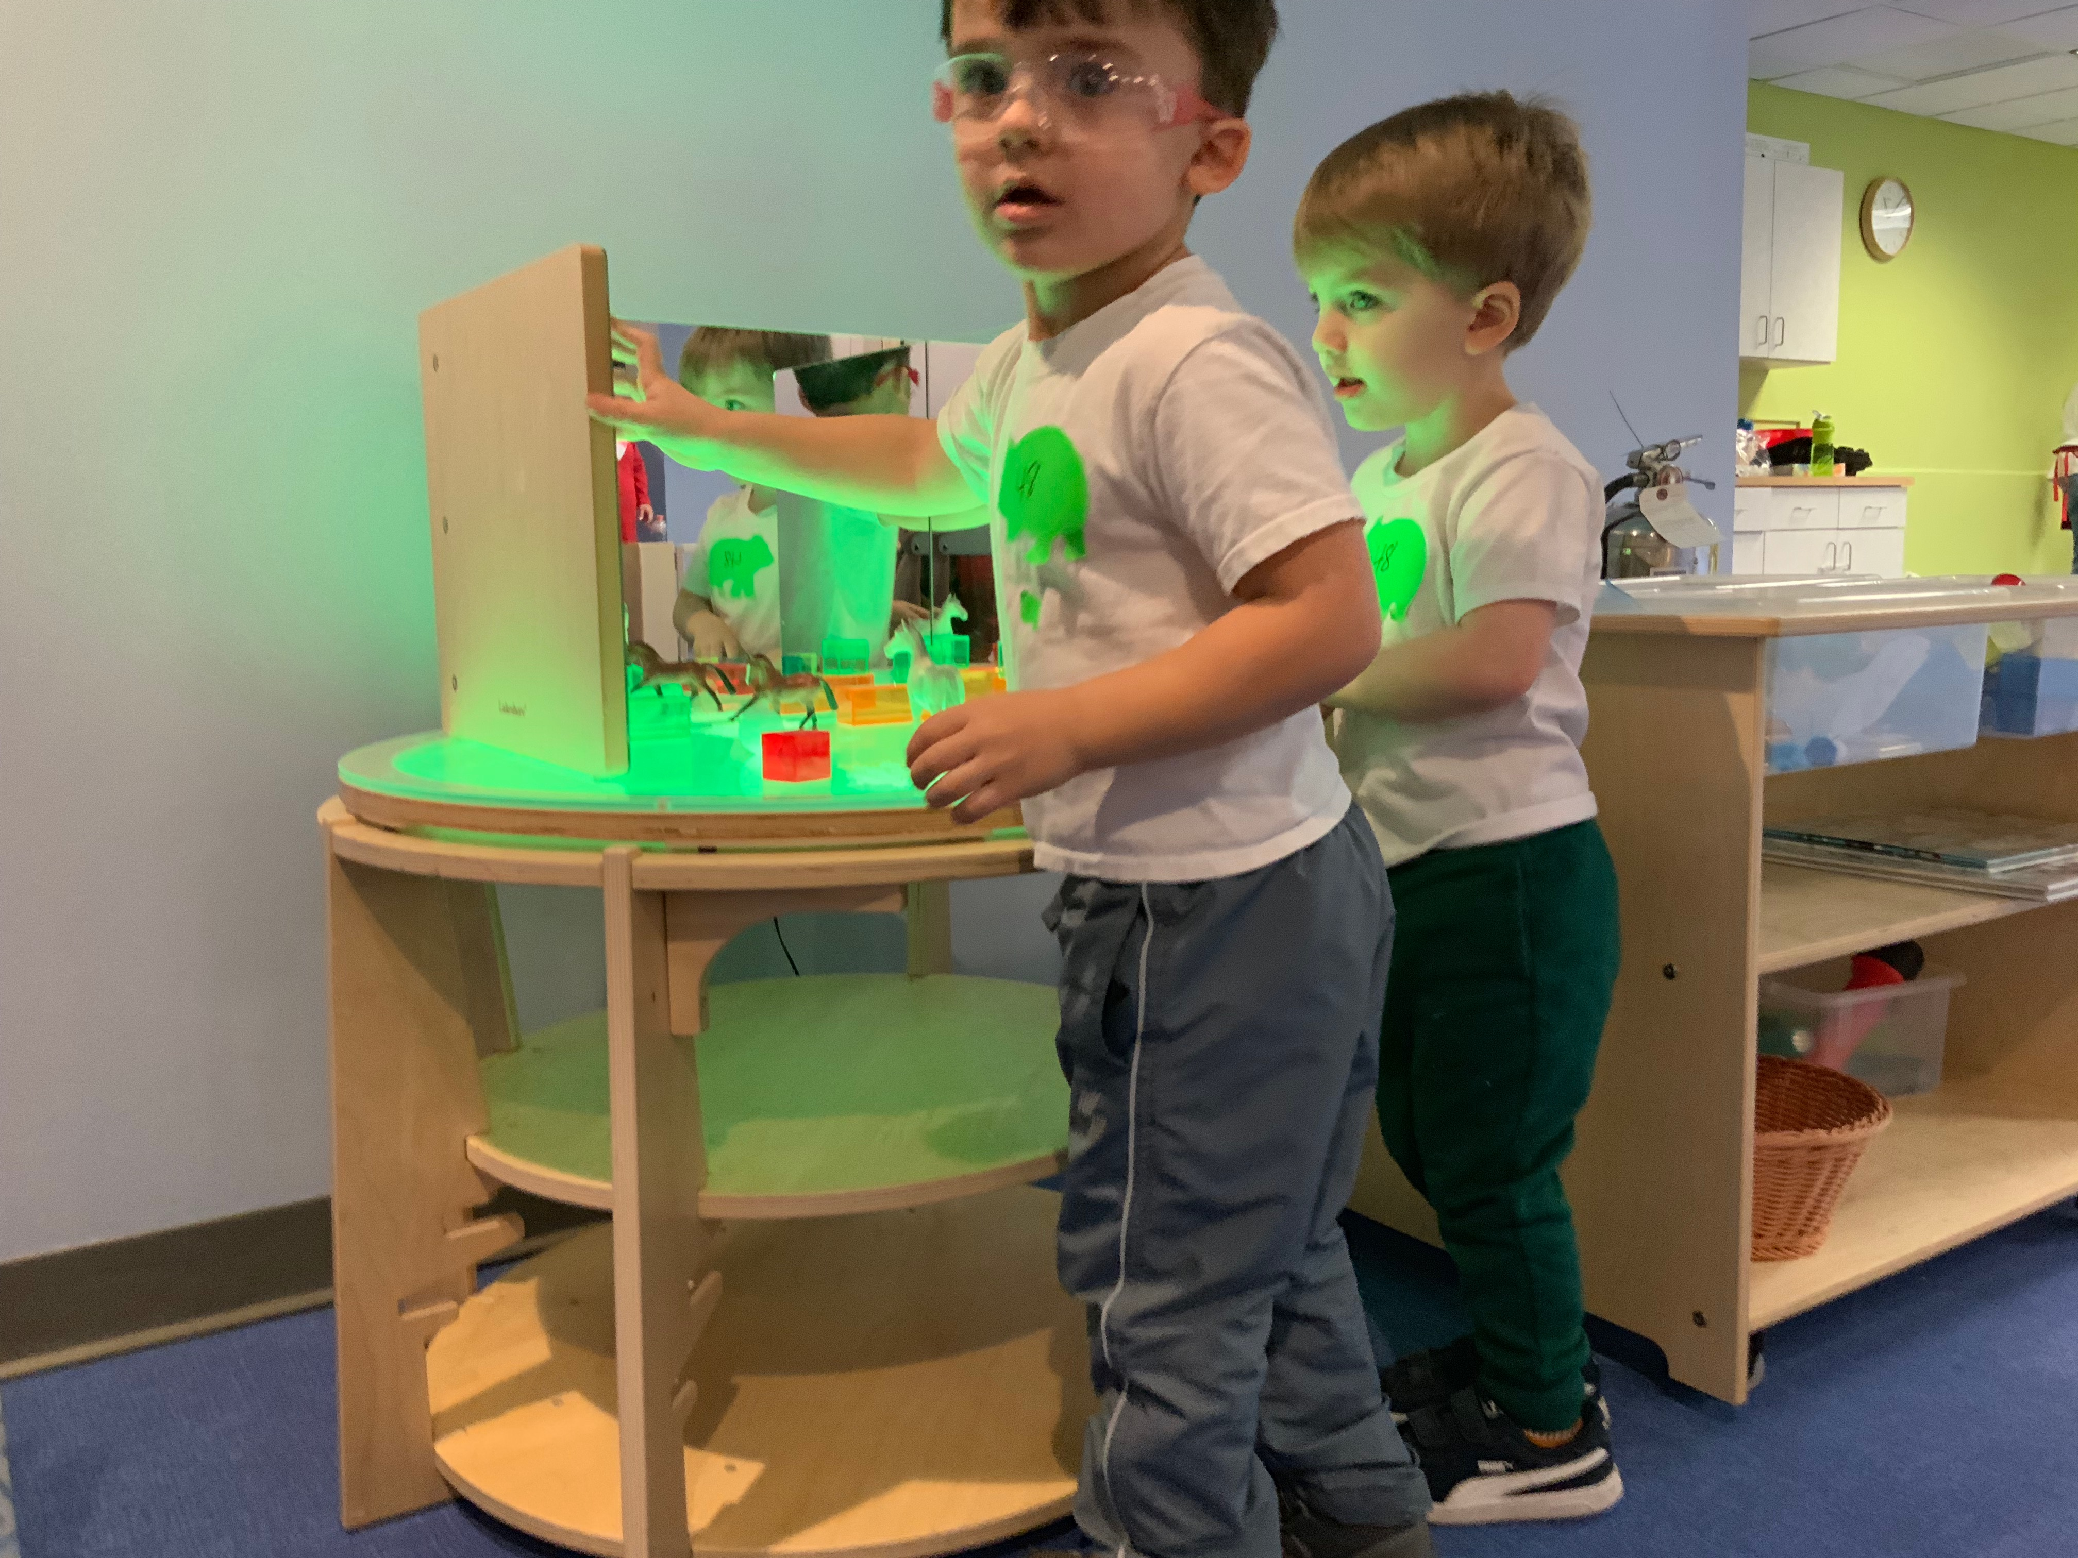
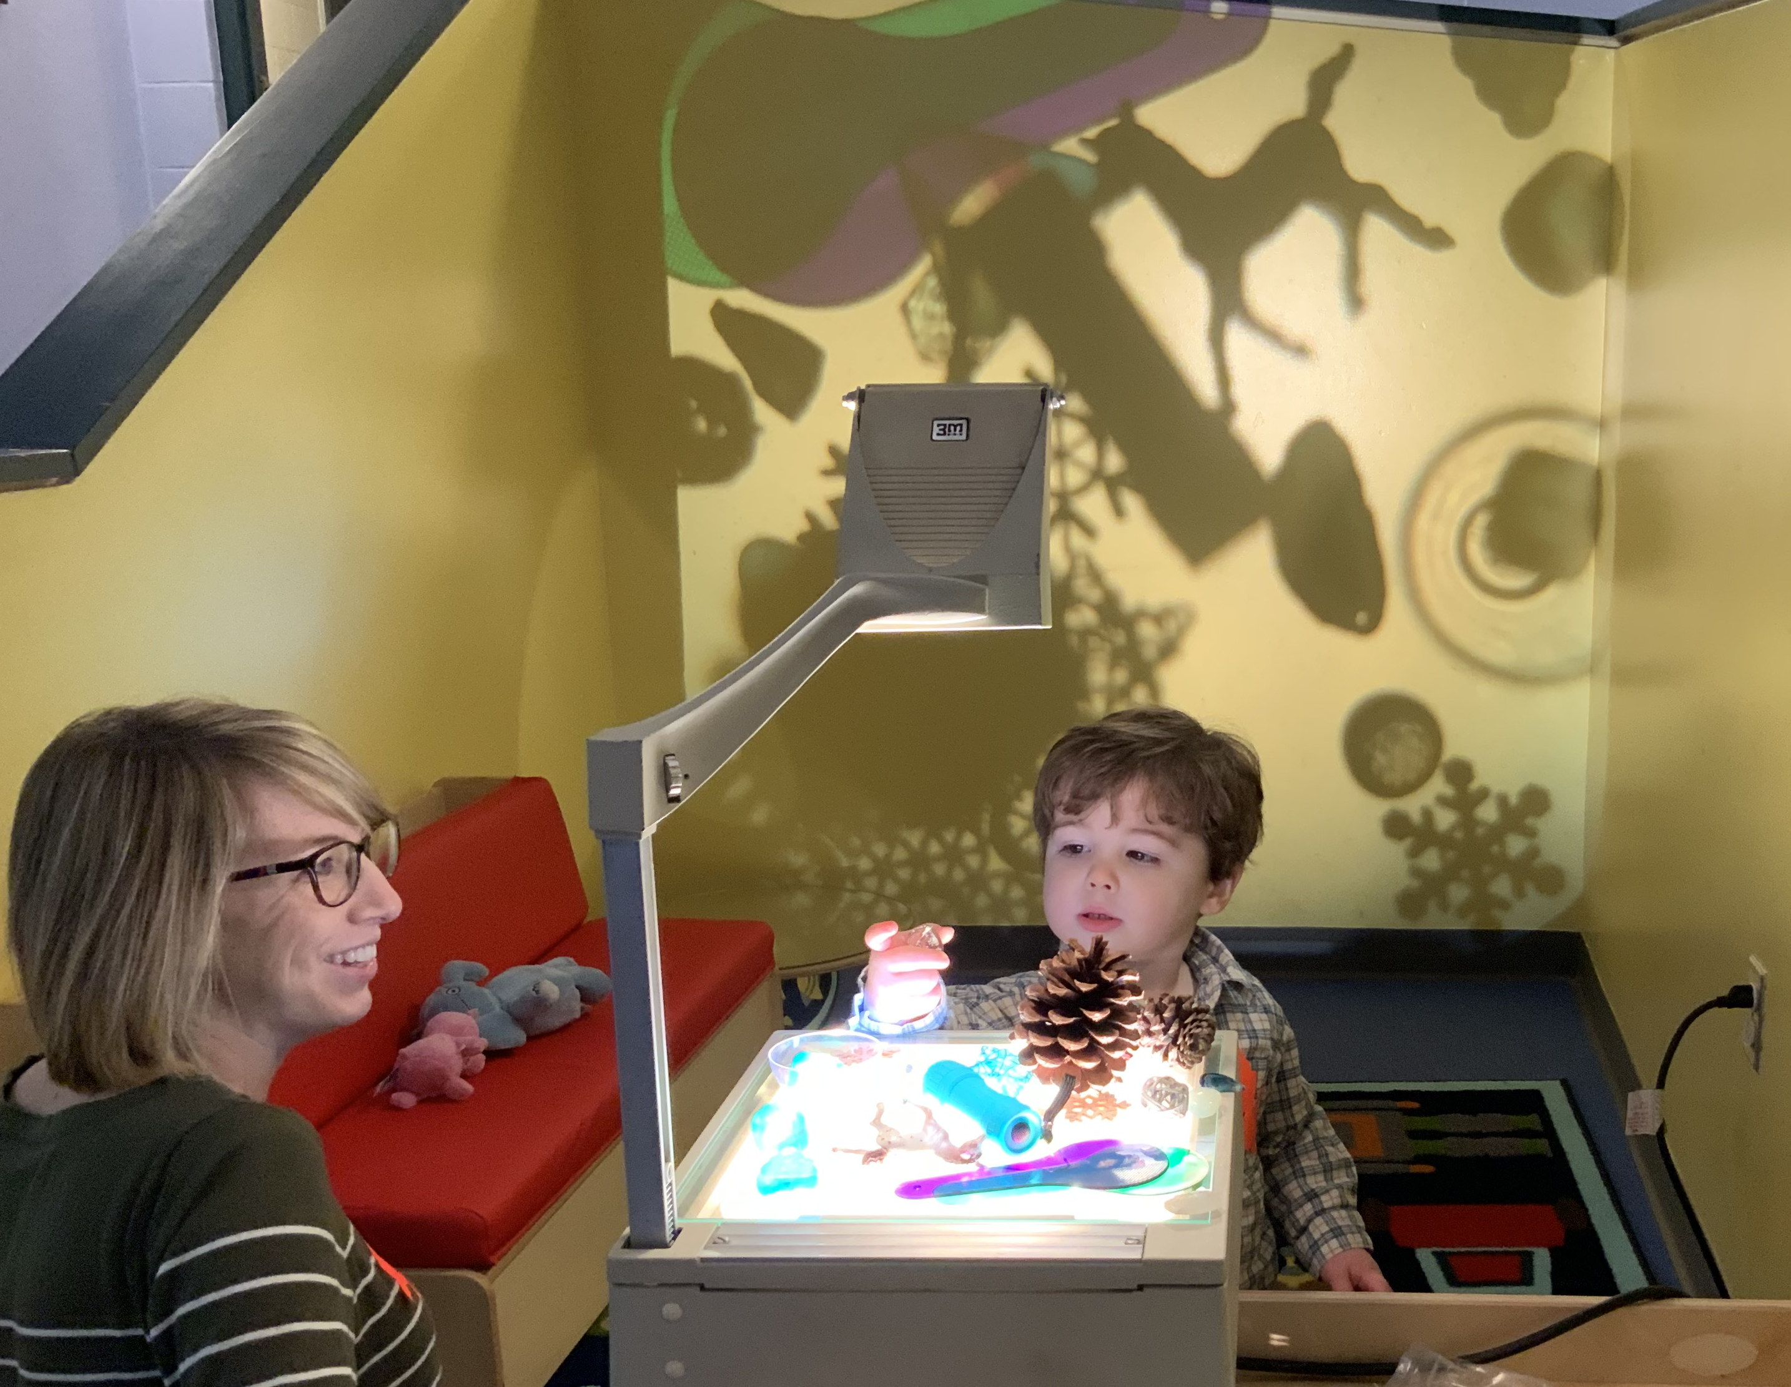
OUR FAVORITE THINGS
Mirror Box
Overhead Projector

Slide 18
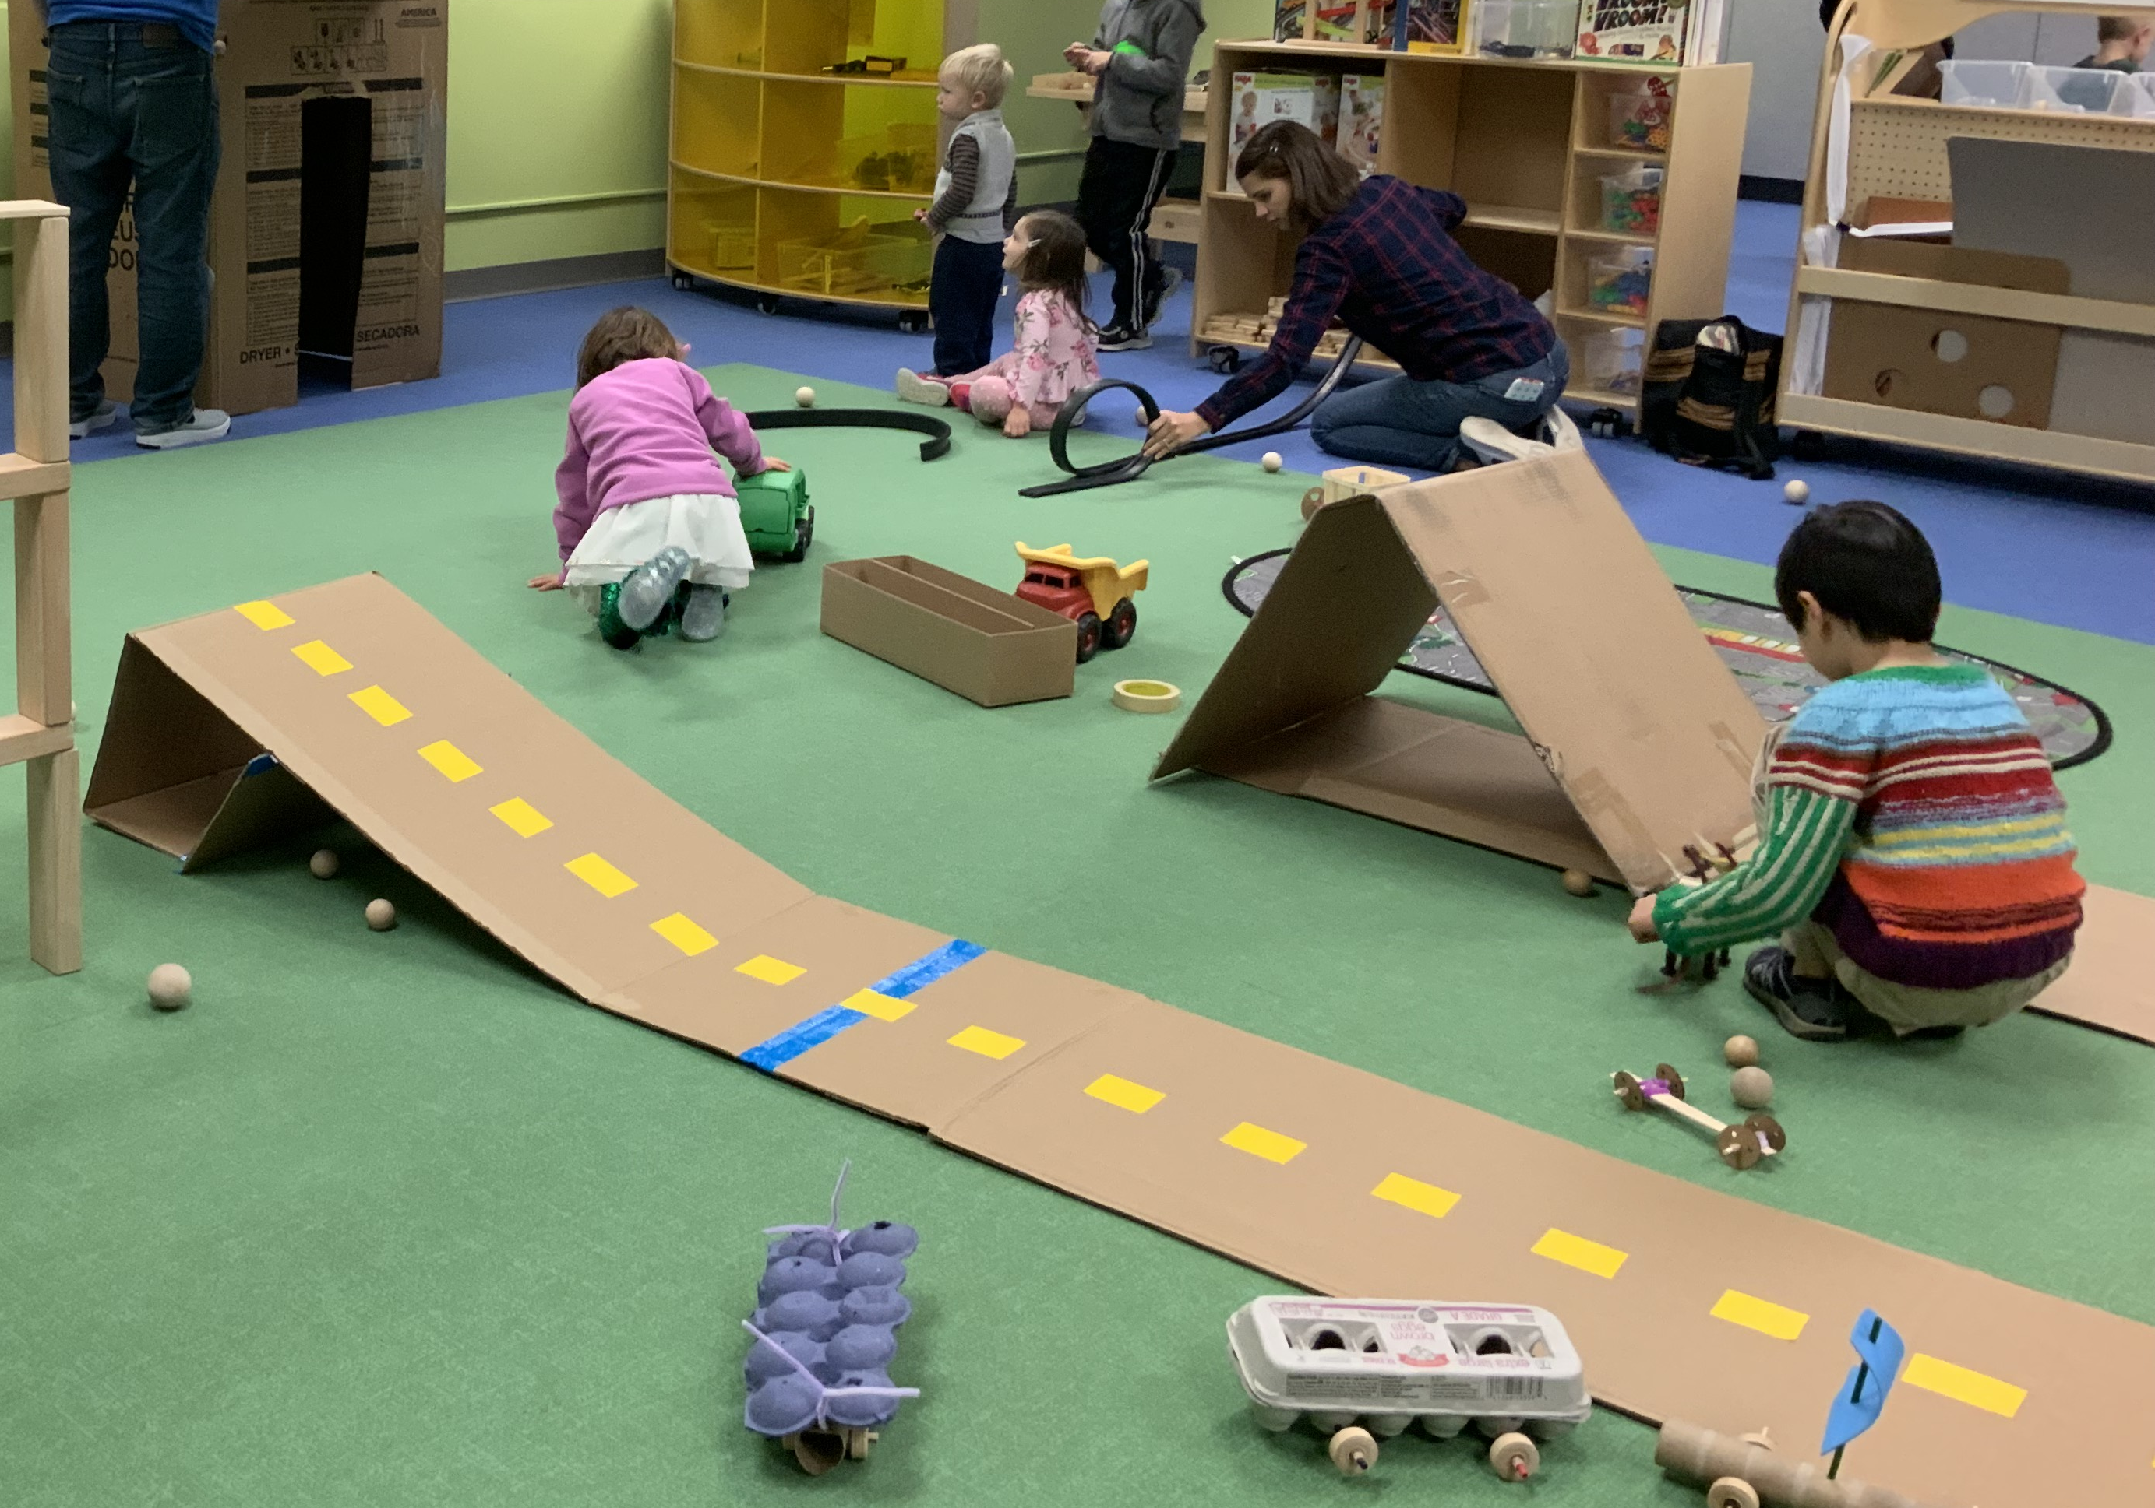
OUR FAVORITE THINGS
Ramps
Conveyer Belt

Slide 19
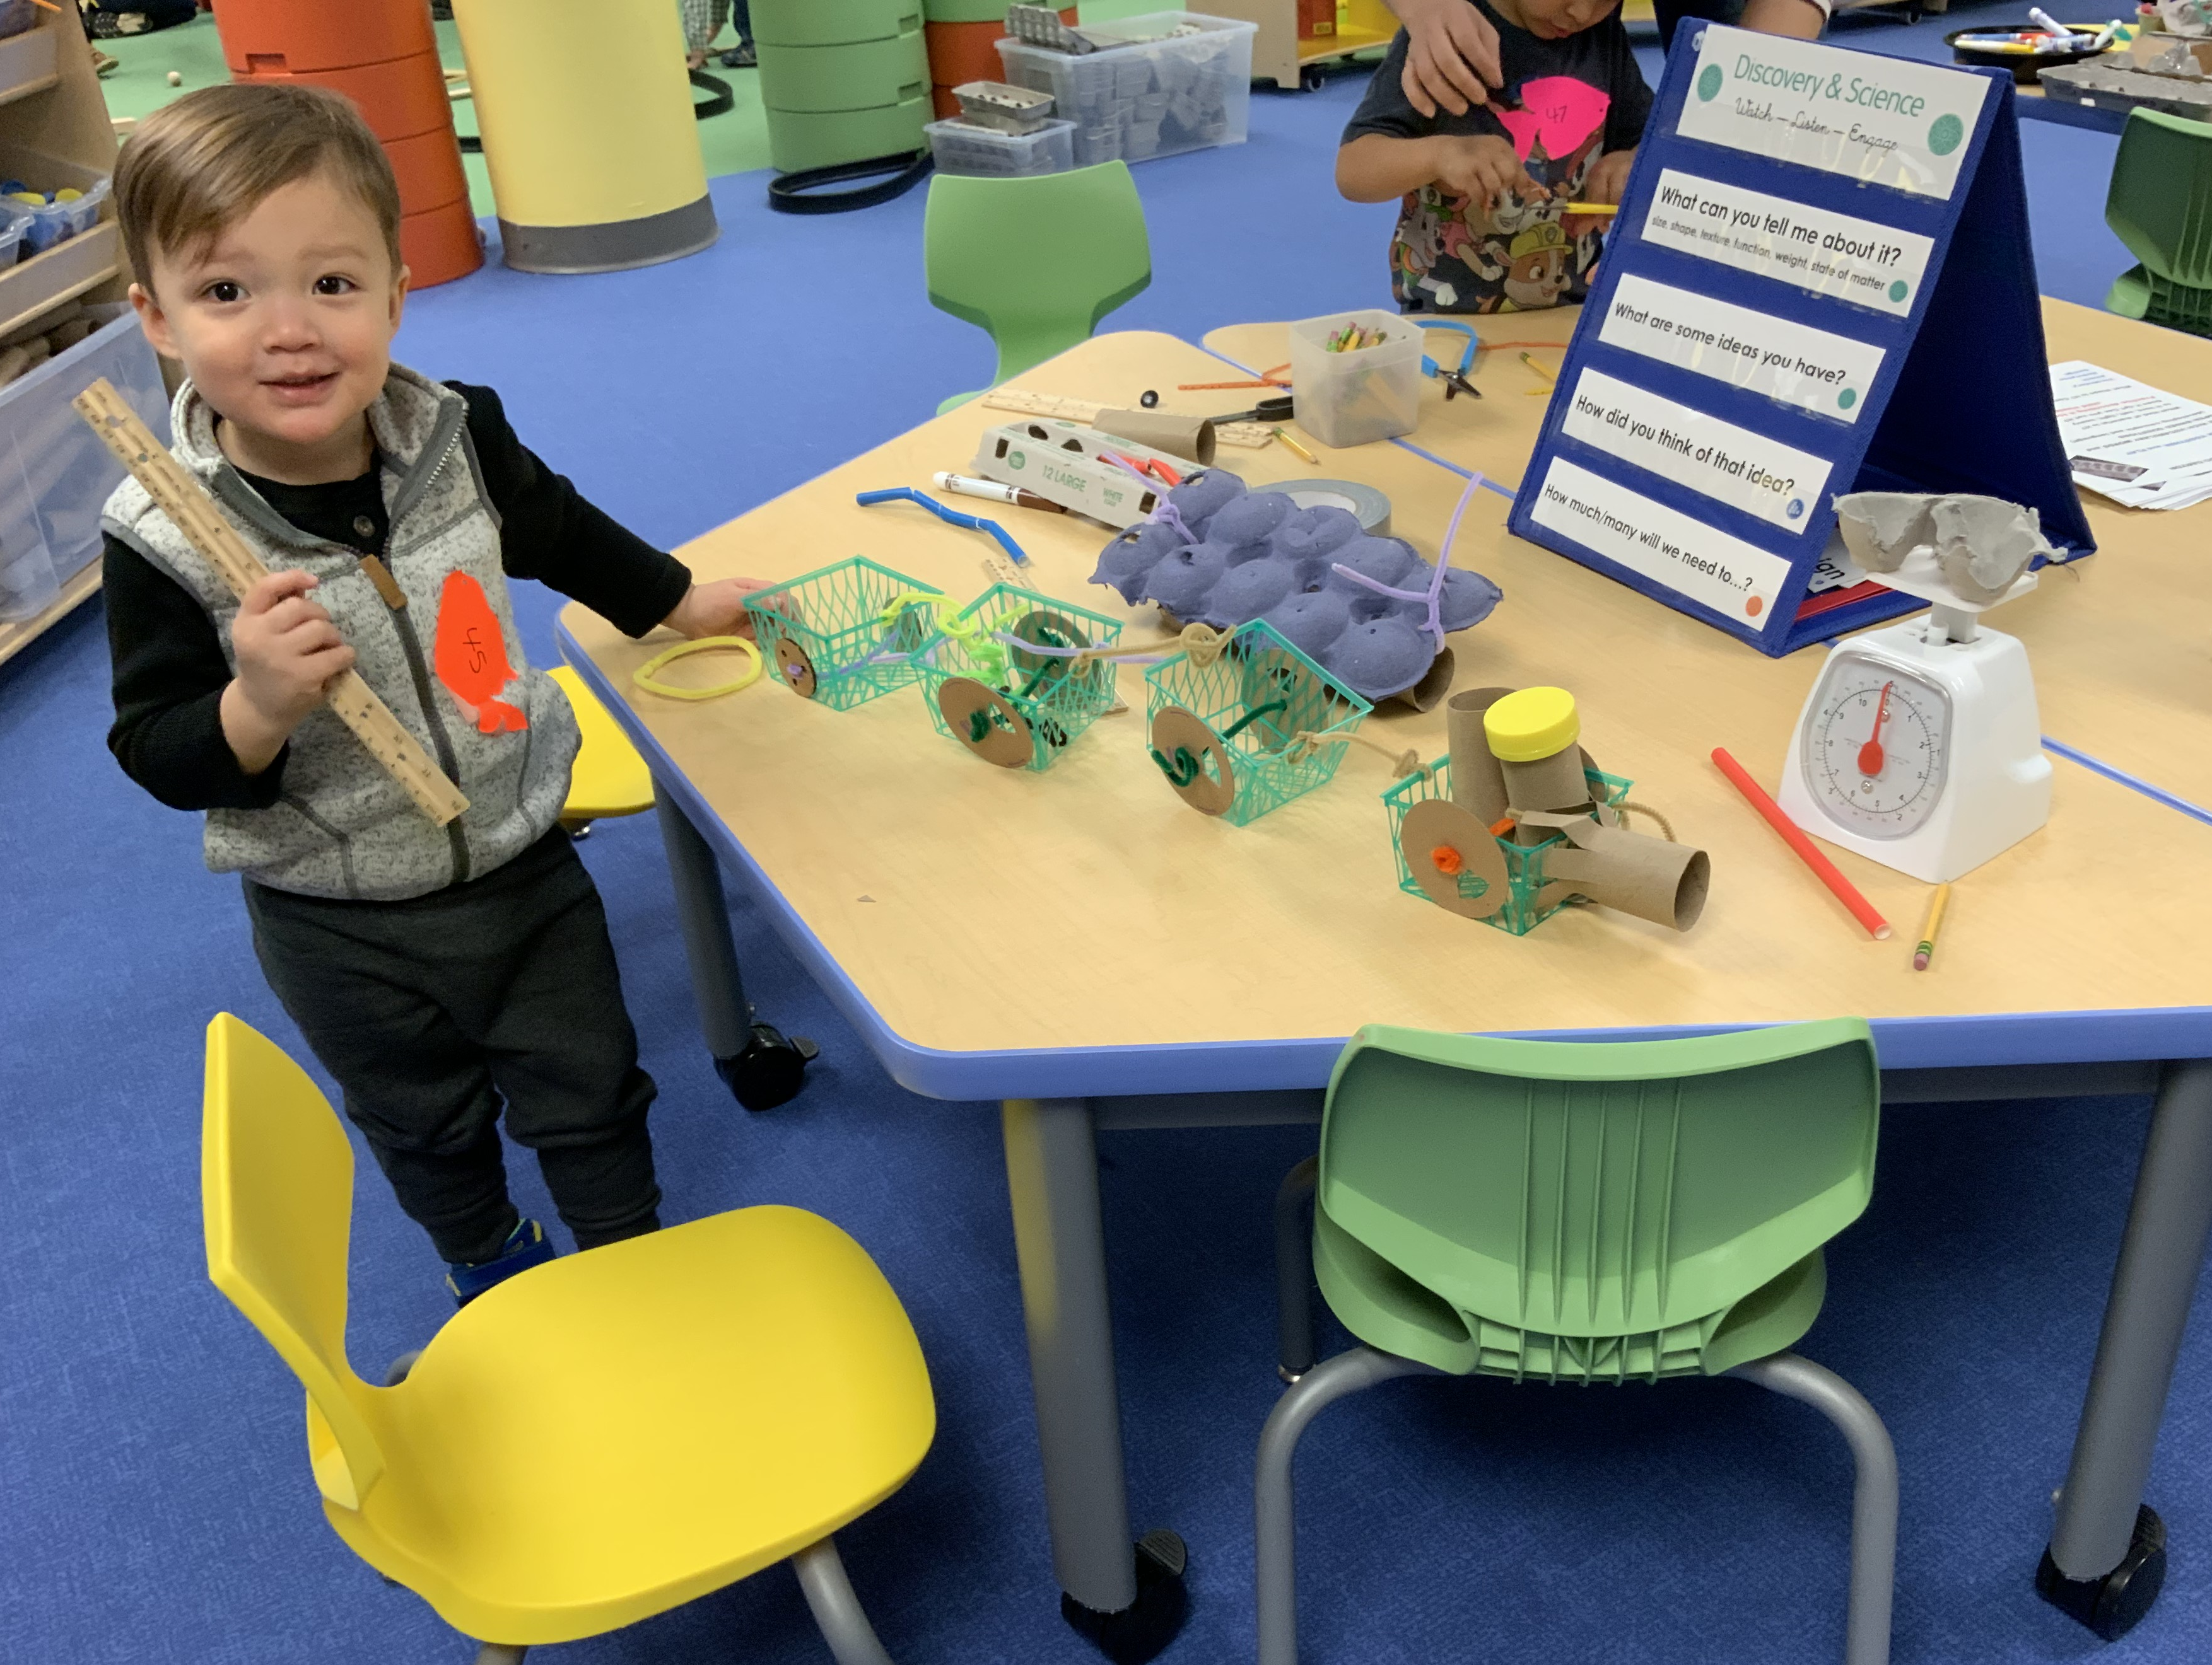
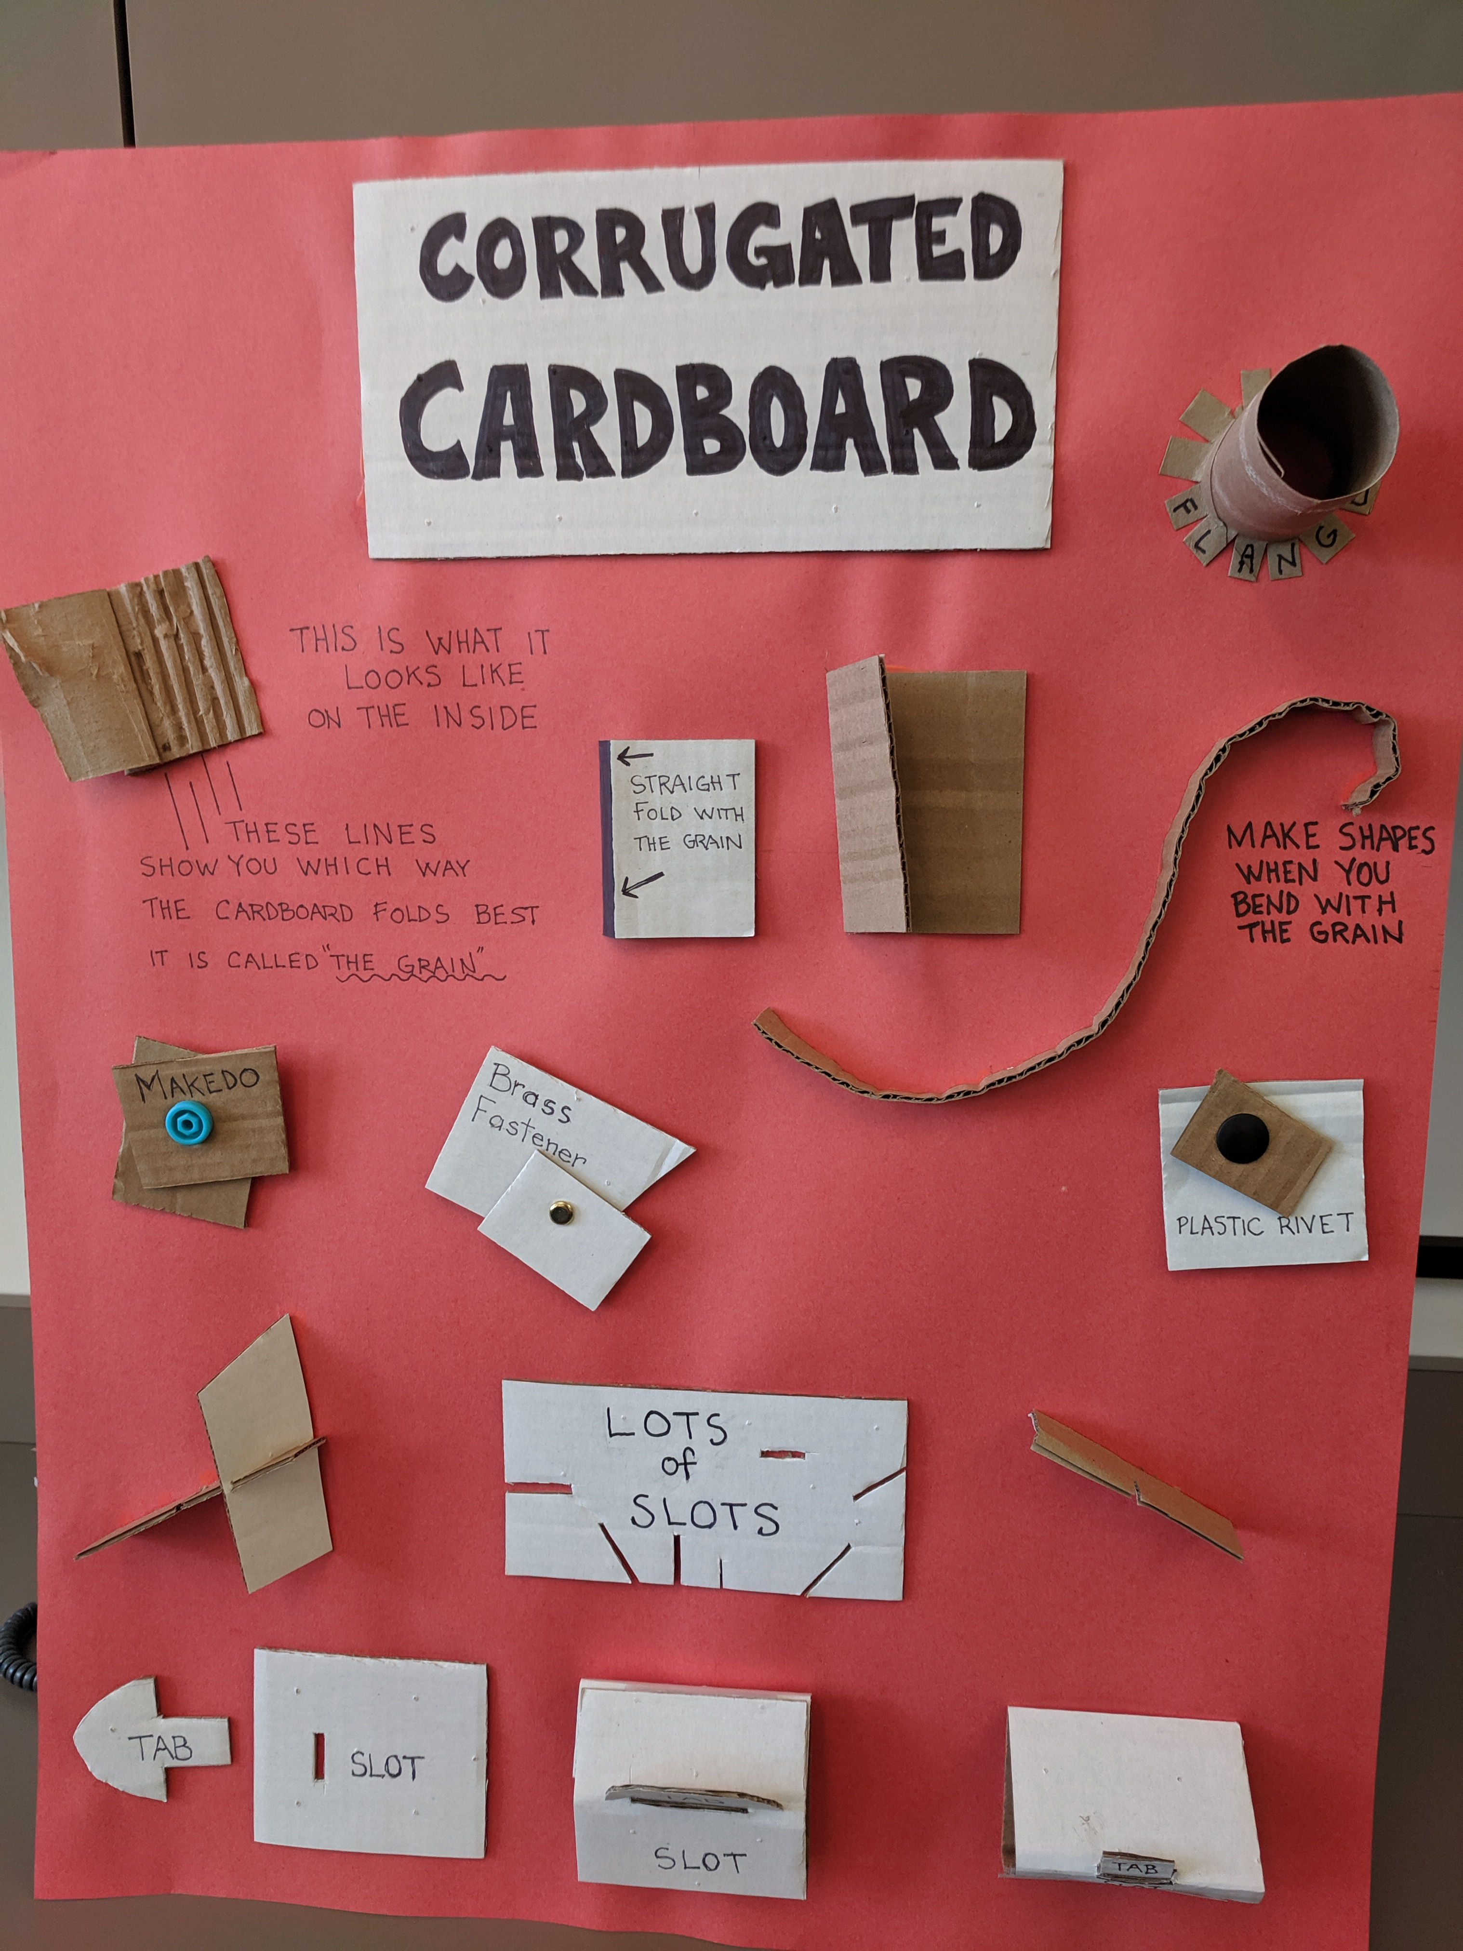
PROMPTS & SIGNAGE

Slide 20
PAUSE & PONDER
In what ways does your space foster curiosity and allow for open-ended exploration for children and adults?
How do children and adults feel when they enter your space?
Where and how will the materials be moved and stored?

Slide 21
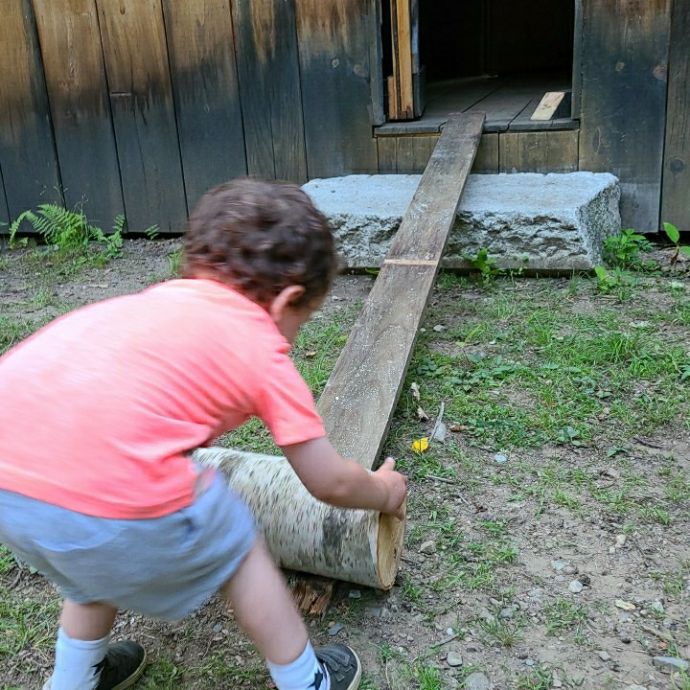
VIRTUAL AT-HOME PROGRAMMING
Should we or shouldn’t we?
Is online learning developmentally appropriate?
How to translate a hands-on tinkering and making program into a virtual platform?
How will we facilitate it?
How will we know if our program was having an impact?
Notes:
Should we or shouldn’t we
We had some momentum going with the in-person programs and like everyone else needed to think fast to figure out how to keep programming available to our families.
Is Online Learning developmentally appropriate? Like many librarians and educators we had reservations about doing virtual learning with children this young. We weren’t sure if we wanted to promote more screen time for young children. We weren’t sure if caregivers would want to participate in this type of programming for their youngest children. Current models weren’t really applicable to working with such young children virtually and our program was a very hands-on interactive program.
So we decided we had to practice what we preach. The Maker Mindset. Try it, experiment and grow through co learning and recreating to meet the needs of children and caregivers.
The Virtual at Home program, like the in-person program went through many iterations.

Slide 22
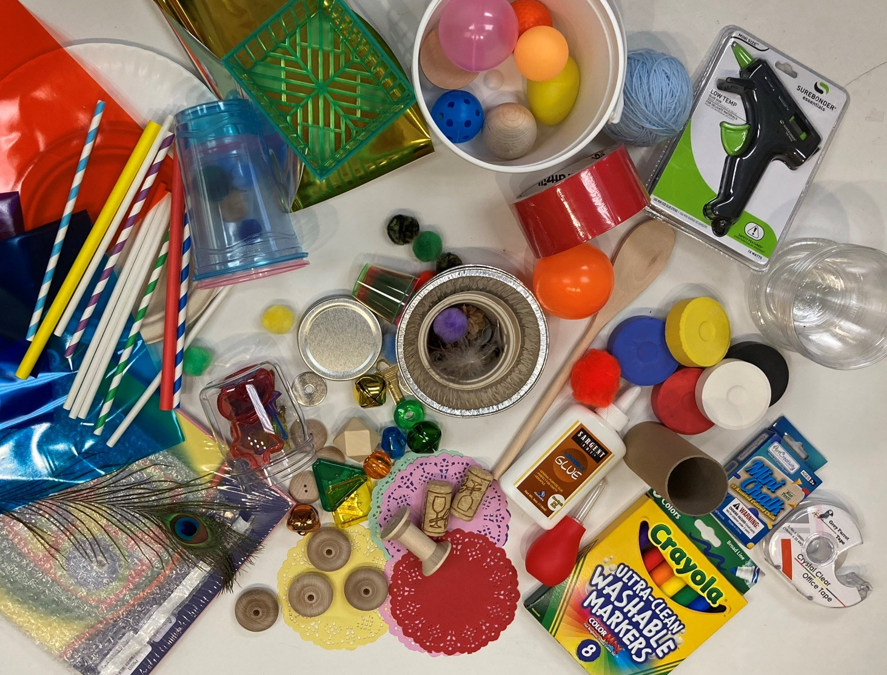
AT-HOME PROGRAMMING
Make it EASY for caregivers to participate
Offer synchronous and asynchronous opportunities
Use easy and familiar tools
  Zoom
  Niche Academy
  Goosechase
Create kits that would provide everything needed to fully participate.

Slide 23
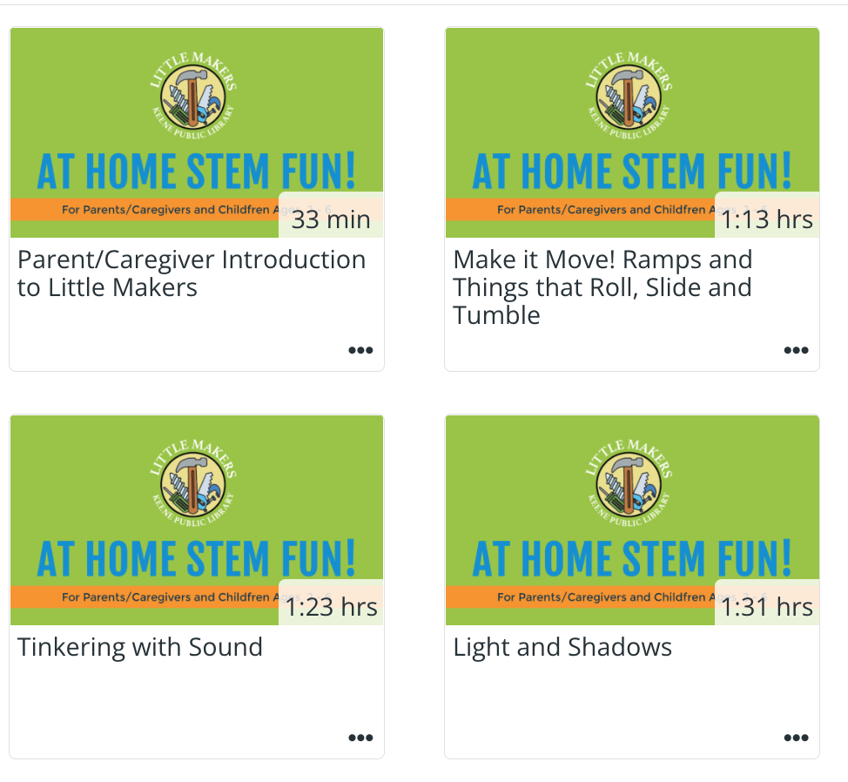
PROGRAM STRUCTURE
How would we engage with caregivers and children?
  Kits with everything needed to participate
  Zoom meetings included Storytime and Play Along activities
  Niche Academy provided information and inspiration
  Goosechase App provided feedback and an opportunity for sharing experiences

Slide 24
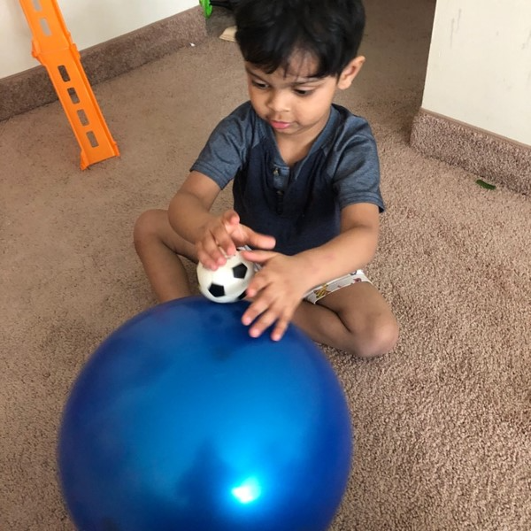
ACTIVITY PLANNING
Appeals to a wide range of ages and abilities
Open-ended
Quality over quantity
Child-directed
Notes:
Should we or shouldn’t we
We had some momentum going with the in-person programs and like everyone else needed to think fast to figure out how to keep programming available to our families.
Is Online Learning developmentally appropriate? Like many librarians and educators we had reservations about doing virtual learning with children this young. We weren’t sure if we wanted to promote more screen time for young children. We weren’t sure if caregivers would want to participate in this type of programming for their youngest children. Current models weren’t really applicable to working with such young children virtually and our program was a very hands-on interactive program.
So we decided we had to practice what we preach. The Maker Mindset. Try it, experiment and grow through co learning and recreating to meet the needs of children and caregivers.
The Virtual at Home program, like the in-person program went through many iterations.

Slide 25
PAUSE & PONDER
How could you use virtual programming to enhance or extend your in-person offerings?
In what ways can you encourage parents and caregivers to engage in STEM learning experiences back at home?

Slide 26
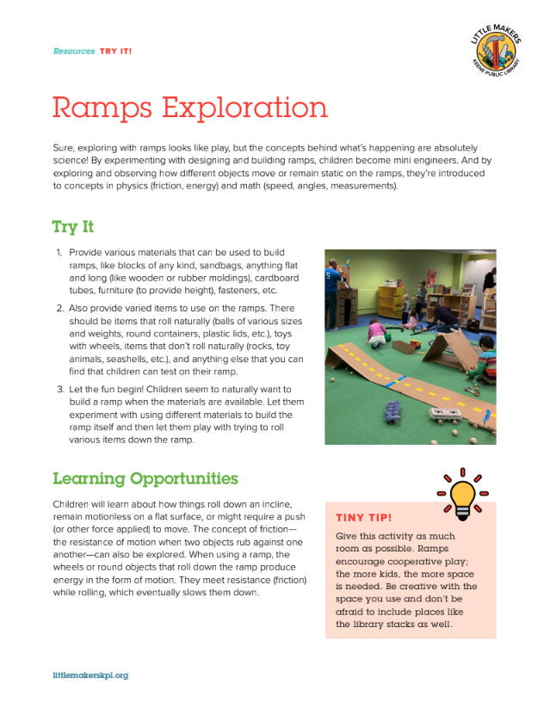
RAMPS ACTIVITY
Easily adaptable to any environment
Endless possibilities
Possibility for lots of problem solving and collaborative play
Easy to relate to other life experiences
Simple machine that helps us do work

Slide 27
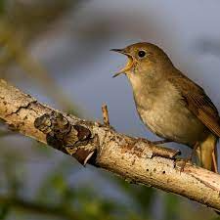
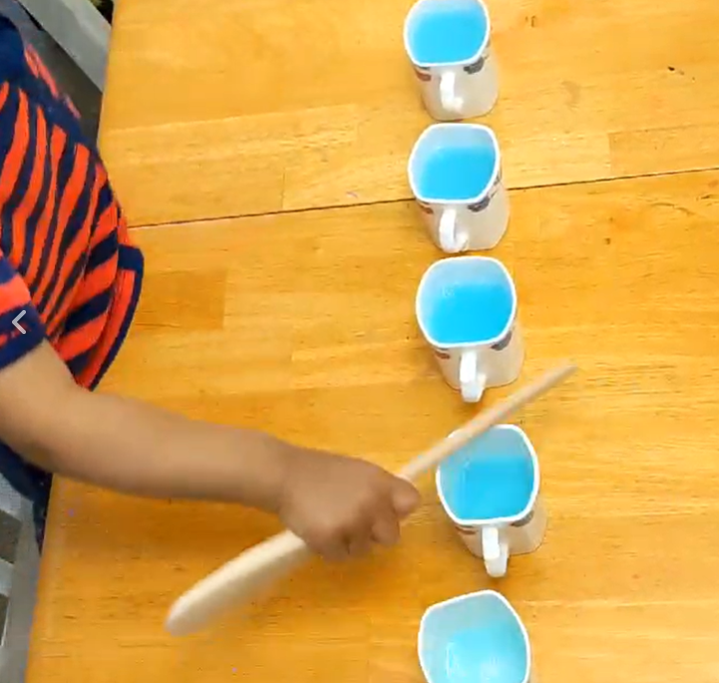
EXPLORING AND MAKING SOUNDS
Listening
Identifying sounds
Making different sounds

Slide 28
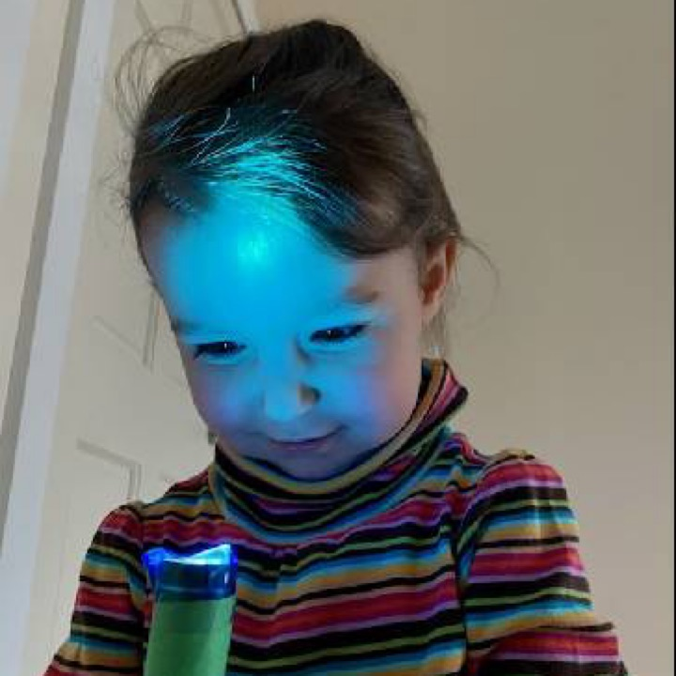
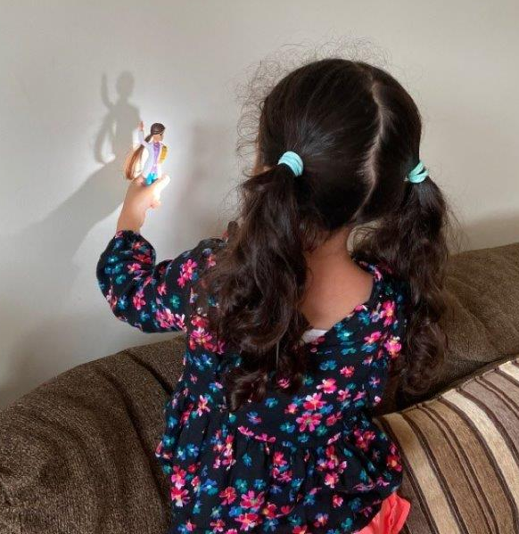
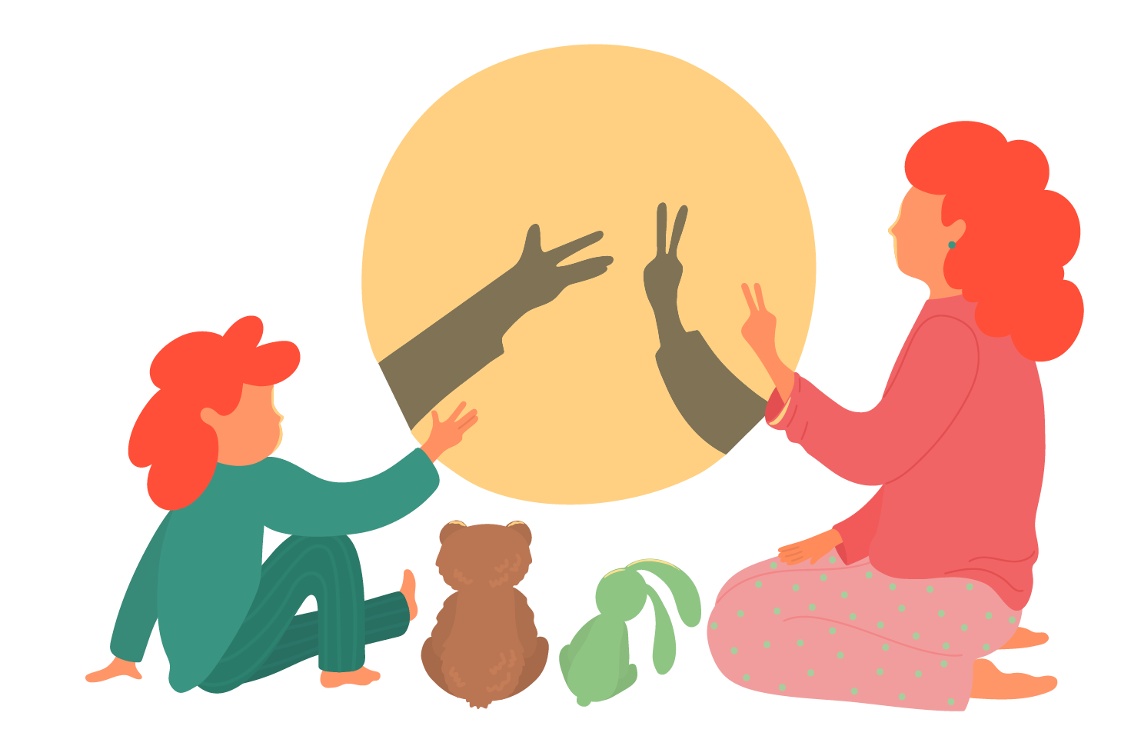
LIGHT AND SHADOW
Identifying light sources
Blocking light
Creating shadows
Changing the direction of light

Slide 29
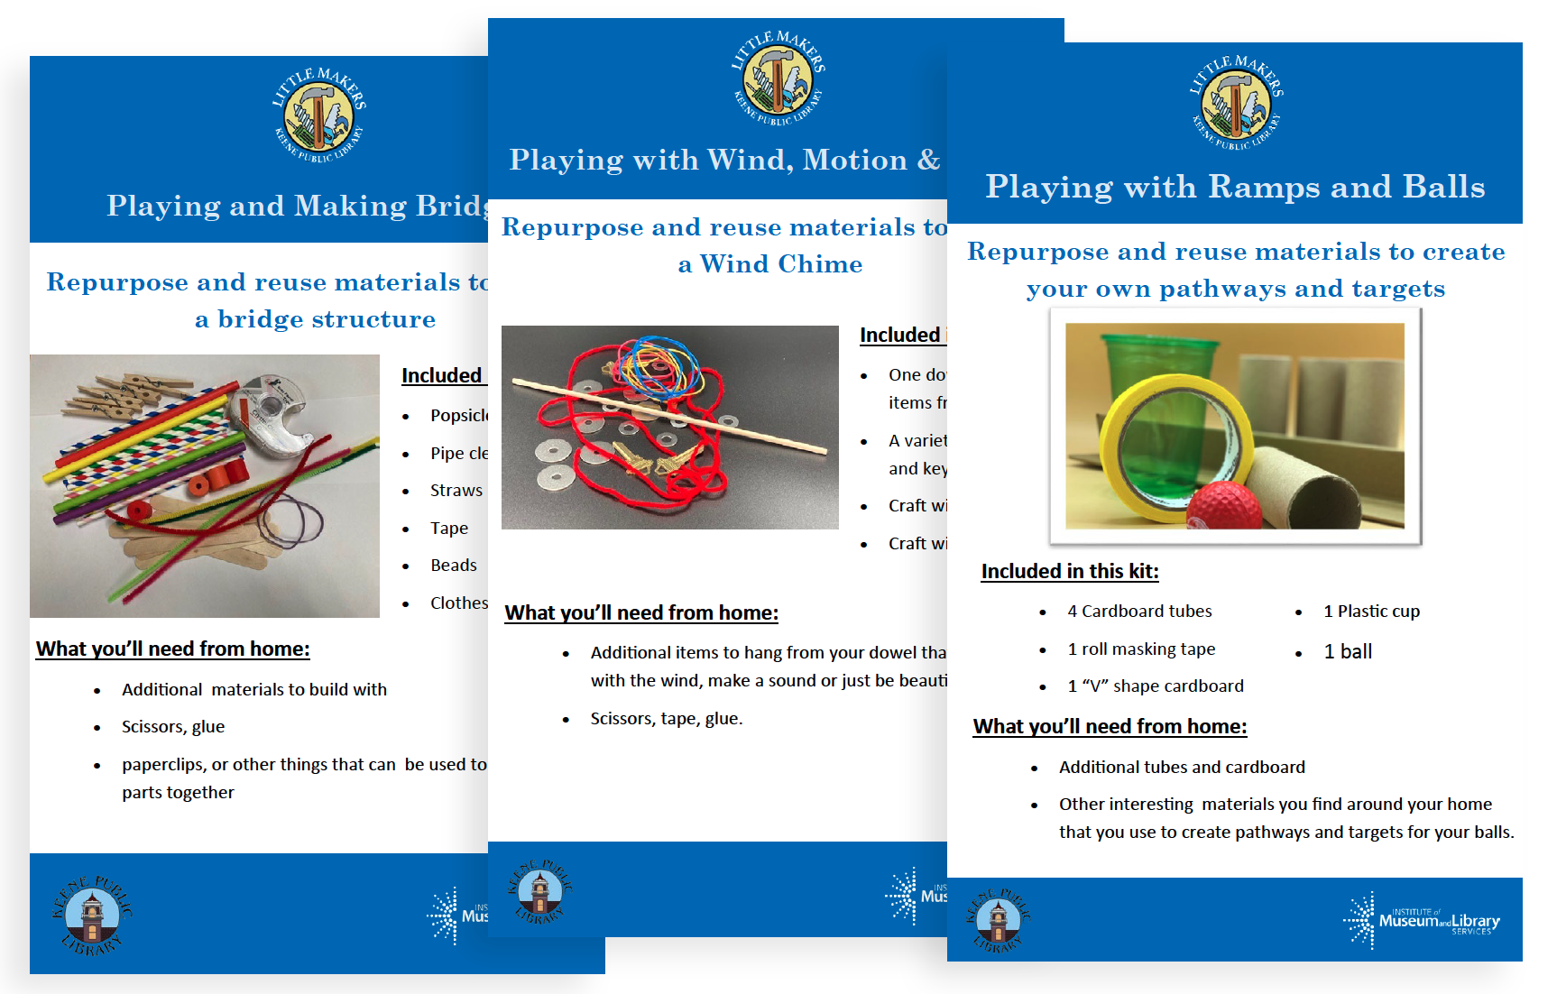
LATEST ITERATION

Slide 30
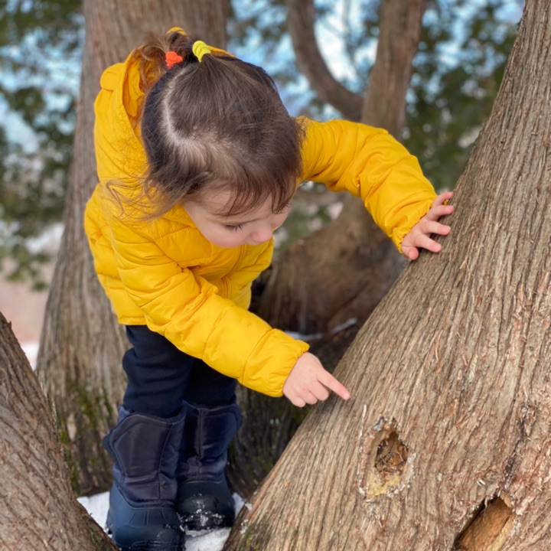
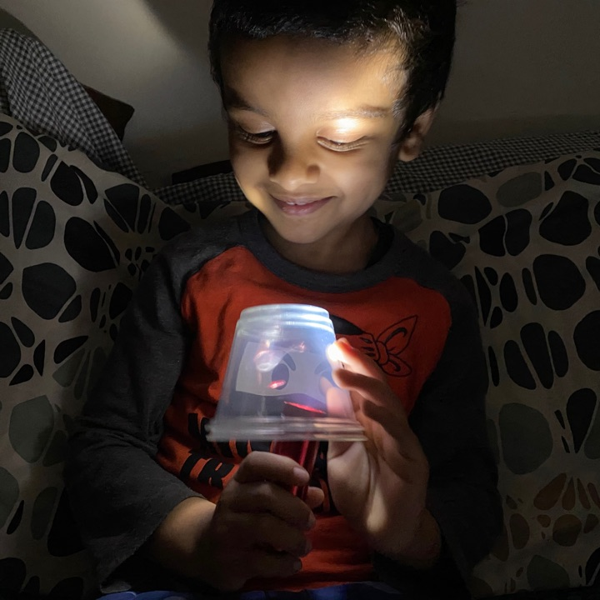
WHAT WE LEARNED
  Caregivers and children have FUN exploring STEM
  STEM tinkering has become an integral dimension of play with caregivers and children who participated in this program.
  Not everyone is comfortable with open-ended tinkering activities.
  Design of program and our support for caregivers integral to success.

Slide 31

LITTLE MAKERS TOOLKIT
Resources on facilitating programming for families at the library and at home!
Activity and evaluation ideas
Inspiration and lessons learned
LittleMakersKPL.org

Slide 32
JOIN US NEXT WEEK FOR WEBINAR #2
Sept. 28, 2022
1 PM EST / 10 AM PST
Facilitation and Reflection
This project was made possible in part by the Institute of Museum and Library Services (#LG-95-18-0191-18).

