Slide 1

LITTLE MAKERS:
FACILITATION AND REFLECTION
Sept. 28, 2022
Gail Zachariah, Keene Public Library
Amy Kraemer, Keene Public Library
Lisa Regalla, Regallium Consulting
This project was made possible in part by the Institute of Museum and Library Services (#LG-95-18-0191-18).

Slide 2
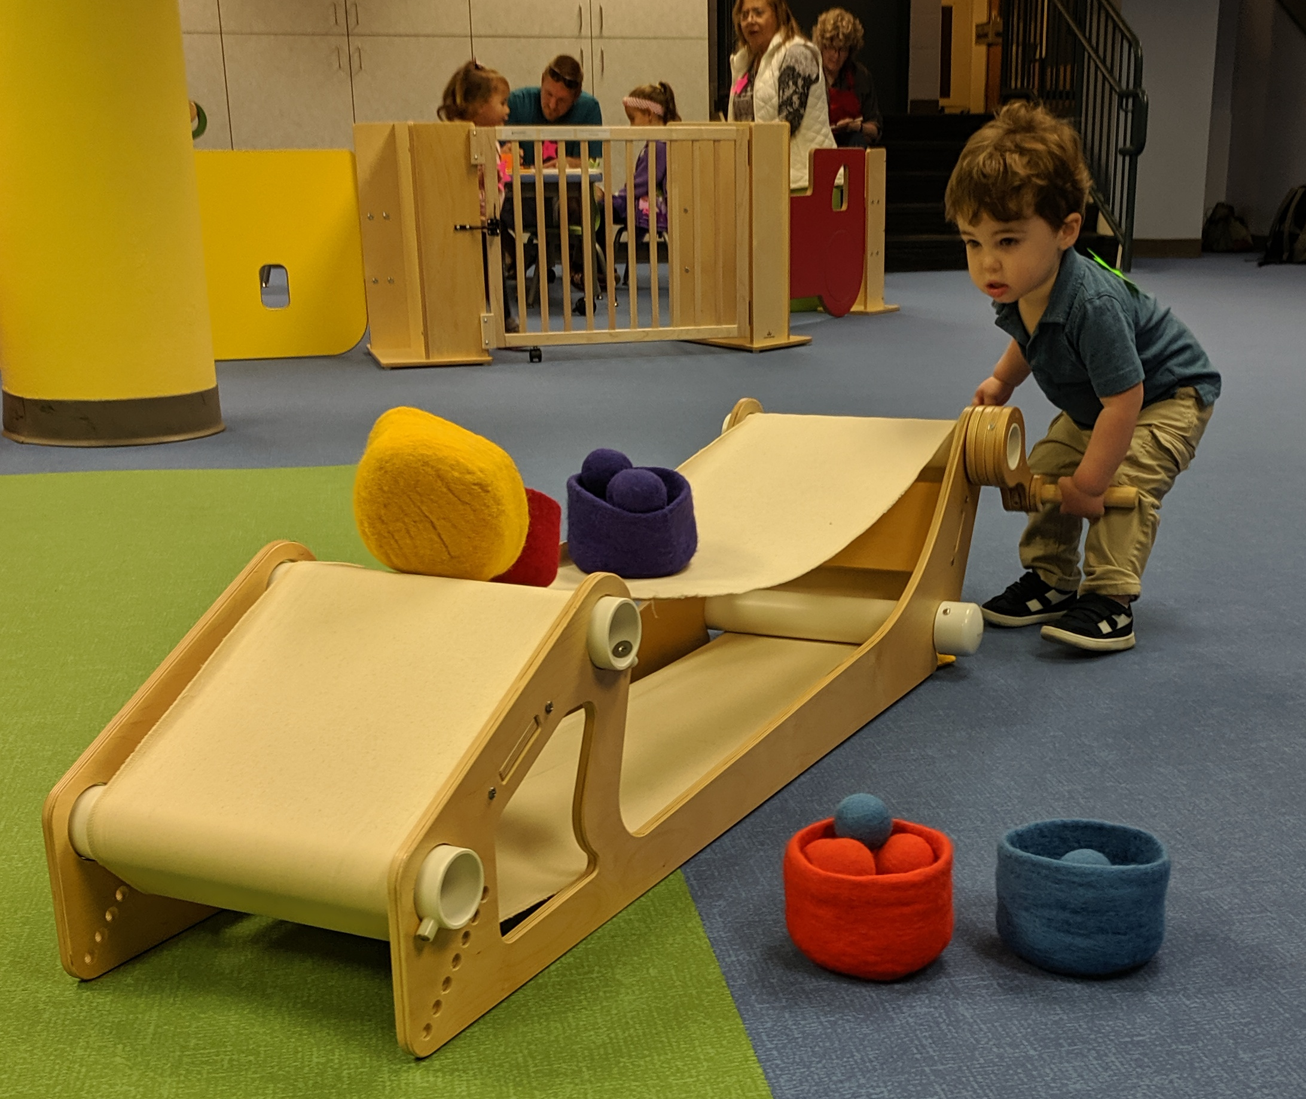
LITTLE MAKERS
Playful Process
Co-learning
Demystifying STEM
Parents and caregivers as key participants

Slide 3
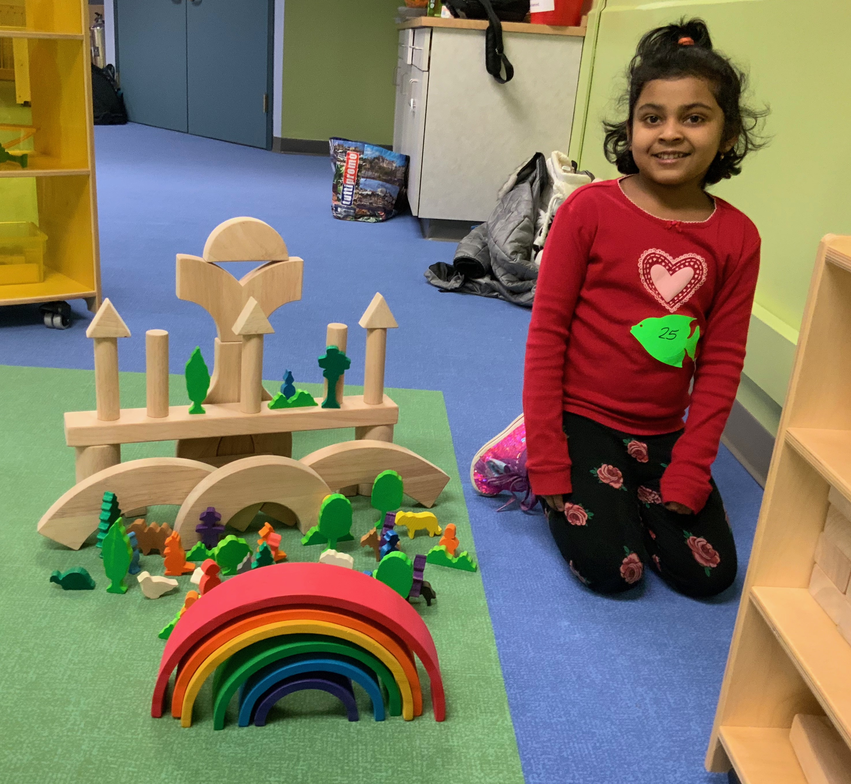
DEMOGRAPHICS
Keene, NH (Population 23,281)
Mixed community with a state college and university, yet there is a lot of poverty
Median Income, $57,393
13% of the community living in poverty
History of precision manufacturing;
now declining

Slide 4
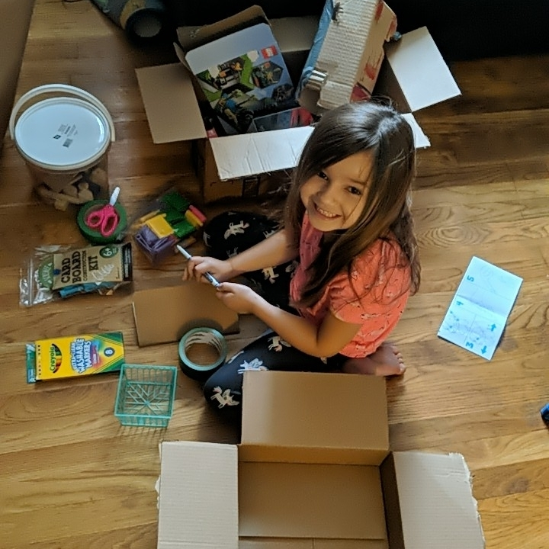
PROJECT GOALS
To engage early learners ages 2 to 6 in STEM, tinkering, and making activities through library programming in and inviting environment
To increase parent/caregiver understanding of the importance of STEM, tinkering, and making activities and efficacy in engaging their children with STEM

Slide 5

AGENDA
Why facilitation & reflection is important
Facilitation
  Questions & prompts, managing frustration, guiding facilitation virtually and more!
Reflective practice - How to gather reflections from staff and patrons
Collecting data
  What can children (& adults) learn through tinkering experiences and how will we know?
Overview of our new free Toolkit!

Slide 6
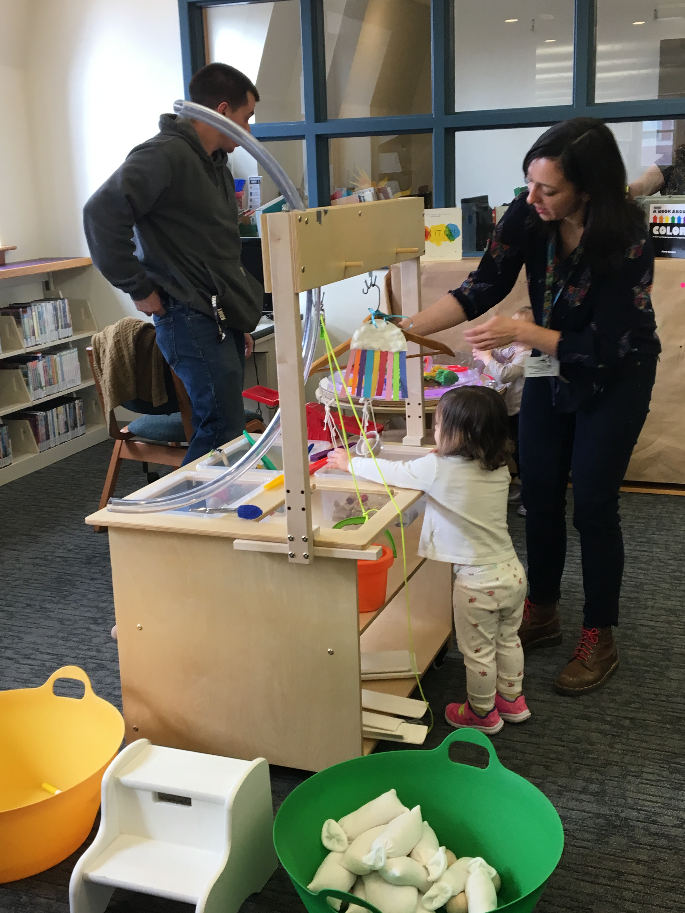
WHY SHOULD I CARE?
Becoming an effective facilitator and model for parents/caregivers is one of the most important things you can do!
Facilitation techniques are constantly tried, evaluated, and iterated on.
Listening to staff and patrons about what they need and how they feel helps people feel valued and invested in your program.
You want to know the impact of your program!

Slide 7
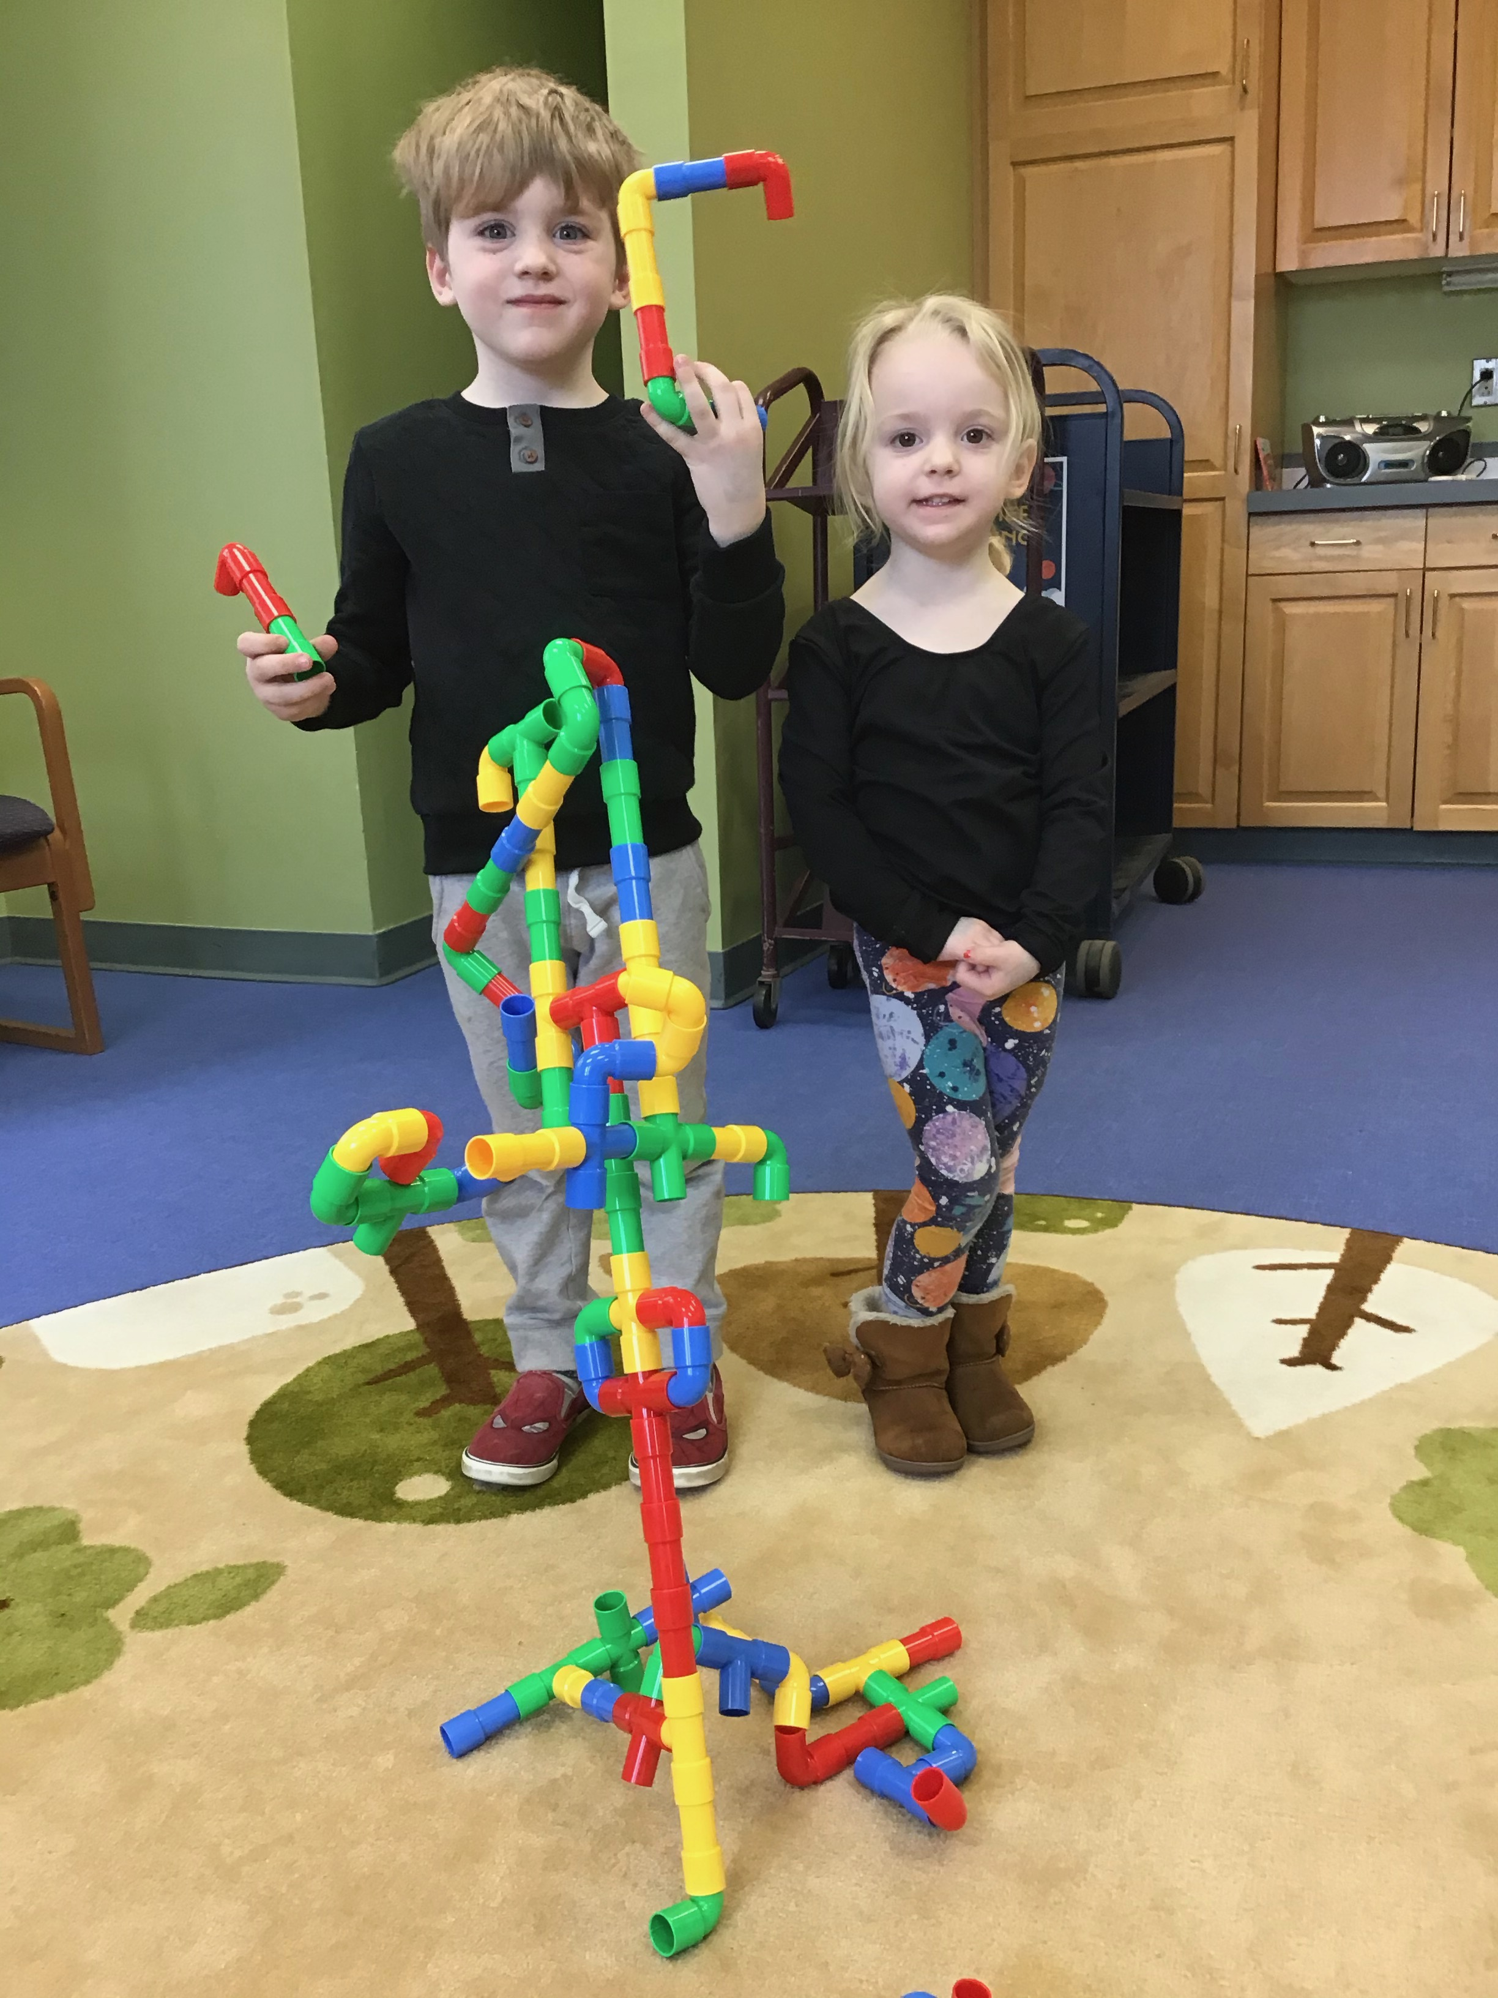
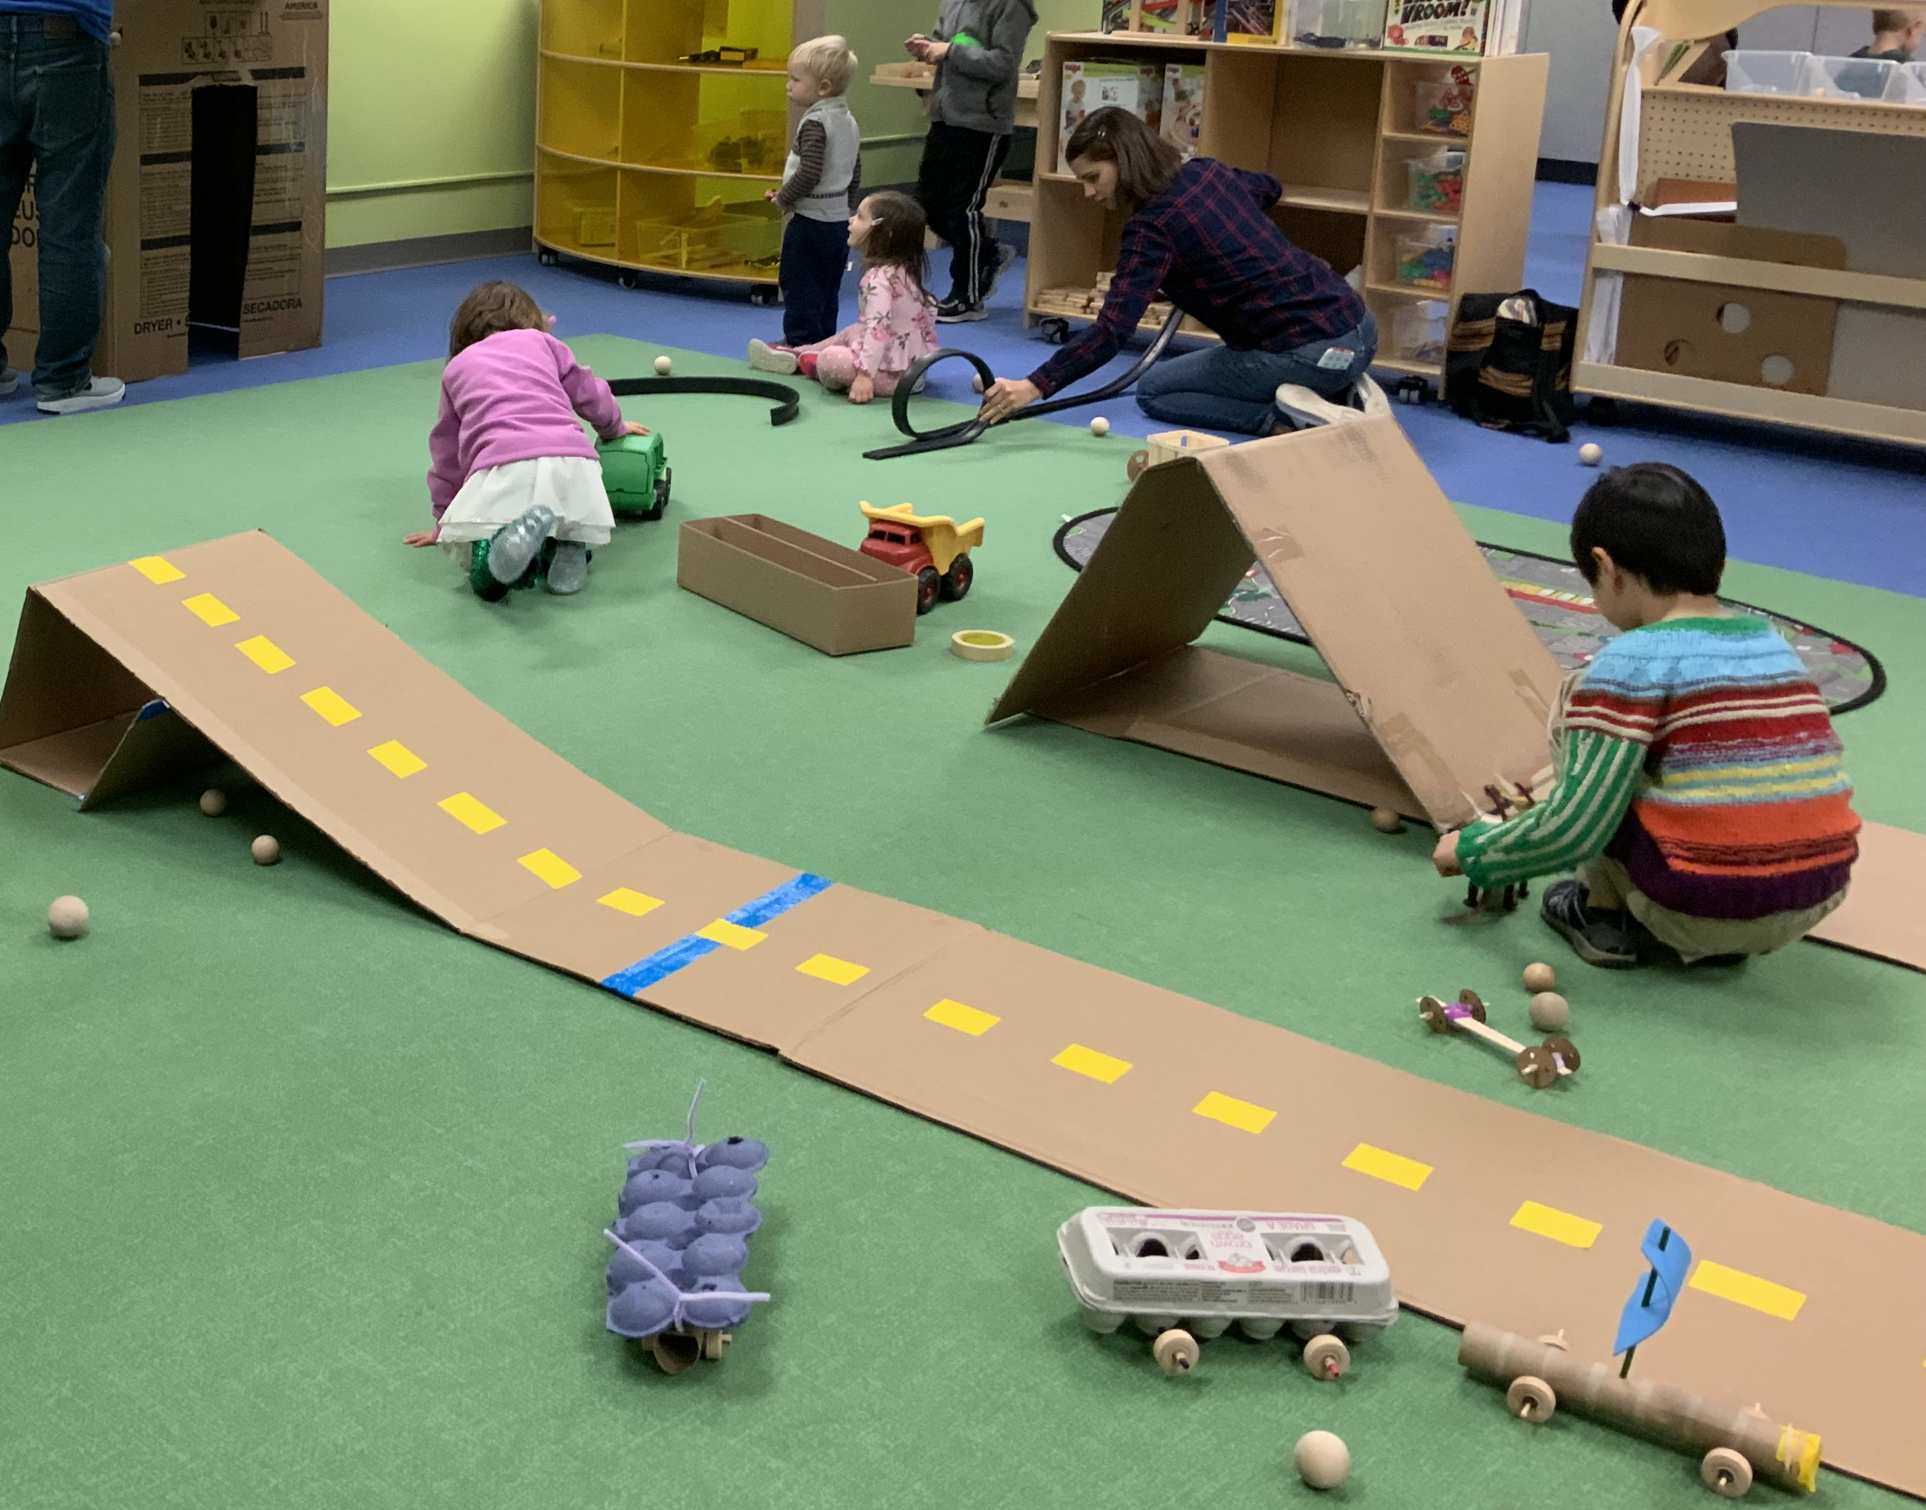
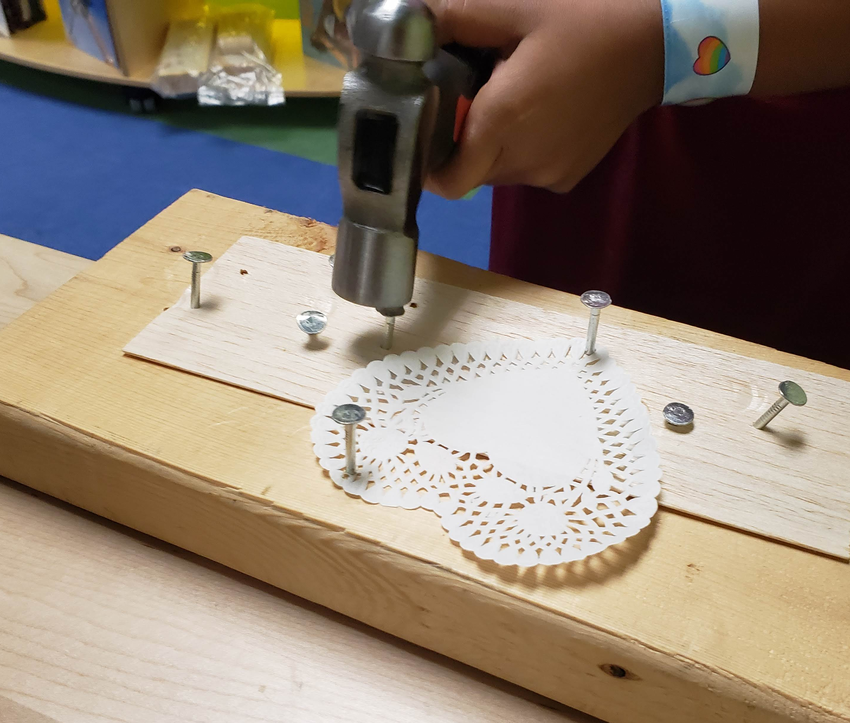
LEVELS OF FACILITATION
Low Medium High

Slide 8
QUESTIONS & PROMPTS
Ask questions before making a suggestion:
Why do you think that happened?
How can you get it to do what you want it to do?
What do you notice?
What are some things you saw other people trying?
I WONDER . . .
What do you think will happen if you _______?

Slide 9
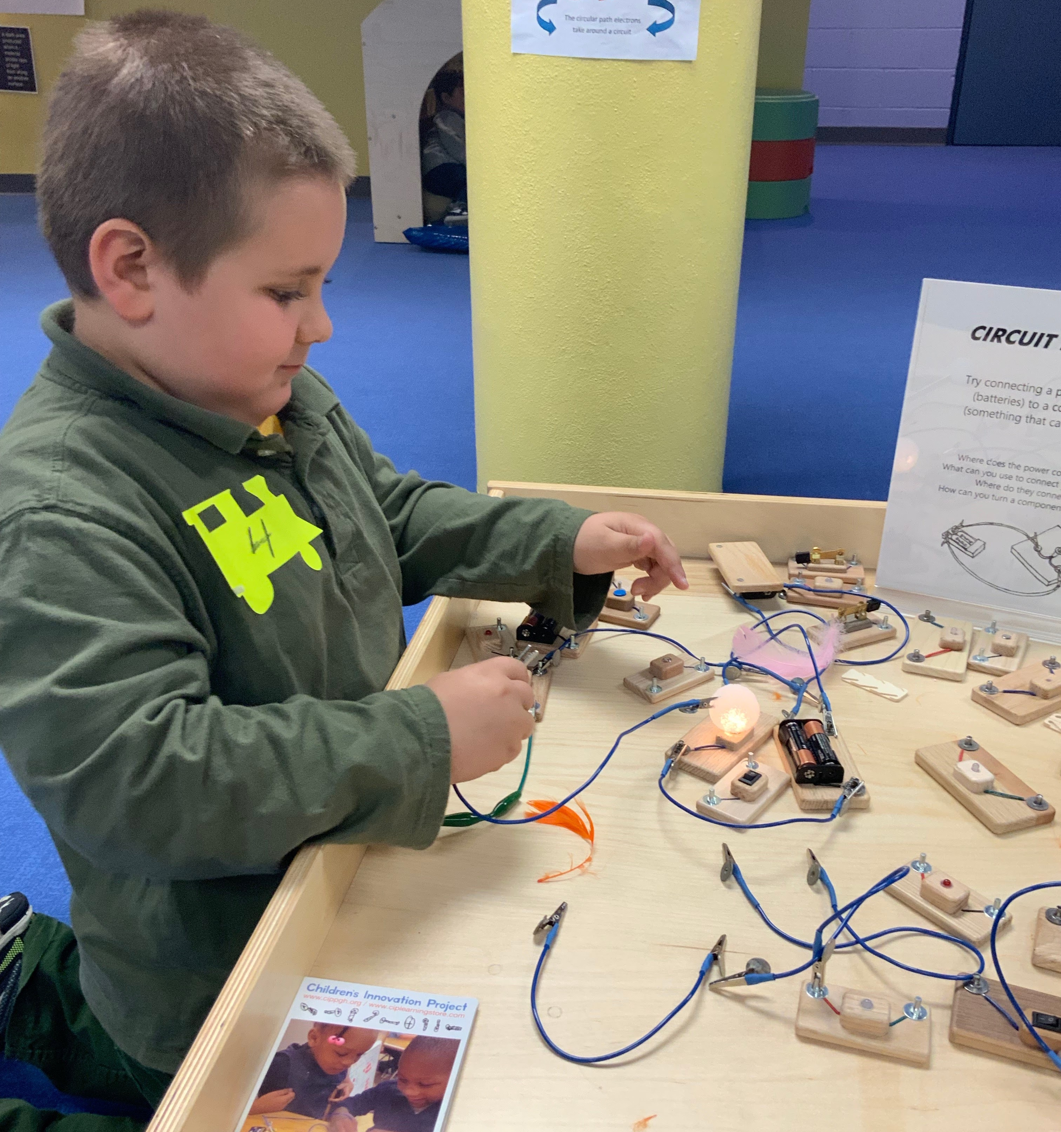
MANAGING FRUSTRATION
Be empathic
Ask questions
Listen carefully
Be patient
Don’t force a solution
Learn from mistakes

Slide 10
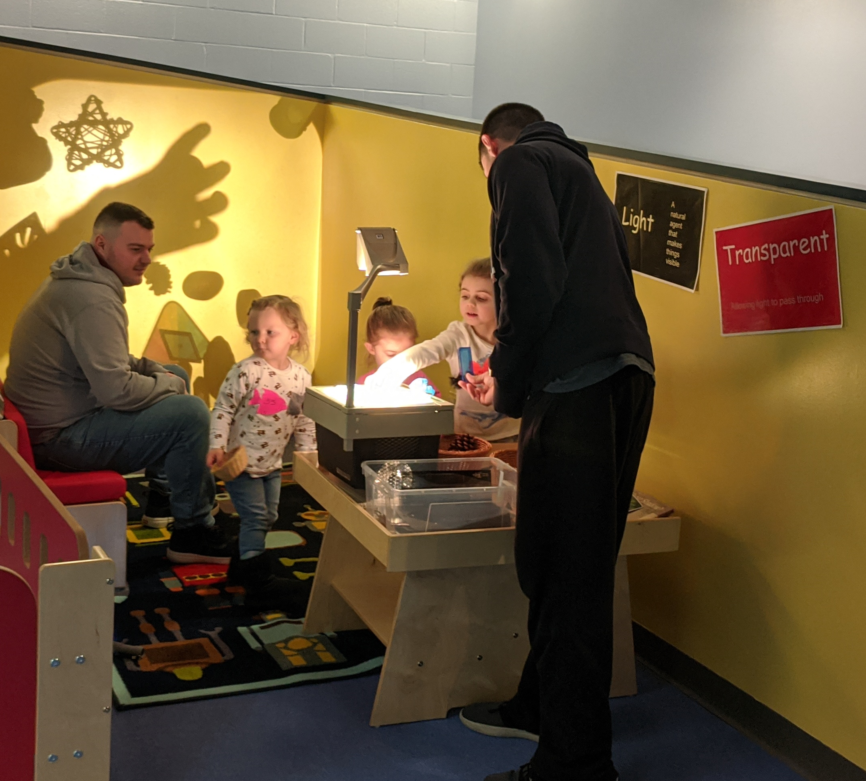
SNEAKY SCIENCE
STEM is already present
Facilitate discovery
Identify STEM concepts
Introduce vocabulary

Slide 11
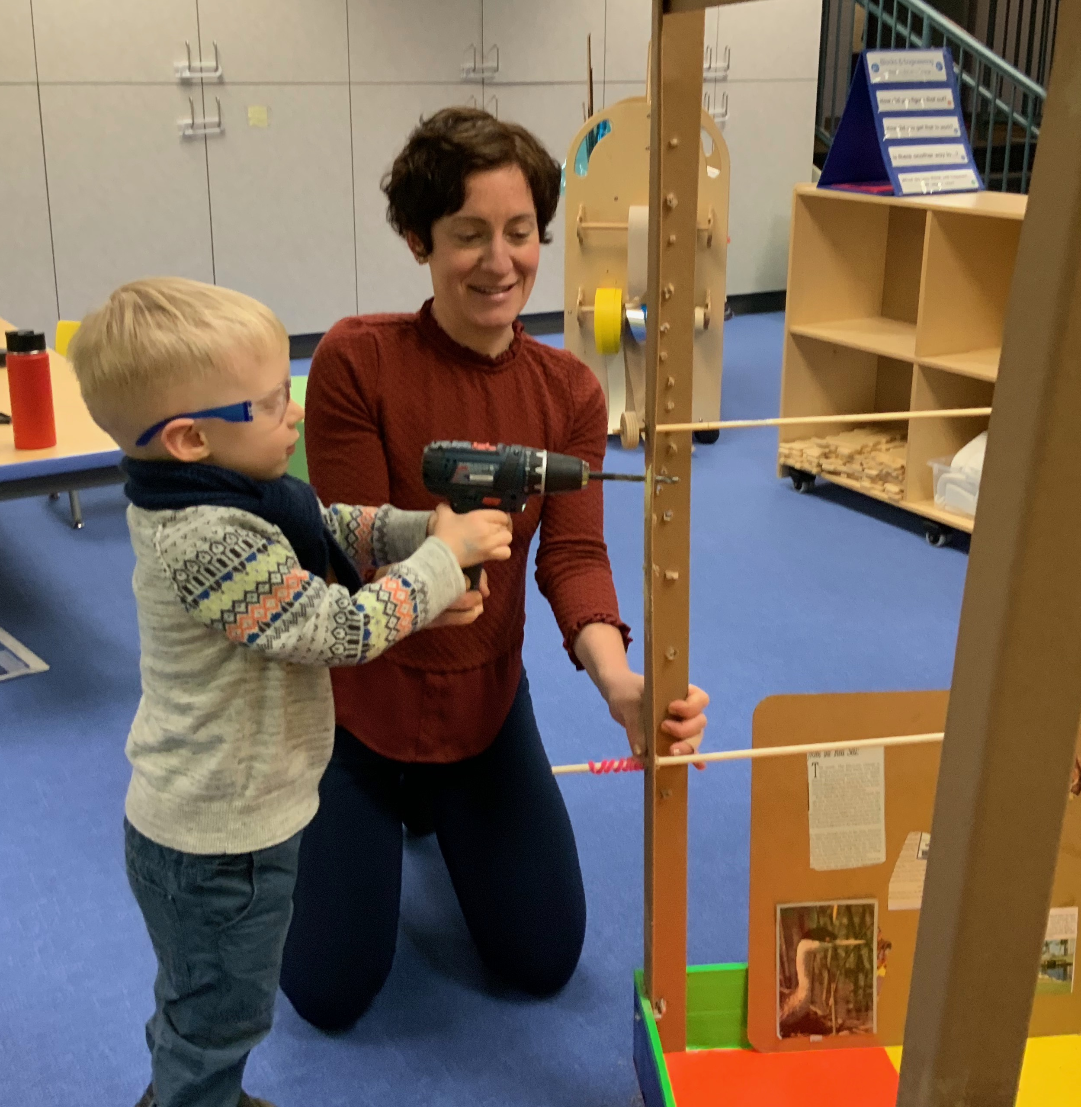
HELPING ADULTS TAKE THE LEAD
Provide an accepting and welcoming environment
You don’t need all the answers
Co-learning = Learning together
Fun is integral component
Model language
Talk about what you are doing and why

Slide 12
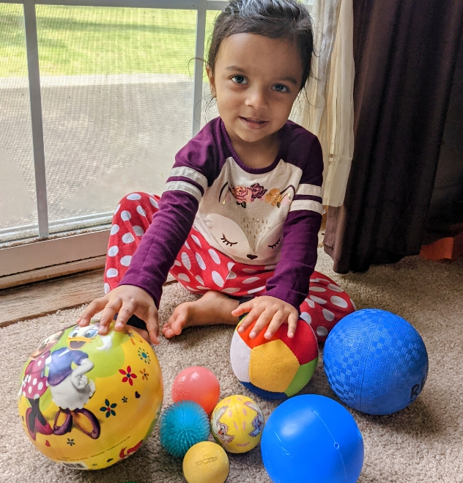
GUIDING FACILITATION VIRTUALLY
ZOOM Meetings
  Play and explore together
Niche Academy
  Tips for parents and caregivers
Goosechase
  Challenge addressed to adult

Slide 13
PAUSE & PONDER
What level of facilitation (high, medium, or low) do you use in your programming?
How many staff members are available for facilitation? How does that affect the type of activities you might offer?
How can parents and caregivers be empowered to help with facilitation?

Slide 14
POLL
Are you currently getting feedback from staff about your early childhood programming?
Always! We have regular staff reflection practices.
Sometimes. It depends on the program.
Rarely, but we would like to do more!

Slide 15
POLL
Are you currently getting feedback from patrons about your early childhood programming?
Always! We never run a program without collecting data
Sometimes. It depends on staffing and capacity.
Rarely, but we would like to do more!

Slide 16
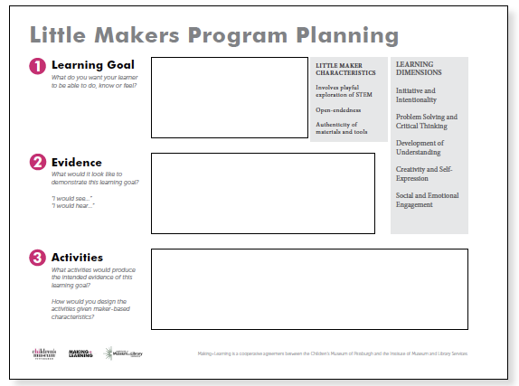
PROGRAM PLANNING
Essential characteristics of Little Maker programming
    Playful exploration of STEM
    Open-ended
    Authenticity of materials and tools
Start small and try things out!

Slide 17
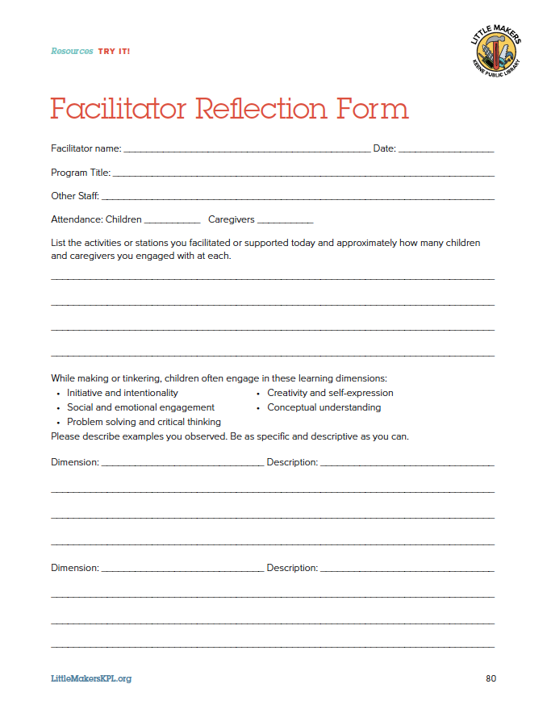
STAFF REFLECTIONS
Document the implementation of the program.
Provide a tool for program facilitators to reflect on the program in practice.
Track potential progress toward meeting intended outcomes and note the strategies implemented to reach them.

Slide 18
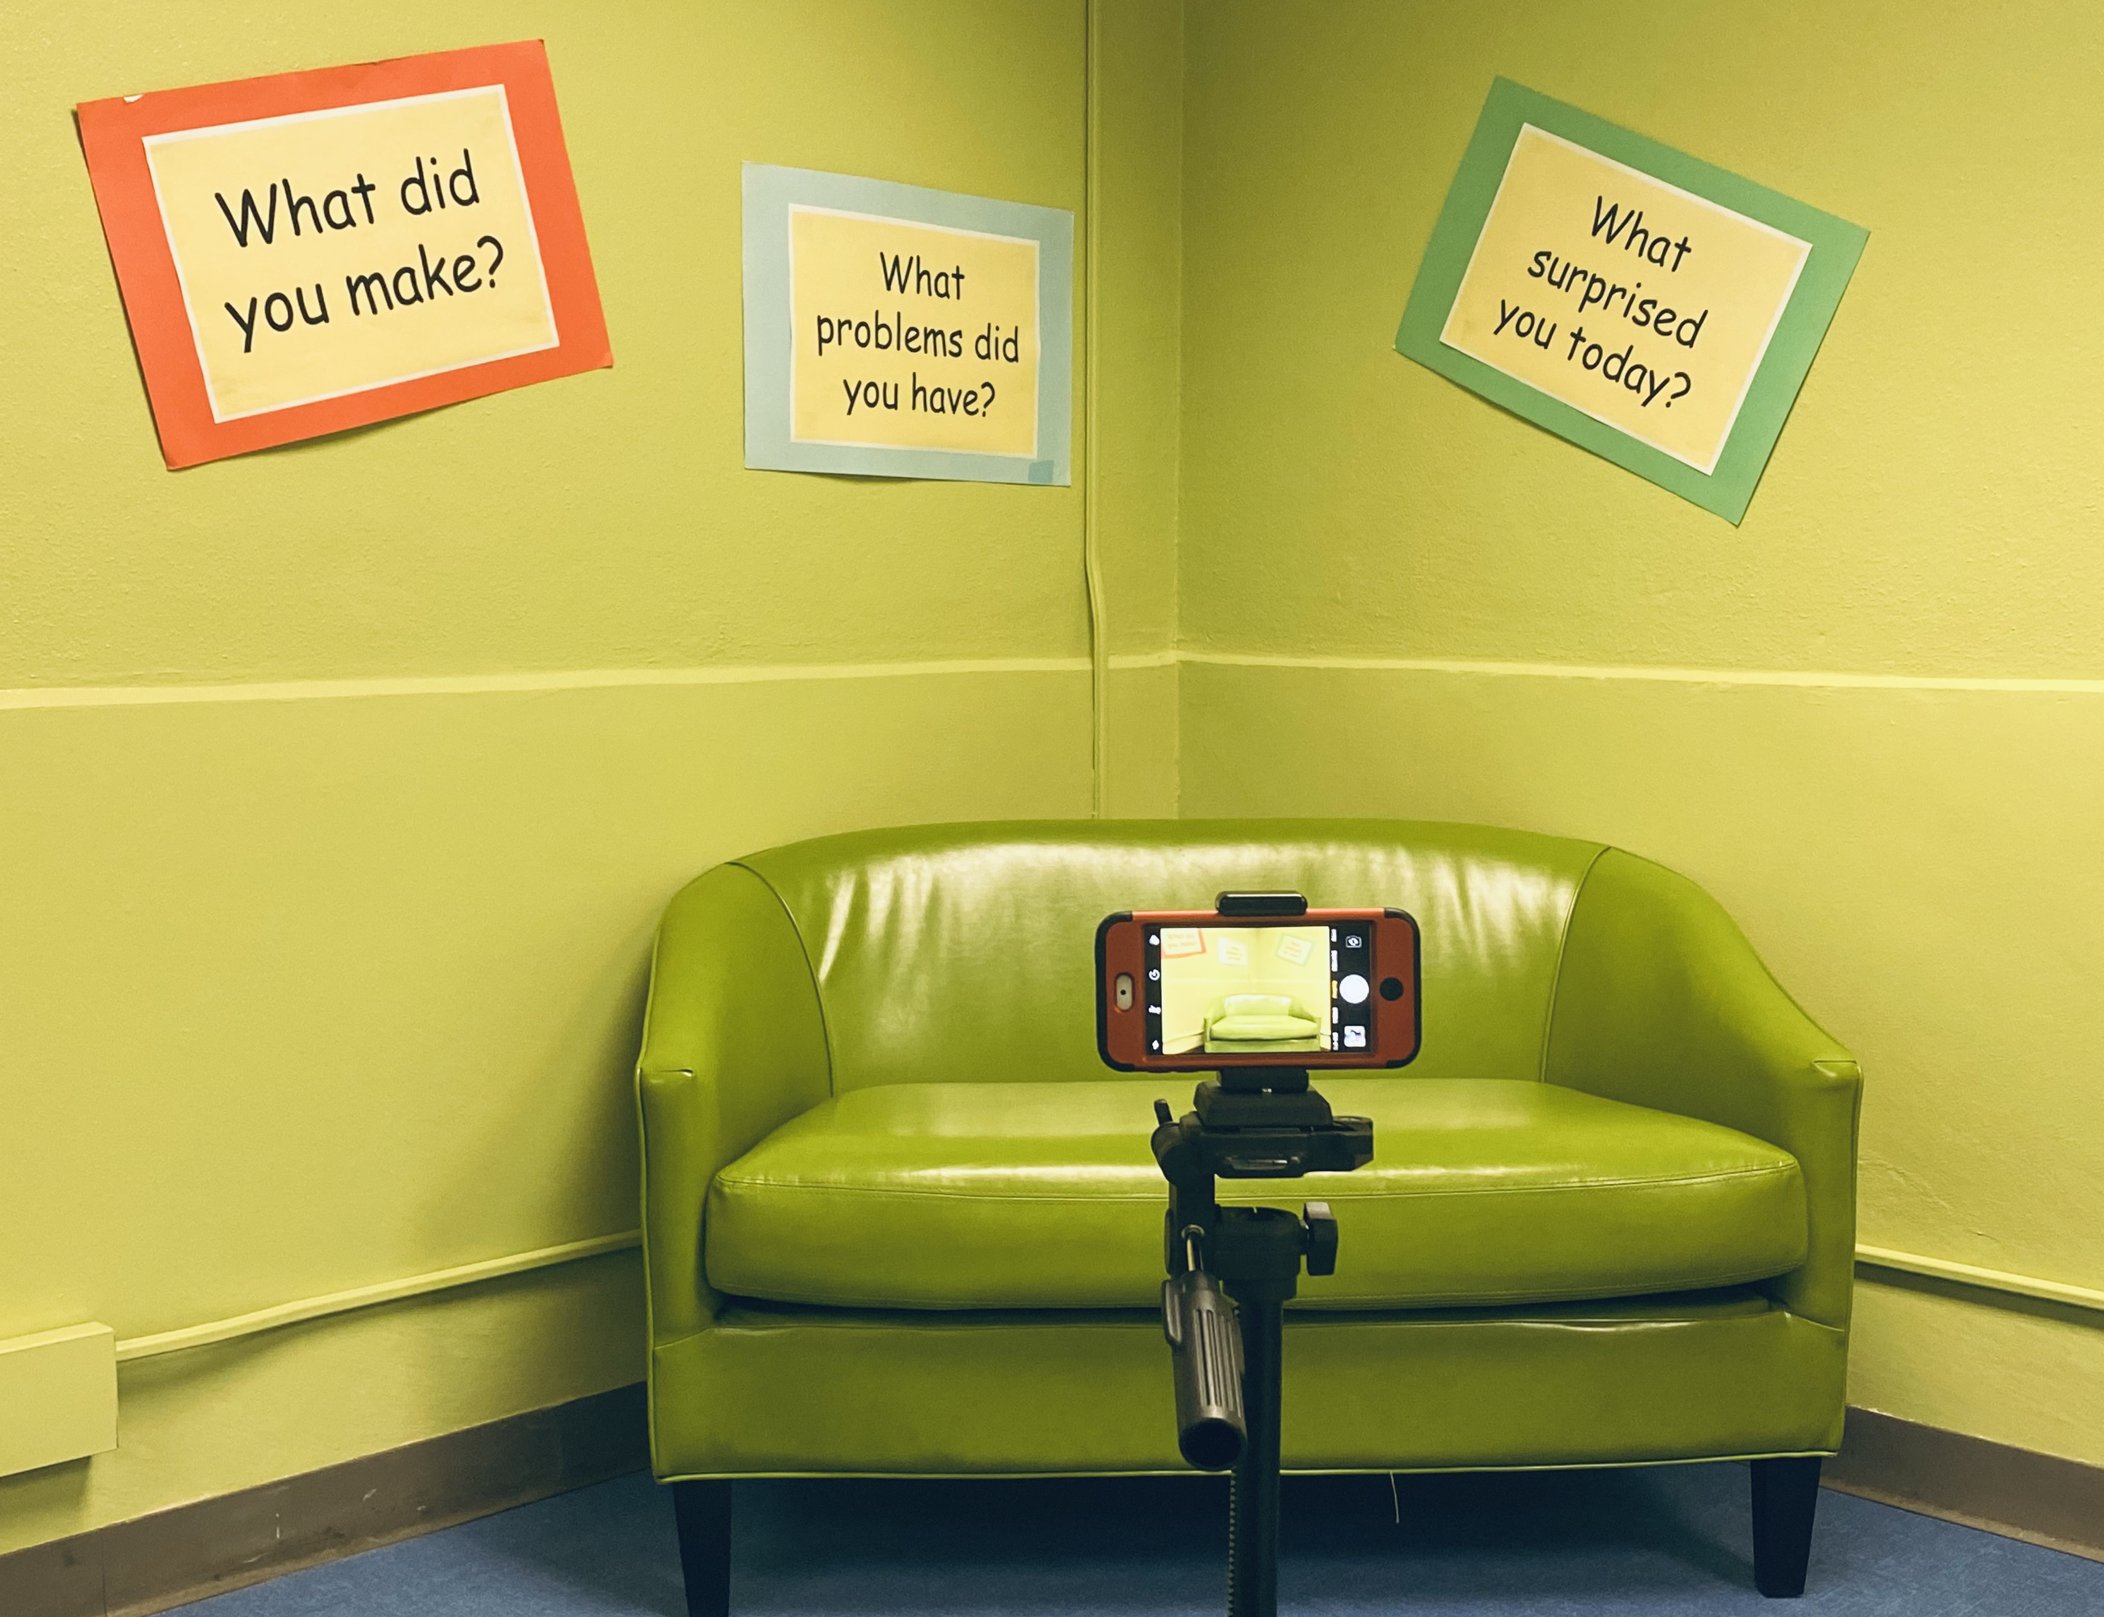
VIDEO SELFIE STATIONS
Tell me about what you made.
Did you have any big problems while you were creating this?
What could you do to improve your design?
Did anyone help you with this? How?

Slide 19
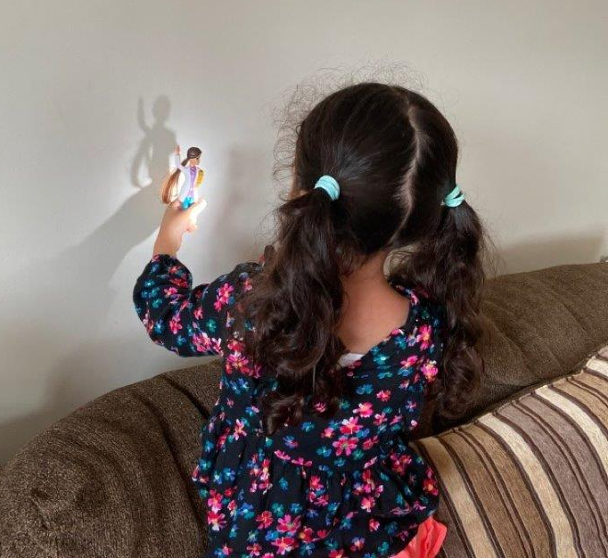
VIRTUAL REFLECTION COLLECTION
Scavenger Hunt on the Goosechase App
Example
Blocking Light: Use your flashlight and see if you can block out all the light with an object like your hand. Take a picture of how you blocked the light.

Slide 20
PAUSE & PONDER
What makes your program unique?
In what ways can you “start small” and try making minor changes to your programming?
How have you collected reflections from staff or patrons?

Slide 21
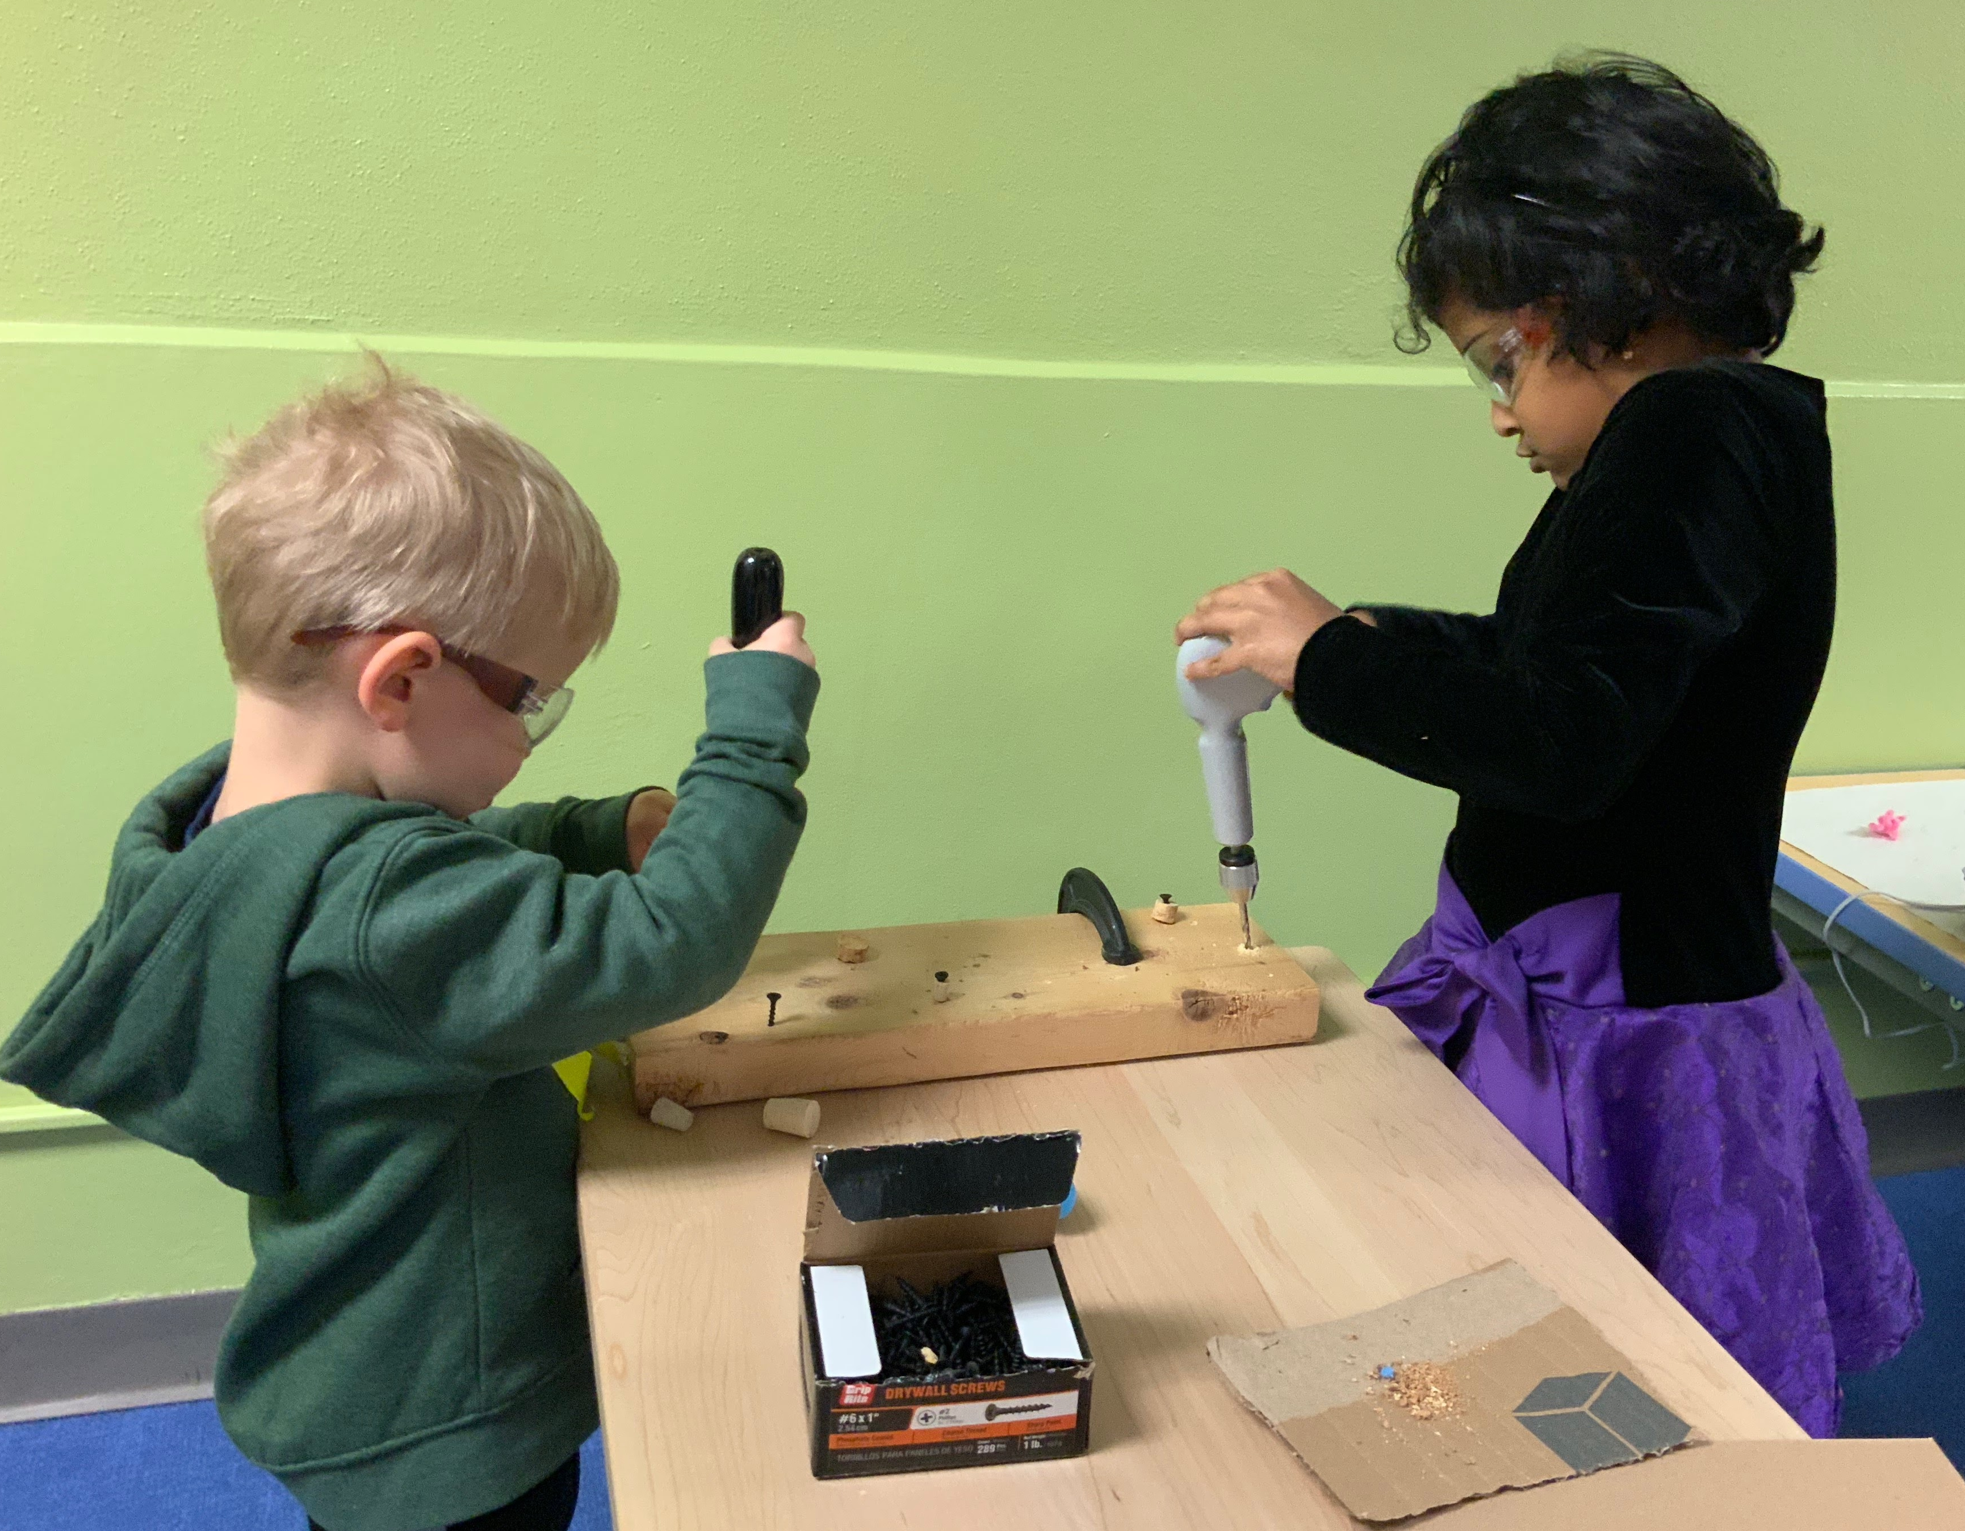
DATA IS YOUR FRIEND!
How will I know if the program was effective?
What meaningful data can I provide to stakeholders to help them understand the value of the program?
How can I move beyond just collecting data on the number served?

Slide 22

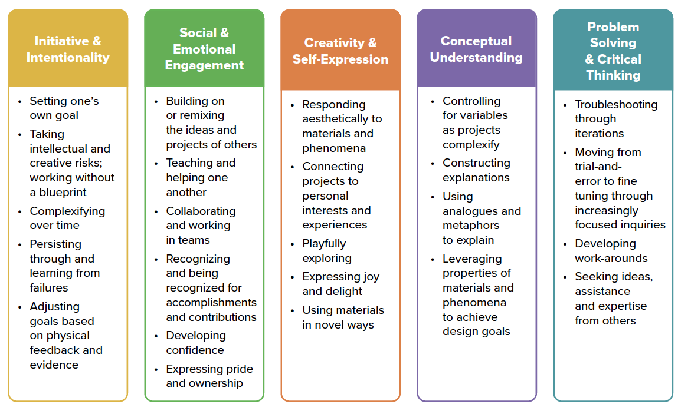
LEARNING DIMENSIONS

Slide 23
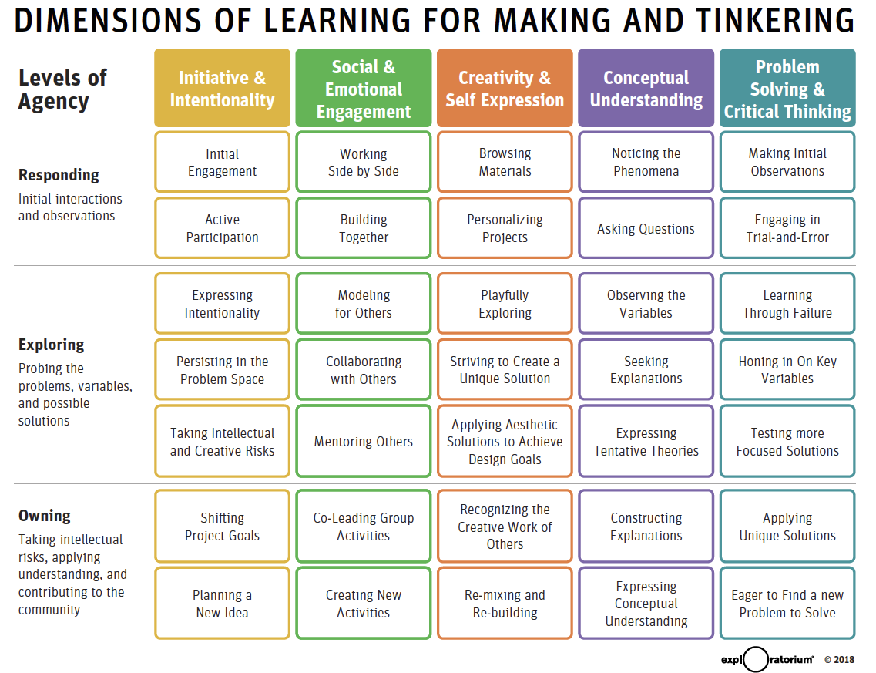
LEARNING DIMENSIONS

Slide 24
LEARNING DIMENSIONS

Slide 25
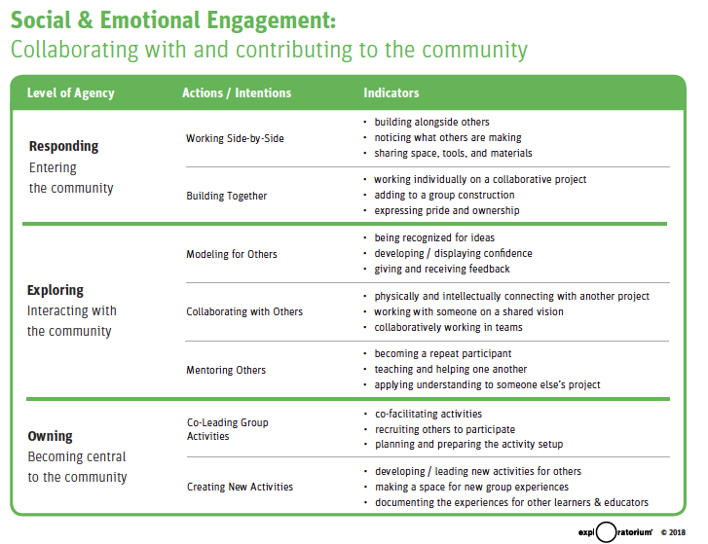
LEARNING DIMENSIONS

Slide 26
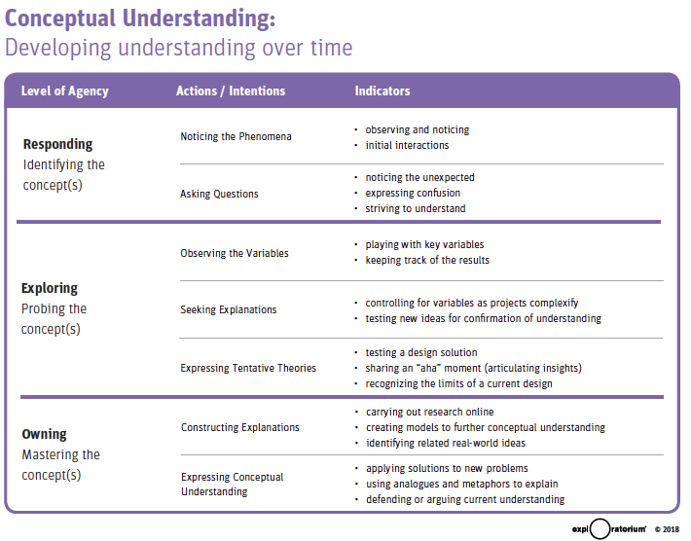
LEARNING DIMENSIONS

Slide 27
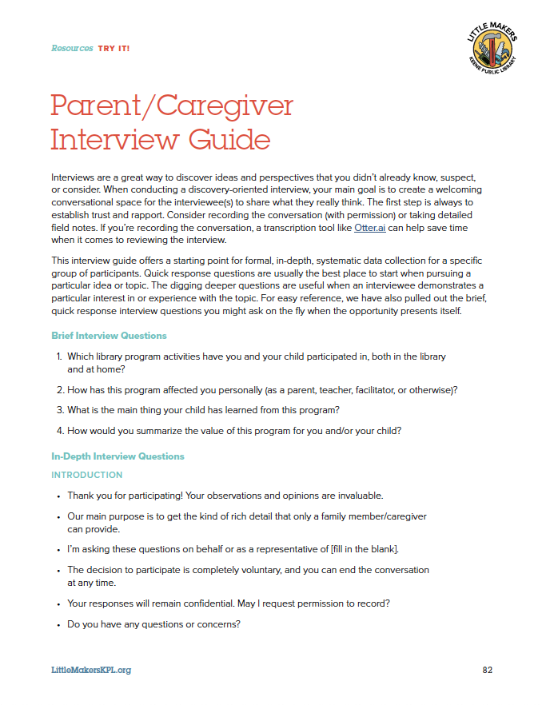
INTERVIEWS & SURVEYS
Set up a time (30 min) for a more formal interview
Catch people “in the moment”
Create your own survey -OR- Combine with a protocol you are already using (EXAMPLE: Project Outcome from PLA)

Slide 28
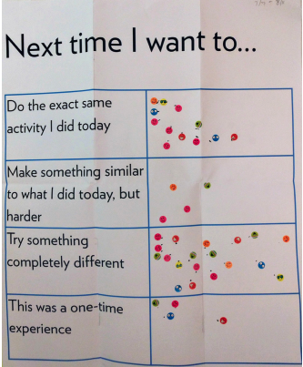

TALKBACK BOARDS
Quick and flexible way to collect data on your program
Can include questions where people ”vote” or questions with open-ended responses
Talkback board repository from the:

Slide 29
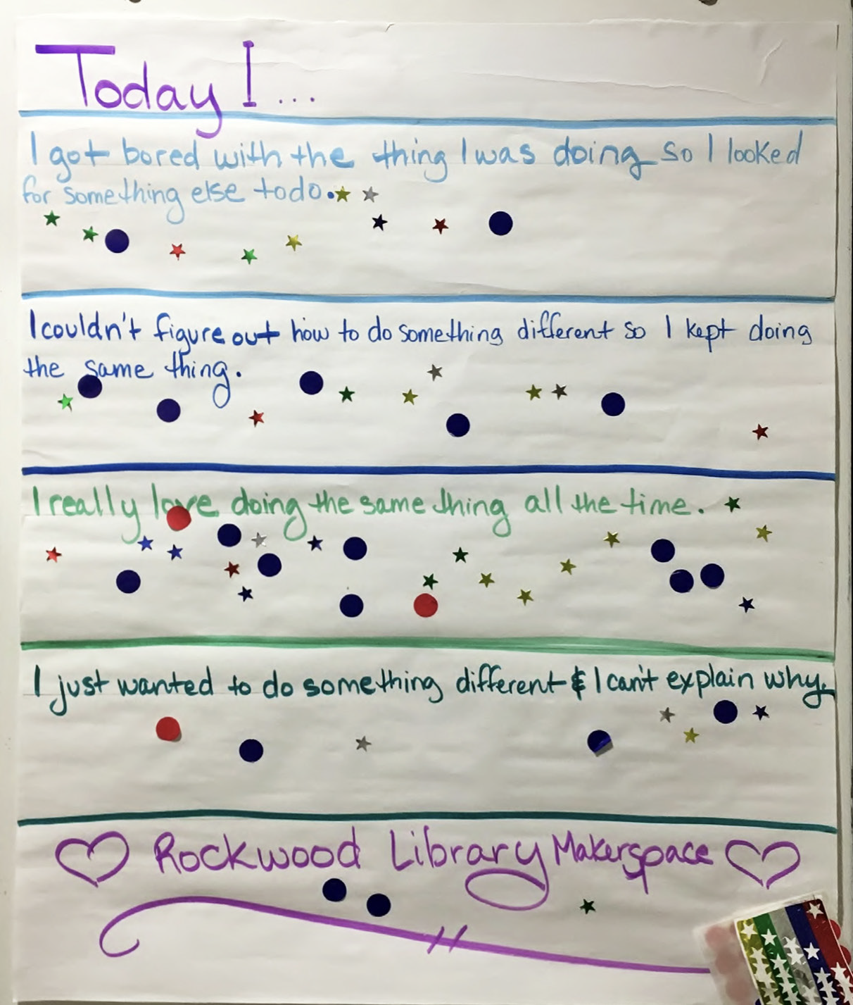
TALKBACK BOARDS
EXAMPLE (for adults):
  I will return for other programs.
  I will tell my friends to come to these programs.
  I would bring my friends to a program like this next time.
  I would be more likely to return if… (open-ended)
EXAMPLE (for children):
  How did you feel about today’s program?
  ☺ 😐 ☹

Slide 30
PAUSE & PONDER
What other ways do you collect data? From adults? From children?
What are some powerful questions that you have asked that gave you meaningful feedback for your programs?

Slide 31

LITTLE MAKERS TOOLKIT
Resources on facilitating programming for families at the library and at home!
Activity and evaluation ideas
Inspiration and lessons learned
LittleMakersKPL.org

