Slide 1
Welcome to today’s Infopeople Webinar!
Infopeople is dedicated to bringing you the best in practical library training and improving information access for the public by improving the skills of library workers. Infopeople, a grant project of the Califa Group, is supported in part by the Institute of Museum and Library Services under the provisions of the Library Services and Technology Act administered in California by the State Librarian. This material is covered by Creative Commons 4.0 Non-commercial Share Alike license. Any use of this material should credit the funding source.

Slide 2
The Art of Coding
An Infopeople Webinar
April 27, 2017
Presented by Sylvia Aguiñaga
Notes:
I’m Sylvia Aguinaga:
Director of Curriculum for DIY Girls. I like using technology to make art and I like helping others do the same. I have an academic background in Psychology and Library and Information Science. I am a coder hobbyist. I code art and synthesize video for fun.

Slide 3
DIY (“Do-It-Yourself”) Girls increases girls’ interest and success in technology, engineering, and making through engaging hands-on projects and solid mentor relationships.
We want girls to apply the tech skills they learn with us to projects they love, for a community they care about.
Notes:
DIY Girls is awesome. We’re an organization for girls driven by an interest in building with technology. We offer after-school and summer programs that provide hands-on STEAM (Science, Technology, Engineering, Art and Math) experiences. Girls learn technical skills and apply them by creating their own creative projects and inventions. They make things they love for a community they care about.

Slide 4
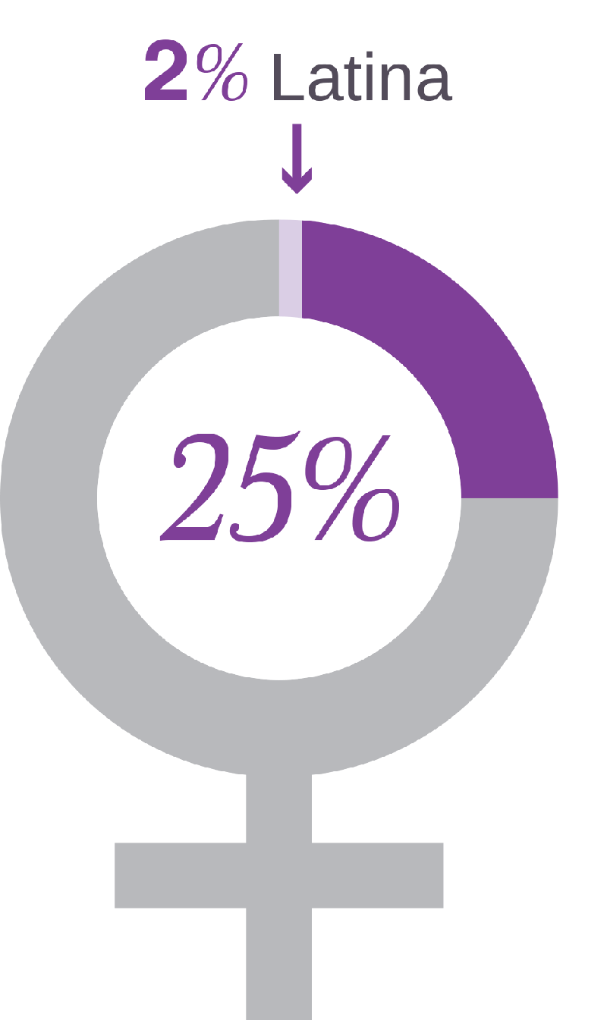
Notes:
We do what we do because it’s critical to growth and diversity of our society. Women make up roughly 25% of the tech industry with Latinas making up 2% of that 25. It’s unacceptable and we make sure to voice this to our girls during recruitment.

Slide 5
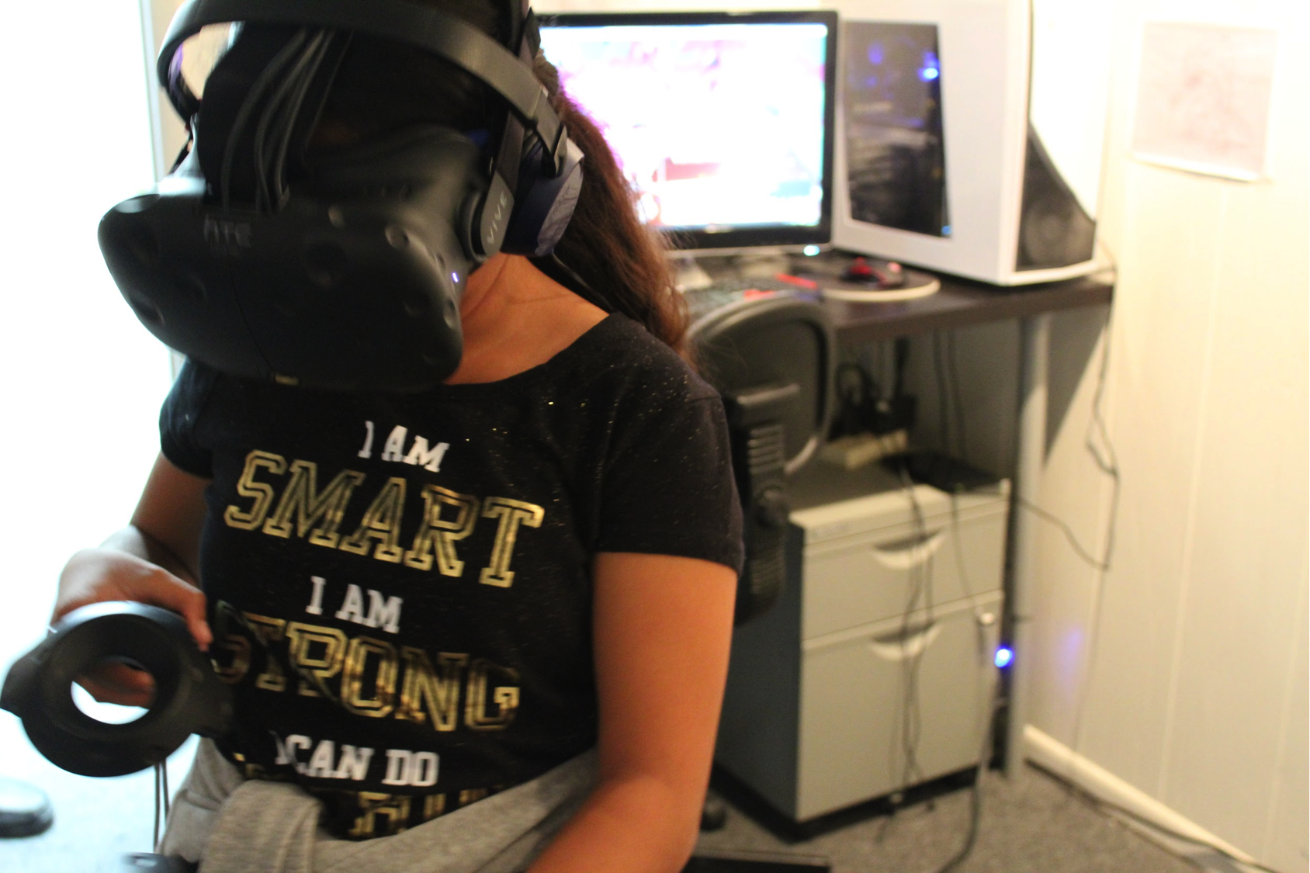
Notes:
Our message is clear: Girls can do anything they put their mind to.
We integrate engagement, capacity building, and continuity to ensure our girls’ success.

Slide 6
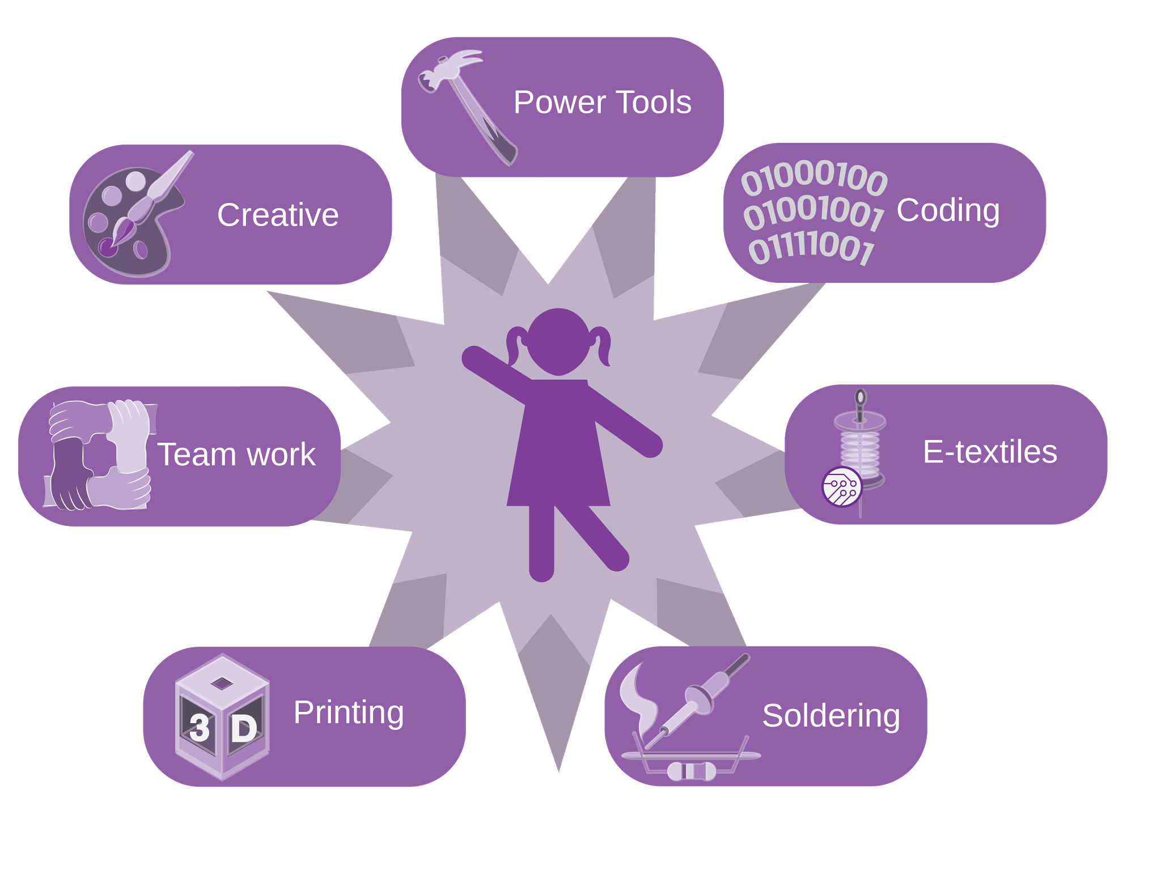

Slide 7
Notes:
We create curriculum to make the world better.
More beautiful, more fun, safer, cleaner, brighter.
Our programs include woodworking, creative electronics, making for good, and creative coding.
Today, I will present to you how we teach code through digital art-making.

Slide 8
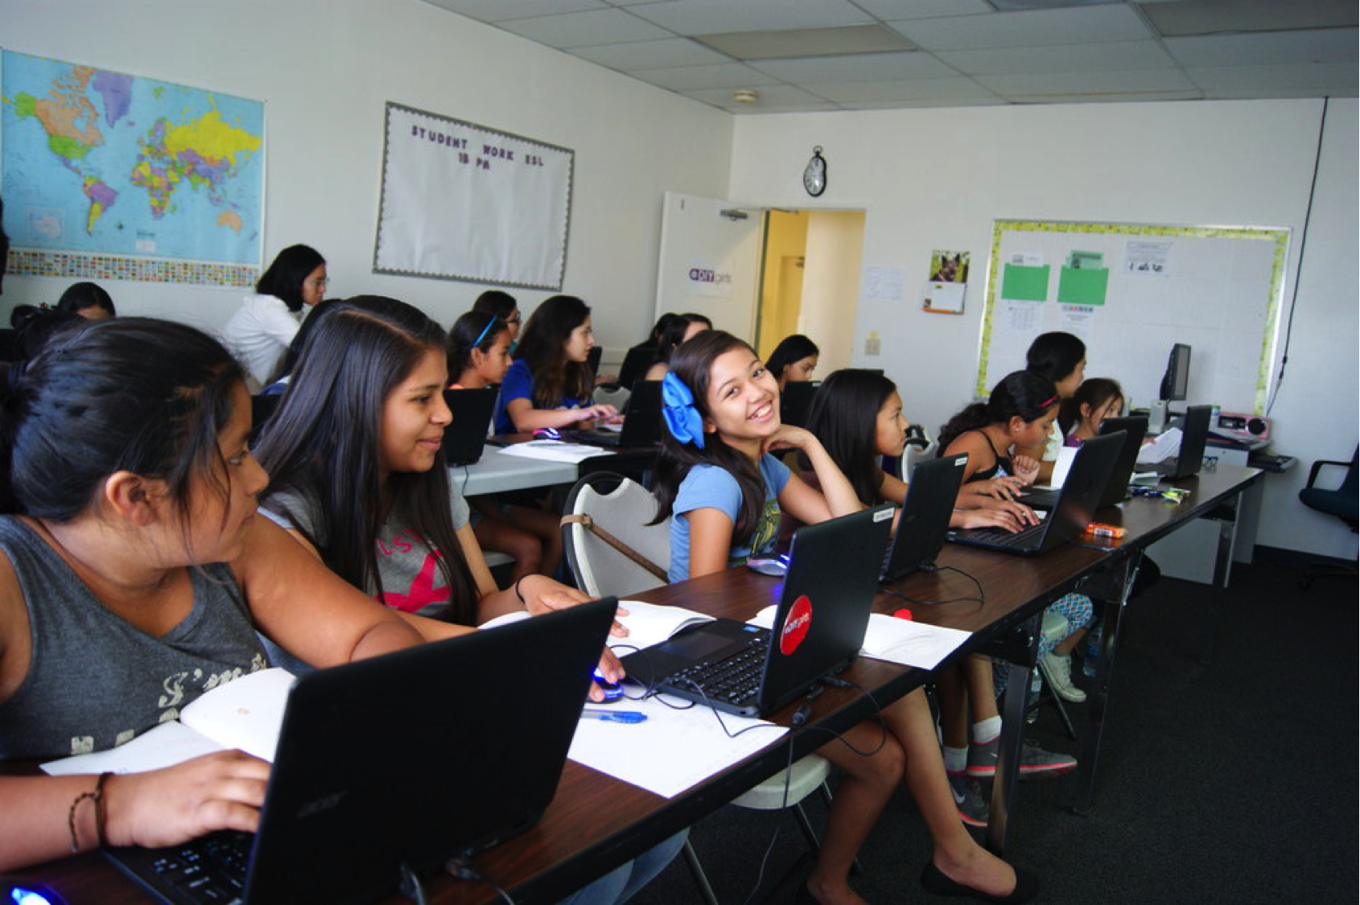
Notes:
Our coding lessons incorporate unplugged and online activities that build connections between coding concepts and apply them to projects. Along with hard skills in coding, students learn the processes and mindsets of a computer programmer. Students learn to approach failure as an opportunity, collaborate with peers on writing and reviewing code, and tap into their own creativity without reservations.
There are many languages out there. We chose one: p5.js.
P5.js is a language for learning how to code within the context of the visual arts. In our class, students practice computational thinking skills and learn the fundamentals of coding to create artwork. Students will learn coding concepts including: variables, operators, and functions with a goal of creating a unique sound machine. Mouse input and keyboard input will be used to interact with their design. At the end of the course, once students have explored P5.js, they will prepare their project to share at a culmination digital gallery showcase.

Slide 9
WHAT?
Notes:
We use a computer language with all its rules and idiosyncrasies to tell a computer to create shapes, color, & sound. Then we interact with it!
❓Think of your computer screen as an art canvas & your code is your paint. What is the keyboard?
✅ The paint brush

Slide 10
WHAT.
Notes:
What is code? What is programming?

Slide 11
Computational Thinking Definition
Computational Thinking is the process of expressing your thinking in a formal structure that a computer can process. Similar to writing notes on a piece of paper to “get your thoughts down,” creating a program allows people to externalize their thoughts in a form that can be manipulated and scrutinized. Programming allows students to think about their thinking; by debugging a program, students debug their own thinking (Papert, 1980).
Notes:
According to Seymour Papert:
“Computational Thinking is the process of expressing your thinking in a formal structure that a computer can process. Similar to writing notes on a piece of paper to “get your thoughts down,” creating a program allows people to externalize their thoughts in a form that can be manipulated and scrutinized. Programming allows students to think about their thinking; by debugging a program, students debug their own thinking.” (Papert, 1980).
So, we’re using computational thinking with the goal of making art.

Slide 12
= $
Notes:
People do it all the time.
https://www.youtube.com/watch?v=Vwz3__JECEM
And they get paid for it.

Slide 13
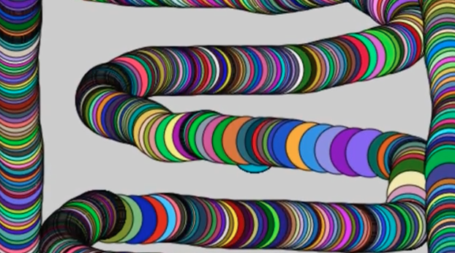
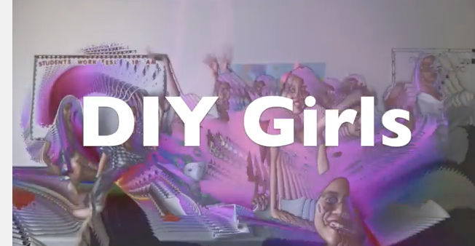
Notes:
I’ll leave you to explore the links I have under inspiration to see what this stuff looks like in the professional world.
These are screenshots of what our final projects look like. I have linked our showcase video under resources so that you can see how one might interact with the final product.
https://www.youtube.com/watch?v=oHMzjJXr59Y&feature=youtu.be
Coding art allows our girls to express themselves in their own way while learning critical skills for the future.
It’s important to teach our kids in this digital age that they can be active participants in a movement of changing and growing as a society.
We cannot settle with consuming products -- even if they’re high quality. We need to make sure our kids have the skills to use products critically, and most importantly, create something new.

Slide 14
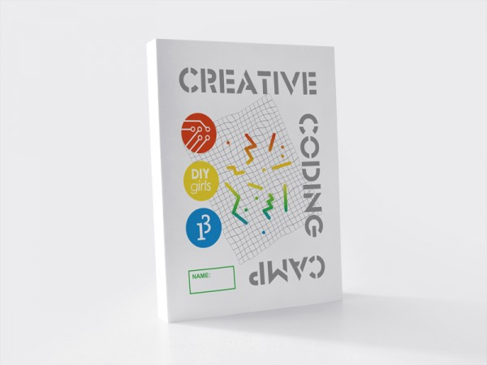
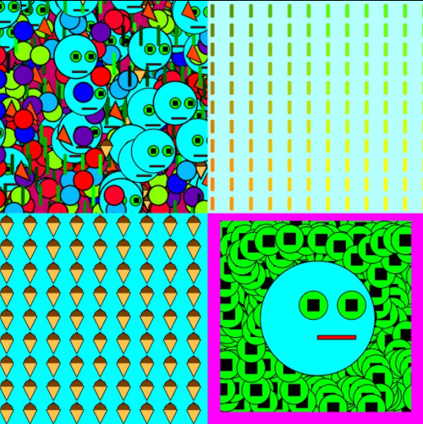
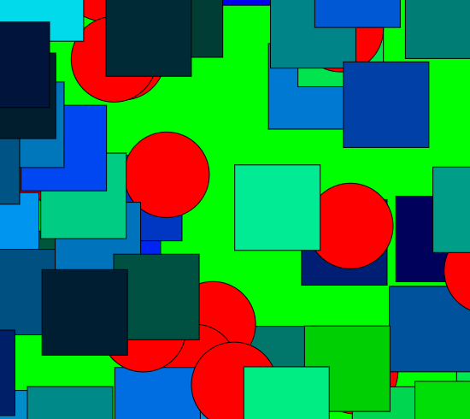
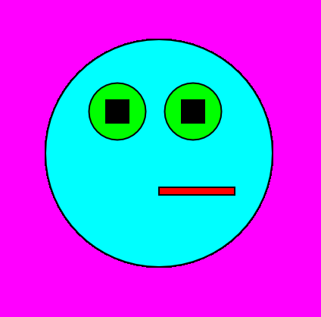
Notes:
To be shared soon!
These materials will allow you to run your own club packed with at least 20 hours of content.
Creative Coding Scope & Sequence
Creative Coding Curriculum
Creative Coding Zine
But what can you do now? Start with a two-hour workshop - Recreate a famous art piece with code.
Share facilitator guide, reference sheet, and LHOC training video.

Slide 15
FAIL.
Notes:
& remember to fail! Failure is the first step in learning. You cannot be afraid.

Slide 16
Let’s try it.
Notes:
Screenshare Open Processing demonstration.
Screenshare explanation of shared folder.

Slide 17
Open Processing
open openprocessing.org in Chrome

Slide 18
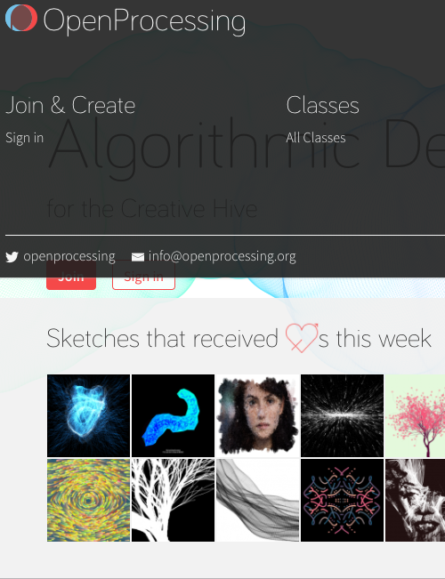
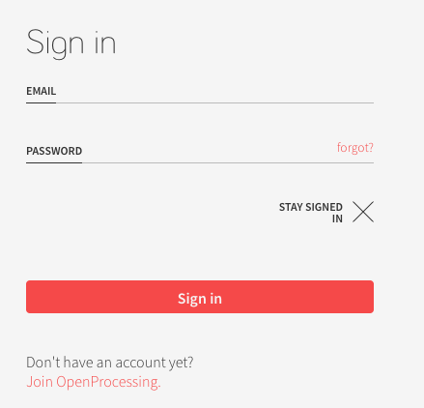

Slide 19
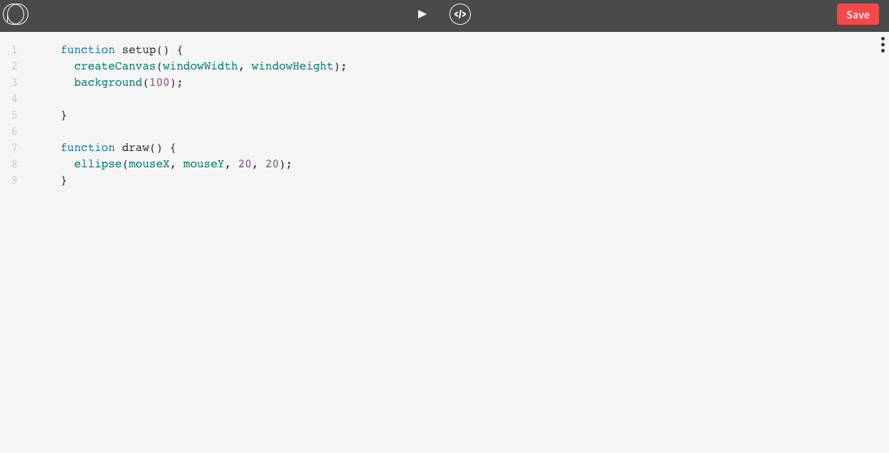
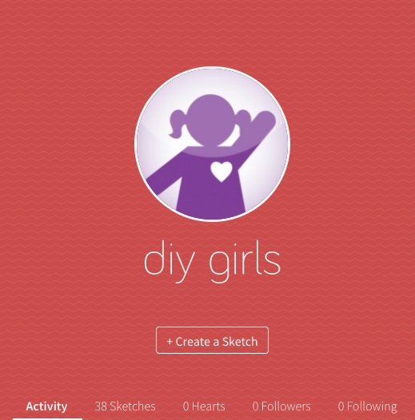
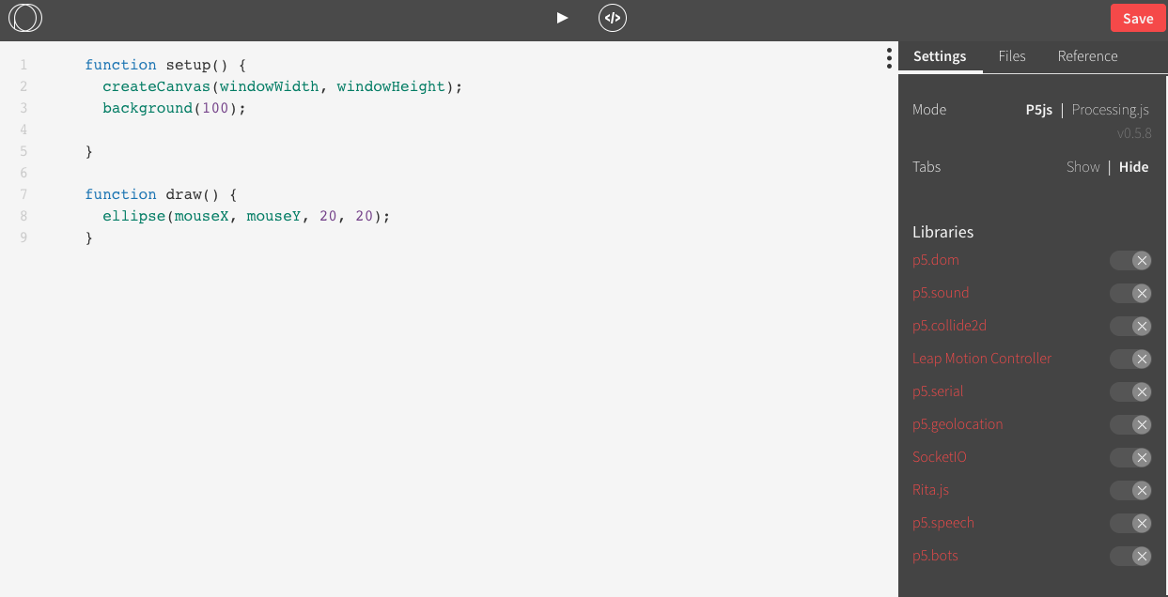

Slide 21
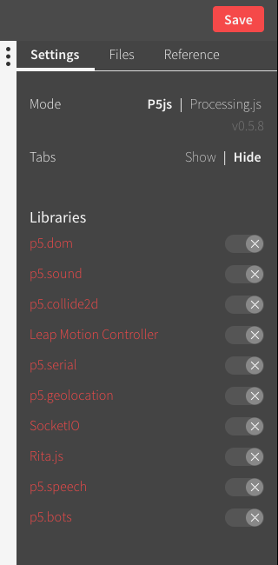
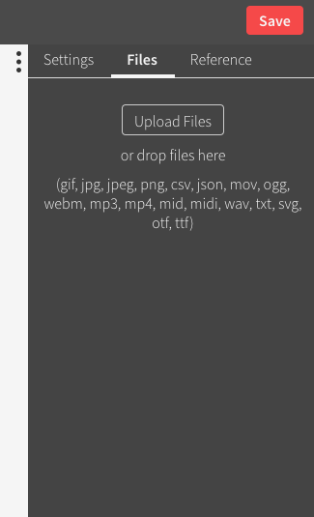

Slide 22
✅ Protocols that help
Notes:
We take

Slide 23
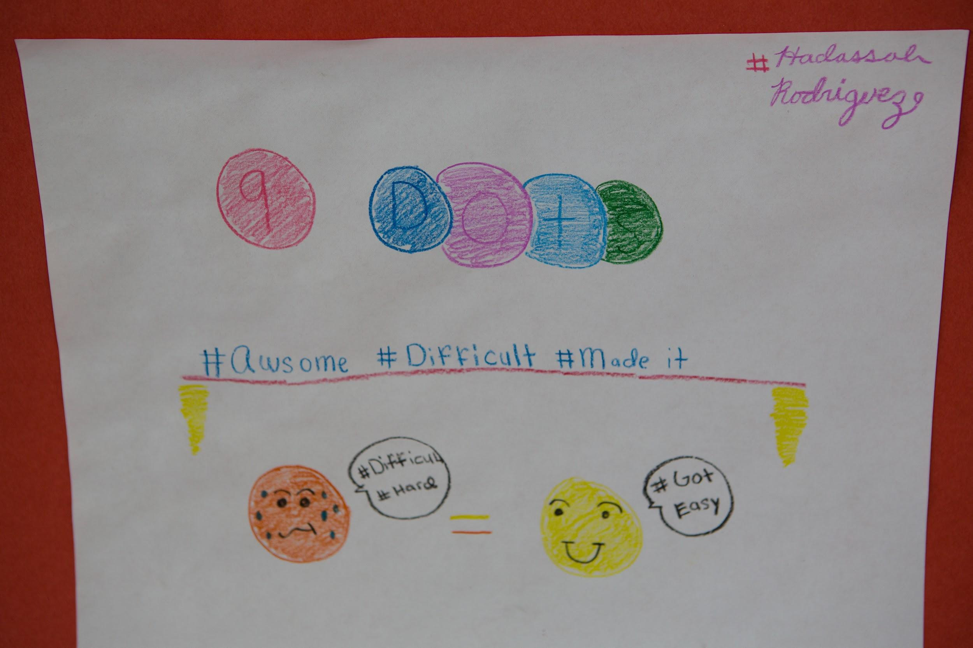
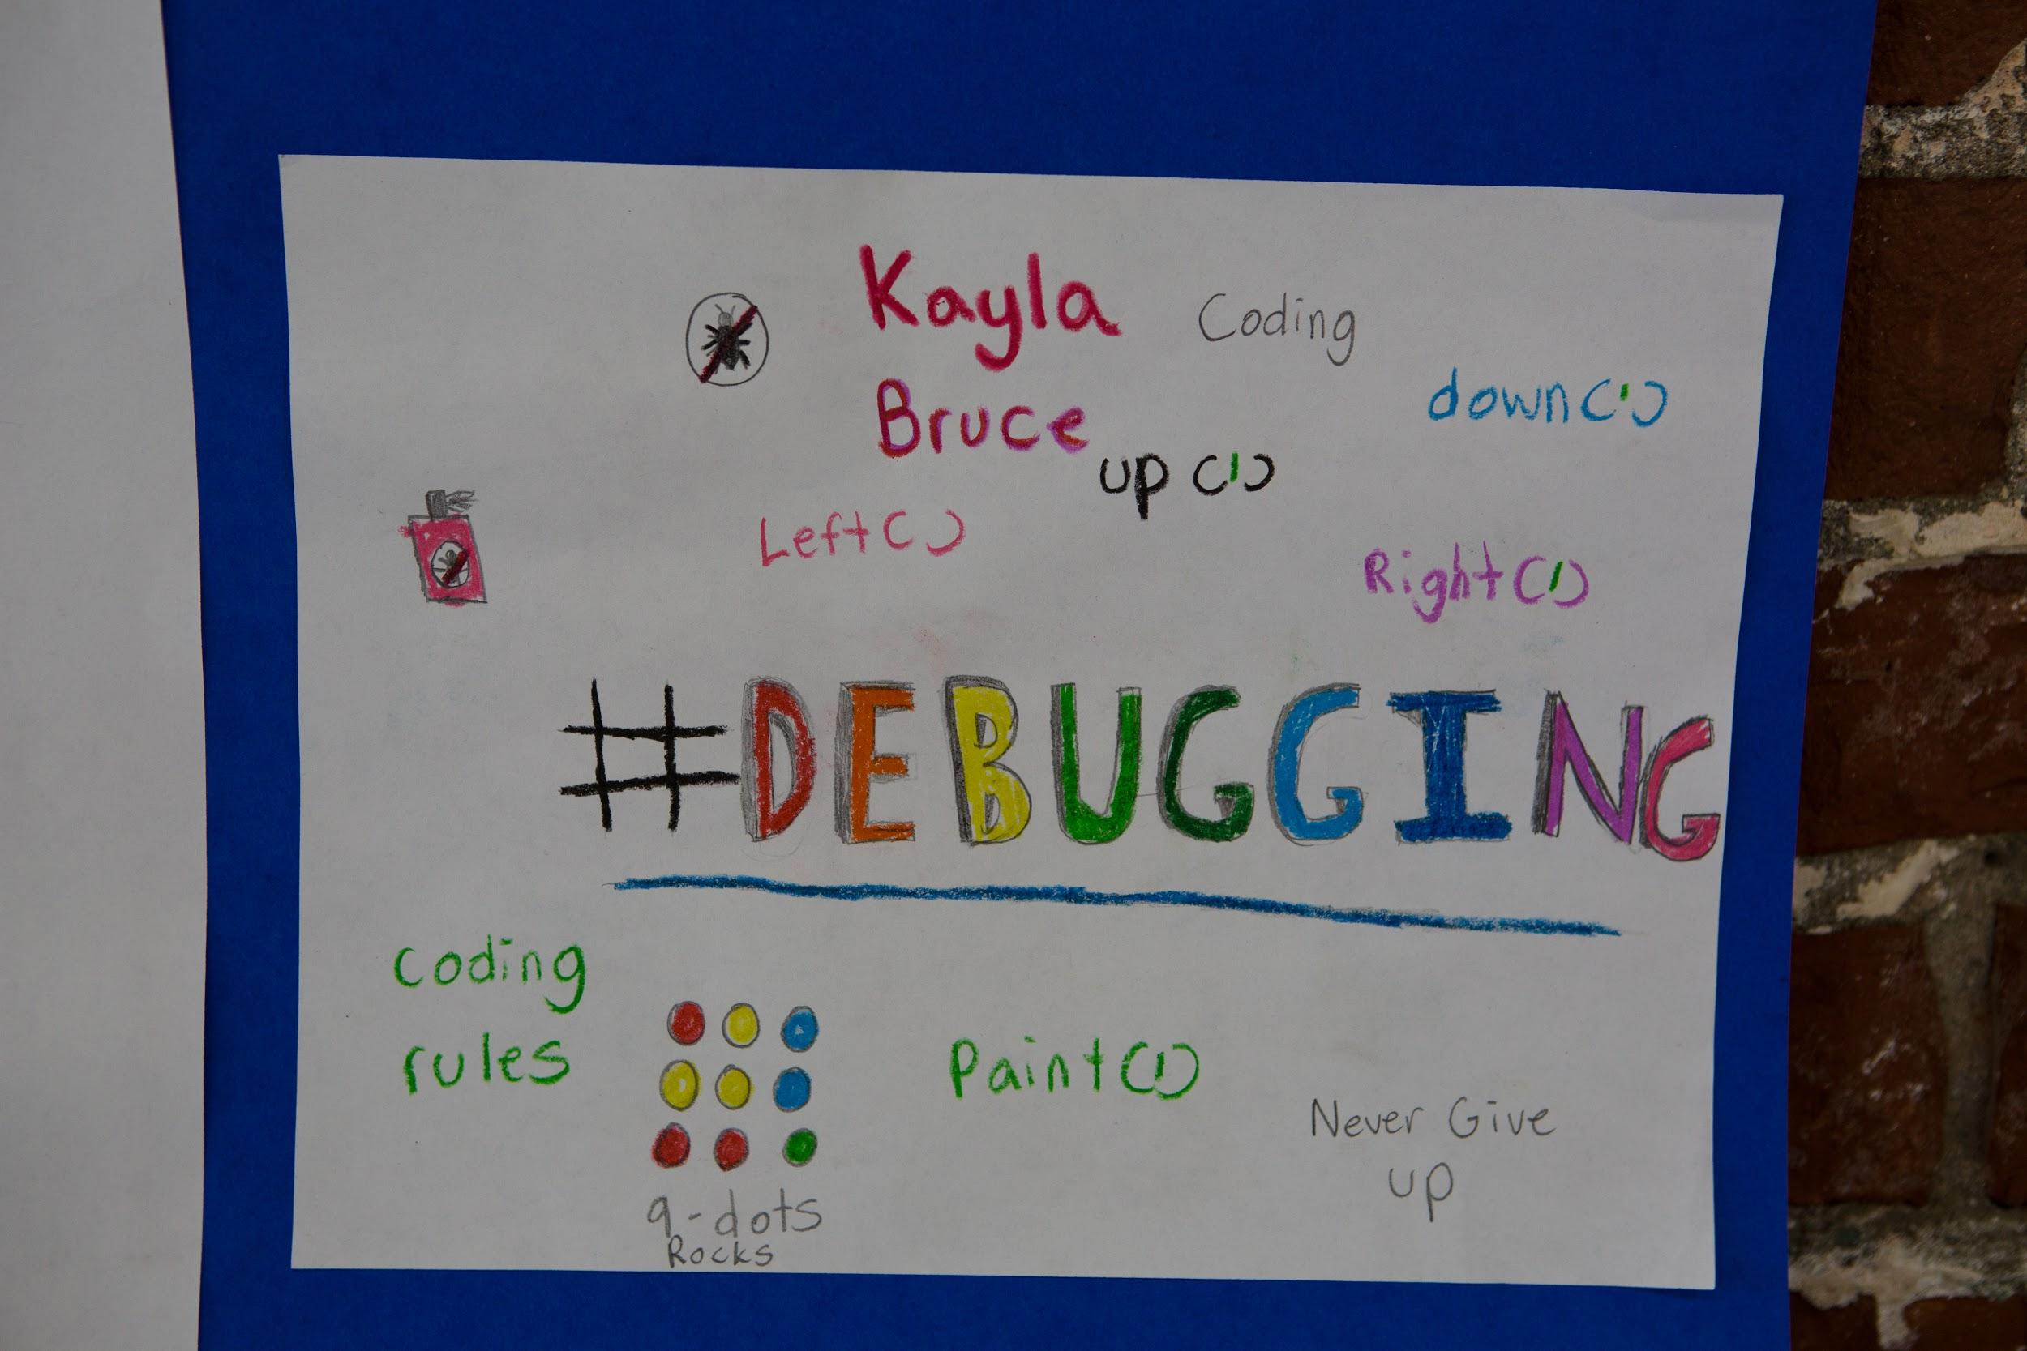
Debug
Notes:
Debugging = Creative problem solving.
A bug is when you think you’re telling the computer one thing, but it’s doing something else - or not doing anything at all.
When your code is broken:
0. Don’t Panic.
- Breathe. Stand up. Look out a window or go outside!
- Your attitude will frame the way you tackle the issue. Be the detective and find out what your code IS doing, not what it is not. Stay positive.
1. Compare - Find - Fix
- Compare what you want with what your code does.
- Find the bug in your code.
- Attempt to fix the bug.
2. Look at documentation and working code
- Look at your notes and past code. See what you can learn.
3. Find a peer or tutor, tell the story, ask a question
- Tell the story of what you have tried. Be detailed.
- Ask a precise question. Share your questions with others.

Slide 24
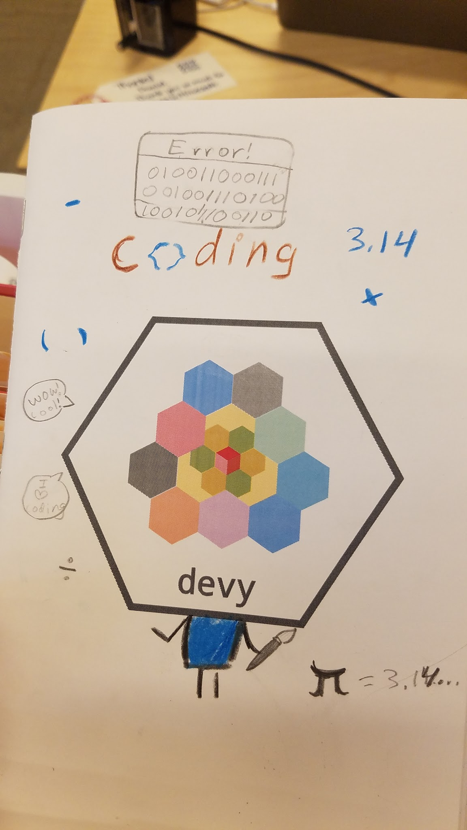
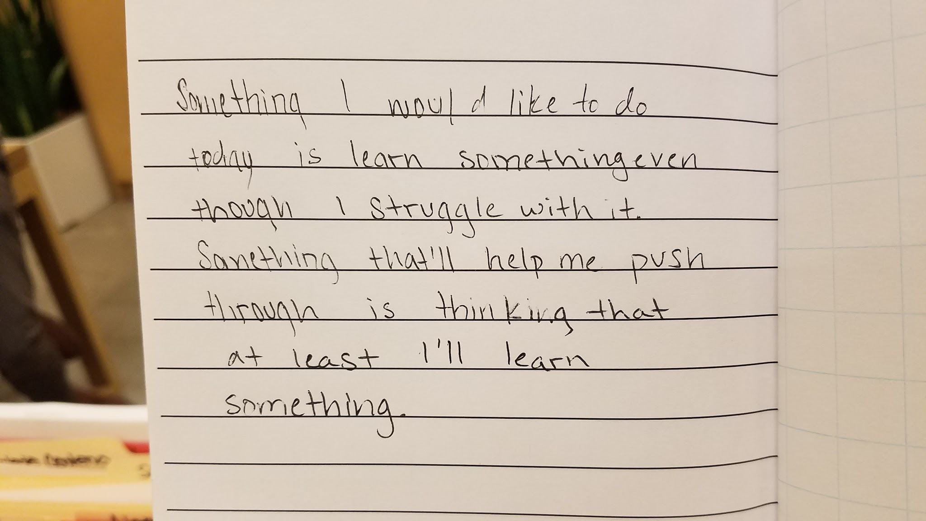
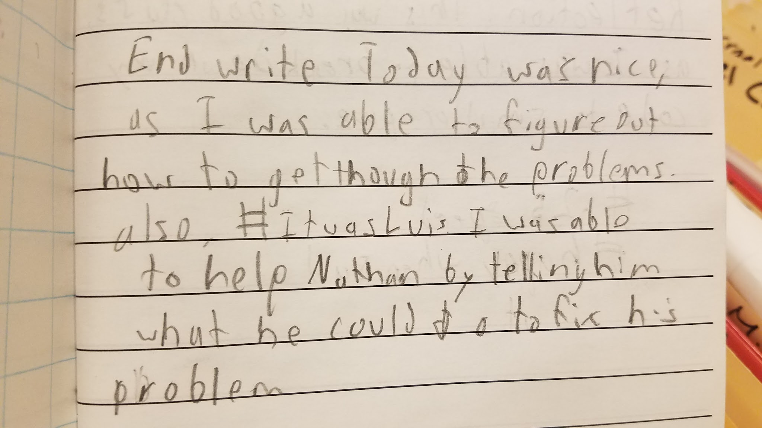
Reflect
Notes:
Reflect as much as possible on the process.

Slide 25
Let’s talk. Bring struggle out of the shadows.
Notes:
Journals come into play here.

Slide 26
Write tiny tweets about how you felt at the time.
(talk with a neighbor and then share)

Slide 27
Tell me about the hardest bit of code you debugged today.
(write in your journal, talk with a neighbor, and then share)

Slide 28
How did you feel when you found your code broke?
(write in your journal, talk with a neighbor, and then share)

Slide 29
What were some successful approaches to debugging?
(write in your journal, talk with a neighbor, and then share)

Slide 30
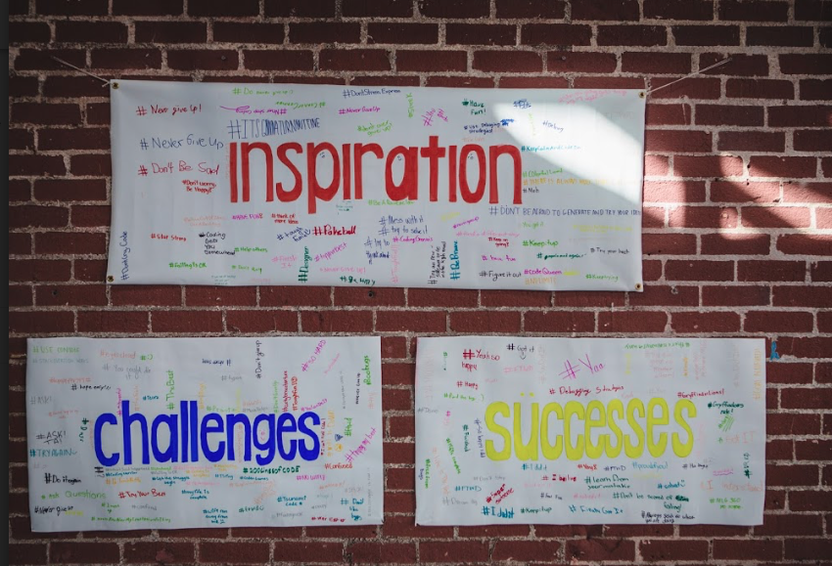
Notes:
Always celebrate with some sort of culmination event.

Slide 31
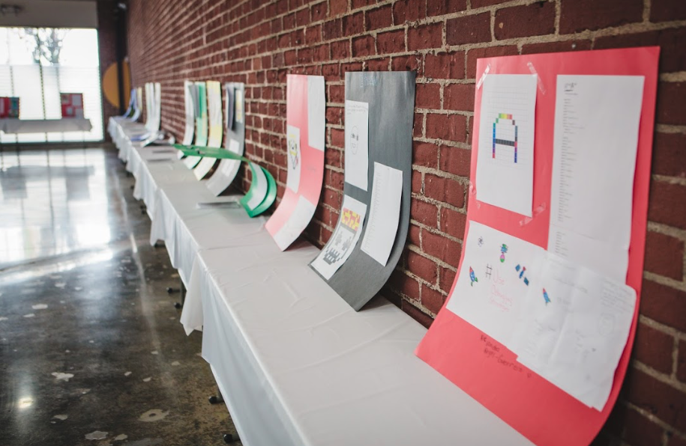

Slide 32
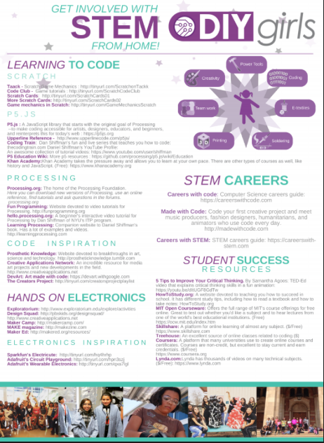
Notes:
I’ve compiled a list of resources we find super helpful.
These include coding resources, but also notes on electrical engineering and STEM careers in general.

Slide 33
tinyurl.com/artofcoding
Notes:
This is where you’ll find all of the material I went through earlier.

Slide 34
@DIYGirls
Notes:
Follow us for updates, release of materials, Spanish translation!

Slide 35
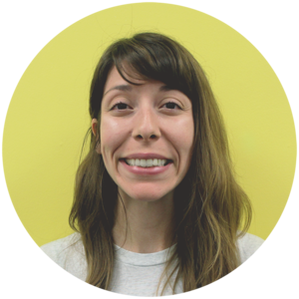
Sylvia Aguinaga
Director of Curriculum
sylvia@diygirls.org

Slide 36
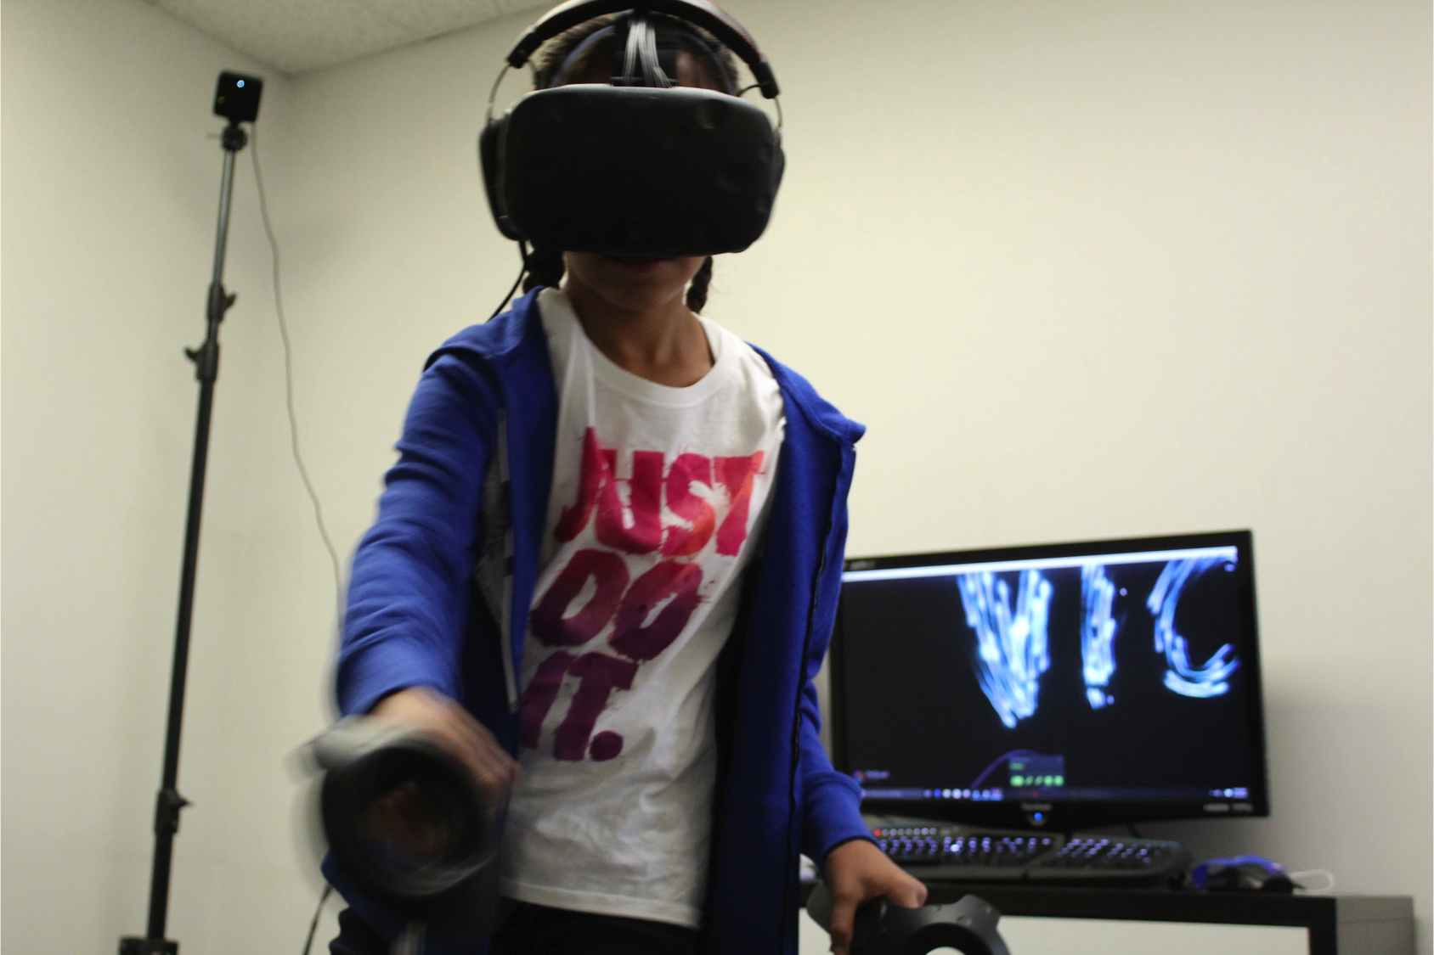
#InThisTogether
Notes:
Ask questions! What keeps me motivated is that we’re endlessly curious about new technology, new studies/findings, new organizations, new collaborations. We’re truly in this together #inthistogether. We all have a mission to make our voices heard as women. as powerful thinkers and leaders. So, go out there and make things happen. Get coding.

