Slide 1
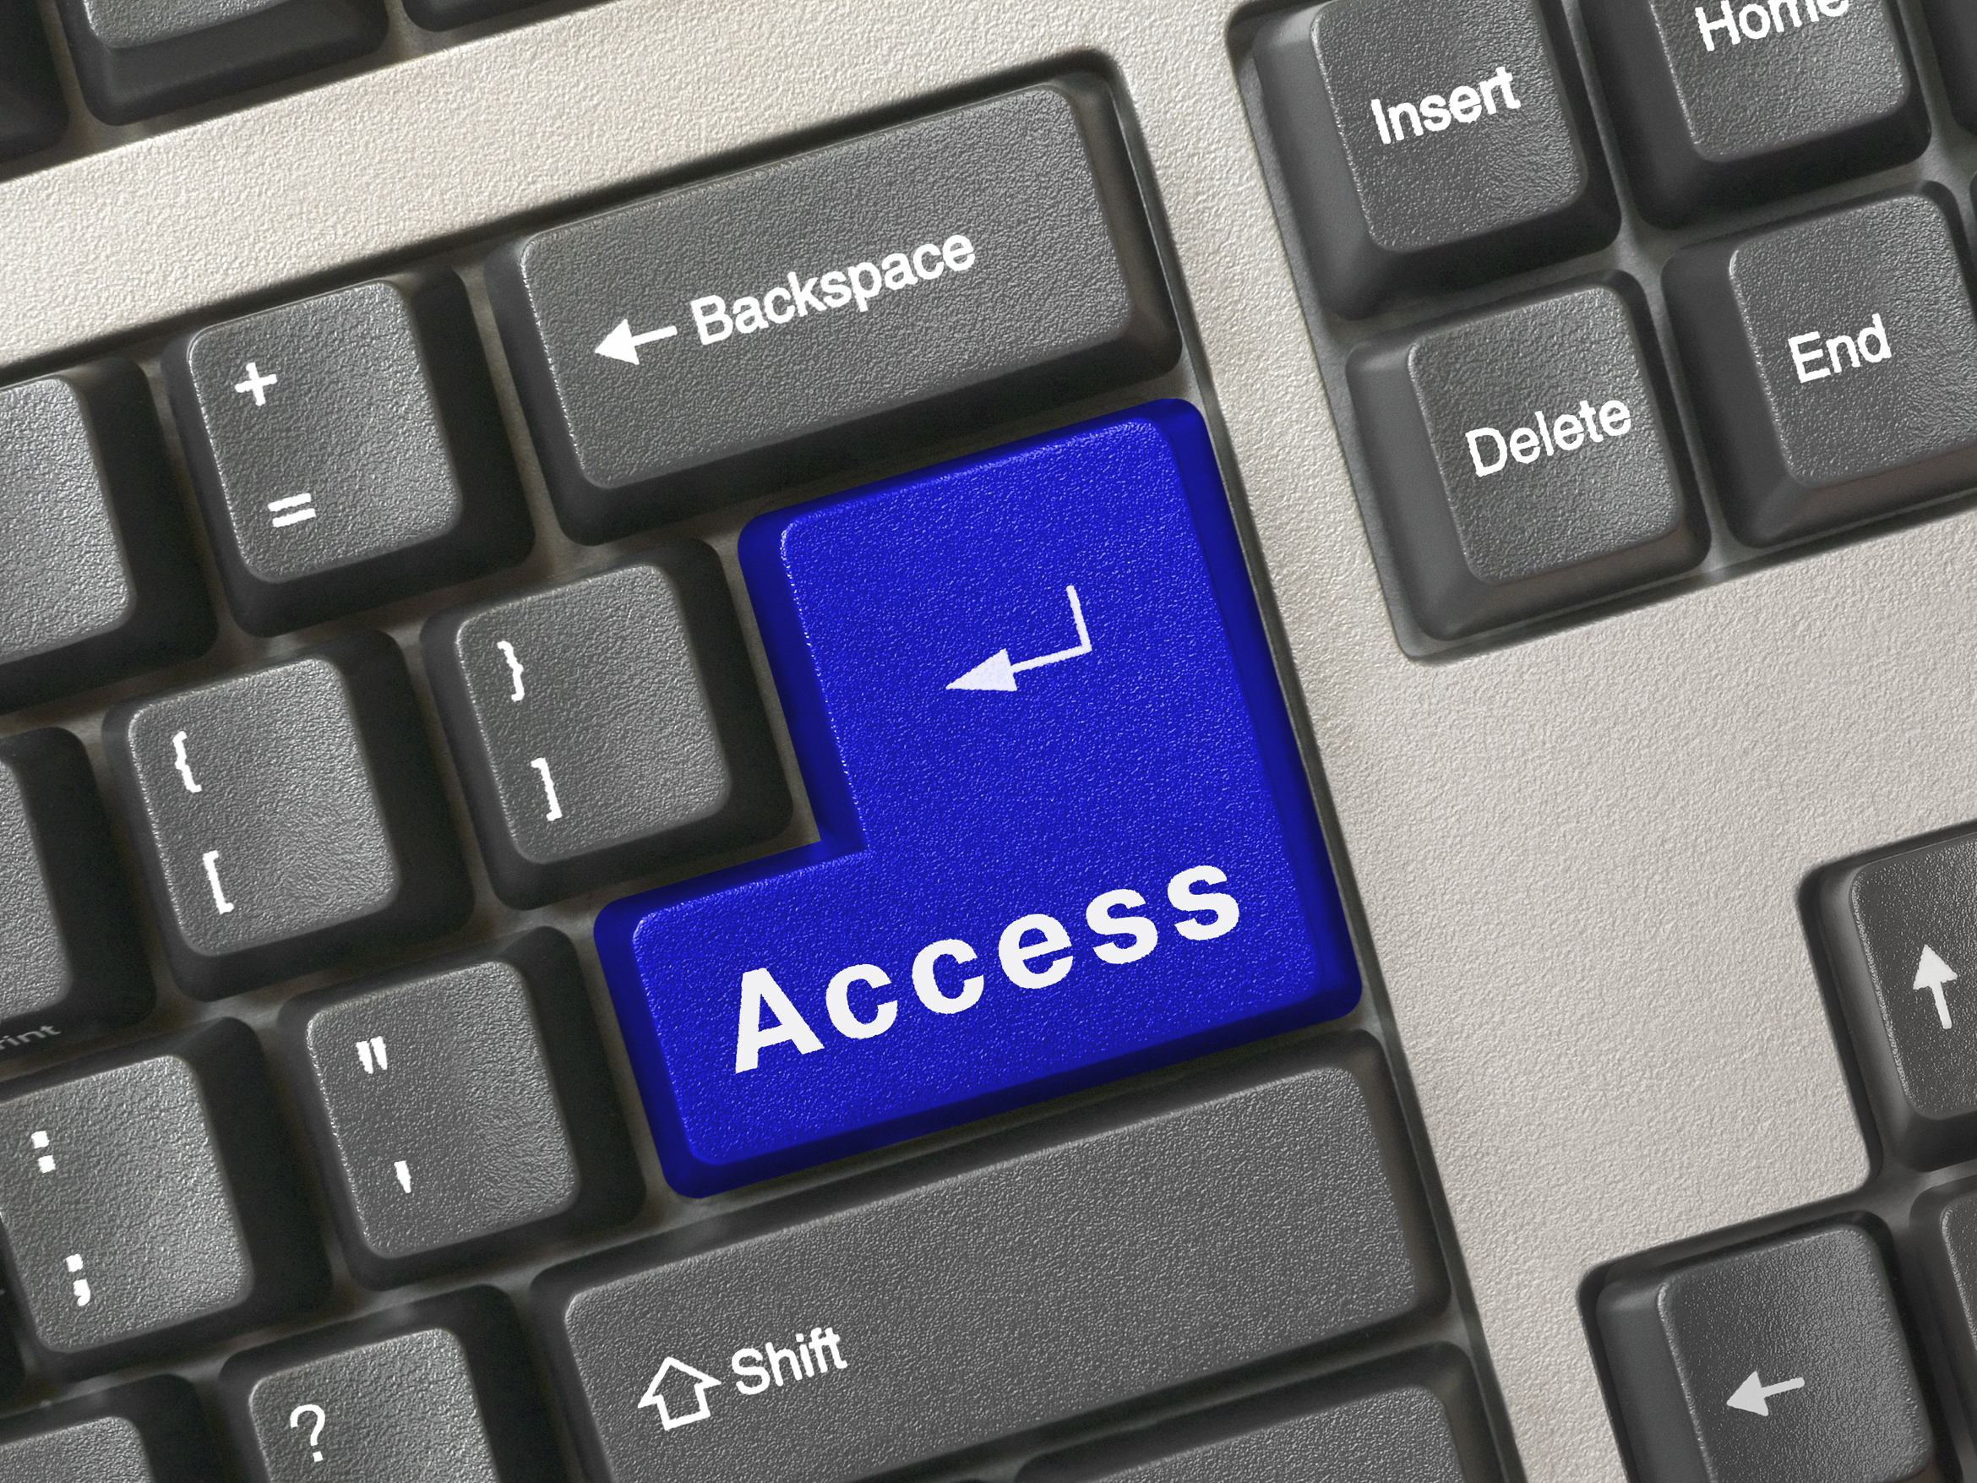
The Accessible Website:
If You Build It, Everyone Can Come!
An Infopeople Webinar
Presented by Kelli Ham
June 6, 2013

Slide 2


Objectives
By the end of the webinar, participants will:
Understand online accessibility issues
Know about accessibility tools for checking websites and content
Have a starting point for
creating accessible content

Slide 3
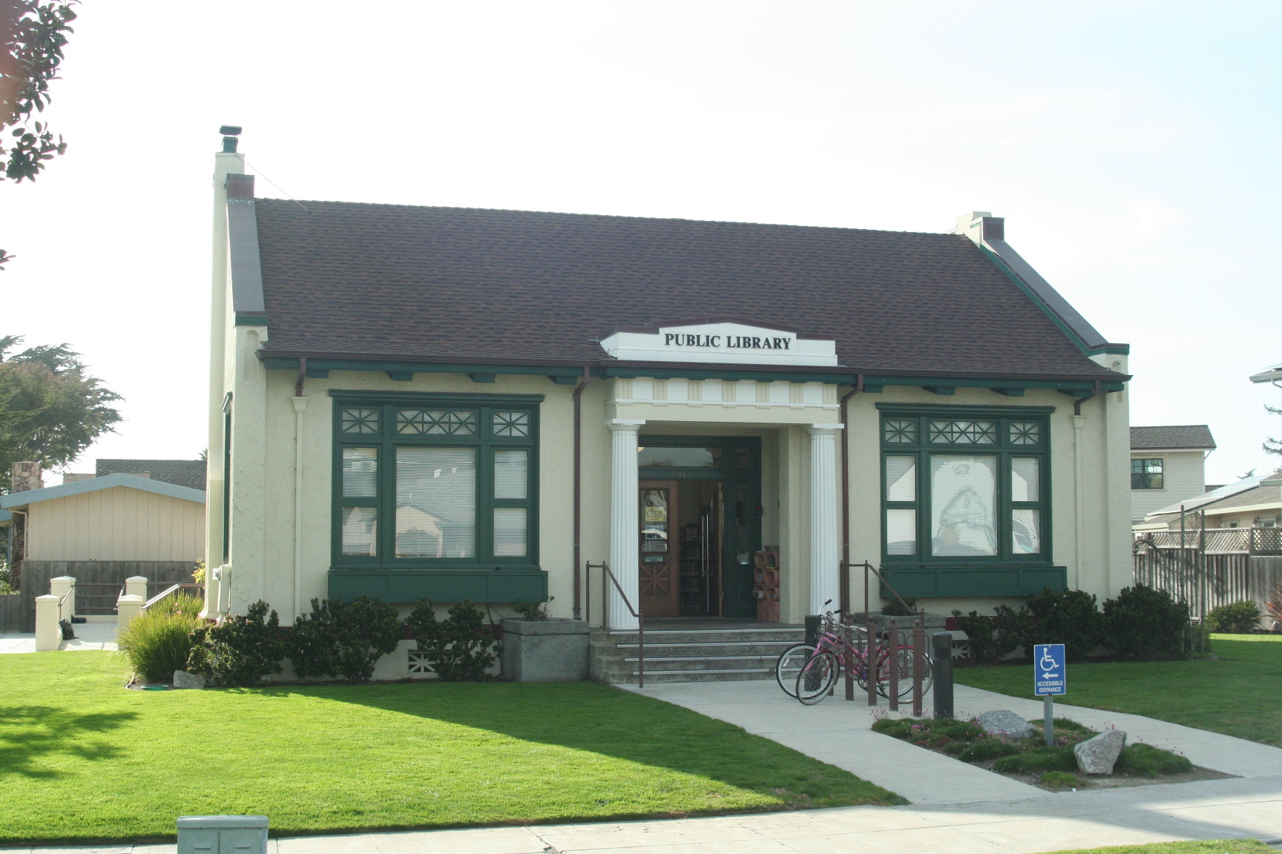
Libraries Are Friendly Places
Notes:
We offer handicapped parking, good signage in the library, and adequate space for wheelchairs. We may offer assistive technologies. We provide books on tape and CD, and large print books,

Slide 4
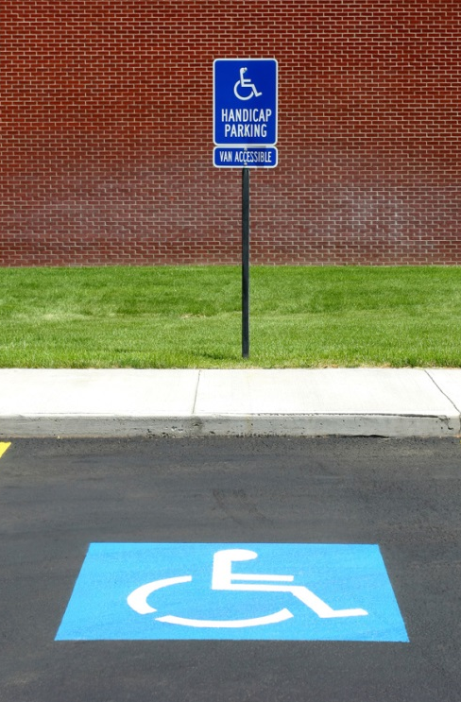
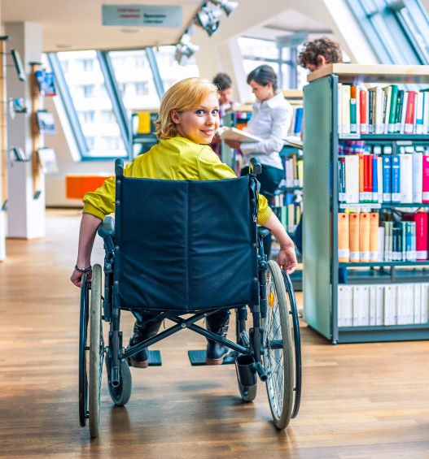
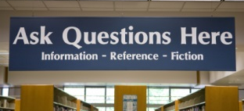

The Physical Presence
Notes:
We offer handicapped parking, good signage in the library, and adequate space for wheelchairs. We may offer assistive technologies. We provide books on tape and CD, and large print books,

Slide 5

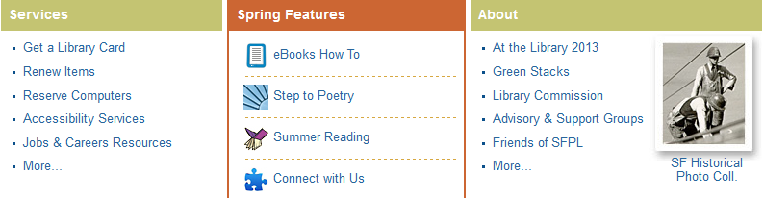
The Library’s Virtual Front Door
Communication, promotion
Current information, services, resources

Slide 6

Our Users
Who is the library for?
  Everyone, not just the ones with good vision, hearing, & mobility!

Slide 7
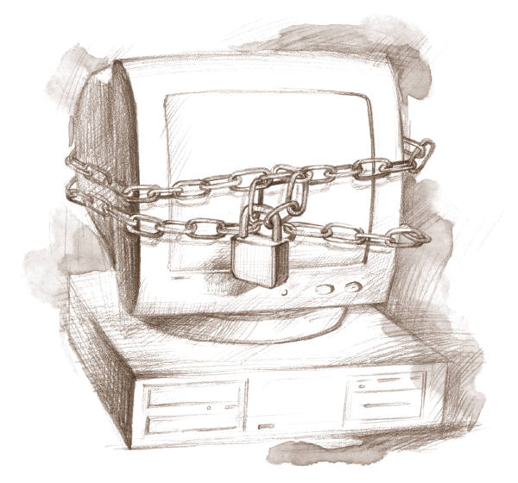
The Library’s Virtual Presence:
Is it User Friendly?
Notes:
Do we provide good access to our website too?

Slide 8
Poll – Where Are You Now?
How far along are efforts to make site accessible?
Not sure; I’m not involved in website development
Just starting to think about it
We have a plan, but haven’t started implementing yet
We are currently implementing
We are done and fully compliant!
Notes:
Poll – How far along are efforts to make your library website accessible?
Not sure; I’m not involved in our website development
We haven’t even thought about it yet
Just starting to plan for it
We have a plan but haven’t implemented yet
We are currently making our site accessible
We are done and fully compliant!

Slide 9
Acronyms and Terms
Organizations
  WebAIM (Web Accessibility in Mind)
  W3C (World Wide Web Consortium)
  NCDAE (National Center on Disability and Access to Education )
WAI (Web Accessibility Initiative)
WCAG (Web Content Accessibility Guidelines)
Section 508 (law)
Notes:
The W3C's Web Accessibility Initiative
The W3C is an international, vendor-neutral group that determines the protocols and standards for the web. They create the specifications for HTML, CSS, etc. A primary initiative of the W3C is to develop accessibility standards.
The goal of Web Accessibility Initiative (WAI) is to develop these accessibility standards. WAI working groups develop accessibility standards for web browsers, authoring tools, evaluation tools, and web content, to name a few.
The Web Content Work Group's standards are called the Web Content Accessibility Guidelines (WCAG).

Slide 10

What is Section 508?
Federally-funded organizations must comply with the law
Section 508 of the Rehabilitation Act (29 U.S.C. 794d), as amended by the Workforce Investment Act of 1998 (P.L.105-220), August 7, 1998.
www.section508.gov/index.cfm?fuseAction=1998Amend

Slide 11

In a Nutshell
When seeking information or services from a Federal department or agency, people with disabilities must have access and use of information that is comparable to that of people without disabilities

Slide 12
But We Aren’t a Federal Agency
Many public agencies, including libraries, are choosing to be as accessible as possible to all users.
It’s the right thing to do. In the United States:
6.4 million people have a visual disability
10.3 million people have a hearing disability
19.5 million people have a ambulatory disability.
13.8 million people have a cognitive disability.
Any way you look at it, millions of people in the United States have at least one disability that Section 508 is meant to address.
2010 Disability Status Report: United StatesErickson, W., et al. (2012)
http://digitalcommons.ilr.cornell.edu/gladnetcollect/558/
Notes:
Improving accessibility improves usability for all users. As you'll see in the findings and guidelines in this paper, making Web sites work for people who use screen readers takes little extra effort while bringing great benefits for everyone.

Slide 13

Consider the User Experience
(Walk a Mile in Their Shoes)

Slide 14
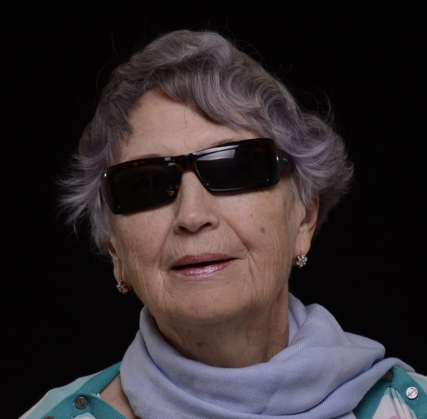

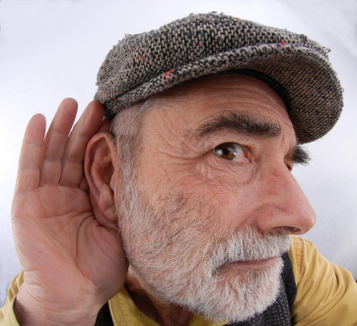
Conditions that make access to web content difficult
Low vision or blindness
Hearing loss or deafness
Mobility issues
Other issues

Slide 15
Accessibility:
Technologies + Practices
Technologies
Practices
Screen readers
Video captions
Text-to-voice
Assistive devices
A keyboard
Good web design practices
Good document design
Administrative policies
Commitment
Staff training
Notes:
Examples of Assistive Technology
Assistive Technology may include any of the following:
Motor Aspects of Writing
Adapted tool grips
Stabilize materials with non-slip material
Slantboard
Stamps
Raised lined paper
Wrist weight
Dictation software
Sticky notes for fill-in-the-blank answers
Drop Down menus in WORD documents
Reading
Book holder/easel
Enlarged text
Color Overlays
Thesaurus
Dictionary
Books on tape
E Texts
Screen readers
Picture Symbols
Highlighter tape
Mobility
gait trainer
stander
walkers
braces
canes
wheelchairs
Vision
Screen Magnifiers
Screen magnification software
Enlarged text
Braille
Handheld magnifiers
Computer Access
Keyguard
Mini mouse
Touch screen
Trackball
Alternate keyboard
Switch interface
Speech to text software
Text to speech software
picture software

Slide 16
Elements of Accessibility
Many elements are the same for webpages, documents and other files.
Learn the basic concepts; apply across all content
Make accessibility a natural part of the workflow
Accessibility doesn’t happen by chance – build it in to all online content

Slide 17
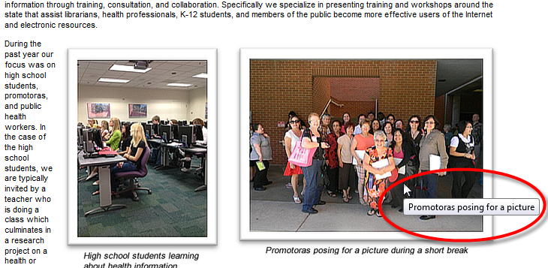
Required Page Elements:
Alt Text
Text equivalents for images and non-text objects
<p><img src="/webreports/psr_blog/uploads/2013/05/promotoras.png" title="Promotoras posing for a picture" alt="Promotoras posing for a picture" align="right" hspace="10" vspace="10" /></p>

Slide 18
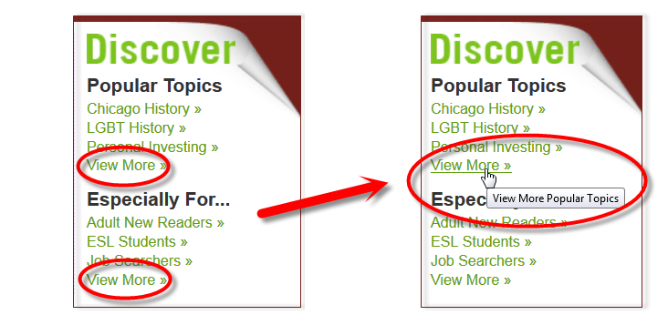
Required Page Elements:
Hyperlinks
Hyperlinks (meaningful text displayed)

Slide 19
Table Formatting
Need row and column headers
No blank cells
Logical order when navigating based on table content (left to right, top to bottom)
In documents, use the Insert Table function rather than copying and pasting

Slide 20
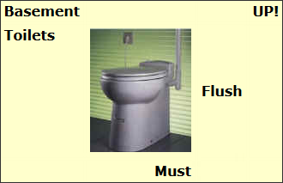
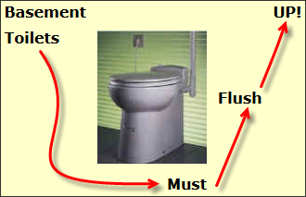
Table Issues
This table was created for visual effect:
Note the visual
reading path →

Slide 21
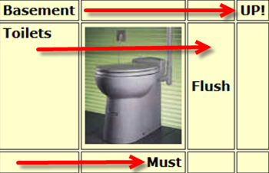
Reading Order
The screen reader will read left to right, down and across. The user will hear or feel via Braille: "Basement UP! Toilets Flush Must“
Creating Accessible Tables, WebAIM http://webaim.org/techniques/tables/

Slide 22
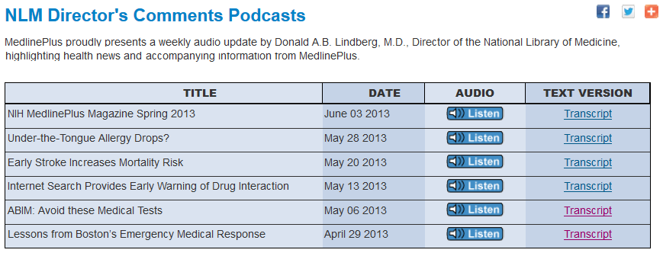
Required Page Elements:
A Few More
Video needs to be synchronized with equivalent alternative (captioning)
Audio needs a written equivalent (transcript)
Notes:
Meaning conveyed by color needs text description or other explanation

Slide 23
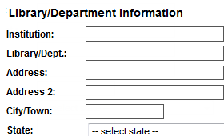
Design Good Forms
Make sure users can complete and submit forms. Form elements (text field, checkbox or dropdown list ) all have labels, and the label is associated to the correct form element using the <label> tag.

Slide 24
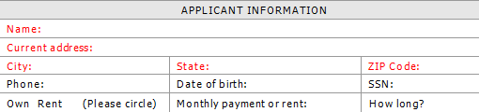
More Considerations
Repetitive navigation links
  Need ability to skip or ignore
Decorative objects (borders)
  Need coding for screen readers to ignore
Use of COLOR to convey meaning
  Avoid using color alone; state what it means

Slide 25
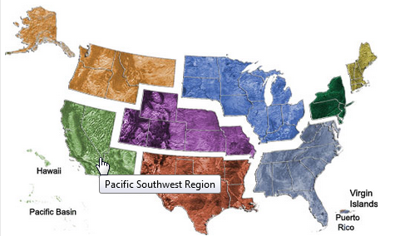
More Best Practices
Avoid flickering, strobing or flashing images
Offer ability to skip navigation
Alert users of timed responses
Use client-side image maps with alt text
Notes:
Reduce Flickering, Strobing or Flashing
Some people may be susceptible to photo epileptic seizures caused by these page graphics. Here are some examples: http://webaim.org/articles/seizure/media/flicker.gif or http://webaim.org/articles/seizure/media/illusion.gif.
Offer Skip Navigation
Providing a method of skipping through sections of navigation will allow those using assistive technologies to navigate the main content of the page.
Alert Users of Timed Responses
When a timed response is required, alert your users when their time is about to run out, and give them an option to request more time if they need it. Web sites sometimes use this technique for account session security or for freeing up bandwidth.
Specify Accessible Applets and Plug-ins
Web pages often require plugins or applets. Provide a link to a page where these can be downloaded.
Use Client-Side Image Maps
Web designers often employ “hotspots” on image maps. Use client-side image maps whenever possible. Client-side refers to the functionality that exists on the user’s machine rather by the server. Label each of the hot spots with alt text to tell the screen reader where each hot spot takes the user.
Provide Redundant Links for Server-Side Maps
When you click on a hot spot of a server-side image map, the server decides where to take you. This poses problems for screen readers, since screen readers do not know where the link goes, which means your users won't know as well. You must provide a redundant link in order for it to be accessible.

Slide 26
Testing for Accessibility
Web Tools
  WAVE
  FANGS
Word and PowerPoint
  Built-in checkers in Microsoft Office software
PDF files
  Accessibility tool in Adobe Acrobat Pro
And many more

Slide 27
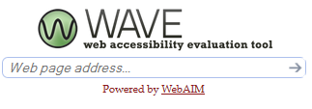
WAVE:
Web Accessibility Evaluation Tool
Wave Online Tool
Works in any browser
http://wave.webaim.org/
Wave Toolbar
Firefox add-on
http://wave.webaim.org/toolbar/
Notes:
Check your own library site.
I did a random check of 7 libraries around the region. I didn’t find any that were 100% compliant (according to the WAVE tool). It ranged from 2 errors to 35 errors in my small sample.
How is the WAVE toolbar different (than wave.webaim.org)?
The WAVE Firefox toolbar evaluates content as it appears within your web browser. This means that you can evaluate private, intranet, password protected, dynamically generated, or scripted web content. All evaluation happens directly within your browser. The toolbar also evaluates content after scripting has been applied, whereas the server version of WAVE removes all scripting.

Slide 28
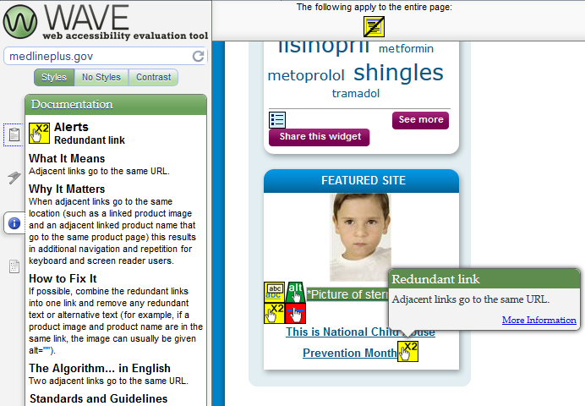
WAVE
Web Accessibility Evaluation Tool

Slide 29
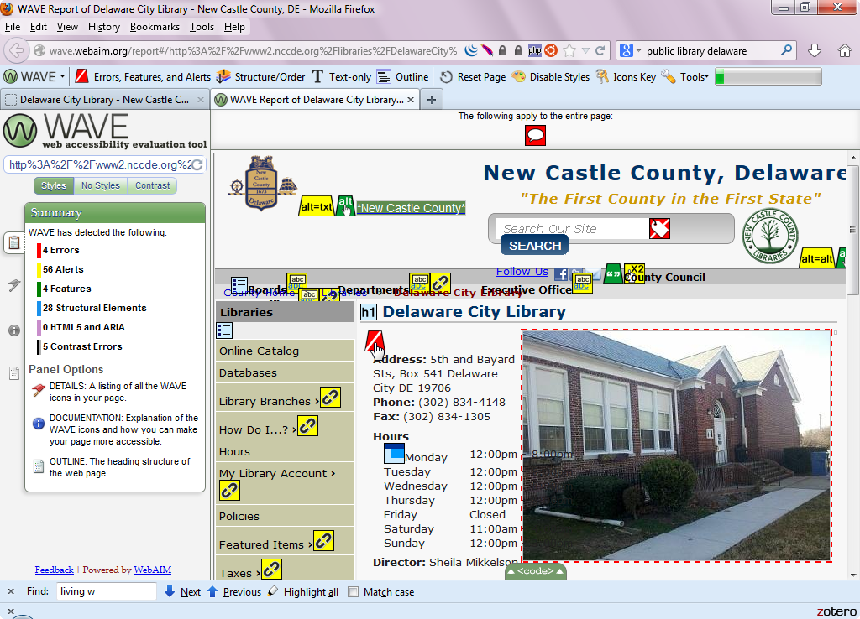
WAVE Example

Slide 30

Form Labels
Accessible Forms
When done correctly, you can see these HTML labels for Name and Email fields when you turn on the WAVE tool:

Slide 31
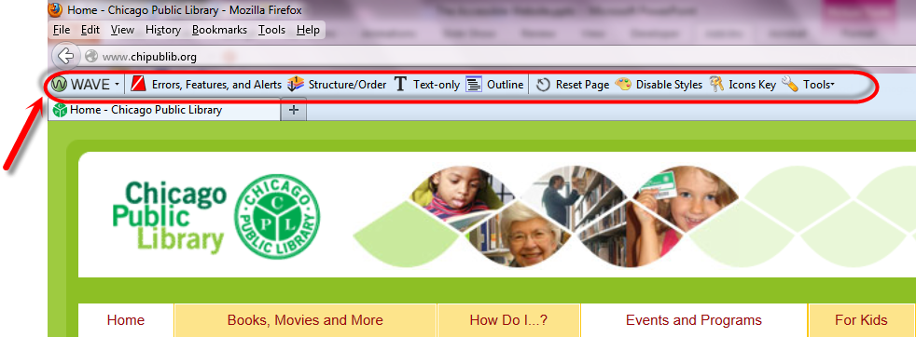
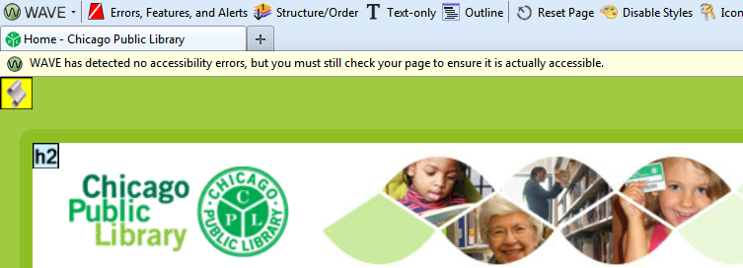
Wave Toolbar Example

Slide 32
What is the Difference?
Wave Toolbar
Evaluation works on local machine only
Evaluates the rendered version, locally displayed styles and dynamically generated content from scripts
Can check intranet, password protected, dynamically generated, or sensitive pages
Wave at WebAim
Request goes through WebAIM server
Notes:
No information is transmitted from the WAVE toolbar, thus allowing secure and private accessibility reporting. The toolbar can check intranet, password-protected, dynamically generated, or sensitive web pages. Also, because the WAVE toolbar evaluates the rendered version of your page, locally displayed styles and dynamically-generated content from scripts can be evaluated.
However, if you select the "Process at wave.webaim.org" option, the current URL you are viewing is transmitted to the WAVE server for evaluation

Slide 33

FANGS
Screen Reader Emulator
Firefox add-on
Provides three options:
  Text of a webpage just as a screen reader would read it
  List of headers
  List of links

Slide 34
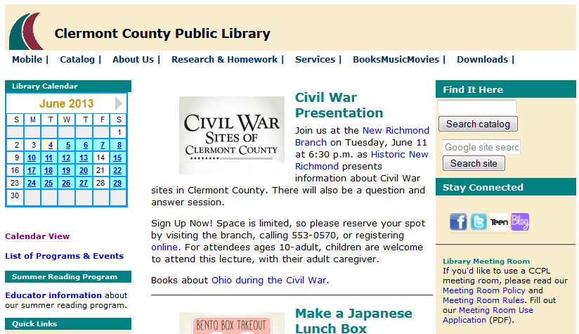
Sample Library Web Page

Slide 35
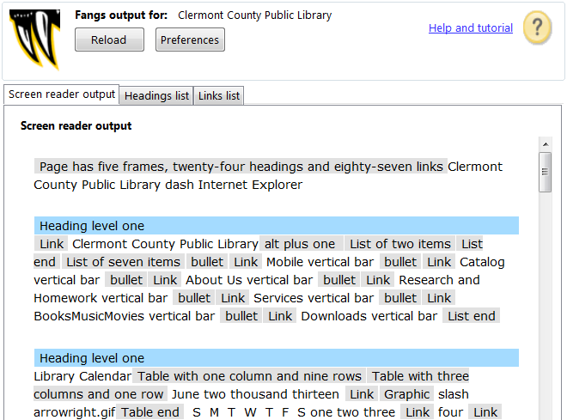
FANGS Output Example

Slide 36
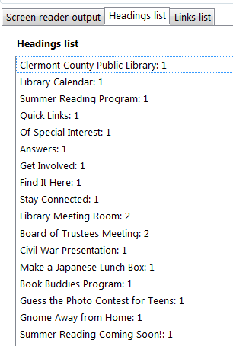
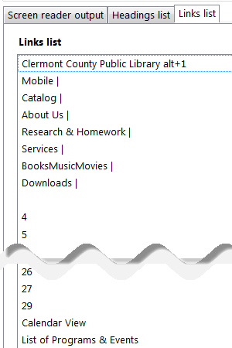
More FANGS View Options
Headings
Links

Slide 37
Tips for Microsoft Word and PowerPoint
Use built-in formatting structures, such as headers, layouts, and bullets. Screen readers rely on formatting.
Images need alt text
Hyperlinks need to be meaningful
Almost always better to start fresh than to remediate

Slide 38
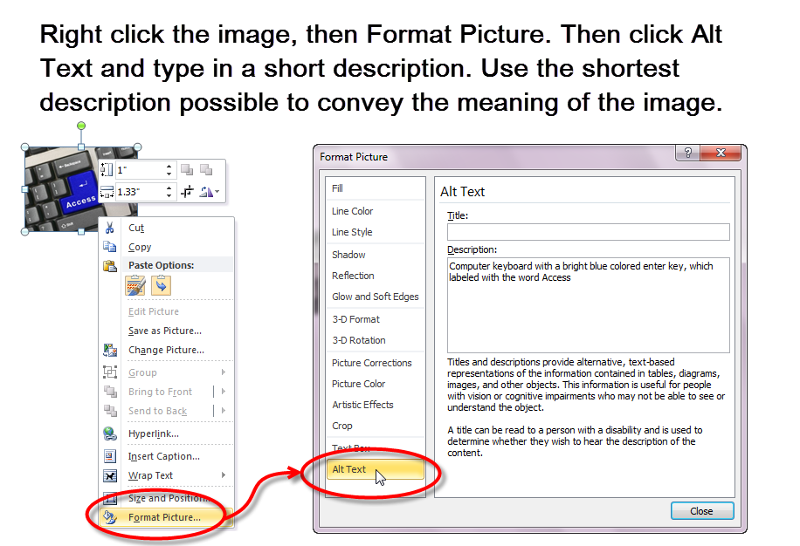
Adding Alt Text in Word

Slide 39
Microsoft Accessibility Checkers
Office 2007 or later
Files must be created as .docx or .pptx to use checker
File menu > Check for Issues > Accessibility
Inspection Results - points to problems and gives suggestions for fixing

Slide 40
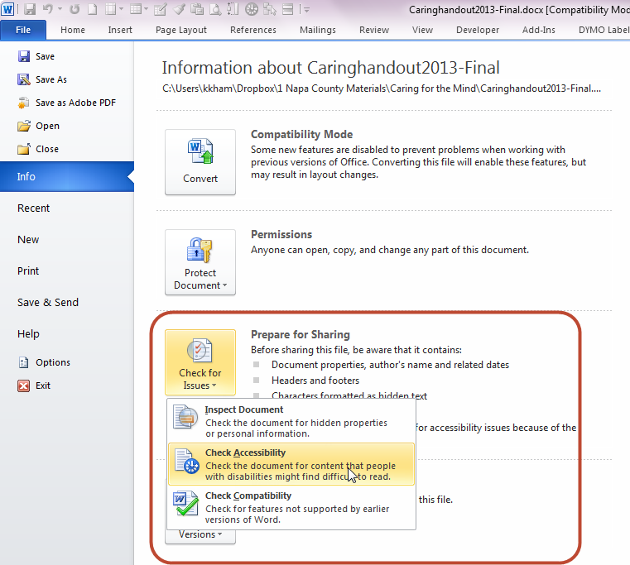
Microsoft Word

Slide 41
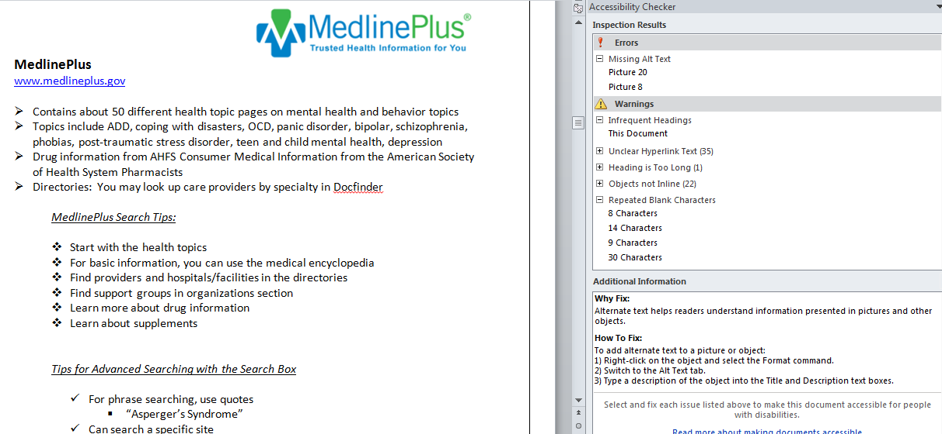
Errors and Warnings

Slide 42
Techniques Unique to PowerPoint
Start building slides using outline view
Each slide needs a title (which can be hidden from view if necessary)
Reading order is important
Avoid using text boxes – screen readers can’t “see” the content. Use the layout and content boxes instead

Slide 43
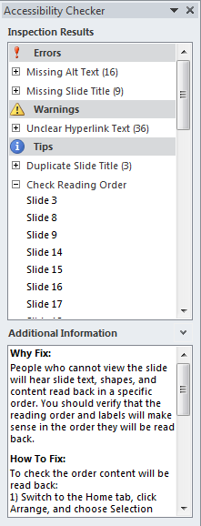
PowerPoint
Errors are mostly missing alt text and slide titles
Warnings – hyperlinks
Duplicate titles
Reading order

Slide 44
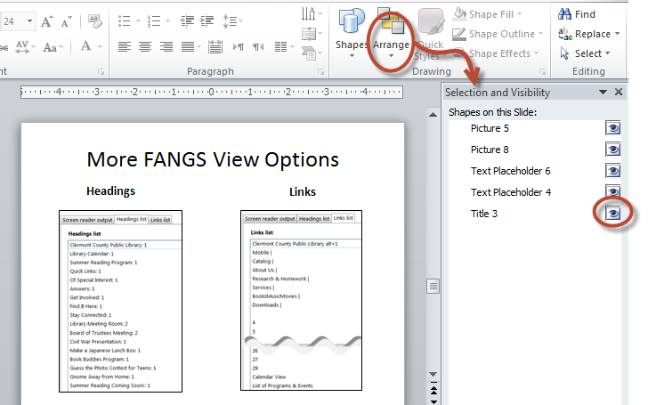
Reading Order Oddity

Slide 45
508ers New Best Friends
Shortcuts can be added to Quick Access toolbar:
Right click in Quick Access toolbar
Choose Customize Quick Access Toolbar
Under “Choose Commands From” look at dropdown, then choose “Commands Not in the Ribbon”
Add Accessibility Checker, Alt Text and Selection Pane (PowerPoint) for one-click access to these important tools

Slide 46
PDF Files
Most complicated
No guarantee that compliant document will retain compliancy when saved as PDF
Structured docs work best
Requires Acrobat Pro

Slide 47
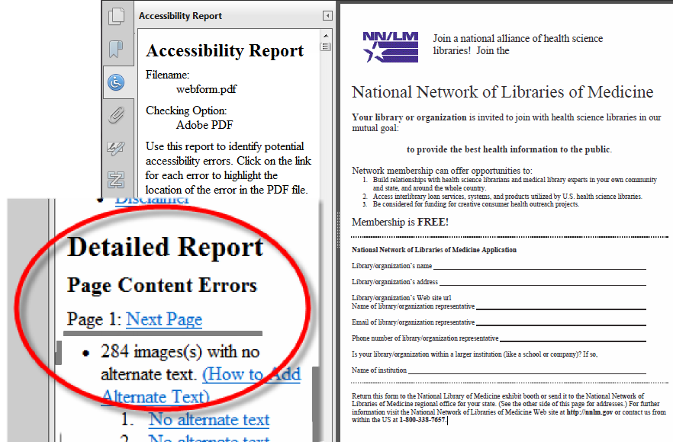
PDF Files Can Cause Headaches!

Slide 48
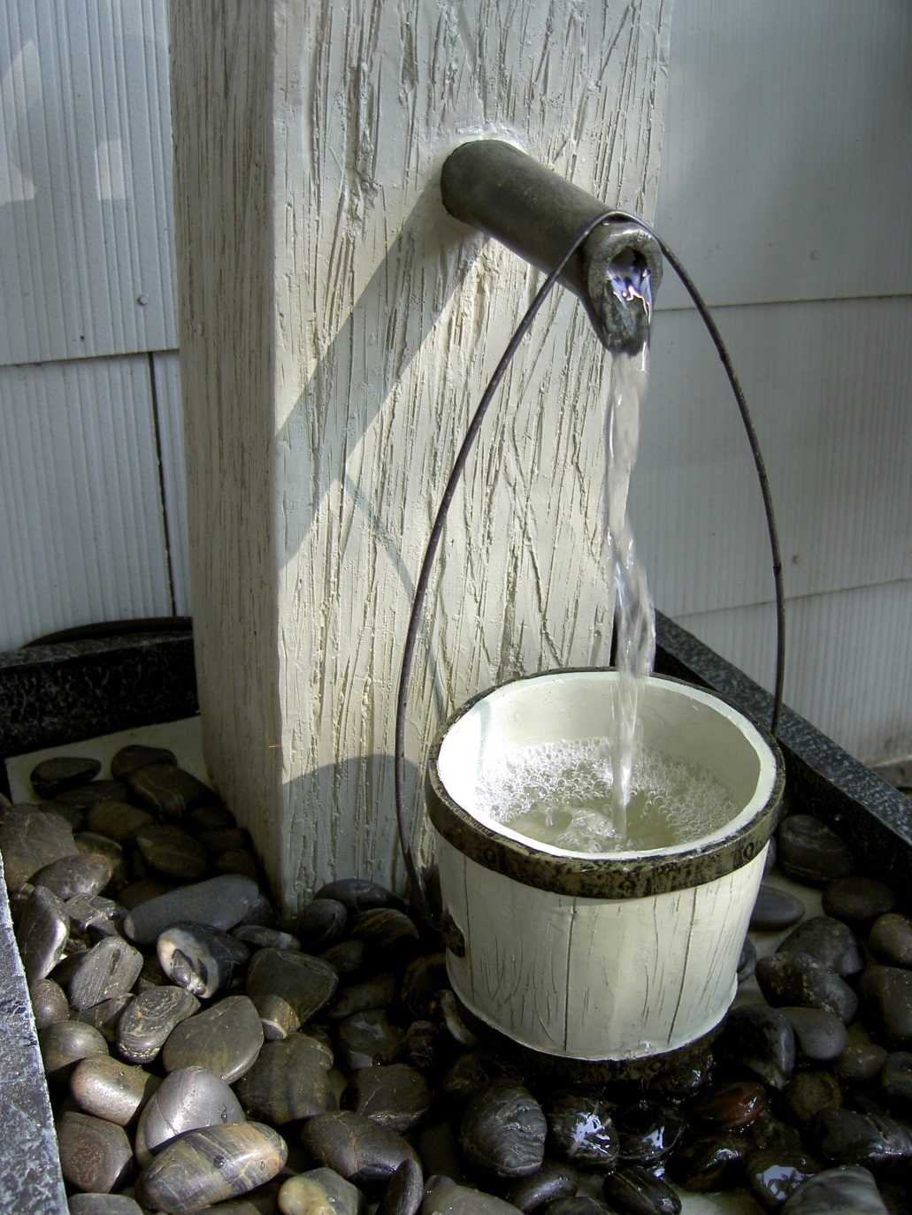
A Drop in the Bucket
Type in the chat box your most pressing training needs:
Web accessibility?
Word?
Powerpoint?
PDFs?
Other?

Slide 49

Form and Function
We can have our cake and eat it too
Commitment
Planning, budgeting
Good design, implementation
Testing, evaluation

Slide 50
Workarounds?
Is text equivalent sufficient? NO
  No one wants to read pages of text.
  Images and other objects can convey meaning and be more interesting for all users
  Plan for equivalent experience to extent possible
Notes:
A user with vision problems doesn’t want to read or listen to pages of text any more than a sighted person does. The goal is to make the experience as equivalent as possible

Slide 51
Summary
Just because it passes the test…
Build accessibility techniques into the workflow
Find solutions, not workarounds
Improving accessibility improves usability for all users.
It’s the right thing to do

Slide 52


Thank You!
Kelli Ham, MLIS
NN/LM Pacific Southwest Region
kkham@library.ucla.edu
http://nnlm.gov/psr/
1-800-338-7657
This project has been funded in whole or in part with Federal funds from the Department of Health and Human Services, National Institutes of Health, National Library of Medicine, under Contract No. HHS-N-276-2011-00009-C with the UCLA Louise M. Darling Biomedical Library.

Slide 53
Infopeople webinars are supported in part by the U.S. Institute of Museum and Library Services under the provisions of the Library Services and Technology Act, administered in California by the State Librarian. This material is licensed under a Creative Commons 3.0 Share & Share-Alike license. Use of this material should credit the author and funding source.

