Slide 1
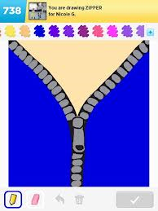
Leadership
Meets Imagination
Joan Frye Williams
July 26, 2013

Slide 2


Not just making stuff up

Slide 3
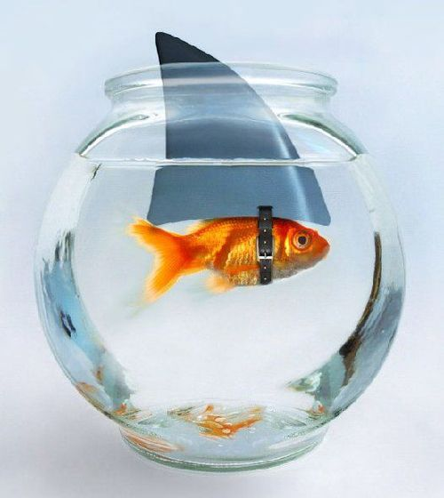
Or wishful thinking

Slide 4

Seldom a bolt from the blue

Slide 5

Envisioning something new

Slide 6
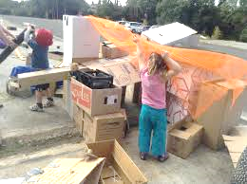
Children are naturally imaginative

Slide 7
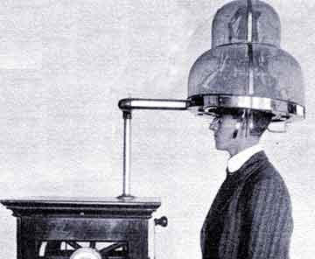
Only adults consider imagination an arcane practice

Slide 8

Imagination is a habit of mind

Slide 9

Analogous

Slide 10

Look for patterns

Slide 11
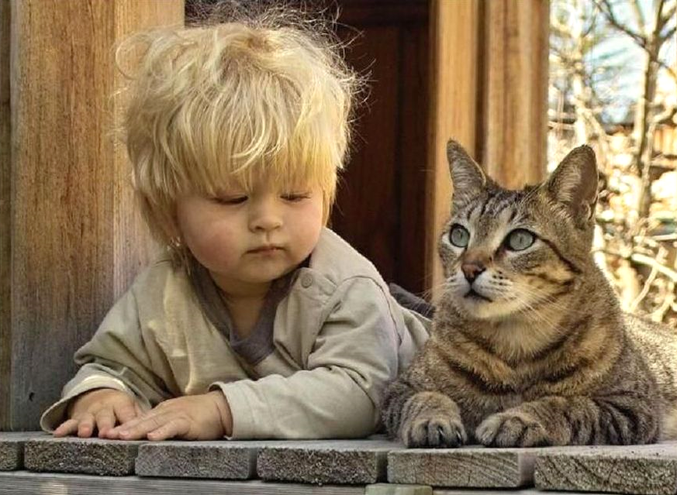
See how others have approached similar problems

Slide 12

Just take the parts you want

Slide 13

Recombinant

Slide 14

Deconstruct the status quo into smaller components

Slide 15
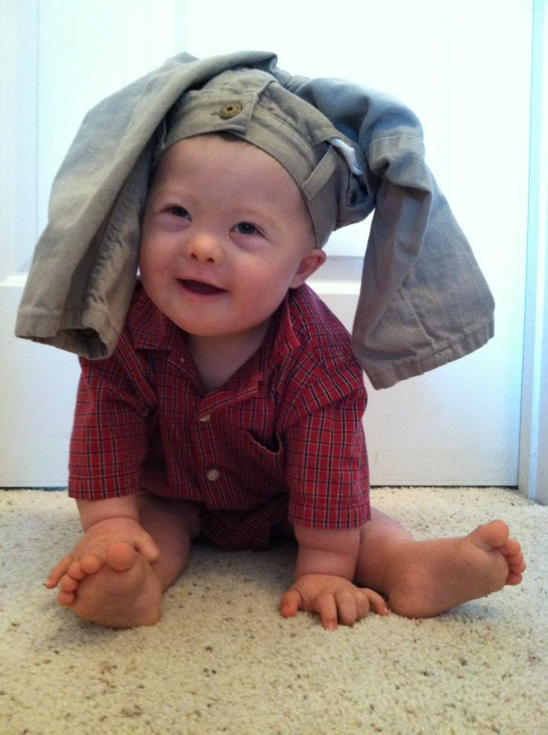
Try familiar things in new ways

Slide 16

Combine the best elements of multiple options

Slide 17

Contrarian

Slide 18

Think about what’s hidden

Slide 19

Do a pre-mortem

Slide 20
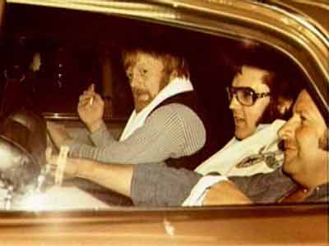
Remember that absence of conflict is not always healthy

Slide 21

Innovative

Slide 22
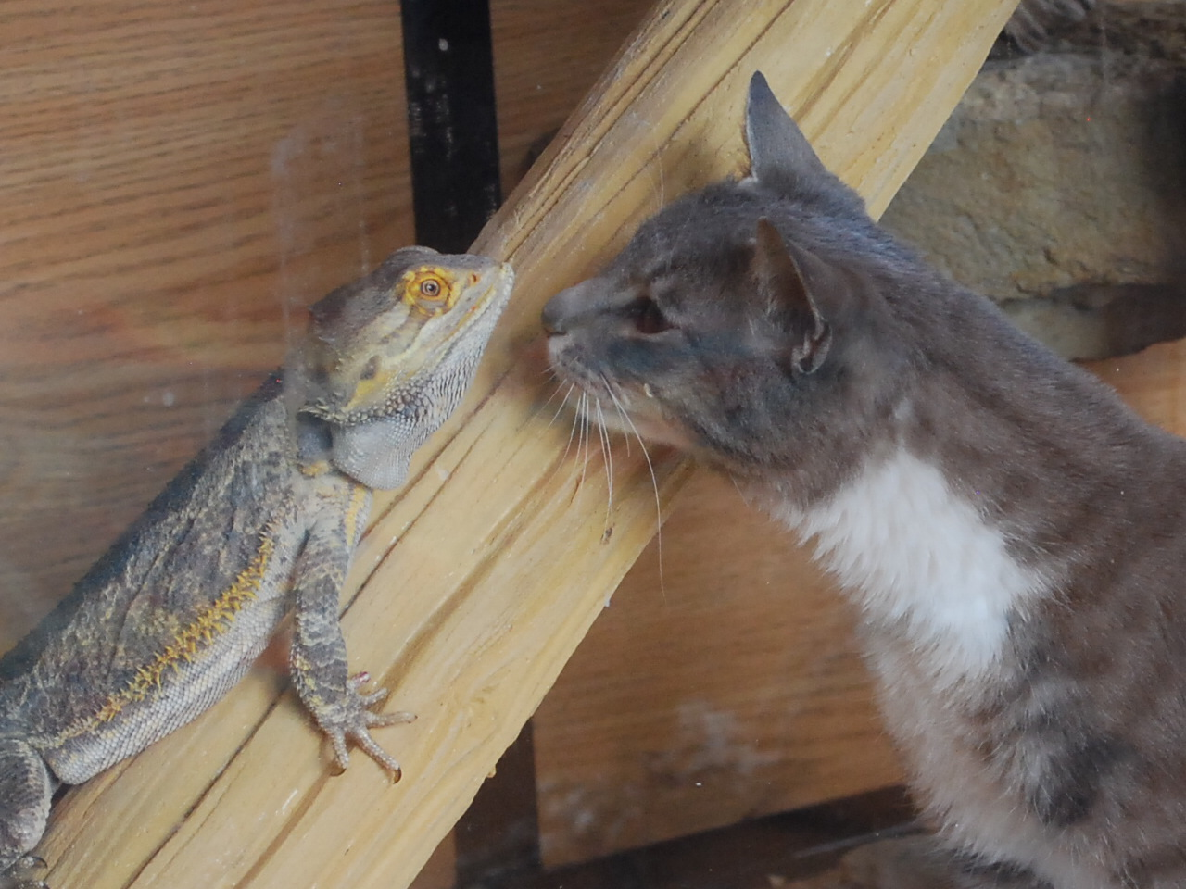
Follow your curiosity

Slide 23

Challenge perceived barriers

Slide 24
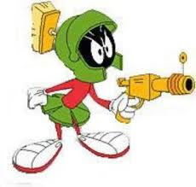
Exploit non-library tools

Slide 25

Original

Slide 26

Look beyond the presenting problem

Slide 27
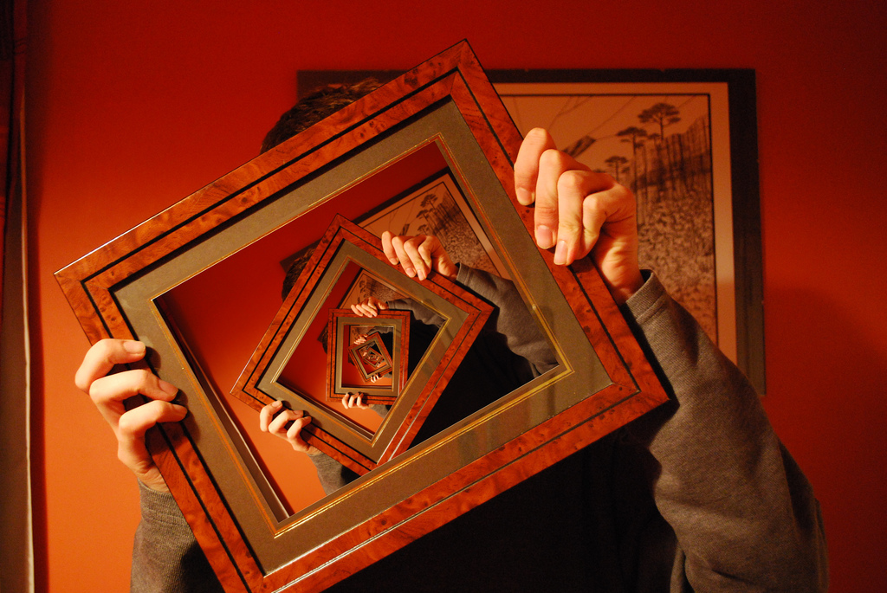
Reframe what you “know”

Slide 28
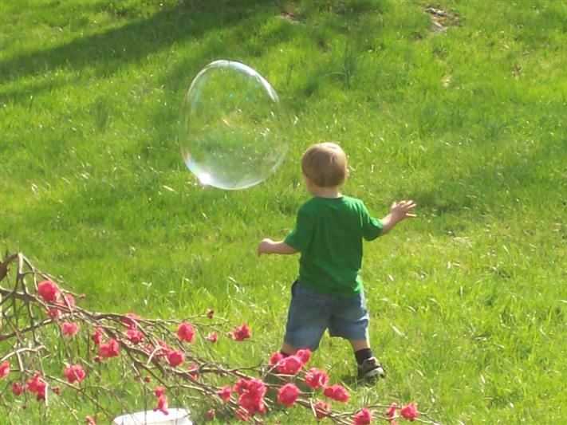
Live in wonder

Slide 29
Expect an iterative, non-linear process

Slide 30

Get some distance

Slide 31

What would your successor do?

Slide 32

What would your role model do?

Slide 33
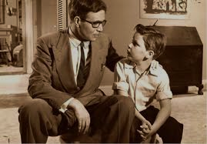
How would you advise someone just starting out?

Slide 34

How would you advise your best friend?

Slide 35

What else could you do if you didn’t do this?

Slide 36

Communicating the “vision thing”

Slide 37
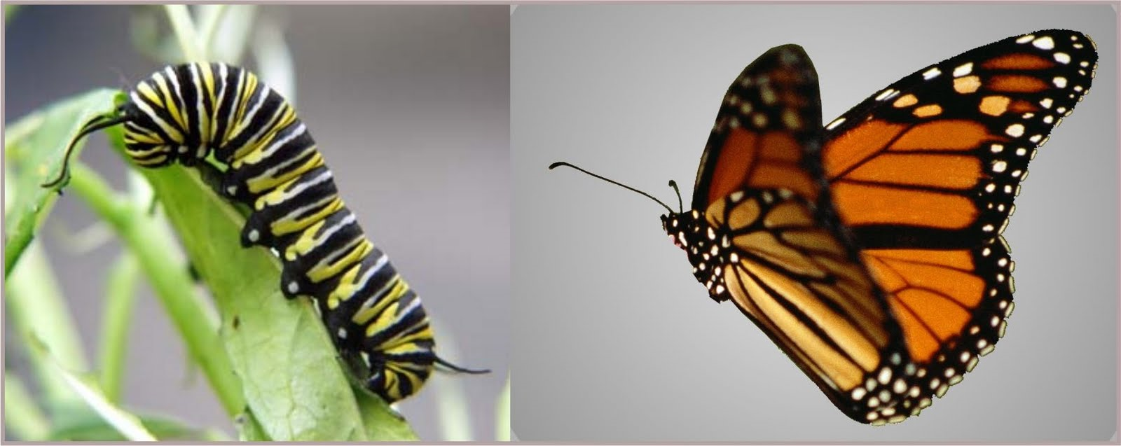
Future state that is both concrete and different

Slide 38
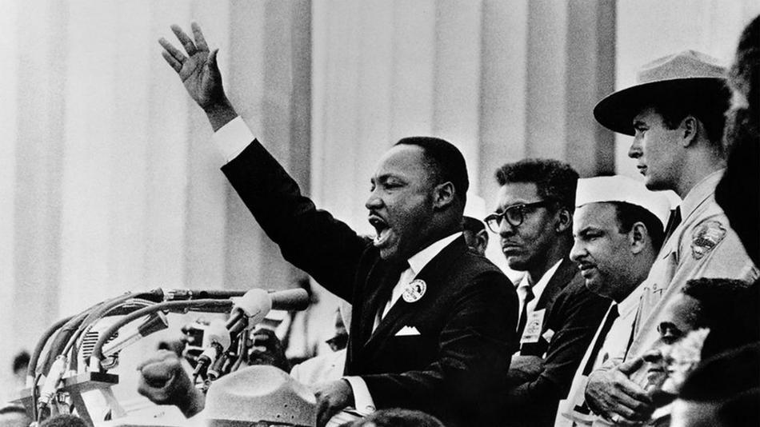
Clear expression of hope and purpose

Slide 39

Acknowledgement of what must remain uncertain

Slide 40

Responsibility for the outcome

Slide 41

Commitment to the hard work of making it happen

Slide 42


Slide 43
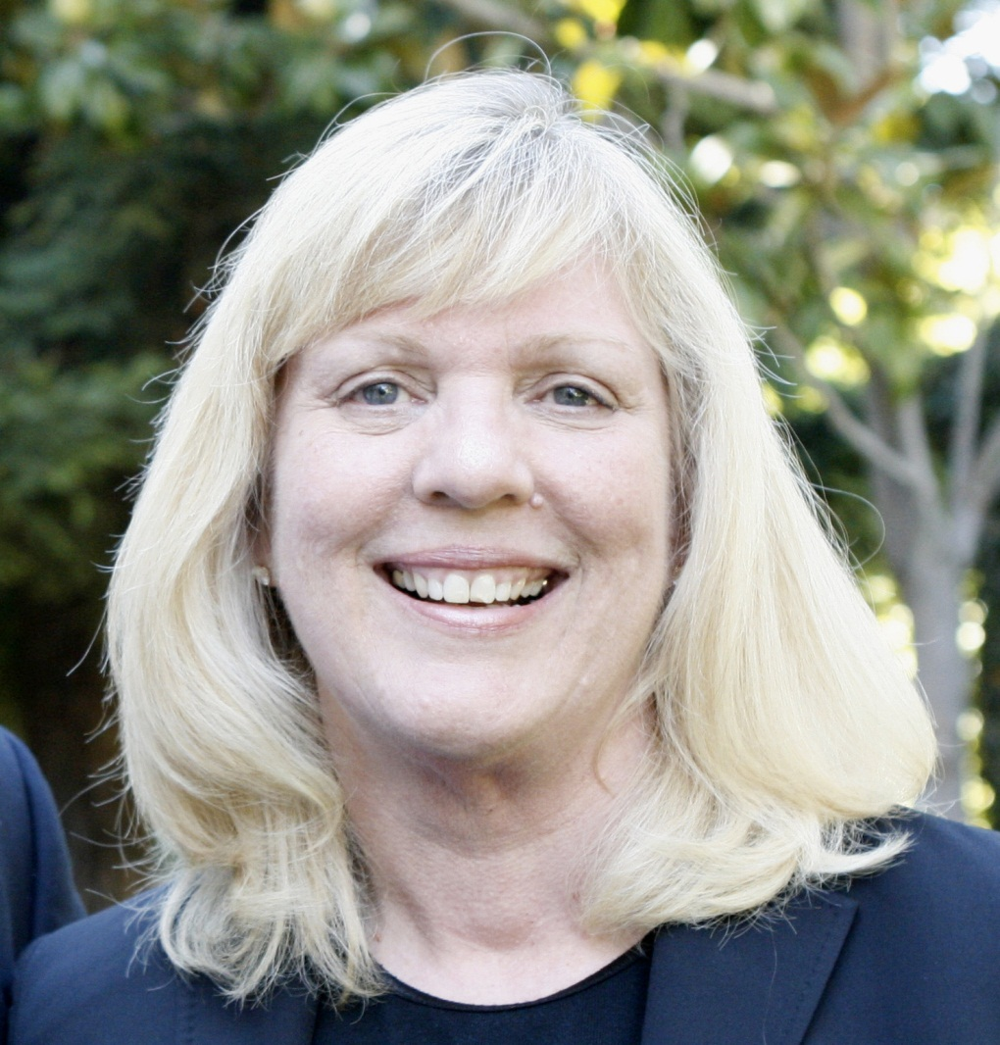
joan@jfwilliams.com
Let’s continue the conversation…
Photo by Chuck O’Shea

