Slide 1
Welcome to today’s Infopeople Webinar!
Infopeople is dedicated to bringing you the best in practical library training and improving information access for the public by improving the skills of library workers. Infopeople, a grant project of the Califa Group, is supported in part by the Institute of Museum and Library Services under the provisions of the Library Services and Technology Act administered in California by the State Librarian. This material is covered by Creative Commons 4.0 Non-commercial Share Alike license. Any use of this material should credit the funding source.

Slide 2
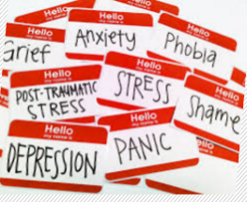
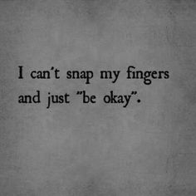
TEEN MENTAL ILLNESS 101
Cheryl Eskin, MFT and Michelle Carlson, MPH

Slide 3
Why We Are Here Today
“Unfortunately we live in a world where when you break your arm, everyone runs over to sign your cast. But if you tell people you're depressed, everyone runs the other way. That's the stigma. We are so so so accepting of any body part breaking down, other than our brains.”
Kevin Breel: Confessions of a Depressed Comic at TEDxKids@Ambleside

Slide 4
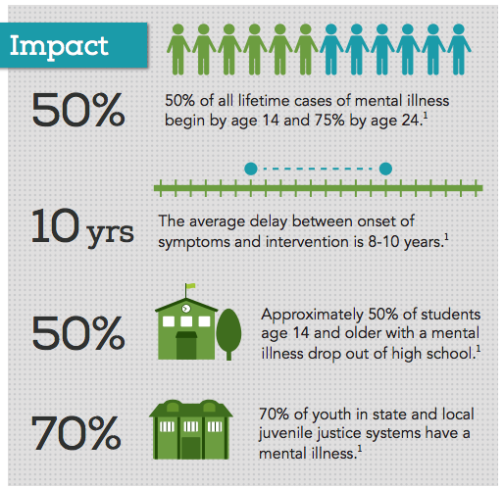
Nami.org
NAMI, 2014

Slide 5
Without Intervention (and Professional Help when appropriate), Teens May Turn to…..
Self-injury
Truancy
Alcohol or other substances
Extreme rebelliousness
Risk taking behaviors
Promiscuity
Suicide
Notes:
Risk Factors
“What are things that could put a person at greater risk of dying by suicide?”
Drugs & alcohol
-Impaired impulse control- as related to being a teenager or being under the influence of drugs or alcohol
Lack of inhibition- not really caring what’s right or wrong
Access to guns- 6x more likely to die by suicide
Previous suicide attempts- if they have attempted before they are at greater risk
Suicide in family- mental illness
Abuse & bullying- if someone is experiencing abuse at home or being bullied at school
Statements
Talking about wanting to die or to kill oneself
Talking about feeling hopeless or having no reason to live
Talking about feeling trapped or in unbearable pain
Talking about being a burden to others
Appearance
Changes from “baseline”
disheveled, no longer caring, big baggy clothes in summer weather
Behavior
Increasing the use of alcohol or drugs
Showing rage or talking about seeking revenge
Displaying extreme mood swings
Change in sleeping/eating habits
Acting anxious or agitated; behaving recklessly
Sleeping too little or too much
Looking for a way to kill oneself, such as searching online or buying a gun
Withdrawing or feeling isolated A
Writings and Drawings about death/suicide
Self Harm Vs. Suicide
Discuss the difference between harming self as maladaptive coping or hurting self with intention to die.
Drop in grades
Giving away possessions- danger in this as being a “will” for young people and a really big “red flag”
Talk, writing, and/or drawing about death- transition in to pictures drawn by teen in the 70’s
Giving away possessions
Feelings/Affect
Expand beyond depression to agitation, anxiety, expansiveness (mania, bi-polorarity), 1&2, Hypomania, dysthmia
Behaviors
Acting anxious or agitated; behaving recklessly
Sleeping too little or too much
Looking for a way to kill oneself, such as searching online or buying a gun
Withdrawing or feeling isolated
Writings and Drawings about death/suicide

Slide 6
Notes:
“sadness untethered” feel adult emotions w/o adult regulation, especially frustrating in gifted kids b/c are intellectuall ythere…
Accelerator w/o brakes
Child first, gifted second
Life experience-take a moment to think about experience of what you felt like…how you wish your parents would have responded, did it make you want to talk further?

Slide 7
“Normal” teen behavior
Moodiness
Less affection and attention with parents
Increased desire for autonomy
Self-involved
Testing limits
Exploring identity
Experimentation with drugs/alcohol/sexual behavior
Peer conflicts
Notes:
Risk Factors
“What are things that could put a person at greater risk of dying by suicide?”
Drugs & alcohol
-Impaired impulse control- as related to being a teenager or being under the influence of drugs or alcohol
Lack of inhibition- not really caring what’s right or wrong
Access to guns- 6x more likely to die by suicide
Previous suicide attempts- if they have attempted before they are at greater risk
Suicide in family- mental illness
Abuse & bullying- if someone is experiencing abuse at home or being bullied at school
Statements
Talking about wanting to die or to kill oneself
Talking about feeling hopeless or having no reason to live
Talking about feeling trapped or in unbearable pain
Talking about being a burden to others
Appearance
Changes from “baseline”
disheveled, no longer caring, big baggy clothes in summer weather
Behavior
Increasing the use of alcohol or drugs
Showing rage or talking about seeking revenge
Displaying extreme mood swings
Change in sleeping/eating habits
Acting anxious or agitated; behaving recklessly
Sleeping too little or too much
Looking for a way to kill oneself, such as searching online or buying a gun
Withdrawing or feeling isolated A
Writings and Drawings about death/suicide
Self Harm Vs. Suicide
Discuss the difference between harming self as maladaptive coping or hurting self with intention to die.
Drop in grades
Giving away possessions- danger in this as being a “will” for young people and a really big “red flag”
Talk, writing, and/or drawing about death- transition in to pictures drawn by teen in the 70’s
Giving away possessions
Feelings/Affect
Expand beyond depression to agitation, anxiety, expansiveness (mania, bi-polorarity), 1&2, Hypomania, dysthmia
Behaviors
Acting anxious or agitated; behaving recklessly
Sleeping too little or too much
Looking for a way to kill oneself, such as searching online or buying a gun
Withdrawing or feeling isolated
Writings and Drawings about death/suicide

Slide 8
“Red flags” or “cries for help”
Suicidal/homicidal ideation
Self-injury
Frequent angry outbursts and excessive aggression
Change in behavior/attitude/appearance/school performance
Lots of somatic complaints
Hopeless, worthless comments
Notes:
Risk Factors
“What are things that could put a person at greater risk of dying by suicide?”
Drugs & alcohol
-Impaired impulse control- as related to being a teenager or being under the influence of drugs or alcohol
Lack of inhibition- not really caring what’s right or wrong
Access to guns- 6x more likely to die by suicide
Previous suicide attempts- if they have attempted before they are at greater risk
Suicide in family- mental illness
Abuse & bullying- if someone is experiencing abuse at home or being bullied at school
Statements
Talking about wanting to die or to kill oneself
Talking about feeling hopeless or having no reason to live
Talking about feeling trapped or in unbearable pain
Talking about being a burden to others
Appearance
Changes from “baseline”
disheveled, no longer caring, big baggy clothes in summer weather
Behavior
Increasing the use of alcohol or drugs
Showing rage or talking about seeking revenge
Displaying extreme mood swings
Change in sleeping/eating habits
Acting anxious or agitated; behaving recklessly
Sleeping too little or too much
Looking for a way to kill oneself, such as searching online or buying a gun
Withdrawing or feeling isolated A
Writings and Drawings about death/suicide
Self Harm Vs. Suicide
Discuss the difference between harming self as maladaptive coping or hurting self with intention to die.
Drop in grades
Giving away possessions- danger in this as being a “will” for young people and a really big “red flag”
Talk, writing, and/or drawing about death- transition in to pictures drawn by teen in the 70’s
Giving away possessions
Feelings/Affect
Expand beyond depression to agitation, anxiety, expansiveness (mania, bi-polorarity), 1&2, Hypomania, dysthmia
Behaviors
Acting anxious or agitated; behaving recklessly
Sleeping too little or too much
Looking for a way to kill oneself, such as searching online or buying a gun
Withdrawing or feeling isolated
Writings and Drawings about death/suicide

Slide 9
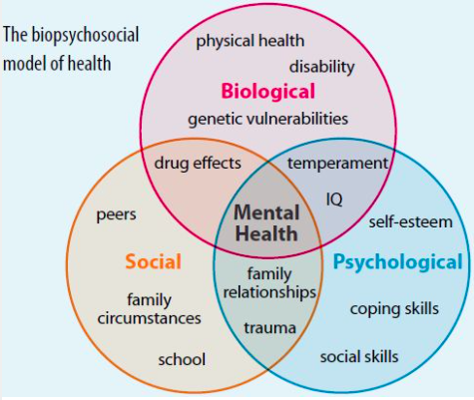

Slide 10
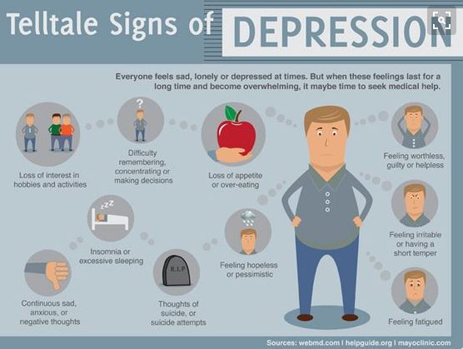

Slide 11
A lot of people think depression is just feeling sad all the time and dressing in black, and for some it may be. But for me, depression is feeling nothing. It's crying at 3 am for no reason... It's losing any interest you once had for something. I'm not sad all the time. I just feel nothing and sometimes I think that's worse.
15 year old girl

Slide 12
Helpless
Pain
No way out
Hopeless
Alone
Tunnel vision
Notes:
Understanding the concept of tunnel vision
A person at risk isn’t thinking about all the great positive things, is only looking at the stressors piled up and feeling
-Hopeless
-Helpless
-Pain
-Alone
- And like there’s no way out

Slide 13
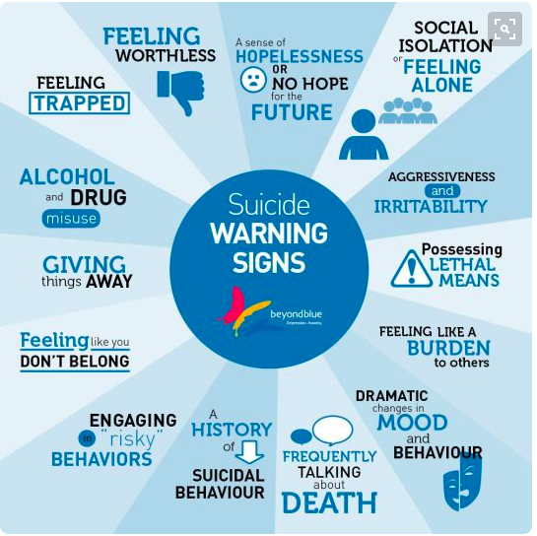

Slide 14
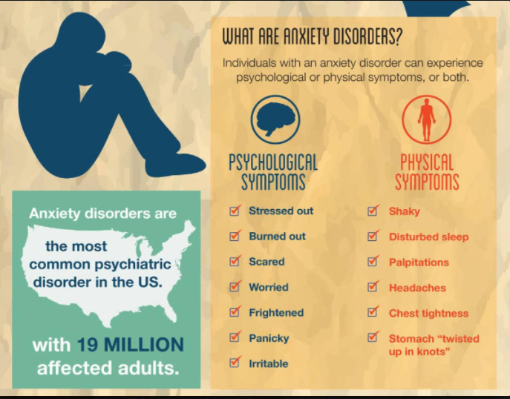
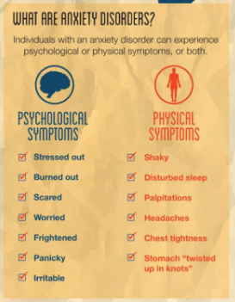

Slide 15
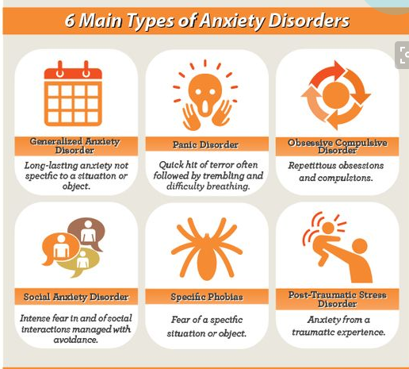
Types of Anxiety Disorders
TowerofPower.com.au

Slide 16
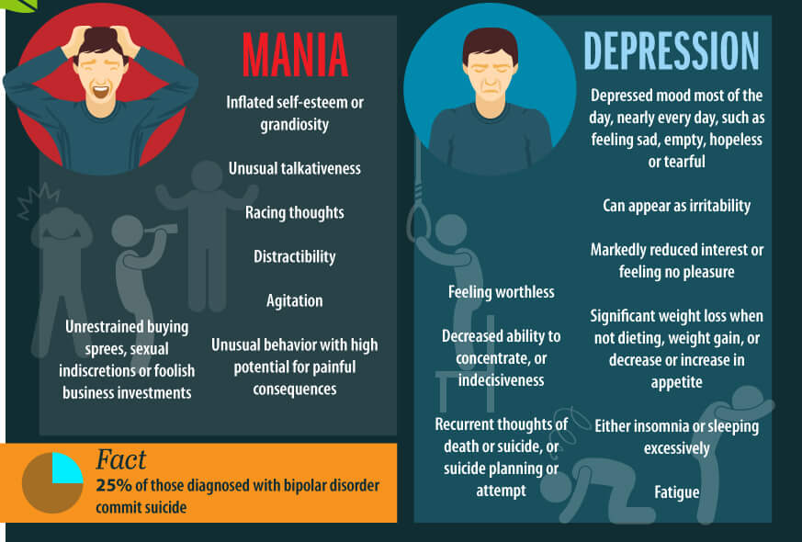
www.topcounselingschools.org/bipolar-disorders

Slide 17
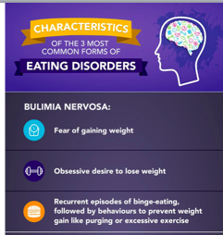
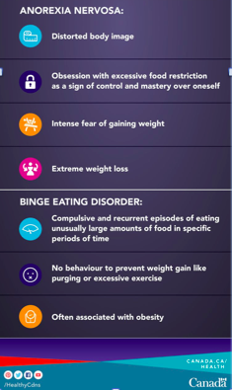

Slide 19
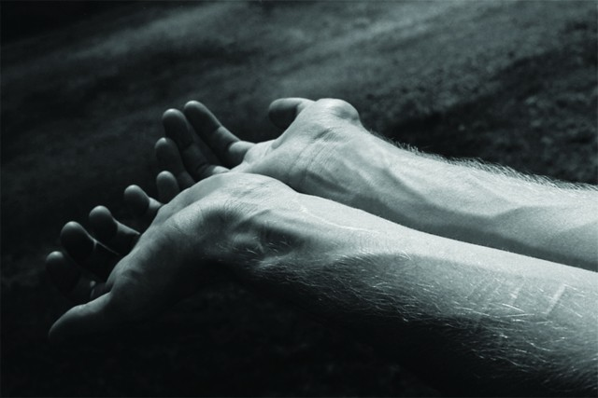
What is self-injury?
Teens self-injure as a way to COPE with intense emotional pain, anger or frustration.
Teens who self injure are often NOT suicidal
Intense SHAME exists around self-injurious behaviors.

Slide 20
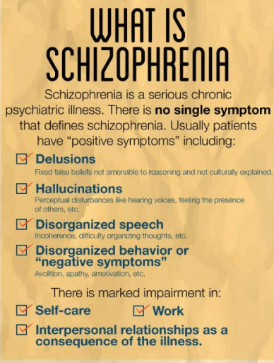
www.gmeded.com

Slide 21
Common Teen Reactions and Replies
“I can handle this by myself” | You are incredibly strong, but this seems like more than one person can handle.
“I’m not crazy” | No you’re not, but you seem to be struggling right now. I want to help you feel better.
“I feel fine,” “nothing’s wrong” | I have noticed changes in you (give concrete examples) and I am concerned.
“I don’t want to talk about this” | I understand this is uncomfortable. It must be hard to talk about. I want to make sure you’re safe, and get you the help you deserve.

Slide 23
How Can You Help a Struggling Teen?
Know the signs!
Don’t be afraid to use words like depression or suicide.
Take words like “crazy” and “mental” out of our vocabulary
Be a listening ear and/or role model
Correct misperceptions
Educate yourself and others around you!
Listen
Empathy
Notes:
Tell them to take turns asking out loud before continuing to other ways of asking

Slide 24
What if you think they may be suicidal?
Ask
Directly!
Are you thinking of killing yourself?
NOT
“Are you thinking of hurting yourself? (too vague) or
“You’re not thinking of killing yourself, are you?” (sounds judgmental)
Notes:
Tell them to take turns asking out loud before continuing to other ways of asking

Slide 25
What if they say YES?
Do you have a plan?
Is it a realistic plan?
Do you have a specific time frame?
Have you attempted before?
If they answer YES to these questions, call 911 or the PET team.
If they answer NO to these questions, this still needs to be taken seriously, and professional help should be obtained ASAP.
ASSESS!!!
Notes:
Tell them to take turns asking out loud before continuing to other ways of asking

Slide 26
Types of Help Available
Cognitive Behavioral Therapy
Behavioral Therapy
Medication
Hospitalization
Wilderness Programs or Intensive Inpatient Therapy
12 step meetings
Apps/hotlines
Notes:
Risk Factors
“What are things that could put a person at greater risk of dying by suicide?”
Drugs & alcohol
-Impaired impulse control- as related to being a teenager or being under the influence of drugs or alcohol
Lack of inhibition- not really caring what’s right or wrong
Access to guns- 6x more likely to die by suicide
Previous suicide attempts- if they have attempted before they are at greater risk
Suicide in family- mental illness
Abuse & bullying- if someone is experiencing abuse at home or being bullied at school
Statements
Talking about wanting to die or to kill oneself
Talking about feeling hopeless or having no reason to live
Talking about feeling trapped or in unbearable pain
Talking about being a burden to others
Appearance
Changes from “baseline”
disheveled, no longer caring, big baggy clothes in summer weather
Behavior
Increasing the use of alcohol or drugs
Showing rage or talking about seeking revenge
Displaying extreme mood swings
Change in sleeping/eating habits
Acting anxious or agitated; behaving recklessly
Sleeping too little or too much
Looking for a way to kill oneself, such as searching online or buying a gun
Withdrawing or feeling isolated A
Writings and Drawings about death/suicide
Self Harm Vs. Suicide
Discuss the difference between harming self as maladaptive coping or hurting self with intention to die.
Drop in grades
Giving away possessions- danger in this as being a “will” for young people and a really big “red flag”
Talk, writing, and/or drawing about death- transition in to pictures drawn by teen in the 70’s
Giving away possessions
Feelings/Affect
Expand beyond depression to agitation, anxiety, expansiveness (mania, bi-polorarity), 1&2, Hypomania, dysthmia
Behaviors
Acting anxious or agitated; behaving recklessly
Sleeping too little or too much
Looking for a way to kill oneself, such as searching online or buying a gun
Withdrawing or feeling isolated
Writings and Drawings about death/suicide

Slide 27
How Do We Advocate for Teens Suffering from Mental Illness
Educate ourselves and others
Dispel myths and assumptions
Provide resources and support
Encourage mental health conversations
Support organizations like NAMI that advocate for decreasing stigma
Notes:
Risk Factors
“What are things that could put a person at greater risk of dying by suicide?”
Drugs & alcohol
-Impaired impulse control- as related to being a teenager or being under the influence of drugs or alcohol
Lack of inhibition- not really caring what’s right or wrong
Access to guns- 6x more likely to die by suicide
Previous suicide attempts- if they have attempted before they are at greater risk
Suicide in family- mental illness
Abuse & bullying- if someone is experiencing abuse at home or being bullied at school
Statements
Talking about wanting to die or to kill oneself
Talking about feeling hopeless or having no reason to live
Talking about feeling trapped or in unbearable pain
Talking about being a burden to others
Appearance
Changes from “baseline”
disheveled, no longer caring, big baggy clothes in summer weather
Behavior
Increasing the use of alcohol or drugs
Showing rage or talking about seeking revenge
Displaying extreme mood swings
Change in sleeping/eating habits
Acting anxious or agitated; behaving recklessly
Sleeping too little or too much
Looking for a way to kill oneself, such as searching online or buying a gun
Withdrawing or feeling isolated A
Writings and Drawings about death/suicide
Self Harm Vs. Suicide
Discuss the difference between harming self as maladaptive coping or hurting self with intention to die.
Drop in grades
Giving away possessions- danger in this as being a “will” for young people and a really big “red flag”
Talk, writing, and/or drawing about death- transition in to pictures drawn by teen in the 70’s
Giving away possessions
Feelings/Affect
Expand beyond depression to agitation, anxiety, expansiveness (mania, bi-polorarity), 1&2, Hypomania, dysthmia
Behaviors
Acting anxious or agitated; behaving recklessly
Sleeping too little or too much
Looking for a way to kill oneself, such as searching online or buying a gun
Withdrawing or feeling isolated
Writings and Drawings about death/suicide

Slide 28
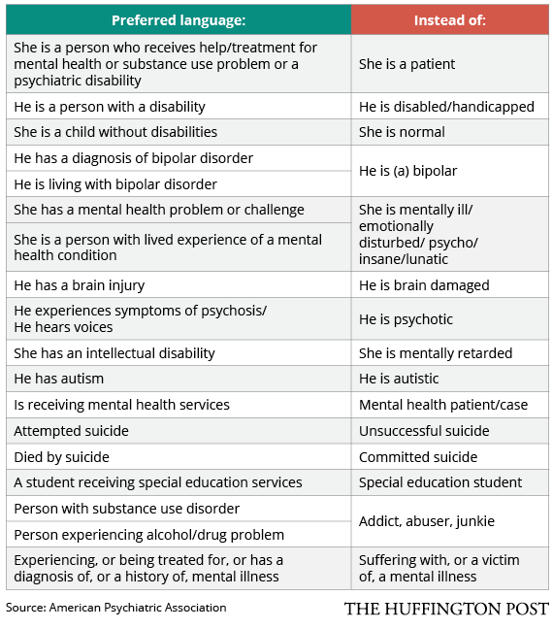

Slide 29
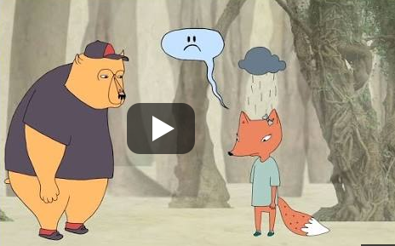
https://www.youtube.com/watch?v=1Evwgu369Jw
BRENE BROWN EMPATHY

Slide 30
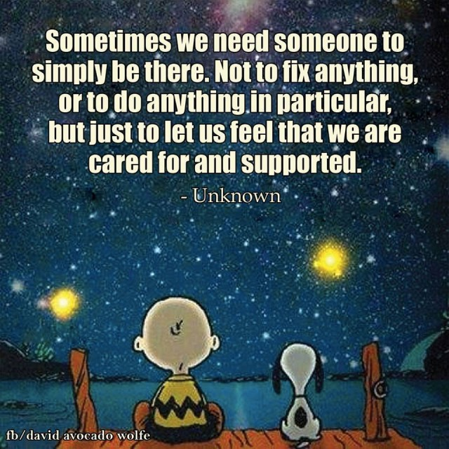

Slide 31
Resources
1-800-273-8255 24/7
SuicidePreventionLifeline.org
Know the Signs
SuicideIsPreventable.org
LGBTQ
1-866-488-7386 24/7
TheTrevorProject.org
310-855-4673 or
Text “TEEN” to 839863
TeenlineOnline.org

Slide 32
Follow-Up Questions?
Michelle Carlson, Teen Line
Executive Director at 310-423-1084 or michelle@teenlineonline.org
Cheryl Eskin, Teen Line
Program Director, at 310-423-1604
or cheryl@teenlineonline.org
THANK YOU FOR YOUR TIME!

